Slide 1
Follow up on TSF for trigger based AMP
May 2025
Doc.: IEEE 802.11-25/0814r0
Date: 2025-05-02
Authors:
Name | Affiliation | Address | Phone | Email
Chuanfeng He | OPPO |  |  | hechuanfeng@oppo.com
Weijie Xu |  |  |  | xuweijie@oppo.com
Yinan Qi |  |  |  | v-qiyinan@oppo.com

Slide 2
Background
Doc.: IEEE 802.11-25/0814r0
The motion about the support of AMP TSF, duty cycle operation and the trigger based AMP uplink PPDU transmission were agreed.[1]
MM-1: If AMP device is able to support AMP TSF, the maximum timing offset is ±10⁴ ppm.
MM-2: 11bp defines a mechanism to allow an AP to solicit AMP uplink PPDU(s) from one or more 802.11bp clients.
MM-4: If an AMP device is able to support TSF, it can monitor AMP DL Frame in a duty-cycle manner.
PM-2: 11bp defines at least one mode of MAC/PHY that allows an AMP-only device with active uplink communication in 2.4GHz subject to the following requirements:
clock accuracy requirement is relaxed compared to legacy 802.11 devices;
the active uplink communication can only be sent in response to being polled by the AP.
Chuanfeng He (OPPO)

Slide 3
May 2025
Doc.: IEEE 802.11-25/0814r0
Recap: Timestamp
Timestamp in legacy 802.11 standards
Timestamp is used to synchronize the TSF timer of non-AP STAs in BSS.
TSF timer is used for STAs to derive the time of TBTT, TWT, SP, and so on.
Each STA shall maintain a TSF timer which is able to span 2⁶⁴ microseconds.
The size of timestamp is 8 Octets, which is carried in Beacon or Probe Response frame.
Slide 3
Chuanfeng He (OPPO)

Slide 4
May 2025
Doc.: IEEE 802.11-25/0814r0
Operation duration of AMP STA
Operation duration for logistics like use cases[2]
Assumption
Starting from maximum available energy storage for operating: 4.125µJ
Power consumption during initial trigger searching window(0.35µJ)
20ms@15µW(i.e. 0.3µJ) for sync detection.
0.5ms@100µW (i.e. 0.05µJ) for initial trigger frame Rx and decoding.
Power consumption during Duty-cycle operation(1.65µJ)
In each duty cycle, energy for sync searching: [2ms + 5ms =7ms] * 15µW=0.105µJ;
Energy consumption for total 10 NSPs for sync searching: 10*[2ms + 5ms =7ms] * 15µW=1.05µJ;
Energy consumption for total 10 NSPs for trigger frame Rx: 10*100µW*0.5ms=0.5µJ
Energy consumption for solicited data Tx: 200µW*0.5ms=0.1µJ.
Total energy consumption: 1.05+0.5+0.1=1.65µJ.
Slide 4
Chuanfeng He (OPPO)

Slide 5
May 2025
Doc.: IEEE 802.11-25/0814r0
Operation duration of AMP STA
Operation duration after wake up[2]
Duty cycle period: 200ms
Initial trigger searching window(ITSW) duration: 20ms
Duty-cycle operation duration
Duty-cycle operation duration includes several duty cycle periods.
For use case such as logistics, AP may try to traverse all the AMP STAs with same Duty-cycle configuration within a Duty-cycle operation duration, based on random access mechanism.
A Duty-cycle operation duration should not be too long because of latency and limited energy storage. It is assumed a Duty-cycle operation duration includes 10 duty cycle periods.
Operation duration: ITSW duration + 10*duty cycle period is about 2.02s.
Slide 5
Chuanfeng He (OPPO)

Slide 6
May 2025
Doc.: IEEE 802.11-25/0814r0
Timestamp size for AMP TSF
Factors to determine timestamp size for AMP TSF
The timing granularity of AMP TSF
Significantly relax the timing granularity requirement for AMP, e.g. to 1024us, is acceptable
Since the TSF clock accuracy is 10^4 ppm, for a 200ms duty cycle, 2ms early wake-up is needed. Hence, it is not necessary to maintain fine timing granularity(i.e. 1us).
The range of AMP TSF
The range of AMP TSF can be determined depending on the length of whole operation duration (e.g., time spending for the whole inventory procedure) or the length of duty cycle period.
For the operation duration, TSF timer only needs to cover operation duration to finish the solicited UL data Tx.
For duty cycle period, TSF timer is used to determine the trigger Tx window within the duty cycle period based on the Duty-cycle configuration.
Slide 6
Chuanfeng He (OPPO)

Slide 7
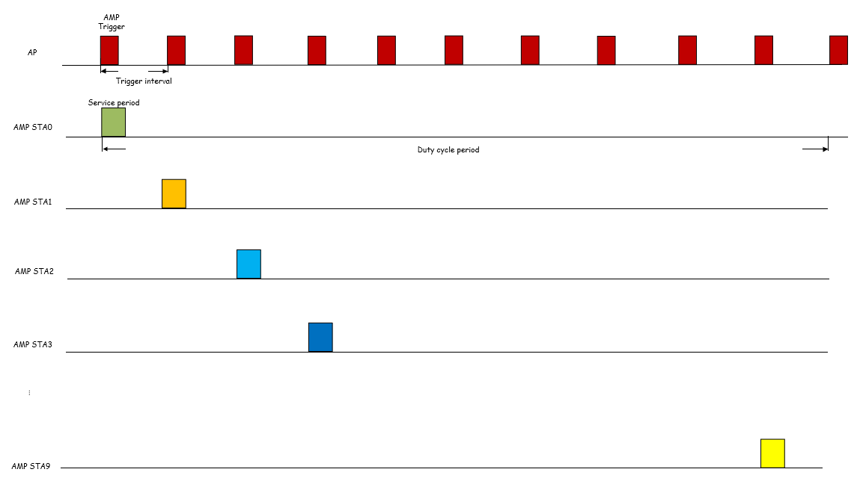
May 2025
Doc.: IEEE 802.11-25/0814r0
Timestamp size for AMP TSF
Example timestamp size for AMP TSF
With the timing granularity of 1024us
E.g., Timestamp size i$s \sim 11bits$to cover a operation duration of 2s.
E.g., Timestamp size i$s \sim 8bits$to cover a 200ms duty cycle period.
Slide 7
Chuanfeng He (OPPO)

Slide 8
May 2025
Doc.: IEEE 802.11-25/0814r0
Timestamp for AMP TSF
Observations:
The total operation duration after wake up may be short due to limited energy storage and low latency for logistics like use cases. The TSF timer can only need to cover operation duration to make AMP STA timing synchronized before success UL PPDU transmission.
Based on the assumption on energy storage and the procedure of success UL PPDU transmission, one practical maximum operation duration is 2.02s, which leads to 11 bits timestamp to cover it, with timing granularity of 1024us.
Consider the low latency for logistics like use cases, maximum duty cycle period, e.g. 200ms, can be assumed, which leads to only 8 bits timestamp to cover it, with timing granularity of 1024us.
Proposals:
Introduce short timestamp for AMP TSF.
Slide 8
Chuanfeng He (OPPO)

Slide 9
May 2025
Doc.: IEEE 802.11-25/0814r0
Timestamp delivery
Why deliver timestamp in AMP trigger:
The main contribution of timestamp is to allow Duty-cycle operation for trigger monitoring.
The main behavior of AMP STAs is the monitoring of AMP trigger after wakeup.
The trigger interval should be short in logistics like use cases, due to energy constraints and low latency requirement. It means AMP trigger is transmitted more frequently, which leads to easier detection for AMP STA after wakeup with less energy consumption.
Why do not deliver timestamp in Beacon:
Beacon is a parallel frame for AMP STA. It may have functionalities other than AMP trigger.
Typical beacon interval is 100ms, which is too long for AMP STA to search after wakeup. It requires more energy consumption for initial beacon searching than that for trigger.
If we consider short beacon interval, e.g. equal to trigger interval, the overhead and energy consumption will be equivalent for beacon and trigger.
After detecting beacon, AMP STA still has to further receive trigger for UL PPDU transmission. Separate reception of timestamp and trigger brings additional complexity and energy consumption.
Proposal:
AMP STA can obtain a short timestamp through AMP trigger.
Slide 9
Chuanfeng He (OPPO)

Slide 10
May 2025
Doc.: IEEE 802.11-25/0814r0
Timestamp delivery in AMP Trigger
TSF timer start or alignment based on timestamp in AMP trigger.
Service period starting determination based on TSF timer.
TSF timer spanning at least one duty cycle period.
Slide 10
Chuanfeng He (OPPO)

Slide 11
May 2025
Doc.: IEEE 802.11-25/0814r0
Proposal
Introduce short timestamp for AMP TSF. The length of timestamp is TBD.
AMP STA can obtain a short timestamp through AMP DL Frame sent by AP for soliciting AMP uplink PPDU(s) from one or more 802.11bp clients.
Slide 11
Chuanfeng He (OPPO)

Slide 12
May 2025
Doc.: IEEE 802.11-25/0814r0
Straw Poll #1
Do you agree with the following text:
Short timestamp is defined to support AMP TSF. The length of timestamp is TBD.
Yes
No
Abstain
Slide 12
Chuanfeng He (OPPO)

Slide 13
May 2025
Doc.: IEEE 802.11-25/0814r0
Straw Poll #2
Do you agree with the following text:
If an AMP device is able to support TSF, it can obtain timestamp through AMP DL Frame sent by AP for soliciting AMP uplink PPDU(s) from one or more 802.11bp clients.
Yes
No
Abstain
Slide 13
Chuanfeng He (OPPO)

Slide 14
Reference
May 2025
Doc.: IEEE 802.11-25/0814r0
IEEE 802.11-24/1613r4, Specification framework for tgbp
IEEE 802.11-25/0813r0, Follow up on Duty-cycle operation for AMP, OPPO
IEEE 802.11-25/0341r0, Details of Duty cycle operation for AMP, OPPO
IEEE 802.11-25-0342r0, TSF for trigger based AMP communication

