Slide 1
Discussion on Design of Interference Mitigation Pilots - Follow up
Date: 2025-05-11
Authors:
Name | Affiliation | Address | Phone | email
Ke Zhong | Ruijie Networks Co., Ltd. |  |  | zhongke@ruijie.com.cn
Fachang Guo

Slide 2
Abstract
Introduction
Discussion on design of interference mitigation pilots
Conclusion

Slide 3
Introduction
In PAR of P802.11bn, the Ultra High Reliability (UHR) capability has been defined to improve Rate-vs-Range enhancement, reduce latency, and reduce power consumption for AP, compared to Extremely High Throughput (EHT) MAC/PHY operation [1].
Interference is one of the most detrimental factors limiting the performance of WLAN systems. To achieve the goal of UHR, the motion for interference mitigation was passed in the September 2024 Interim meeting [2]:
Several contributions [3]-[10] have been submitted to investigate the design of additional pilots for interference mitigation including its rationality, benefits, required number of additional pilots and impact on Tx block, as well as signalling etc.
A few more progress for Interference Mitigation (IM) was achieved in the January 2025 Interim meeting [2]:
Define a mode with additional pilots, located within the data portion of the PPDU, which are used for interference estimation and mitigation.
Note: zero-energy pilots alternative to be considered as well
[Motion #35, [1] and [87]]
The Interference Mitigation feature is only defined with LDPC.
[Motion #245, [264] and [279]]
For each bandwidth, there is a fixed number of IM pilots (value TBD).
[Motion #246, [264] and [279]]
Within any transmission that uses IM pilots, they are used in every data OFDM symbol and in the same corresponding subcarriers positions, for a given BW.
[Motion #247, [264] and [279]]

Slide 4
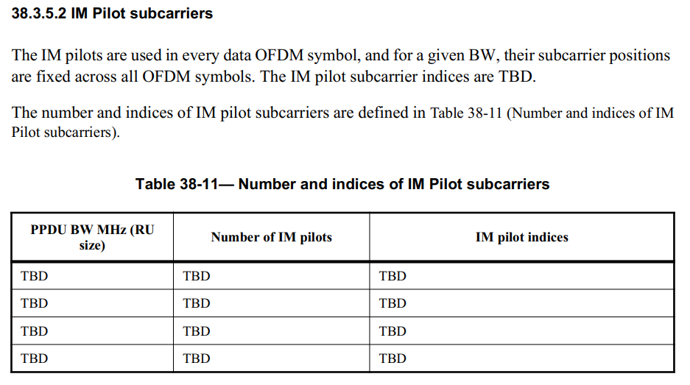
Current PDT PHY Interference Mitigation [11],[12] - Recap
No progress on IM pilots design so far including in March meeting.
PPDU BW (RU size), number of IM pilots and IM pilots indices are still TBD.
In this contribution, some further thoughts on design of IM pilots are provided for discussion.

Slide 5
Discussion on design of interference mitigation pilots
For PPDU BW, it is proposed that IM pilots can be used in at least one of 20MHz, 40MHz, 80MHz, 160MHz and 320MHz PPDU.
It is proposed that IM pilots can be used in RUs for DL and/or UL transmissions including in at least one of 26-tone RU, 52-tone RU, 106-tone RU, 242-tone RU, 484-tone RU, 996-tone RU, or any valid combinations (e.g., multiple RU ( MRU)).
It is proposed that IM pilots can be used in both non-OFDMA and OFDMA transmissions.
Current pilot subcarriers presented in Data field are used for phase information and parameter tracking. The number of pilot subcarriers in current regular RUs (RRUs) are listed below:
Current pilot subcarriers presented in Data field
 | 20MHz | 40MHz | 80MHz | 160MHz | 320MHz
26-tone RU | 2 | 2 | 2 | 2 | 2
52-tone RU | 4 | 4 | 4 | 4 | 4
106-tone RU | 4 | 4 | 4 | 4 | 4
242-tone RU | 8 | 8 | 8 | 8 | 8
484-tone RU | N/A | 16 | 16 | 16 | 16
996-tone RU | N/A | N/A | 16 | 16 | 16

Slide 6
Discussion on design of interference mitigation pilots
IM pilots are additional pilots, located within the data portion of the PPDU, which are used for interference estimation.
On possible solution for the number of IM pilot (only additional pilot) subcarriers in RRUs is shown below:
 | 20MHz | 40MHz | 80MHz | 160MHz | 320MHz | Ratio
26-tone RU | 2 (additional pilot) | 2 (additional pilot) | 2 (additional pilot) | 2 (additional pilot) | 2 (additional pilot) | 7.69%
52-tone RU | 4 (additional pilot) | 4 (additional pilot) | 4 (additional pilot) | 4 (additional pilot) | 4 (additional pilot) | 7.69%
106-tone RU | 8 (additional pilot) | 8 (additional pilot) | 8 (additional pilot) | 8 (additional pilot) | 8 (additional pilot) | 7.55%
242-tone RU | 16 (additional pilot) | 16 (additional pilot) | 16 (additional pilot) | 16 (additional pilot) | 16 (additional pilot) | 6.61%
484-tone RU | N/A | 32 (additional pilot) | 32 (additional pilot) | 32 (additional pilot) | 32 (additional pilot) | 6.61%
996-tone RU | N/A | N/A | 64 (additional pilot) | 64 (additional pilot) | 64 (additional pilot) | 6.43%
(Not preferred)
Note:
The design is based on the number of IM pilot (only additional pilot) subcarriers in 26-tone RU equals to 2 and then doubles its value for larger tone sizes.
< 8% of the resources for IM pilots may not be enough.

Slide 7
Discussion on design of interference mitigation pilots
IM pilots are additional pilots, located within the data portion of the PPDU, which are used for interference estimation.
Another possible solution for the number of IM pilot (only additional pilot) subcarriers in RRUs is shown below:
 | 20MHz | 40MHz | 80MHz | 160MHz | 320MHz | Ratio
26-tone RU | 3 (additional pilot) | 3 (additional pilot) | 3 (additional pilot) | 3 (additional pilot) | 3 (additional pilot) | 11.54%
52-tone RU | 5~6 (additional pilot) | 5~6 (additional pilot) | 5~6 (additional pilot) | 5~6 (additional pilot) | 5~6 (additional pilot) | 9.62% ~ 11.54%
106-tone RU | 10~12 (additional pilot) | 10~12 (additional pilot) | 10~12 (additional pilot) | 10~12 (additional pilot) | 10~12 (additional pilot) | 9.43% ~ 11.32%
242-tone RU | 22~29 (additional pilot) | 22~29 (additional pilot) | 22~29 (additional pilot) | 22~29 (additional pilot) | 22~29 (additional pilot) | 9.09% ~ 11.98%
484-tone RU | N/A | 44~58 (additional pilot) | 44~58 (additional pilot) | 44~58 (additional pilot) | 44~58 (additional pilot) | 9.09% ~ 11.98%
996-tone RU | N/A | N/A | 90~119 (additional pilot) | 90~119 (additional pilot) | 90~119 (additional pilot) | 9.04% ~ 11.95%
Preferred
Note:
The design is based on the number of IM pilot (only additional pilot) subcarriers in 26-tone RU equals to 3 and then doubles its value for larger tone sizes.
About 9% ~ 12% of the resources for IM pilots maybe enough.
Need to further decide a fixed number of IM pilots within the proposed range for each RU size, respectively.

Slide 8
Discussion on design of interference mitigation pilots - an example
IM pilots are additional pilots, located within the data portion of the PPDU, which are used for interference estimation.
One example of a fixed number of IM pilot (only additional pilot) subcarriers in RRUs for the preferred solution is shown below:
 | 20MHz | 40MHz | 80MHz | 160MHz | 320MHz | Ratio
26-tone RU | 3 | 3 | 3 | 3 | 3 | 11.54%
52-tone RU | 6 | 6 | 6 | 6 | 6 | 11.54%
106-tone RU | 12 | 12 | 12 | 12 | 12 | 11.32%
242-tone RU | 28 | 28 | 28 | 28 | 28 | 11.57%
484-tone RU | N/A | 56 | 56 | 56 | 56 | 11.57%
996-tone RU | N/A | N/A | 116 | 116 | 116 | 11.65%
Note: about 11% of the resources for IM pilots.

Slide 9
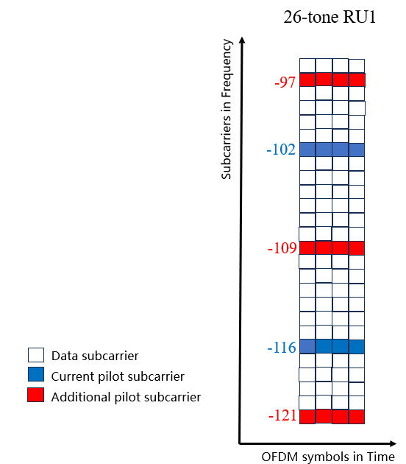
Discussion on design of interference mitigation pilots - an example
IM pilots are additional pilots, located within the data portion of the PPDU, which are used for interference estimation.
One example of a fixed number of IM pilot (only additional pilot) subcarriers and IM pilots indices in 26-tone RU for the preferred solution.
IM pilot ratio = 11.54%

Slide 10
Conclusion
Some further thoughts on design of interference mitigation pilots were provided in this presentation.
For PPDU BW, it was proposed that IM pilots can be used in at least one of 20MHz, 40MHz, 80MHz, 160MHz and 320MHz PPDU.
It was proposed that IM pilots can be used in RUs for DL and/or UL transmissions including in at least one of 26-tone RU, 52-tone RU, 106-tone RU, 242-tone RU, 484-tone RU, 996-tone RU, or any valid combinations (e.g., MRU).
It was proposed that IM pilots can be used in both non-OFDMA and OFDMA transmissions.
Some specific examples about number of IM pilots and IM pilot indices were presented which satisfy 9% ~ 12% of the resources for IM pilots.
The number of IM pilot subcarriers should include only additional pilot subcarriers.

Slide 11
Straw Poll 1
May 2025
Do you agree to include the following into the 11bn SFD?
IM pilots can be used in at least one of 20MHz, 40MHz, 80MHz, 160MHz and 320MHz PPDU.
Yes:
No:
Abstain:
Ke Zhong, Ruijie Networks Co., Ltd

Slide 12
Straw Poll 2
May 2025
Do you agree to include the following into the 11bn SFD?
IM pilots can be used in RUs for DL and/or UL transmissions including in at least one of 26-tone RU, 52-tone RU, 106-tone RU, 242-tone RU, 484-tone RU, 996-tone RU, or any valid combinations (e.g., MRU).
Yes:
No:
Abstain:
Ke Zhong, Ruijie Networks Co., Ltd

Slide 13
Straw Poll 3
May 2025
Do you agree to include the following into the 11bn SFD?
IM pilots can be used in both non-OFDMA and OFDMA transmissions.
Yes:
No:
Abstain:
Ke Zhong, Ruijie Networks Co., Ltd

Slide 14
References
[1] IEEE 802.11-23/0480r3, UHR proposed PAR, Laurent Cariou (Intel)
[2] IEEE 802.11-24/0209r8, Specification framework for TGBn, Ross Jian Yu (Huawei)
[3] IEEE 802.11-23/1490r0, Physical layer reliability improvements, Shimi Shilo (Huawei)
[4] IEEE 802.11-23/1943r1, Physical layer reliability improvements – follow up, Shimi Shilo (Huawei)
[5] IEEE 802.11-24/107r0, PHY layer interference mitigation for improved reliability, Shimi Shilo (Huawei)
[6] IEEE 802.11-24/437r0, Interference mitigation for improved reliability – more insights, Shimi Shilo (Huawei)
[7] IEEE 802.11-24/0889r0, Interference mitigation for improved reliability – link adaptation perspective, Rani Keren (Huawei)
[8] IEEE 802.11-24/1264r0, Supporting rx interference mitigation in TGbn, Shimi Shilo (Huawei)
[9] IEEE 802.11-24/1747r0, Discussion on signalling of additional pilots for interference mitigation, Ke Zhong (Ruijie)
[10] IEEE 802.11-25/0344r0, Discussion on design of interference mitigation pilots, Ke Zhong (Ruijie)
[11] IEEE 802.11-24/2008r2, PDT PHY Interference Mitigation, Shimi Shilo (Huawei)
[12] Draft IEEE P802.11bn D0.2

