Slide 1
Sync field for AMP PPDU
May 2025
Doc.: IEEE 802.11-25/0801r0
Date: 2025-05-09
Authors:
Name | Affiliation | Address | Phone | Email
Ke Wang | OPPO |  |  | wangke6@oppo.com
Jinyu Zhang |  |  |  | v-qiyinan@oppo.com
Weijie Xu |  |  |  | xuweijie@oppo.com
Yinan Qi
Sehngjiang Cui

Slide 2
Abstract
Doc.: IEEE 802.11-25/0801r0
In our previous contribution[1][2][3], sync field for AMP PPDU has been intensively discussed, including the design criterions /requirements for AMP sync. The sync performance including sync timing performance, its impact on data decoding etc., were intensively studied for various candidates of sync sequence, sync length and chip duration.
In this contribution, false alarms issue is identified based on further study. We propose to further optimize the sync filed design to address this issue.
In addition, we propose the design criterions and a set of simulation assumption to 802.11bp group for further evolution campaign.

Slide 3
Recap: High-level requirements for AMP sync
Doc.: IEEE 802.11-25/0801r0
In [1][2][3]. the following requirements for AMP sync are discussed.
  Different sync sequences for DL/UL for indication.
  Support two different AMP DL rate
    e.g. 1Mbps and 250kbps using 2 different sync
    A correlator can distinguish between Sync length 16 and 32.
  The Sync sequence has the same number of 1 and 0.
  Good auto-correlation
  The sequence have 3 consecutive 1/0, which can help distinguish synchronization field and data field with Manchester coding.

Slide 4
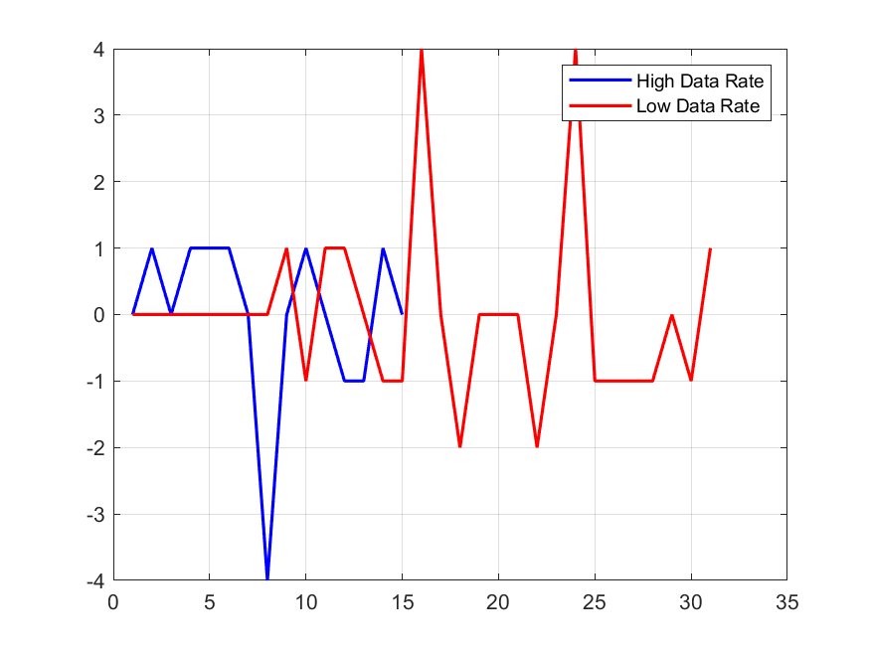
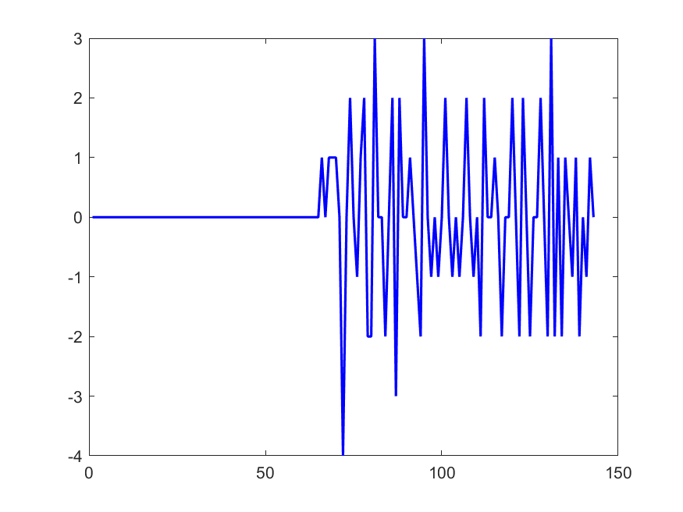
Recap: Sync sequence length(1)
Doc.: IEEE 802.11-25/0801r0
For length 8, the auto-correlation is not so good and cross-correlation with random Manchester symbols become unacceptable.
  One sequence after computer searching is '10001101'
AC_H: -4 AC_L: 2
Cross-correlation with Random Manchester symbols

Slide 5
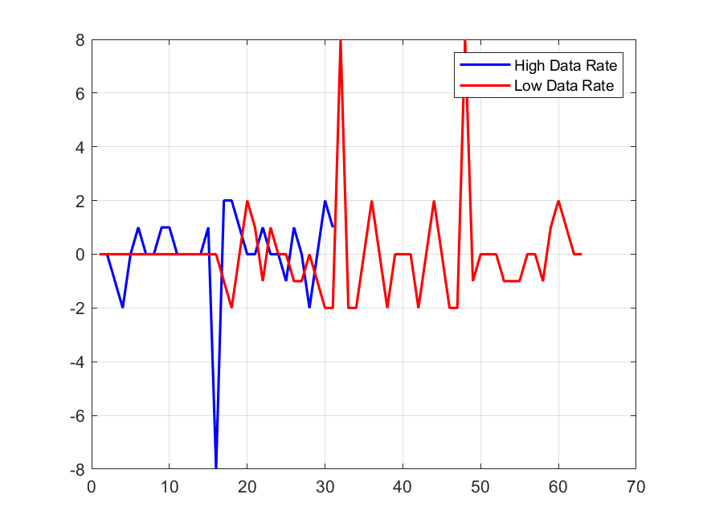
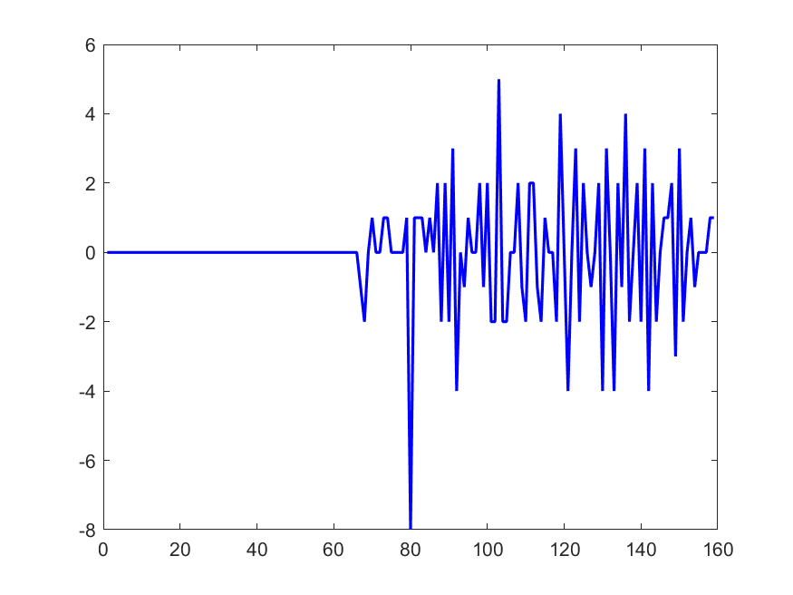
Recap：Sync sequence length(2)
Doc.: IEEE 802.11-25/0801r0
For length 16, the auto-correlation and cross-correlation with random Manchester symbols were evaluated. It shows good auto-correlation. And with limited samples of data, no big issue is observed for cross-correlation.
  One candidate sequence after computer searching is '1100100101011100'
AC_H: -4 AC_L: 4
Cross-correlation with Random Manchester symbols

Slide 6
False alarms issue(1)
Doc.: IEEE 802.11-25/0801r0
The identified sync sequence can well meet the design requirements as listed in slides 3. Note that the design requirements are very similar as what are used for WUR sync sequence.
However, as we further evaluated the cross-correlation between the sync sequence and data field with more samples of random Manchester coded data symbols. It is found that the cross-correlation property is not good enough to avoid false alarm detection in the data portion!!!
  Although obvious peak is detected in the sync field, there are lots of high side lode peaks in the data field. The ratio of the peak in sync field to the highest peak in data field is very small, only 32/24 for the 16bits sync sequence.
Sync length | 16bits
Sampling rate | 2MHz/8MHz
Chip duration of sync | 2us
Chip duration of data | 2us
Data length | 10000bits
Cross-correlation between sync and Random Manchester data symbols

Slide 7
False alarms issue(2)
Doc.: IEEE 802.11-25/0801r0
  Then in the same way, we further evaluate the cross-correlation property of WUR sync sequence. The cross-correlation with data part becomes slightly better (the ratio is 64/40), but still not acceptable.
  False alarm will results in bad receiving performance at the AMP STA
    It will affect the sync timing performance and degrade the data decoding performance.
    It will also waste AMP STA’s power, when data decoding is triggered by a false peak in the data field (Note that an AMP STA may wake-up and begin to receiver DL PPDU when one AMP DL PPDU is transmitting).
WUR Sync length | 32bits
Sampling rate | 2MHz/8MHz
Chip duration of sync | 2us
Chip duration of data | 2us
Data length | 10000bits

Slide 8
Analysis of False alarms issue
Doc.: IEEE 802.11-25/0801r0
  Why is there so severe false alarm issue?
    The sync field is one pseudo binary sequence and the data part, though with Manchester coding, is also random binary sequence. There is probability that for some data bits segment, the binary bits sequence will has high correlation with the sync sequence.

Slide 9
Revisiting requirements for AMP sync(1)
Doc.: IEEE 802.11-25/0801r0
  With the above new findings and analysis, we propose to revisit the design requirement for AMP Sync:
  Can differentiate DL PPDU with UL PPDU.
  Can indicate two different AMP DL rates
  The Sync sequence has the same number of 1 and 0.
  Good auto-correlation
  The sequence have 3 consecutive 1/0, which can help distinguish synchronization field and data field with Manchester coding.
  Good Cross-Correlation

Slide 10
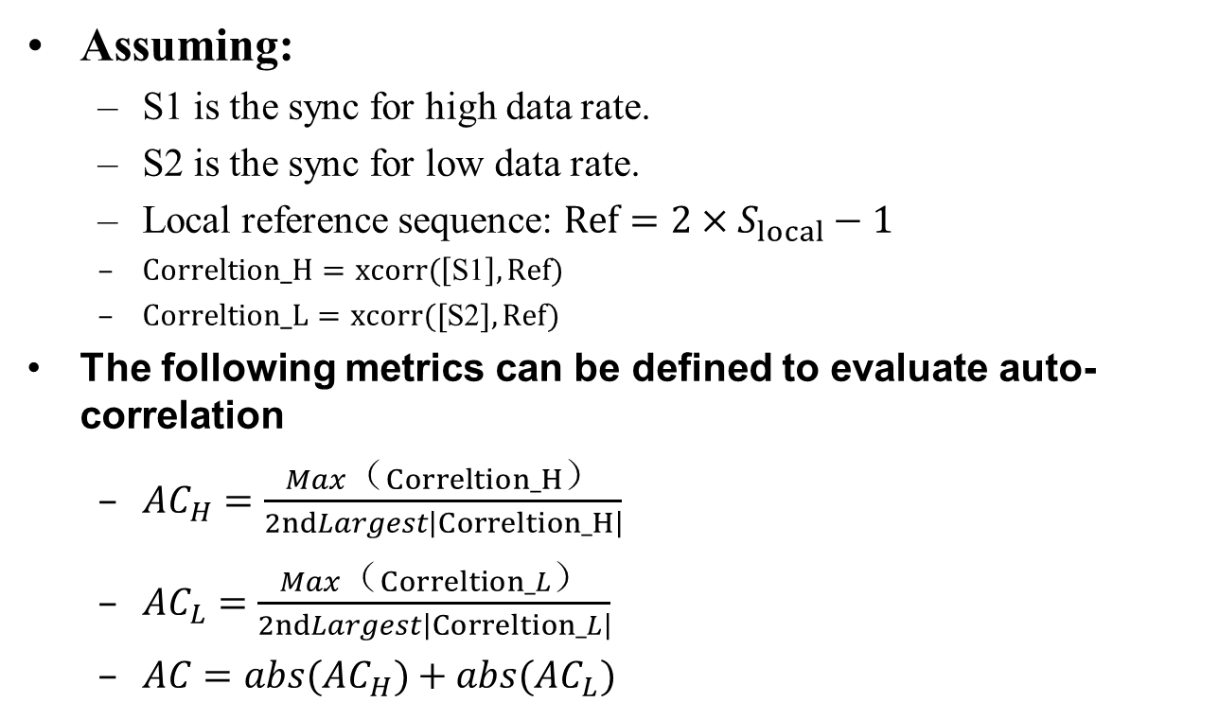
Metrics to evaluate Auto-Correlation
Doc.: IEEE 802.11-25/0801r0
Assuming:
  S1 is the sync for high data rate.
  S2 is the sync for low data rate.
  Local reference sequence: $Ref=2×S_{local}−1$
  $Correltion_H=xcorr(\left[\text{S}\text{1}\right], Ref)$
  $Correltion_L=xcorr([\text{S}\text{2}], Ref)$
The following metrics can be defined to evaluate auto-correlation
  $AC_{H}=\frac{Max（Correltion_H）}{2ndLargest\left|Correltion_H\right|}$
  $AC_{L}=\frac{Max（Correltion_L）}{2ndLargest\left|Correltion_L\right|}$
  $AC=abs(AC_{H})+abs(AC_{L})$

Slide 11
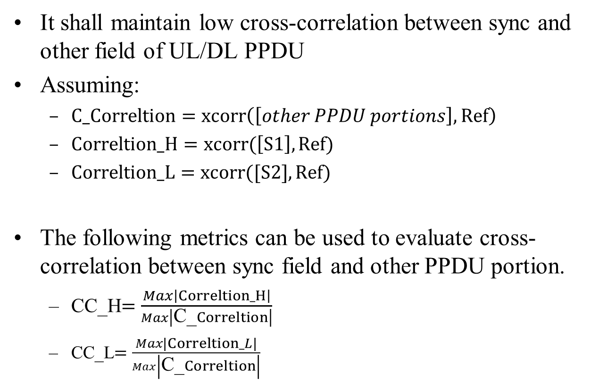
Metrics to evaluate Cross-Correlation
Doc.: IEEE 802.11-25/0801r0
It shall maintain low cross-correlation between sync and other field of UL/DL PPDU
  Assuming:
  C_$Correltion=xcorr\left(\left[other PPDU portions\right], Ref\right)$
  $Correltion_H=xcorr(\left[\text{S}\text{1}\right], Ref)$
  $Correltion_L=xcorr([\text{S}\text{2}], Ref)$
  The following metrics can be used to evaluate cross-correlation between sync field and other PPDU portion.
  CC_H$=\frac{Max\left|Correltion_H\right|}{Max\left|\text{C}\text{_}Correltion\right|}$
  CC_L$=\frac{Max\left|Correltion_L\right|}{Max\left|\text{C}\text{_}Correltion\right|}$

Slide 12
Evaluation for AMP sync(1)
Doc.: IEEE 802.11-25/0801r0
  With the above metrics,
    In order to have good auto-correlation performance, the AC_H and AC_L need to be as large as possible.
    In order to have good cross-correlation performance, CC_H and CC_L need to be as large as possible.
  When the AMP STA perform synchronization, a small false alarm rate (e.g., 1%)is acceptable.
    The false alarm rate is defined as: number of false alarm sync detection/total number of sync detections.
    Process of one AMP PPDU is counted as one sync detection. The following figure shows a detection process of one AMP PPDU
  The sync detection rate can be further evaluated with the restriction of a specific false alarm rate.

Slide 13
Proposed simulation assumptions for sync performance evaluation
Doc.: IEEE 802.11-25/0801r0
  Note: For ED receiver, it directly receiver the RF signal and derive its envelope, then it samples the OOK envelope and perform correlation detection. For IF receiver, RF signal is converted to baseband signal and then it samples the baseband OOK signal and perform correlation detection.
Parameters | Values
Sync sequence | TBD, reported by submission
Waveform for DL PPDU | OOK(waveform and BW TBD)
Channel model | AWGN/Channel B/Channel D
Chip duration of sync | TBD
Sampling rate at AMP device | 2MHz/8MHz
Length of data field | 120bits
Receiver type | ED/IF receiver

Slide 14
Summary
Doc.: IEEE 802.11-25/0801r0
In this submission, sync sequence for AMP is discussed. Based on the discussion, the following is proposed.
  Propose pay attention to the false alarm issue
  Propose new sync design requirements and the evaluation metrics
  Propose the simulation assumptions
Ke Wang (OPPO)

Slide 15
May 2025
Doc.: IEEE 802.11-25/0801r0
Straw Poll #1
Do you agree with the following design requirements for AMP sync:
  Can differentiate DL PPDU with UL PPDU.
  Can indicate two different AMP DL rates
  The Sync sequence has the same number of 1 and 0.
  Good auto-correlation
  Good Cross-Correlation
Yes
No
Abstain
Slide 15
Ke Wang (OPPO)

Slide 16
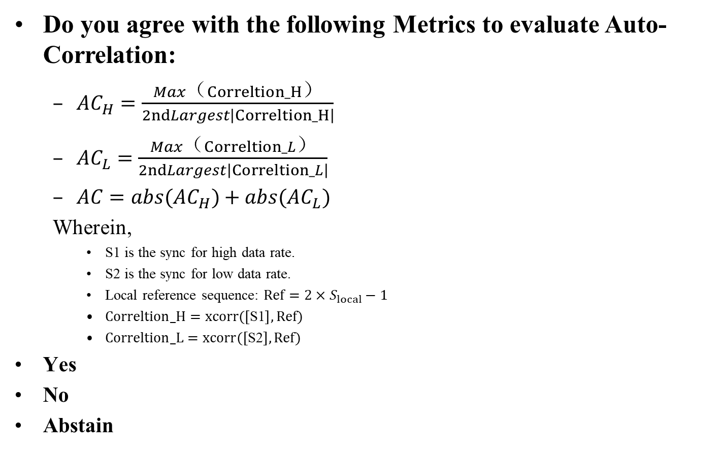
May 2025
Doc.: IEEE 802.11-25/0801r0
Straw Poll #2
Do you agree with the following Metrics to evaluate Auto-Correlation:
  $AC_{H}=\frac{Max（Correltion_H）}{2ndLargest\left|Correltion_H\right|}$
  $AC_{L}=\frac{Max（Correltion_L）}{2ndLargest\left|Correltion_L\right|}$
  $AC=abs(AC_{H})+abs(AC_{L})$
  Wherein,
    S1 is the sync for high data rate.
    S2 is the sync for low data rate.
    Local reference sequence: $Ref=2×S_{local}−1$
    $Correltion_H=xcorr(\left[\text{S}\text{1}\right], Ref)$
    $Correltion_L=xcorr([\text{S}\text{2}], Ref)$
Yes
No
Abstain
Slide 16
Ke Wang (OPPO)

Slide 17
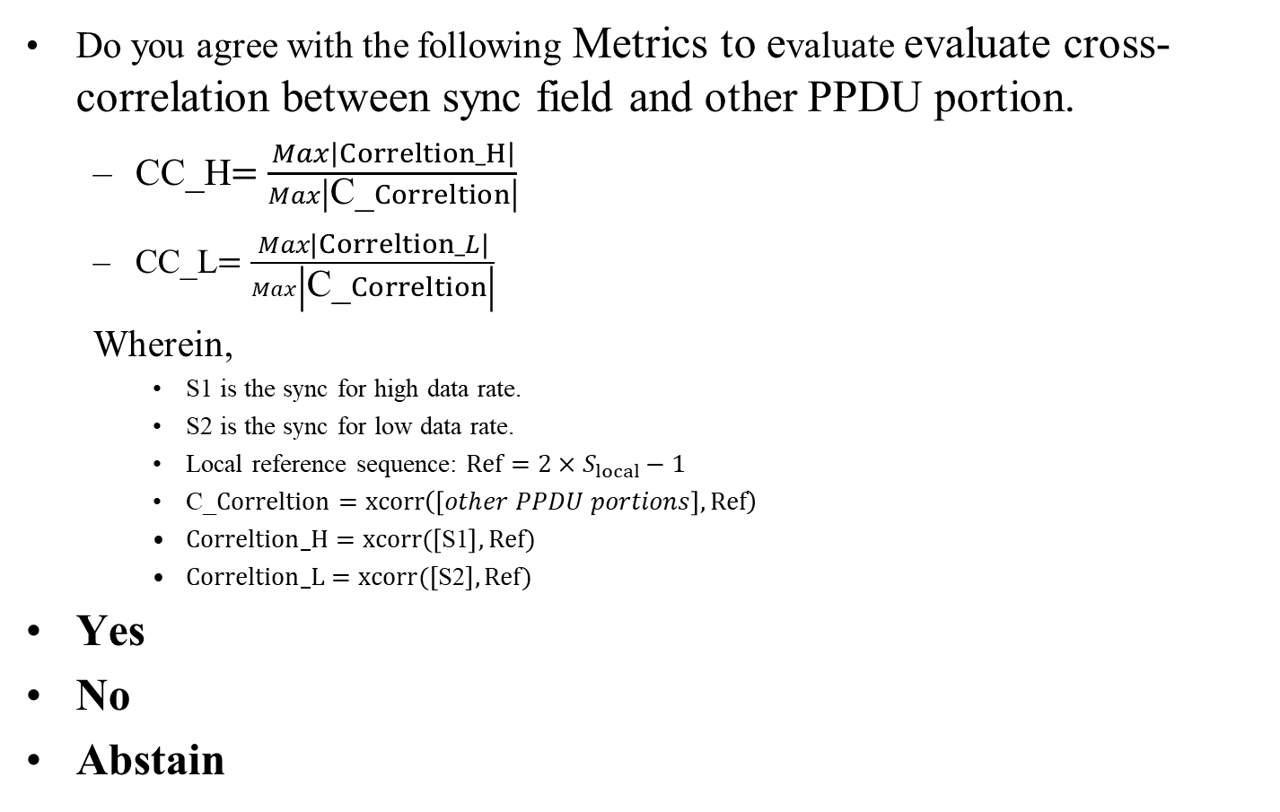
May 2025
Doc.: IEEE 802.11-25/0801r0
Straw Poll #3
  Do you agree with the following Metrics to evaluate evaluate cross-correlation between sync field and other PPDU portion.
  CC_H$=\frac{Max\left|Correltion_H\right|}{Max\left|\text{C}\text{_}Correltion\right|}$
  CC_L$=\frac{Max\left|Correltion_L\right|}{Max\left|\text{C}\text{_}Correltion\right|}$
  Wherein,
    S1 is the sync for high data rate.
    S2 is the sync for low data rate.
    Local reference sequence: $Ref=2×S_{local}−1$
    C_$Correltion=xcorr\left(\left[other PPDU portions\right], Ref\right)$
    $Correltion_H=xcorr(\left[\text{S}\text{1}\right], Ref)$
    $Correltion_L=xcorr([\text{S}\text{2}], Ref)$
Yes
No
Abstain
Slide 17
Ke Wang (OPPO)

Slide 18
May 2025
Doc.: IEEE 802.11-25/0801r0
Straw Poll #4
  Do you agree with the following simulation assumptions for sync performance evaluation.
Yes
No
Abstain
Parameters | Values
Sync sequence | TBD, reported by submission
Waveform for DL PPDU | OOK(waveform and BW TBD)
Channel model | AWGN/Channel B/Channel D
Chip duration of sync | TBD
Sampling rate at AMP device | 2MHz/8MHz
Length of data field | 120bits
Receiver type | ED/IF receiver
Slide 18
Ke Wang (OPPO)

Slide 19
Reference
May 2025
Doc.: IEEE 802.11-25/0801r0
IEEE 802.11-24/1803r0 Sync field for AMP PPDU
IEEE 802.11-25/0034r2 Sync field for AMP PPDU
IEEE 802.11-25/0321r0 Sync field for AMP PPDU

