Slide 1
High Level Thoughts on Uplink SYNC Field Design for Backscatter STAs
Date: 2025-05-12
Authors:
Name | Affiliations | Email
Manideep Dunna | Qualcomm | mdunna@qti.qualcomm.com
Steve Shellhammer |  | sshellha@qti.qualcomm.com
Alice Chen |  | alicel@qti.qualcomm.com
Bin Tian |  | btian@qti.qualcomm.com

Slide 2
Introduction
CTS to Self
Preamble
Downlink to the AMP tag
Excitation signal
Uplink from the tag
SYNC
DATA
Backscatter uplink happens during the excitation signal portion of the PPDU
Smartphone decodes the backscattered packets from the tag

Slide 3
Backscatter Uplink Constraints
AMP backscatter transmission can start anytime during the excitation signal portion
SYNC field to indicate the beginning of the Backscatter uplink transmission
AMP backscatter clock has clock error up to +/- 100k ppm
The large clock error causes drift in DATA field decoding
A reader like smartphone has a capable receiver with high sampling rate. It is desired to estimate the large clock offset using the SYNC field and help the DATA field decoding

Slide 4
SYNC Design Objectives
SYNC field design needs to support reliable detection at SNR lower than that of the DATA field. For example:
1% False alarm rate over 360us of AWGN input [1]
1% Sync Mis-Detection rate at 10% data PER SNR
Obtain the timing to find the beginning of the DATA field
Estimate the clock error and use it to correct the drift in the DATA field symbols
Notes:
(new feature compared to Manchester encoded SYNC)

Slide 5
Backscatter Waveform Assumptions
Excitation signal in the PPDU is formed using OFDM symbols that occupy 20MHz bandwidth
To maximize the downlink power transmitted by obeying the PSD limit
LTF can be used as the building block for generating the Excitation signal
Consequently, the backscattered signals from the tag also occupy the same bandwidth as 20MHz excitation signals
The uplink receiver has channel selective filters and hence the noise bandwidth is also 20MHz at the receiver
Notes:
(new feature compared to Manchester encoded SYNC)

Slide 6
Thoughts on the AMP reader
Unlike on the downlink, a reader like smartphone has lot of compute power to implement a high-end receiver
A sample level correlator can be implemented for SYNC detection with better sensitivity
A non-coherent receiver is possible for both monostatic and bistatic backscatter
A coherent receiver is possible only for monostatic backscatter as the transmitted waveform is available at the AMP reader.
Notes:
(new feature compared to Manchester encoded SYNC)

Slide 7
Proposed Simulation Assumptions
Parameter | Value | Comment
Transmit Bandwidth | < 20 MHz
Transmit Waveform | Either OFDM or Simple OOK is fine
Receiver Bandwidth | 20 MHz | There is a 20 MHz RF Filter
SNR Definition | RX Signal Power (in dB) minus Noise Power over 20 MHz (in dB). Using the 20 MHz receive waveform. | If zero padding is done before and after the signal, that portion is not included in the RX Signal Power
STA Transmitter Clock Accuracy | $±100,000$ PPM | SFD does not specify Tag TX Clock accuracy, but most companies agree on this value
Receiver Architecture | Full Wi-Fi Receiver capable | Receiver is a Smartphone
Sync Detection False Alarm Rate Definition Interval | 360 µs | Uplink is Triggered but there is also a delayed Transmission, which can lead to some time uncertainty

Slide 8
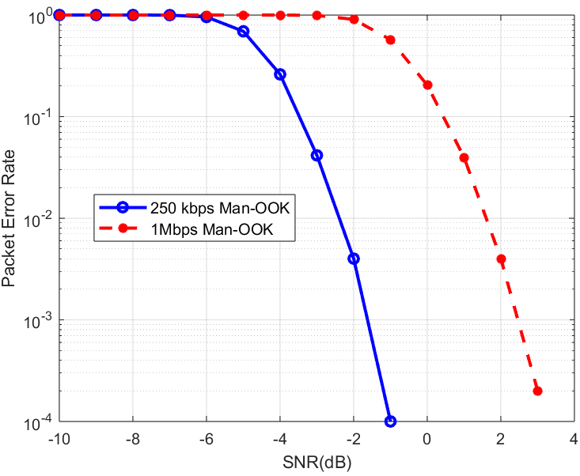
DATA Field Performance
For Manchester encoded DATA field: To get 10% PER with ideal timing,
Data Rate | DATA Field SNR
250 kbps | -3.5 dB
1 Mbps | 0.5 dB
Above results are obtained with a non-coherent receiver
Packet error rate (PER) evaluated with a 100-bit payload
SYNC should be detected at lower SNR than the above DATA field SNRs

Slide 9
Summary
A high-end correlator could be implemented on the AMP reader
SYNC should support the estimation up to 100k ppm clock error on the tag and correct for the DATA symbol drift
SYNC field should have a good SNR margin than the DATA field for reliable detection
Simulations assumptions and parameters to compare different proposals are listed

Slide 10
References
Rui Cao, et. al., “AMP Backscattering PPDU and SYNC Design,” IEEE 802.11-23/0306r0, March 2025

