Slide 1
Follow-up on AMP Open Service Period
Date: 12 May 2025
Name | Affiliation | Address | Phone | Email
Ian Bajaj | Huawei | Singapore |  | ian.bajaj@huawei.com
Lei Huang
Rojan Chitrakar
Notes:
Jul 12, 2010
Page 1

Slide 2
Background
AMP Open Service Period (OSP) was highlighted in [1] to discuss how unassociated non-AP AMP STAs can cycle between idle and operational modes based on an SP Interval to save significant power from random channel sensing.
In [2] the timing synchronization for non-AP AMP STAs to wake up at the start of the OSP was discussed through a decremental counter (namely, SP Advert count) sent by the AMP AP.
In this contribution, we wish to discuss:
The importance of service period for power management and resource scheduling, while providing a recap on the AMP Open Service Period.
More details on the frame signaling, communication overhead and periodicity (or channel utilization).

Slide 3
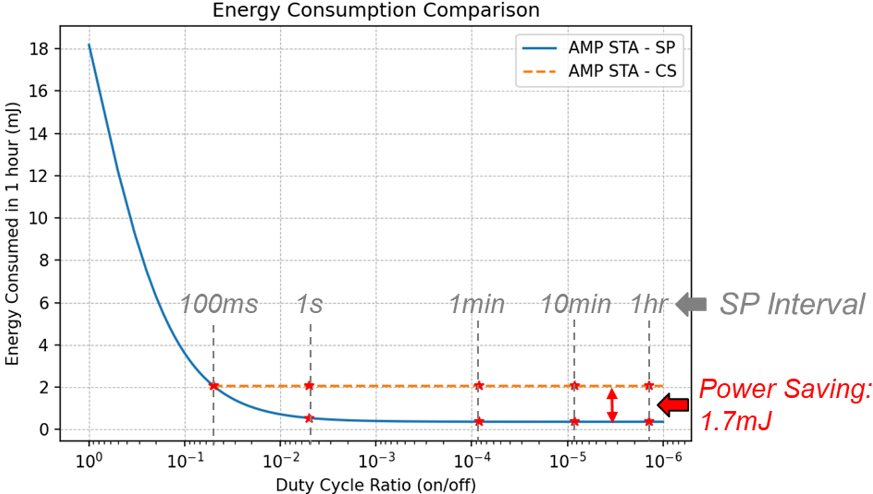
Importance of Service Period (1/2)
[1] demonstrated the significant power savings when an AMP STA operates in an SP compared to random channel sensing, with up to 1.7mJ saved every hour for as small as a 1min SP interval (off period)
Alternatives to SP for Active Tx non-AP AMP STA:
AMP STAs always channel sense – AP allocates channel resources, and triggers the AMP STAs
Requirement: AMP STA is always in channel sensing (RX on) when not transmitting.
Consequence: Huge AMP STA power consumption and higher strain or requirement for constant Energizing (WPT).
AMP STAs die after transmission. WPT waveform is used to charge and wake up the AMP STAs to be in RX to receive upcoming AP DL PPDU.
Requirement: Strict control and synchronization for Energizer WPT transmission
Consequence: Tags cannot maintain state (association), memory or data buffer when they lose power.

Slide 4
Importance of Service Period (2/2)
A Service Period allows:
Scheduling of resources from an AP to contend for TXOP, to manage control over the Energizer.
Power saving at the AMP STA by allowing it to remain in idle mode, with no RF activity until the start of the service period.
Requirement: AMP STA maintains a timer in idle mode
Consequence:
AP transmits timing synchronization frames in the form of AMP SP Advert [2] to correct the AMP STA clocks – only for the clock drift margin before the start of the SP
AMP STA consumes negligible power maintaining a timer, sub-nWs (0.51nW [1]) compared to tens of uWs remaining in a channel sensing state (10uW [1])

Slide 5
AMP Open Service Period – Recap (1/2)
In [2], AMP Open Service Period (OSP) was defined as a window that the AMP AP will gain a TXOP for any non-AP AMP STAs in its BSS, regardless of association.
At the start of the OSP, within the SP minimum wake duration, the AMP AP will send for example, an AMP Poll to enable channel access for the non-AP AMP STAs. If the non-AP AMP STAs do not receive any AMP DL PPDU from the AP, the non-AP AMP STA will return to idle mode for the SP interval duration (wake up at the start of the following OSP).
The OSP parameters, namely, SP start time, SP interval and SP minimum wake duration may be carried in an SP Info frame sent periodically by the AMP AP. The SP start time maybe expressed as an absolute TSF time or a relative time from the end of frame carrying this field.

Slide 6
AMP Open Service Period – Recap (2/2)
To provide a timing reference, the AMP AP can transmit SP Advert Frames that indicate the Advert interval and Advert count (no. of remaining Advert frames to the start of the OSP). An OSP ID can be used to identify the OSP that the SP Advert Frame is pointing to.
The Advert Interval must be less than the SP minimum wake duration.
The SP Advert Frame will only need to be transmitted closer to the start of the OSP (to cover clock drift), thus avoiding channel congestion.
The AMP non-AP STA can reset its counter based on the remaining time to the start of the SP, given by Advert_interval * Advert_count

Slide 7
AMP SP Info Frame Body Details
The AMP SP Info Frame Body can have a Type Dependent Control (sub-type field, presence bitmap) and Type Dependent Payload.
The Type Dependent Payload may contain:
OSP ID (4 bits) – To uniquely identify the OSP
SP Parameters (0 or 12 bits) – To carry the SP Interval (8 bits) [2], and SP Minimum Wake Duration (4 bits, expressed as a multiple of TUs)
SP Start Time (0 or 12 bits) – To indicate the start of the OSP
SP Timing Sync (24 bits) – To carry the SP Advert Interval (12 bits), SP Advert Count (10 bits), and Reserved field (2 bits). With 12 bits, the SP Advert Interval can support a duration up to 130ms with a 32us granularity (based on expectation that minimum wake duration for channel sensing <=100ms)
The typical overhead from the SP Info Frame Body is 5 octets (40us @ 1Mbps) to serve the following purposes:
Advertising the ongoing OSP, by transmitting the SP Parameters and SP Start Time fields (Low periodicity announcement)
Provide timing synchronization for the OSP, by transmitting the SP Timing Sync field (Medium periodicity burst with low channel utilization)
At any point, either the SP Start Time or the SP Timing Sync fields will be present, but not both.

Slide 8
Summary
The importance of AMP Service Period for Active Tx non-AP AMP STAs was presented. The benefits can be seen in the form of:
Resource scheduling at the AMP AP (deterministic channel access periods).
Less stringent control for Energizing (compared to a WPT triggered service period).
Significant power savings at the Active Tx non-AP AMP STA (compared to constant or periodic channel sensing) and subsequently less strain on the charging required over the WPT link.
Active Tx non-AP AMP STAs can maintain memory, and have a deterministic window to receive AMP DL and transmit AMP UL PPDUs.
The AMP SP Info Frame was introduced to:
Advertise the ongoing AMP OSP, by carrying the SP Parameters, and SP Start Time fields.
Provide timing synchronization for the Active Tx non-AP AMP STAs to wake up at the start of the OSP, by carrying SP Advert Interval and SP Advert Count fields.
The typical overhead and the expected signaling periodicity for the SP Info Frame was also discussed.

Slide 9
SP1
Do you agree to add the following text to TGbp SFD?
IEEE 802.11bp defines an AMP Open Service Period, that allows an Active Tx non-AP AMP STA to enter doze state after a minimum wake up time since the start of the AMP Open Service Period, if the Active Tx non-AP AMP STA does not receive any AMP DL PPDU from the AMP AP.
[Reference: 11-25/0039r0, 11-25/0285r1, 11-25/0787r0]

Slide 10
SP2
Do you agree to add the following text to TGbp SFD?
IEEE 802.11bp defines an AMP SP Info frame (name TBD) to carry the OSP ID, SP Start Time, SP Interval, and SP Minimum Wake Duration. The OSP ID serves to uniquely identify the AMP Open Service Period.
[Reference: 11-25/0039r0, 11-25/0285r1, 11-25/0787r0]

Slide 11
SP3
Do you agree to add the following text to TGbp SFD?
AMP SP Info frame further optionally includes SP Timing Sync, to allow Active Tx non-AP AMP STAs that do not support TSF, to monitor AMP DL frames in a duty cycle manner.
The SP Timing Sync includes at least the SP Advert Interval (name TBD), and SP Advert Count (name TBD).
The SP Advert Interval is the periodicity of the SP Info frame when carrying the SP Timing Sync field.
The SP Advert Count is as a decremental counter, that is counted down in each subsequent AMP SP Info frame, to assist Active Tx non-AP AMP STAs to wake up at the start of the service period.
If SP Timing Sync is present, the AMP SP Info frame may not carry SP Start Time.
[Reference: 11-25/0039r0, 11-25/0285r1, 11-25/0787r0]

Slide 12
References
[1] 11-25/0039r0, AMP Open Service Period
[2] 11-25/0285r1, SP Timing Synchronization with AMP Beacon

