Slide 1
Bi-static Backscatter Protection Mechanisms – follow up
Date: 2025-05-11
Authors:

Slide 2
Abstract
Follow up on our presentation 11-25/0264 Bi-static Backscatter Protection Mechanisms
How do we reserve medium use on two channels?
Notes:
This is a follow-up to our contribution 25/0264, which presented a mechanism to reserve two channels for a bi-static BS. In this, we address some concerns raised by the group.

Slide 3
Review: Two-channel Backscatter Operations [1]
Effective method for reducing self-jamming and increasing range for bistatic backscatter operations.
With this method, the link margin is related directly to
The receiver’s ability to reject adjacent channel interference.
The receiver’s ability to decode signals in the presence of in-band interferers.
The transmitter’s emissions mask.
Notes:
To summarize the need for this, two-channel Backscatter is an effective method for reducing self-jamming and increasing communication range. The link margin is directly related to the receiver’s ability to reject adjacent-channel interference and to decode signals in the presence of in-band interferers, as well as to comply with the transmission mask.

Slide 4
Recap: Medium Usage on Two-Channels[2]
Requirements
The transmission needs to protect a TXOP on both channels. (the excitation signal and the backscattered signal).
The TXOP protection mechanism needs to work for legacy 802.11 STAs.
TXOP on the UL channel can be shorter than TXOP on the DL channel due to channel conditions.
Notes:
Some main requirements for the protection mechanism are as follows: The mechanism needs to protect TXOPs on both channels. The protection mechanism should be compatible with the legacy 802.11 STAs. TXOP on the UL channel can be shorter due to the channel conditions.

Slide 5
Medium Usage on Multiple Channels
The AMP-enabled STA (Initiator) can include an energizer, and the AMP-enabled STA (Receiver) can be an AMP-enabled AP.
Initially, the initiator and the receiver will operate on the same channel.
The Initiator STA sends a control frame on the excitation channel to initiate the process.
Receiver STA changes its operating channel to the backscatter channel to receive the backscattered PPDU.
Upon completion of the TXOP, the receiver STA reverts to the excitation channel and transmits a control frame to the initiator, acknowledging receipt of the backscattered PPDU.
Notes:
This mechanism is designed for the bi-static use case. It is initiated by an AMP-enabled STA called the Initiator in contribution. The initiator can include an energizer. The receiver in this mechanism can be an AMP-enabled STA. This receiver can be an AMP-enabled AP STA.
Both the initiator and receiver start on the same channel. The initiator starts the mechanism by transmitting a CF. This CF solicits the Receiver to change its channel to the UL/BS channel. At the end of the TXOP on the receiver reverts to the DL/excitation channel and transmits a control frame called CFR to acknowledge the BS PPDU.

Slide 6
Concerns addressed in this submission
It is difficult to synchronize CTS-to-Self on Channel A and B.
Two channels are used for one transmission.
How often are both channels available at the same time in the real world?
Notes:
The main concerns addressed in this contribution, as raised by the group, are as follows:…….

Slide 7
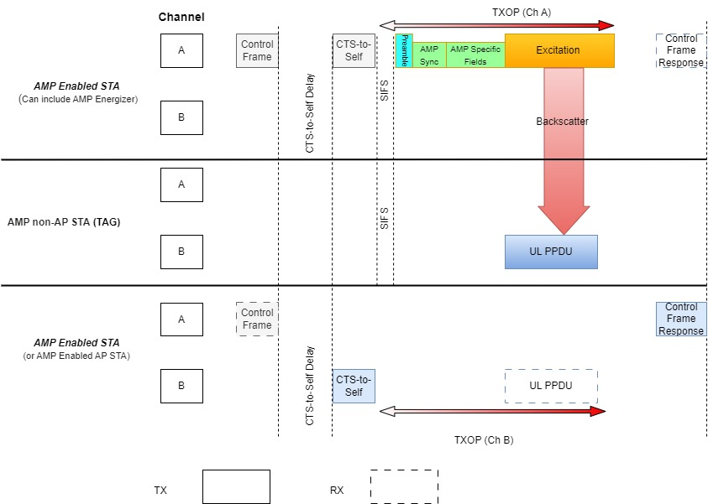
Medium Usage on Multiple Channels
The Initiator STA transmits a control frame to initiate the mechanism. After receiving the backscattered PPDU, the Receiver STA transmits a control frame to acknowledge receipt of the backscattered PPDU after the backscatter TXOP completes.
Notes:
Hereby reducing the TXOP up to the end of the Excitation signal, we make it more compact and robust. The CFR is an 802.11-compatible control frame and does not require protection of the TXOP. Now the receiver can go back to the DL channel after the TXOP and transmit the CFR with the acknowledgement.

Slide 8
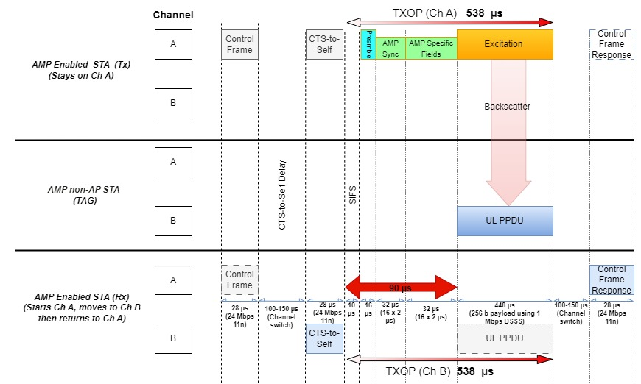
Approximate TXOP duration for the mechanism
TXOP is around 538 µs on the DL and UL channel each, total TXOP duration is 1076 µs. Less than the TXOP limit for AC_BK.
Notes:
We address the concern related to the channel usage, We want to stress the point that our mechanism is designed for use cases with a very low duty cycle. In addition to this, it’s approx. channel usage is around 538 usec on each channel. Hence, the total TXOP duration is less than the TXOP limit for AC_BK.
To our advantage, there is a slack time of around 90-100 usecs on the UL channel to get access of the channel and transmit CTS-to-Self.

Slide 9
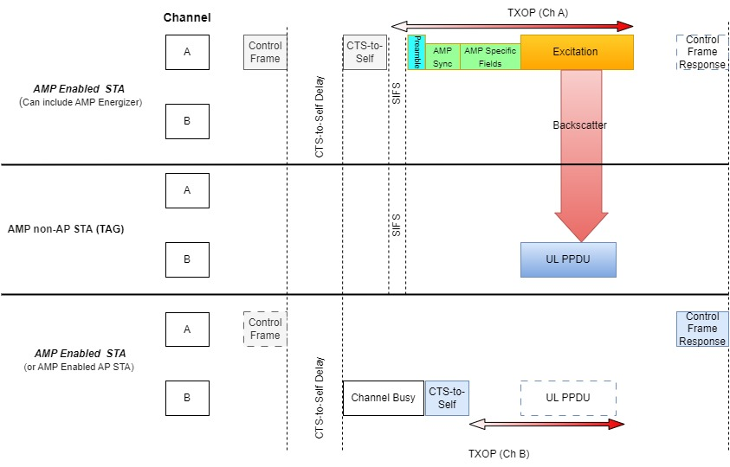
Adjust according to channel condition on channel B
CTS-to-Self can be delayed and the TXOP can be adjusted on channel B if the channel is busy.
Notes:
Therefore, in case if the UL channel is busy, we can delay the CTS-to-Self and adjust the TXOP accordingly. If the receiver is unsuccessful, then the CFR will notify the initiator to retry the transmission, like other 802.11 scenarios.

Slide 10
AMP Control frame to initiate backscatter TXOP
The Initiator STA may use the Bandwidth Signaling frame to convey additional information, such as:
CTS-to-Self delay
TXOP duration

Slide 11
AMP control frame response acknowledges the backscatter TXOP
The control frame response acknowledges the status of receiving the Backscatter PPDU.

Slide 12
Recap
This two-channel scheme helps us in providing a better range for BS, and the CTS-to-Self protection provides additional reliability for bistatic backscatter.
CFR is there to give feedback to the initiator for retransmissions.
We can expand the CFR to provide more feedback.
Notes:
Just to recap and re-iterate:

Slide 13
Simultaneous availability of two channels
We measured the availability of two channels to transmit CTS-to-Self simultaneously after CCA (channel is free for DIFS + Backoff)
In different environments, channels A and B are free independently between 50% to 75% of the total time to transmit CTS-to-Self.
Given that one channel is free, the probability that the other channel is also free for CTS-to-Self is between 60% to 65%.

Slide 14
Conclusion
There is an approximate slack time of 100 µs for CTS-to-Self on Channel B, allowing for potential delays if the channel is busy.
The total channel usage time remains within the TXOP limit for AC_BK, and the duty cycle is also very low.
A measurement study was conducted on Clear Channel Assessment across two channels in various real-world environments to estimate the success probability of the protection mechanism.

Slide 15
SP 1
Do you agree that 11bp should define a medium protection mechanism for bistatic backscatter that coordinates medium use on two channels?

Slide 16
SP 2
Do you agree that the initiator (AMP Enabled STA and may include AMP Energizer) transmits a Control Frame to request the responder (AMP Enabled STA may include an AMP AP) to receive an AMP UL PPDU on a different channel?

Slide 17
SP 3
Do you agree that the responder, in a Control Frame Response, can tell the initiator the result of the AMP UL PPDU transmission?

Slide 18
References
[1] Costa et al., Frequency Shifting in Backscatter Operations, 11-24/1687, November 2024.
[2] Kamran et al., Long-Range Backscatter Protection Mechanisms, 11-25/0264r0

Slide 19
Appendix
We measured Channel A and Channel B using two envelope detectors simultaneously every 10 µsecs.
The channel is classified as free to transmit if it is free for DIFS + Backoff
Backoff slots | Channel A % | Channel B % | % both free | Conditional Probability
0 | 59 | 60.04 | 39.82 | 66.3
1 | 57.55 | 58.45 | 38.32 | 65.6
2 | 56.25 | 57.07 | 37.05 | 64.9
3 | 55.03 | 55.87 | 35.95 | 64.3
4 | 53.87 | 54.87 | 34.97 | 63.7
5 | 52.76 | 53.99 | 34.01 | 63
6 | 51.71 | 53.31 | 33.25 | 62.4

Slide 20
Appendix
One more example scenario with the same data
Backoff slots | Channel A % | Channel B % | % both free | Conditional Probability
0 | 61.69 | 66.37 | 42.39 | 63.9
1 | 60.32 | 65.07 | 40.96 | 62.9
2 | 59.09 | 63.98 | 39.8 | 62.2
3 | 57.89 | 62.97 | 38.73 | 61.5
4 | 56.74 | 62.09 | 37.77 | 60.8
5 | 55.63 | 61.3 | 36.84 | 60.1
6 | 54.67 | 60.63 | 36.06 | 59.5

