Slide 1
On The Medium Synchronization for NPCA Capable STAs
Date: 2025-07-28
Authors:
Name | Affiliations | Address | Phone | Email
Salvatore Talarico | Nokia |  |  | salvatore.talarico@nokia.com
Klaus Doppler
Mika Kasslin
Okan Mutgan
Prabodh Varshney
Qing Xia
Behnam Dezfouli
Behnam Dezfouli
Mika Kasslin
Mikhail Liubogoshchev
Eda Genc
Juhyung Lee
Juhyung Lee
Juhyung Lee
Kerstin Johnsson
Kerstin Johnsson
Mario Costa

Slide 2
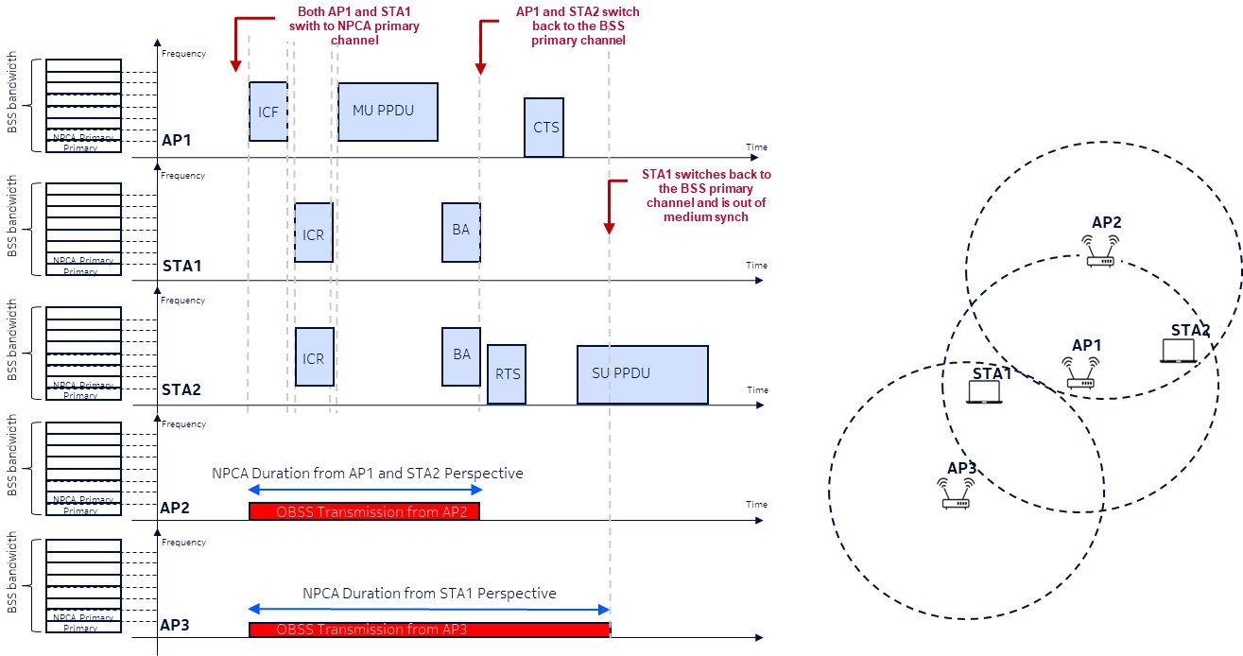
Problem Statement (1/2)
While a lot of progress has been made during the past IEEE 802.11 Interim and Ad-Hoc meetings ([1-10]) to define the NPCA design, the conditions upon which STAs shall return to the BSS’s primary channel are still TBD.
It is important to remark that if STAs switch back at different times as for example they may be subject to different OBSSes, they may lose medium synchronization as suffer from EDCA deafness.

Slide 3
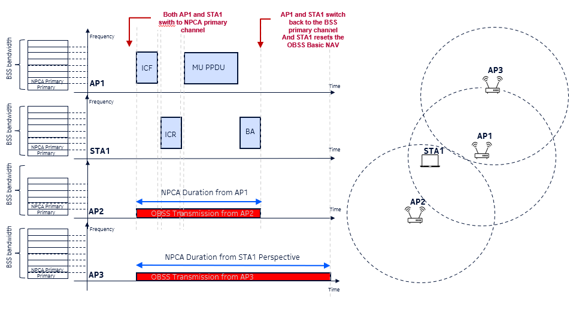
Problem Statement (2/2)
Notice that same issue may arise, even in the case when STAs exchange information regarding their own view of the OBSS (e.g., ICF and ICR contain the NPCA duration) and negotiate to return to the BSS’s primary channel at the same time, if they improperly reset the OBSS Basic NAV on the primary channel.

Slide 4
Recap: 802.11be Medium Synchronization Mechanisms
In 802.11be to help a STA re-gain medium synchronization a recovery procedure was introduced, where a timer called MediumSyncDelay (which is given in increments of 32 μs) is started unless:
the transmission that led to loss of medium synchronization is shorter than 72us (which is to cover length for RTS/CTS/Ack frame length);
the MediumSyncDelay timer started previously, and it has not yet elapsed.
To regain medium synchronization two methods were defined:
ED-based recovery procedure
If the medium is lost and the timer has not expired, a STA shall use a different sensitivity for the CCA, called dot11MSDOFDMEDthreshold.
If the STA is capable to obtain a TxOP, then
If it is a non-AP STA, it shall transmit an RTS frame to its associated AP as the initial frame in an obtained TXOP
If it is an AP affiliated with an NSTR mobile AP MLD, then the AP shall transmit an RTS frame to an associated non-AP STA as the initial frame in an obtained TXOP and follow the rules defined in 35.3.19 (NSTR mobile AP MLD operation).
Shall not attempt to initiate a TXOP more than dot11MSDTXOPMax times since the start of the timer
Otherwise, it shall perform CCA until the MediumSyncDelay timer has expired before it initiates a transmission.
AP Assisted recovery procedure:
this is a service provided by an AP MLD to help a non-AP STA that has lost medium synchronization to transmit a frame without causing collision with another transmission

Slide 5
Recovery Procedure and Behavior For NPCA STAs
Proposal 1: the ED-based approach defined for 802.11be should be modified as follows:
Upon switching to the BSS’s primary channel a STA shall maintain the knowledge of the Basic NAV of the OBSS that triggered the switch to the NPCA primary channel
NPCADwellingTimer is started upon switching to the BSS’s primary channel
A STA shall not transmit or resume EDCA procedure until the intra-BSS and OBSS Basic NAV have expired if the NPCADwellingTimer has not expired
If NPCADwellingTimer has not expired, a STA that would like to transmit
uses a threshold that NPCA specific when resuming EDCA
If the STA is a non-AP STA it shall transmit an RTS to its associated AP, and if the STA is an AP, it shall transmit an RTS to its associated non-AP STA
Shall not attempt to initiate a TXOP more than a certain number of times since the start of the timer.
Proposal 2: Since both AP and STA switch to the NPCA primary channel and may both lose medium synchronization, the AP-assisted method is not applicable for NPCA.

Slide 6
Summary
In this contributions, we discussed the issue of medium synchronization loss in NPCA
To overcome this issue the following is proposed:
The 802.11be ED-based recover procedure is modified as follows:
Upon switching to the BSS’s primary channel a STA shall maintain the knowledge of the Basic NAV of the OBSS that triggered the switch to the NPCA primary channel
MediumSyncDelay is started upon switching to the BSS’s primary channel
A STA shall not transmit or resume EDCA procedure until the intra-BSS and OBSS Basic NAV have expired if the MediumSyncDelay has not expired
If MediumSyncDelay has not expired, a STA that would like to transmit
uses a threshold that NPCA specific when resuming EDCA
If the STA is a non-AP STA it shall transmit an RTS to its associated AP, and if the STA is an AP, it shall transmit an RTS to its associated non-AP STA
Shall not attempt to initiate a TXOP more than a certain number of times since the start of the timer.
The 802.11be AP assisted method is not applied to NPCA.

Slide 7
References
[1] IEEE 802.11-23/34, “Non-primary channel utilization”, Sindhu Verma
[2] IEEE 802.11-23/631, “Secondary channel usage and secondary 20MHz channel backoff”, Liwen Chu
[3] IEEE 802.11-23/797, “Non-primary channel access”, Yongho Seok
[4] IEEE 802.11-23/961, “UHR secondary channel access”, Minyoung Park
[5] IEEE 802.11-23/1112, “Thoughts on secondary channel access”, Insun Jang
[6] IEEE 802.11-23/1365, “Discussions on non-primary channel access”, Sanghyun Kim
[7] IEEE 802.11-23/1891, “Nonprimary Channel Access Follow-Up”, Gaurang Naik
[8] IEEE 802.11-23/1911, “Secondary channel access and frame transmission”, Dongju Cha
[9] IEEE 802.11-23/1951, “Concurrent CCA for non-primary channel access”, Leonardo Lanante
[10] IEEE 802.11-24/1762, “PDT-MAC-NPCA”, Matthew Fischer

