Slide 1
Follow-up on AP Power Save
Date: 2025-06-30

Slide 2
Abstract
Operators are pressured to reduce the power consumption of their residential broadband gateways.
A big part of this power consumption is due to Wi-Fi.
Power consumption is even more significant since the introduction of 6 GHz – which added a third radio
At present few solutions for non-mobile AP power are in draft 0.3.
We need more solutions, including backward compatible solutions.

Slide 3
Background: power consumption mitigation for APs
With the European Climate Law, the EU is committing to carbon neutrality by 2050.
Target power consumption of residential gateways (“stand-by mode”) will be 7W in 2027 in Europe.
Telecommunication operators must reduce their emissions footprints.
They focus on the major sources of scope 3 emissions, such as handset, residential gateways, network equipments… it represented 81% of Orange carbon emissions in 2023.
More globally, 221 companies of the telecommunication sector have targets to reduce their carbon emissions: Target dashboard - Science Based Targets Initiative
Most of power saving features in Wi-Fi are addressing non-AP STAs, because they are often battery-powered devices, while APs are wall-powered and need to be always awake.
We need efficient solutions for APs.

Slide 4
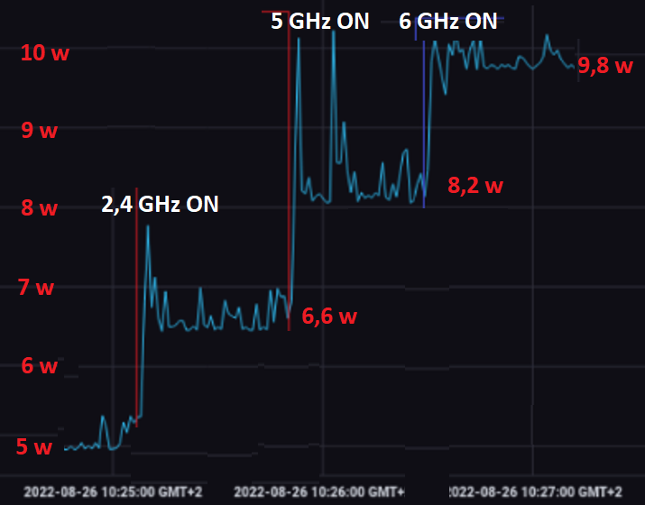
Illustration of a tri-band AP power consumption
Measurements performed by Orange on its 802.11ax tri band gateway
By default, even without any traffic, the Wi-Fi represents 50% of the total energy consumption of this residential gateway
Aggregation of total household power consumption is increasing (more frequency bands, more devices)

Slide 5
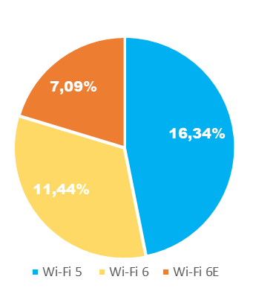
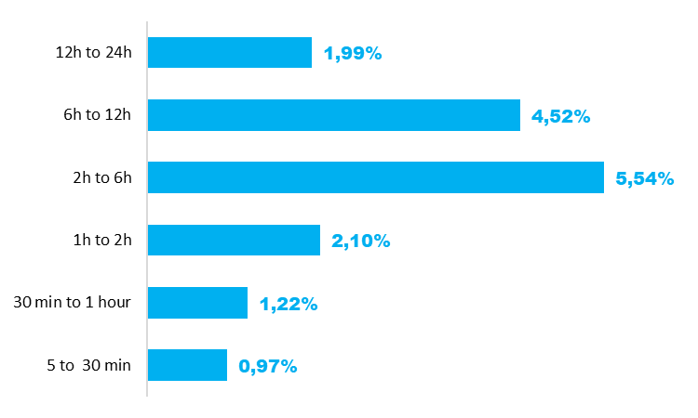
Experimenting 5 GHz deactivation
Deactivation ratio
per GW type
Experimentation by Bouygues Telecom
3 types of GW: Wi-Fi 5, Wi-Fi 6 and Wi-Fi 6E
SSID configuration: a single unified SSID (2.4 & 5 GHz or 2.4, 5 & 6 GHz)
Scenario: 5000 GWs for each GW type
Test duration: 1 month
Chosen trigger: Deactivate 5 GHz band when there is no associated device on any band
5 GHz is reactivated whenever a device associates with the GW (on either 2.4 or 6 GHz).
A simple mechanism provides promising results:
Gain: 15K hours have been “saved” over a month.
No impact on overall Wi-Fi performance
Note: Newest GWs (Wi-Fi 6E) tend to have more Wi-Fi devices hence getting a lower 5 GHz deactivation ratio with the chosen trigger.
Focus on Wi-Fi 5 GW
Total 5 GHz deactivation duration per day

Slide 6
Other advantage of reducing the AP power consumption
Reducing the AP power consumption increases its service life
Increases customer satisfaction due to cost savings for customers

Slide 7
Constraints
The features must be backward compatible
It must be possible to enable them even if pre 802.11bn devices are associated to the AP
More constraints on the 2.4GHz band where IoT devices are still using old Wi-Fi versions
The features must not prevent the AP from receiving packets from associated STAs

Slide 8
Related work
Many contributions already presented discuss some existing features for power save and propose new solutions
Existing features are not always implemented / widely supported
Existing solutions include (but are not limited to):
BW reduction
Nss / antennas reduction
Limitation of the 802.11 capabilities (generation/MCS etc)
Disablement of a frequency band:
in particular the 6GHz band if there is no 6GHz capable device in the home,
even in addition the 5GHz when there is no traffic

Slide 9
Adopted (non-Mobile) AP power save mechanism in 802.11bn
2 motions were voted:
Motion #49: Define a new mechanism and/or enhance existing mechanism for AP power save
Motion #161: Scheduled periodic power save on AP side is performed in UHR using Broadcast TWT with TWT ID=0 with Responder PM=1 (Rules for TWT scheduling AP)
Power saving features in P802.11bn draft 0.3:
DPS: efficiency on AP power consumption (excluding non-mobile APs) is not clear
AP PUO (Periodic Unavailability Operation) mode: all the STAs must support the feature
Are these features compatible with legacy devices?
Operators need additional solutions

Slide 10
Summary
802.11bn needs more power saving features for non-mobile APs
Backward compatible features for existing generations of STAs
New features for 802.11bn and future generations of APs and STAs

Slide 11
References
[1] 11-22/1809 A Perspective on UHR Features for Operator Residential Deployments
[2] 11-23/10 Considerations for enabling AP power save
[3] 11-23/15 AP MLD power management
[4] 11-23/225 Considering Unscheduled AP Power Save
[5] 11-23/1922-01 multi-link sm power save mode
[6] 11-23/1936-00 ap mld power-save follow-up
[7] 11-23/1965-02 dynamic power-save follow-up
[8] 11-23/18365-00 AP Power Management
[9] 11-23/2112-01 Power Save for UHR
[10] 11-24/97-00 AP Power Management – Follow-up
[11] 11-24/451-00 AP state transitions in DPS mode
[12] 11-24/589-00 Dynamic TID-To-Link Mapping for AP MLD Power Save
[13] 11-24/602-00 Multi link Power Management for MLO

Slide 12
References
[14] 11-24/659-01 Thoughts on AP Power Save
[15] 11-24/671-00 Enhancements on AP Power Save
[16] 11-24/813-00 Discussions on AP Power Save
[17] 11-24/833-00 Dynamic Power Saving for AP
[18] 11-24/1166-00 TWT-Based Power Save with Enhanced Flexibility
[19] 11-24/1167-00 EML(SR/MR) Based Dynamic Power Save Design
[20] 11-24/1502-00 Discussion on AP Power Save
[21] 11-24/1602-01 Power Save Enhancements in UHR
[22] 11-24/2001-00 Multi-Link scheduled Power Save for AP MLD
[23] 11-24/2040-01 Enabling AP power save – Follow Up
[24] 11-25/355-00 Considerations for AP Dynamic Power Save
[25] 11-24/578-00 TWT-Based AP Power Save
[26] 11-25/355-00 Considerations for AP Dynamic Power Save

