Slide 1
Co-RTWT protection for Multi-AP
Date: 2025-04-01
Authors:

Slide 2
Abstract
This contribution is a follow-up of 11-24-742, and highlights additional medium access functionalities during a Co-RTWT SP for multi-AP coordination in 802.11bn (AP side).

Slide 3
Introduction
Multi-AP (MAP) Coordination is one of the key features considered for IEEE 802.11bn.
The Co-RTWT was incorporated in D0.1 (section 37.8.2.4)
Currently the only existing protection is: “the Co-RTWT coordinated AP as a TXOP holder shall ensure that its TXOP ends before the start time of any active Co-RTWT SP for which protection is extended”.
Recent contributions (e.g. [3]) discuss some degree of protection for the negotiating R-TWT
Only AP protects
AP and associated STAs protect (e.g. [2] )
The present contribution falls into the “only AP Protects” category

Slide 4
Recap of [2]
2 neighbouring APs negotiate with each other a TWT schedule for the coordinated BSS (AP2) that at least partially overlaps with a first TWT schedule set in the coordinating BSS (AP1)
A coordinated AP adjusts the communication policy of its own STAs:
Option 1: OBSS TWT element forbids the stations of the AP2 BSS to access the medium during the second TWT SPs
Option 2: OBSS TWT element defines a waiting time for the stations of AP2 BSS to access the medium that is larger than a waiting time for stations of AP1 BSS to access the medium during the first TWT SPs. Typically, STAs perform a CCA (channel sensing) during a larger time. e.g. degraded AIFSN value
Option 3: OBSS TWT element indicates a temporary operating channel for stations of AP2 BSS to switch to for their communication during the second TWT SP
E.g. Channel Switch Announcement, DSO, Secondary Channel Access , …

Slide 5
Recap of [2] (cont.)
An SP was run for [2] on 12/12/2024 :
Shortly failed: 53 yes / 28 no / 40 abstain
Feedback received:
Co-RTWT is built on legacy R-TWT
Co-RTWT was supposed to be an AP feature that has no modification on STA side

Slide 6
Proposal : protection by APs
Target:
The coordinating AP keeps priority in accessing the channel during the TWT schedule, thereby protecting it from OBSS interference from the second BSS.
How:
The coordinating AP waits for less time before decrementing a backoff counter and accessing the channel, compared to the coordinated AP and the coordinated BSS.
R-TWT SP
Waiting time for coordinating AP
MAP Req
AP1
Beacon
First
BSS
beacon
STA11
Waiting time for coordinated AP
MAP Resp
AP2
Second
BSS
STA21
Sensing period for non-AP STAs of coordinated BSS
STA22
TWT IE
TWT SP

Slide 7
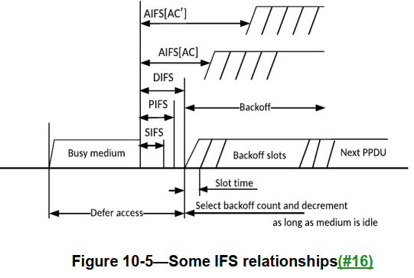
Example recommendations
Minimum time durations are negotiated in between the Requesting and Responding APs, or imposed by the Requesting AP :
For instance, the parameters in the MAP coordination frame include an AIFSN increment :
AIFSN for the coordinating AP can be set to 0.
AIFSN for the coordinated AP can be set to 1.
AIFSN for coordinated non-AP STA can be set to 2.
For instance, coordinating AP takes always a strict and shortest waiting time,
such as the PIFS value
AP adopts different contention behaviours (different sets of parameters) depending on whether it operates during SPs of a TWT schedule or not.
If required, coordinated AP announces a new update of the EDCA Parameter Set for the coordinated BSS.
Notes:
PIFS = aSIFSTime + aSlotTime
DIFS = aSIFSTime + 2 * aSlotTime
AIFS[AC] = aSIFSTime + AIFSN[AC] × aSlotTime.
For non-AP STAs : The AIFSN subfield indicates the number of slots after a SIFS a STA defers before either invoking a backoff or starting
a transmission. The minimum value of the AIFSN subfield is 2.

Slide 8
Advantage
The behaviour of the non-AP stations of the coordinated BSS does not need to be modified, resulting in both:
legacy stations in the coordinated BSS
and stations capable of R-TWT operations
keeping the same behaviour .

Slide 9
Summary
To reduce OBSS interference among a Multiple AP set, we introduced concepts and solutions for reduced communication activities for stations of neighbouring BSS during the Coordinated R-TWT (Co-RTWT) SPs.
Present document provides protection mechanism by APs.

Slide 10
Straw Poll
Do you agree to add to the TGbn SFD the following ?
define additional mechanisms that enable APs of a Multi-AP set to protect the coordinating AP during Co-RTWT SP
example mechanism is that a coordinating AP keeps priority in accessing the channel during its Co-RTWT SP .

Slide 11
References
[1] 802.11bn PAR
[2] 11-24/742 OBSS TWT management for MAP, Pascal Viger (Canon)
[3] 11-24/909 R-TWT Announcement in Multi-BSS - Follow up, SunHee Baek (LG)
[4] 11-24/1966 PDT MAC CRTWT

