Slide 1
Details on Ove-the-DS Probe Mechanism
July 2024
Date: 2025-04-22
Authors:
Notes:
September 2012

Slide 2
Introduction
Considering the following motion had been approved in 11bn, this contribution discusses some details on the over-the-DS probe mechanism.
(Motion 333) Move to add to the TGbn SFD the following:[1]
Define a mechanism to retrieve probe response content for neighboring AP MLD(s) of the current AP MLD, through the current AP MLD
Note. The neighboring AP MLD and the current AP MLD are in the same ESS
Generally, there are two options to design the over-the-DS probe mechanism.
  Option 1. One is to reuse the existing ML Probe Request/Response frames with some modifications;
  Option 2. the other one is to define new protected Action frames.
In this contribution, we will also compare these two options.

Slide 3
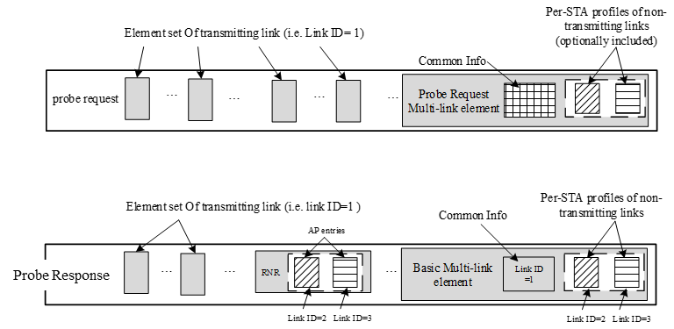
Existing ML Probe
The existing ML probe allows a non-AP STA affiliated with a non-AP MLD to request an AP affiliated with an AP MLD to include the complete or partial profile of the AP(s) affiliated with the AP MLD in the ML Probe Response frame.[2]
  Note that the complete profile on the transmitting link shall be included within ML Probe Response frame body (excluding the Basic ML element). For the over-the-DS probe scenario, this info is useless.

Slide 4
Option 1. Reuse Existing ML Probe
The behavior of the legacy device is uncertain when it receives a protected Probe Response frame but cannot parse the content of the frame body of the Probe Response frame.
No need to include the info on the transmitting link of the current AP MLD.
  Furthermore, there is no precedent about including the info on the two non-collocated AP MLDs within the Probe Response frame.

Slide 5
Option 2. New Action frames (Prefer)
Define a new protected action frame exchange, e.g. Tunneled Probe Request/Response frames. Based on the offline discussion, there are the following two sub-options.
Option 2a. Reuse the info organization manner of the existing ML Probe Response frame. Specifically,
  Reuse the inheritance rules defined in 11be
  Include the info on all APs affiliated with the target AP MLD in RNR of the Probe Response frame body field of the Tunneled Probe Response frame.
    The reason is to include the BSSID of the affiliated AP which is indicated through the frame body outside of the Basic ML element
  This design can minimize the changes on the existing ML probe mechanism.
Option 2b. The info on each AP affiliated with the target AP MLD is included within a Per-STA Profile subelement of the Basic ML element
  Similar to the info organization manner of the Link Reconfiguration Response frame
  No any inheritance rules are applied.

Slide 6
Other Details
The non-AP MLD can obtain the target AP MLD address info by leveraging the BTM operation, or directly set the MLD MAC Address subfield to a broadcast address.
Then the current AP MLD will reply a Tunneled Probe Response frame with all known neighboring AP MLDs.
  Each neighboring AP MLD is signaled through a Basic ML element.

Slide 7
Summary
In this contribution, we propose a very simple solution to enable the over-the-DS probe mechanism by newly defining Protected Tunneled Probe Request/Response frames.
In addition, a broadcast over-the-DS probe manner is proposed, which allows the non-AP MLD to gather the info on all the known neighboring AP MLDs of the current AP MLD (i.e. on-hop neighboring AP MLDs).

Slide 8
References
[1] 11-25-0014-14-00bn-tgbn-motions-list-part-2
[2] Draft P802.11be_D7.0.pdf

Slide 9
SP 1
Do you support to define new protected Action frames to retrieve the info on a neighboring AP MLD of the current AP MLD, through the current AP MLD
  The info on each AP affiliated with the neighboring AP MLD is included within a Per-STA Profile subelement of the Basic ML element
  No any inheritance rules are applied.
  Note. The neighboring AP MLD and the current AP MLD are in the same ESS.

Slide 10
SP 2
Do you support to define a probe manner in which the non-AP MLD can retrieve the info on all the known neighboring AP MLDs of the current AP MLD by setting the MLD MAC Address subfield of the Probe Request Multi-link element to a broadcast address?
  Each neighboring AP MLD is signaled through a separate Basic ML element.

