Slide 1
MAPC C-SR Scheduling with
Multi-Armed Bandits Revisited
Authors:
Date: 2025-05-13

Slide 2
Abstract
TGbn is developing Co-SR (Coordinated Spatial Reuse), a variant of MAPC (Multi-AP Coordination).
Co-SR configuration (AP selection etc.) remains an open challenge.
We apply reinforcement learning to learn best Co-SR configurations.
This solution is related to the AIML TIG Technical Report use case for MAPC.
Significant extension of previous AIML SC presentation [1].
Detailed explanation of all results in preprint [2].
Code available as open source [3].

Slide 3
Background
Fully random access insufficient for dense deployments
TGbn is introducing multi-AP coordination (MAPC) w/ several modes:
  Coordinated Spatial Reuse (Co-SR), Coordinated Beamforming (Co-BF), etc.
TGbn SFD [4]
  "TGbn defines a multi-AP Coordinated Spatial Reuse (Co-SR) at TXOP-level with power control."
  "A sharing AP that intends to initiate a Coordinated Spatial Reuse transmission shall transmit a Trigger frame to initiate concurrent Co-SR transmissions with one (whether to allow more is TBD) other AP within its obtained TXOP."
In Co-SR, APs transmit simultaneously, on the same channel, with adjusted Tx power to avoid interference
Co-SR != 802.11ax OBSS_PD SR

Slide 4
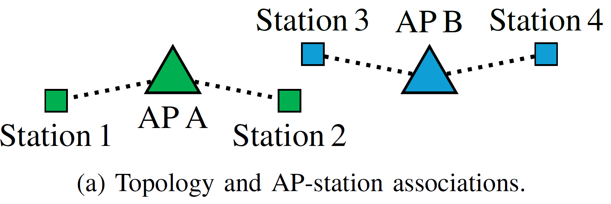
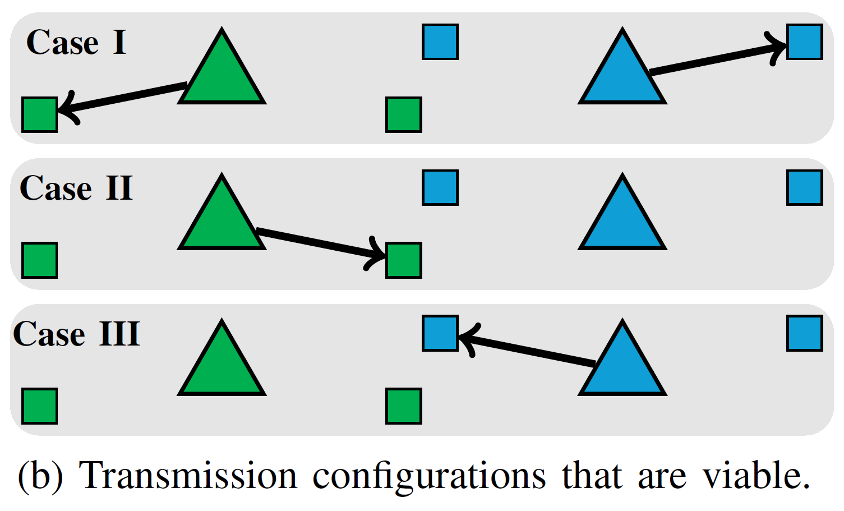
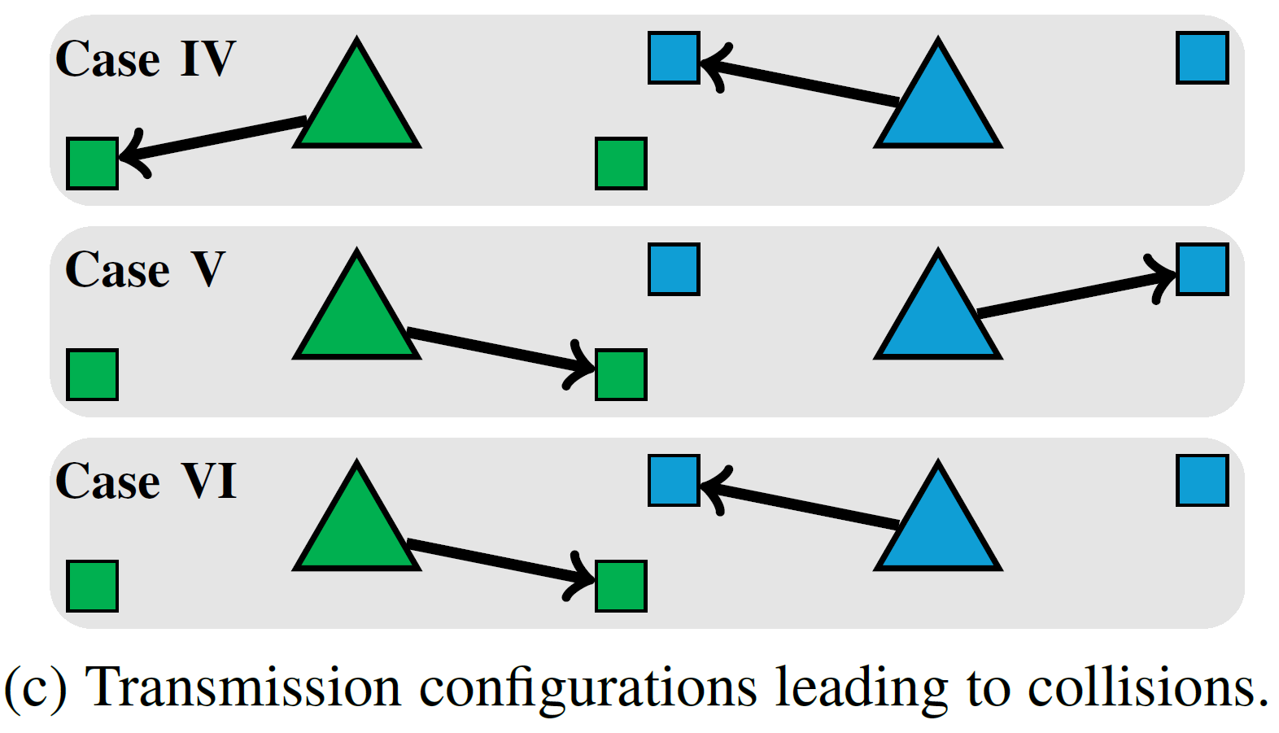
C-SR Example
Downlink
Omnidirectional antennas
Tx power levels omitted for clarity

Slide 5
Problem Statement
Which APs should transmit?
Which STAs can be the receivers?
What should be the TX power levels?
Selecting such transmission configurations is the C-SR scheduling problem.

Slide 6
Solutions
Measurements: RSS or CSI
Problems
  Measurements needed between each pair of devices (scalability issues)
  RSS overhead – RSS measurements at STAs from AP beacons, need to be reported upstream
  RSS unreliability – high variance
  CSI – even more overhead, more processing power, frame exchange between AP and non-associated STAs
Alternative: probing-based approach
  Try-and-find out what works
  No extra signalling
Similar problem: rate selection
  Many measurement-based solutions proposed
  Current solutions (e.g., Minstrel) are probing-based

Slide 7
Our Proposal – MABs
Machine learning (ML) → Reinforcement learning (RL) → Multi-armed bandits (MABs)
MABs
  No a priori knowledge
  Online learning
  Adaptable to randomness of 802.11 topologies
Research questions
  How quickly can MABs learn which C-SR transmission configurations to use?
  How close to optimal are the transmission configurations found?

Slide 8
Flat and Hierarchical MABs for Co-SR
Traditional (flat) MABs: each configuration is an independent action
  Configuration = {transmitting APs, recipient STAs, tx power levels}
  Explosion of no. actions – exploration becomes time-consuming
Hierarchical MAB architecture – reduces the large search space [5]
  Level 1 agents select APs
  Level 2 agents select STAs
  Level 3 agents select TX power levels

Slide 9
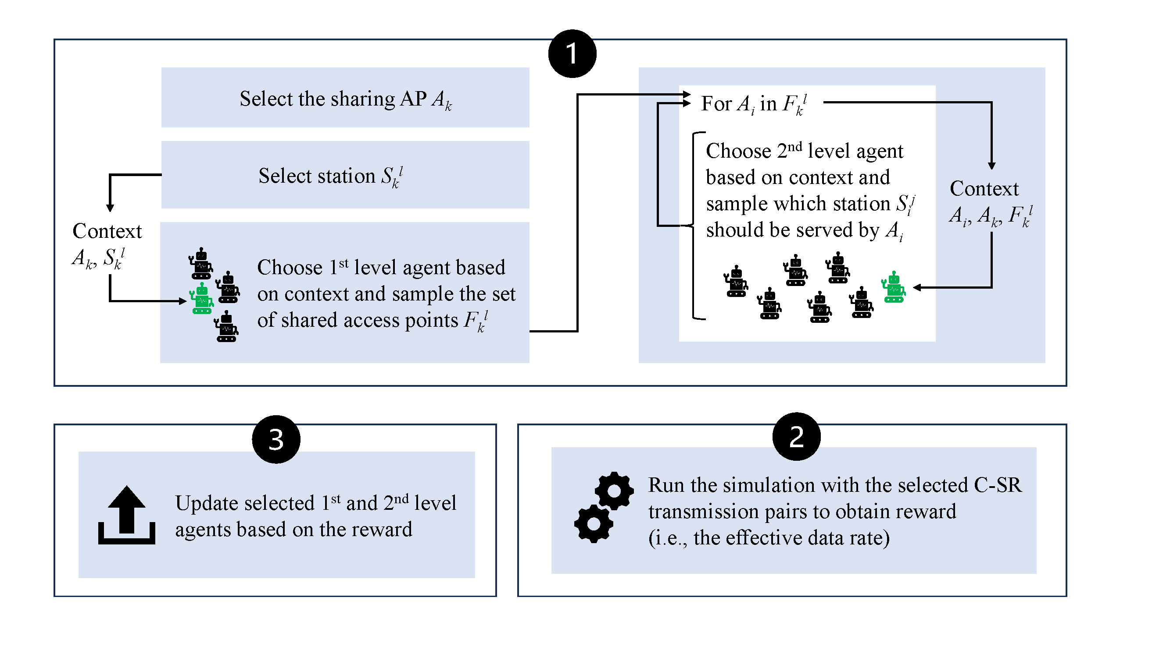
H-MABs
Diagram for 2 levels [6]
Since then, we’ve added a 3rd level (TX power selection)
Run the selected Co-SR
transmission pairs to obtain reward
(i.e., the effective data rate)

Slide 10
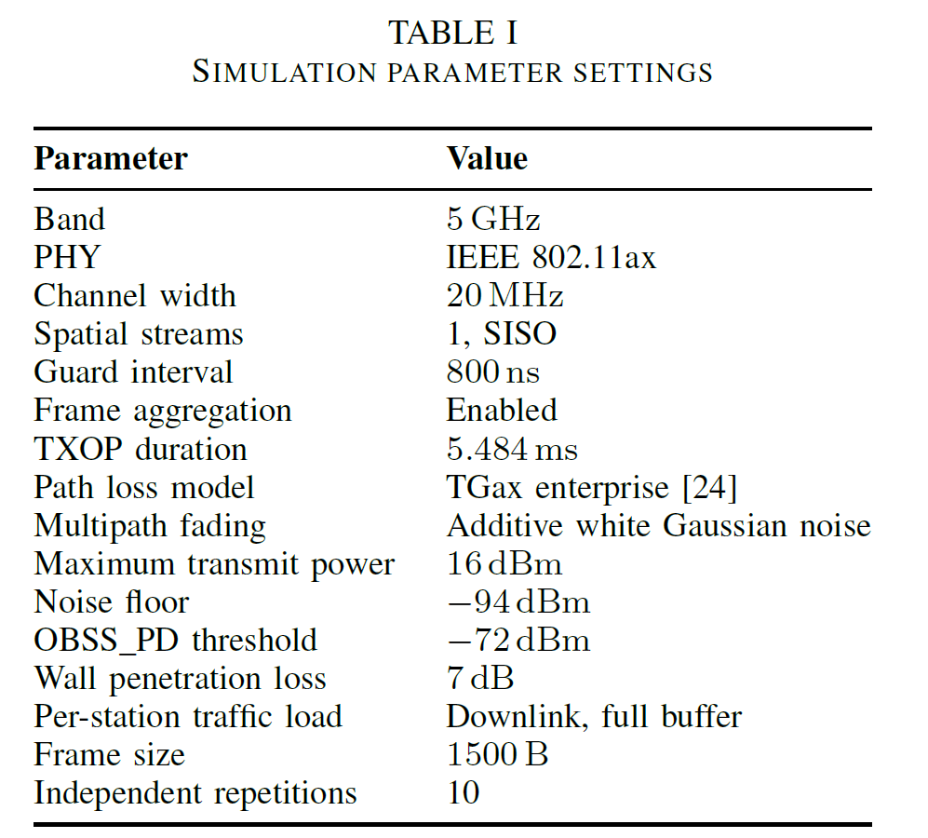
Simulation Setup
Baselines
DCF
SR
Upper bounds (cf slide 19)
  Throughput: T-Optimal
  Fairness: F-Optimal
Our proposals
MABs
H-MABs
Frequency reuse = 1

Slide 11
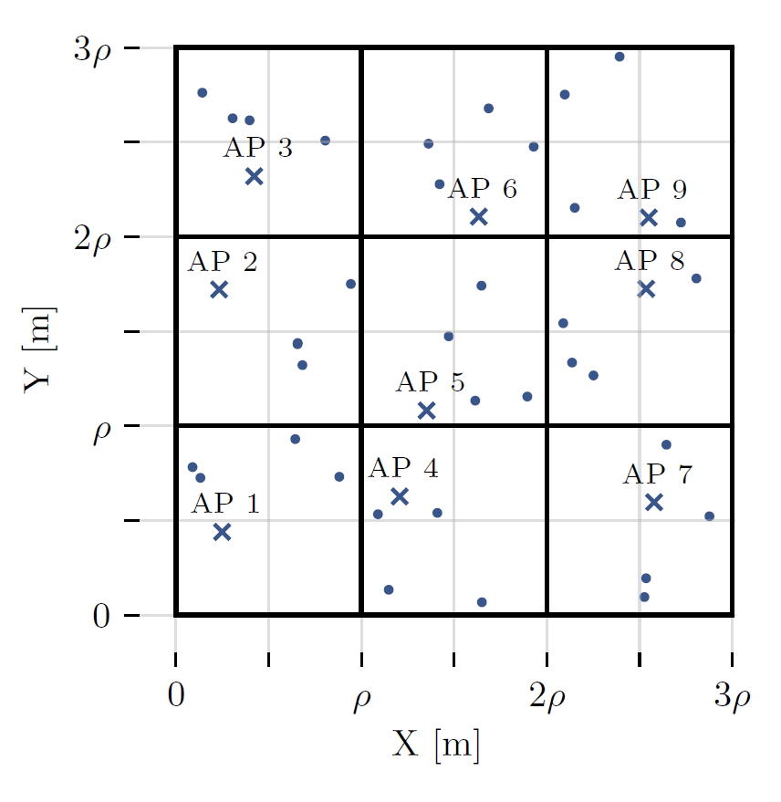
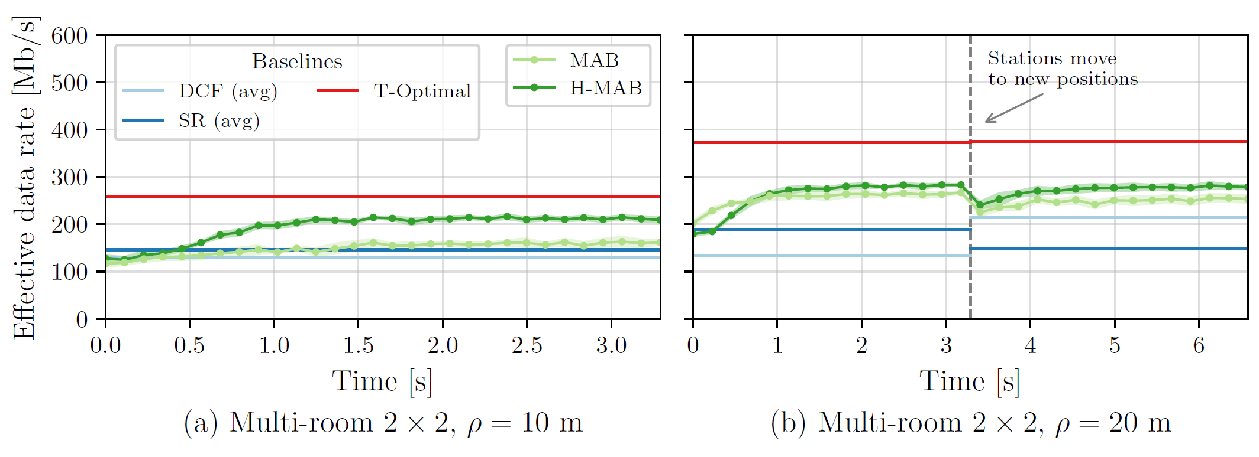
Transient Performance
Rapid convergence
Effective data rate
  H-MAB > MAB
Impact of nomadic mobility
  Both MABs quickly converge

Slide 12
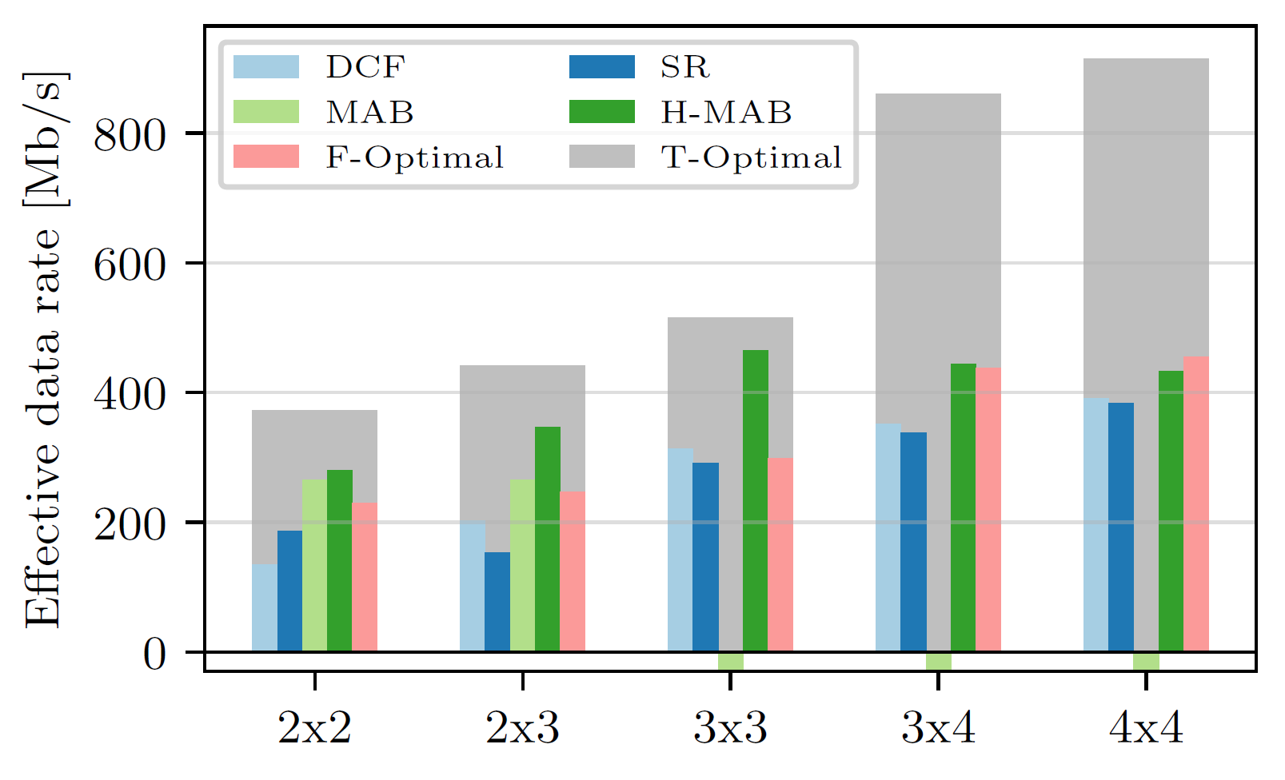
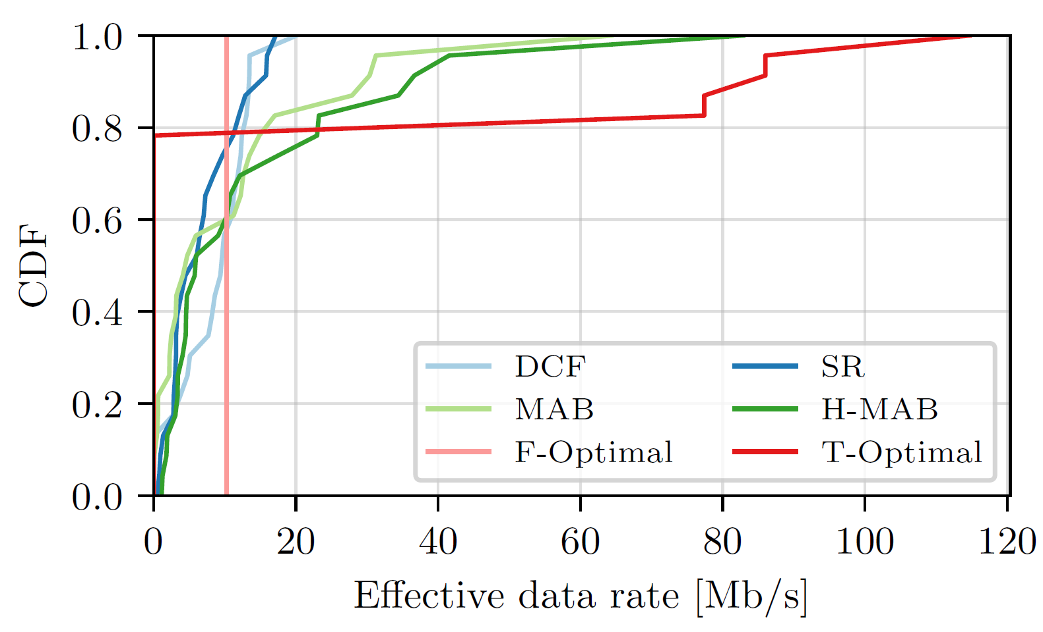
Steady-State Performance
H-MABs significantly outperform MABs and baselines
  Except 3x4 and 4x4 mulit-room topologies
Throughput distribution in 2x3 multi-room topology
Fairness-throughput tradeoff

Slide 13
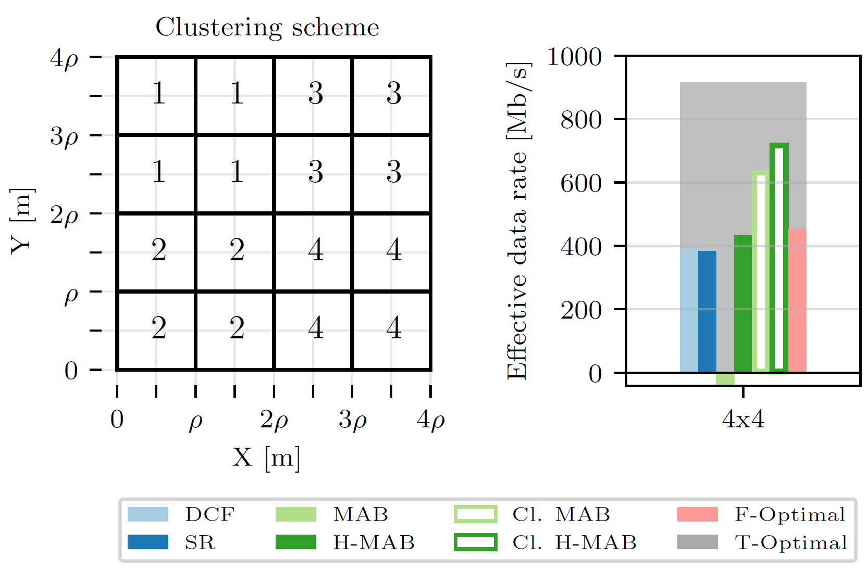
Benefits of Clusterization
For the 3x4 and 4x4 multi-room topologies
Separate agent in each cluster
Clustered versions show much better performance
  Also in terms of convergence times

Slide 14
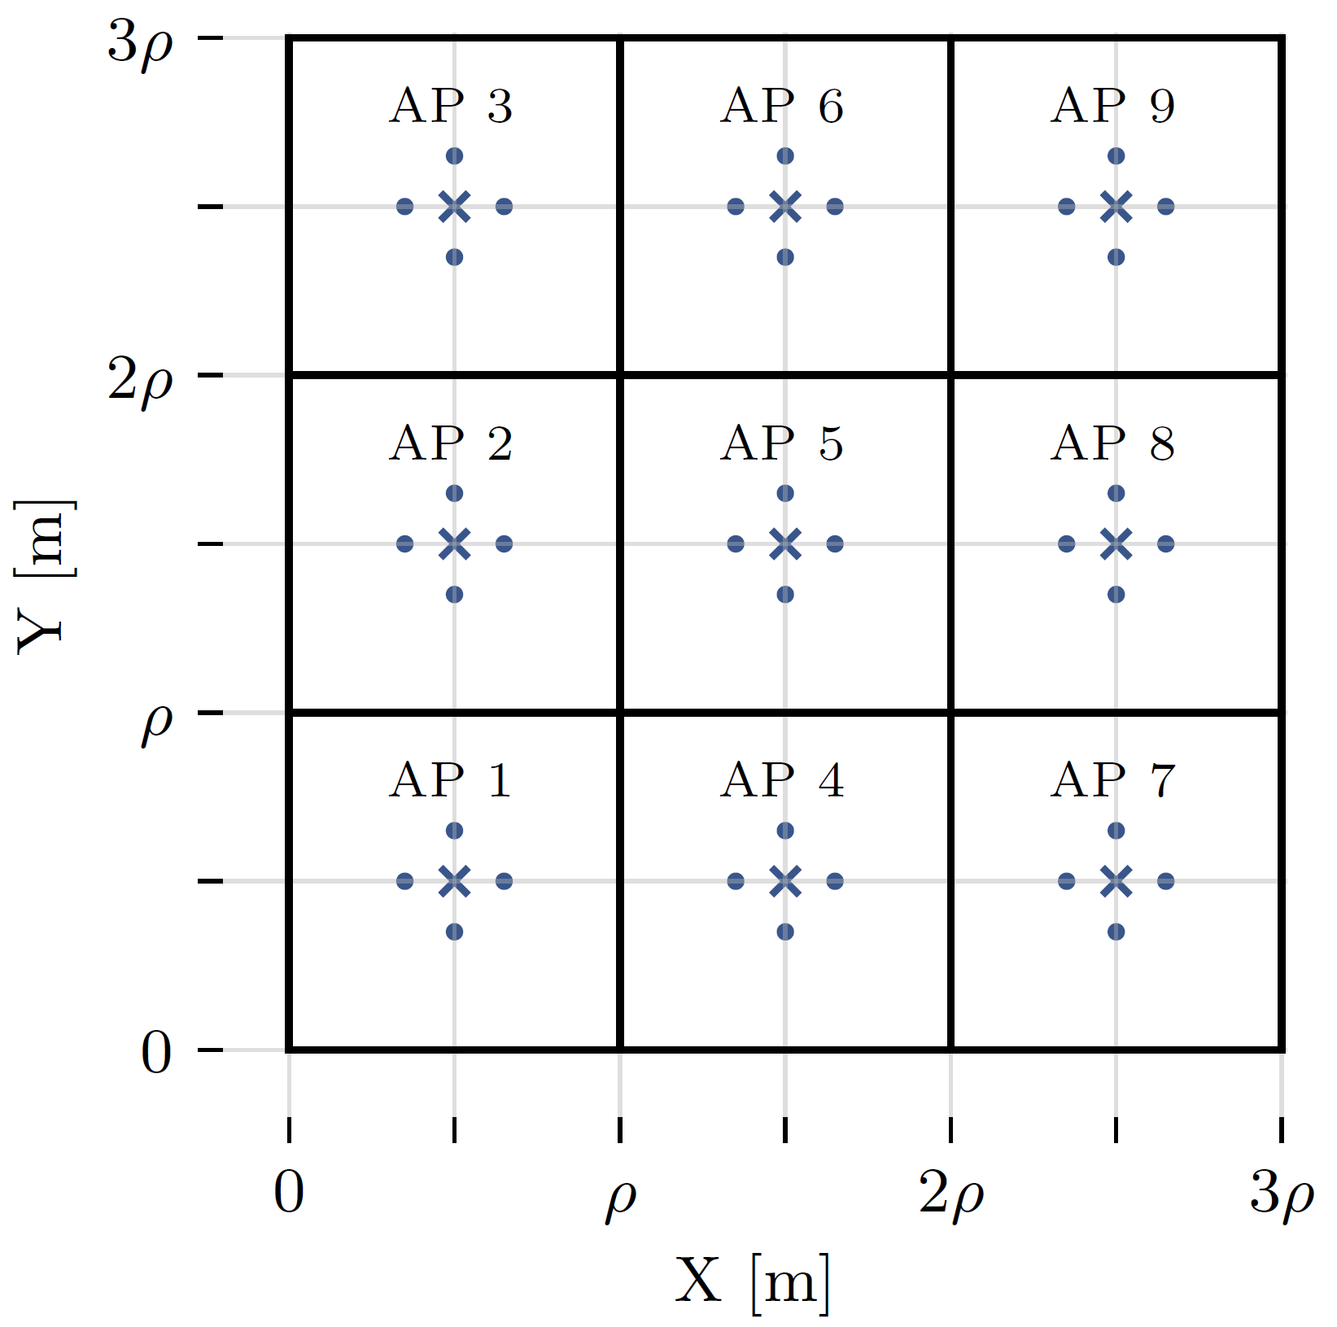
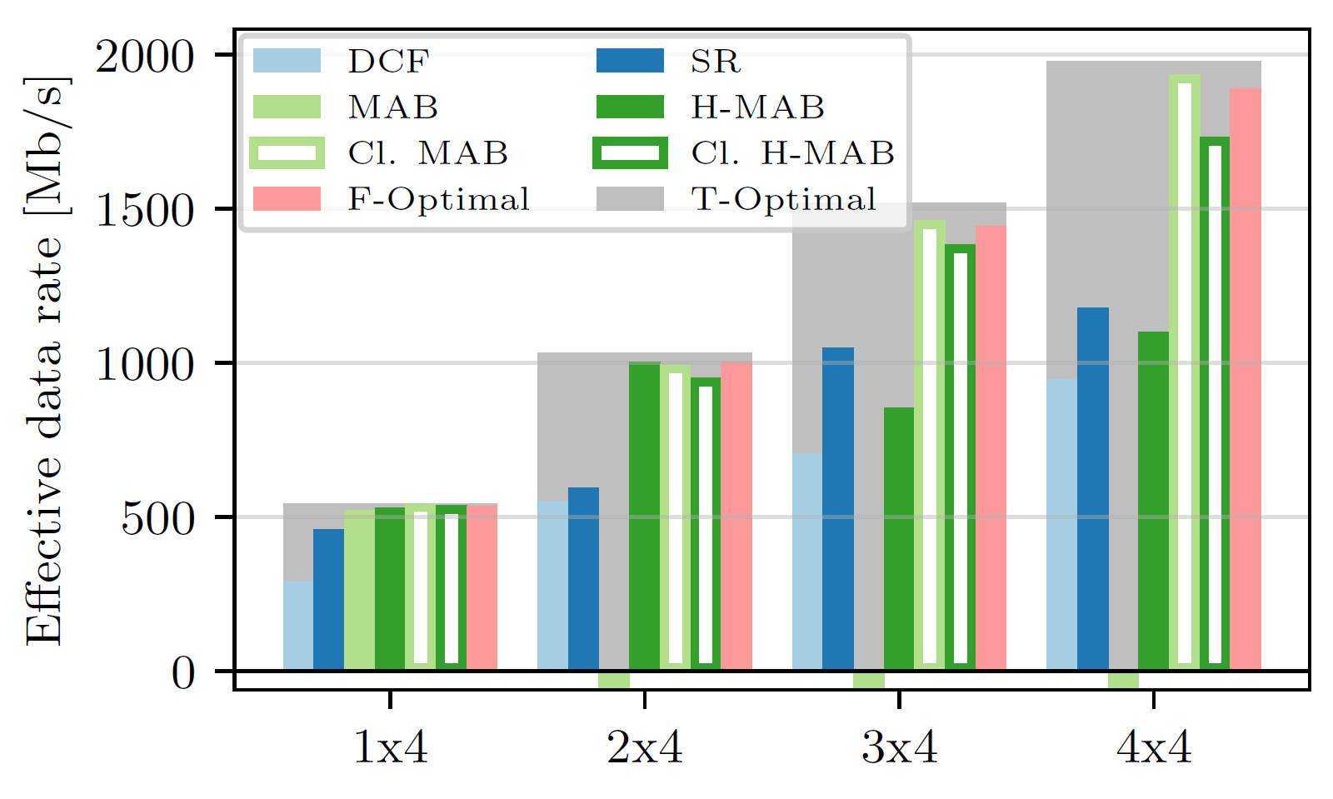
Symmetrical Enterprise Scenario
Inspired by TGax enterprise scenario
Best-case topology for Co-SR
In 4x4, MABs close to both optimal baselines

Slide 15
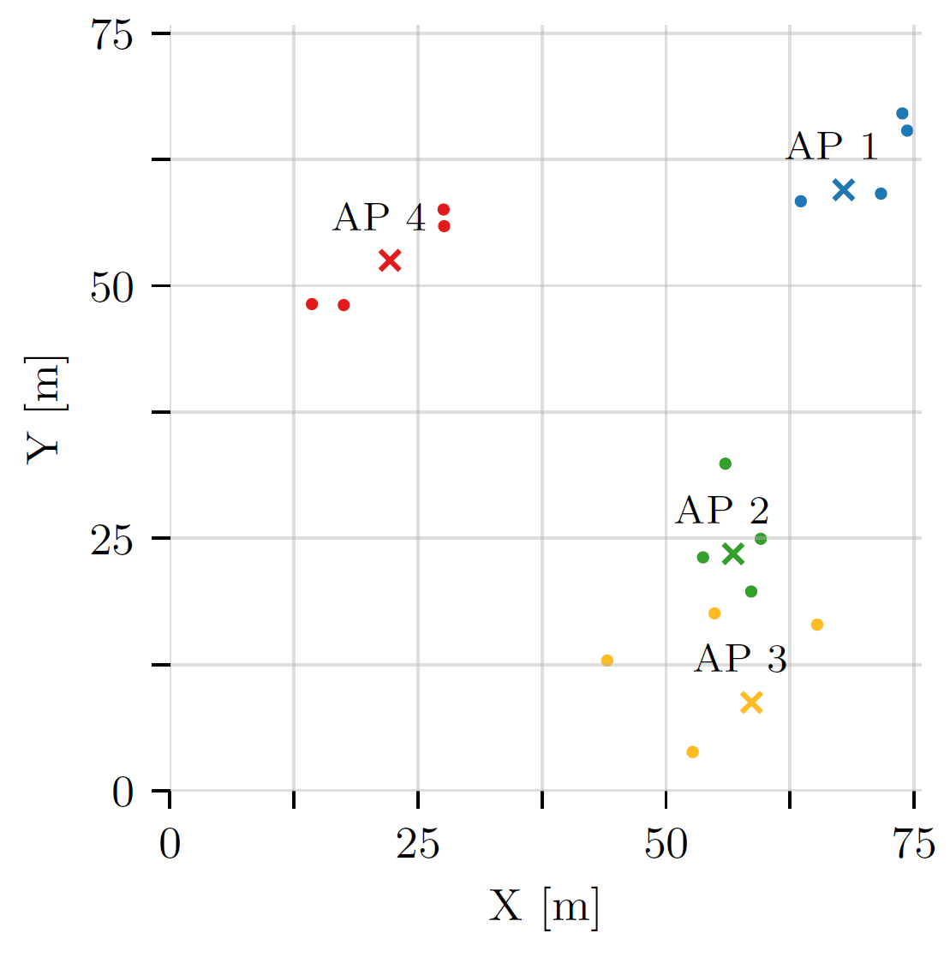
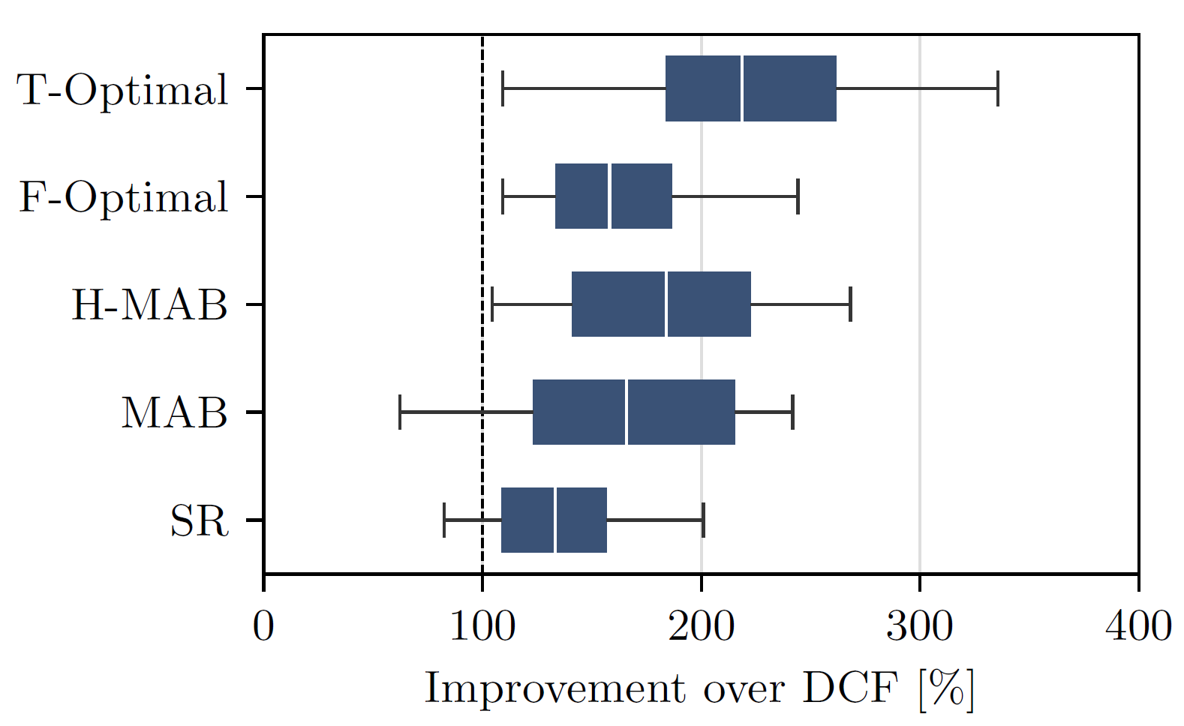
Random Open Space Topologies
Topology change halfway through the simulation
Both MABs better than DCF on average by 80%
Only H-MABs consistently outperform DCF

Slide 16
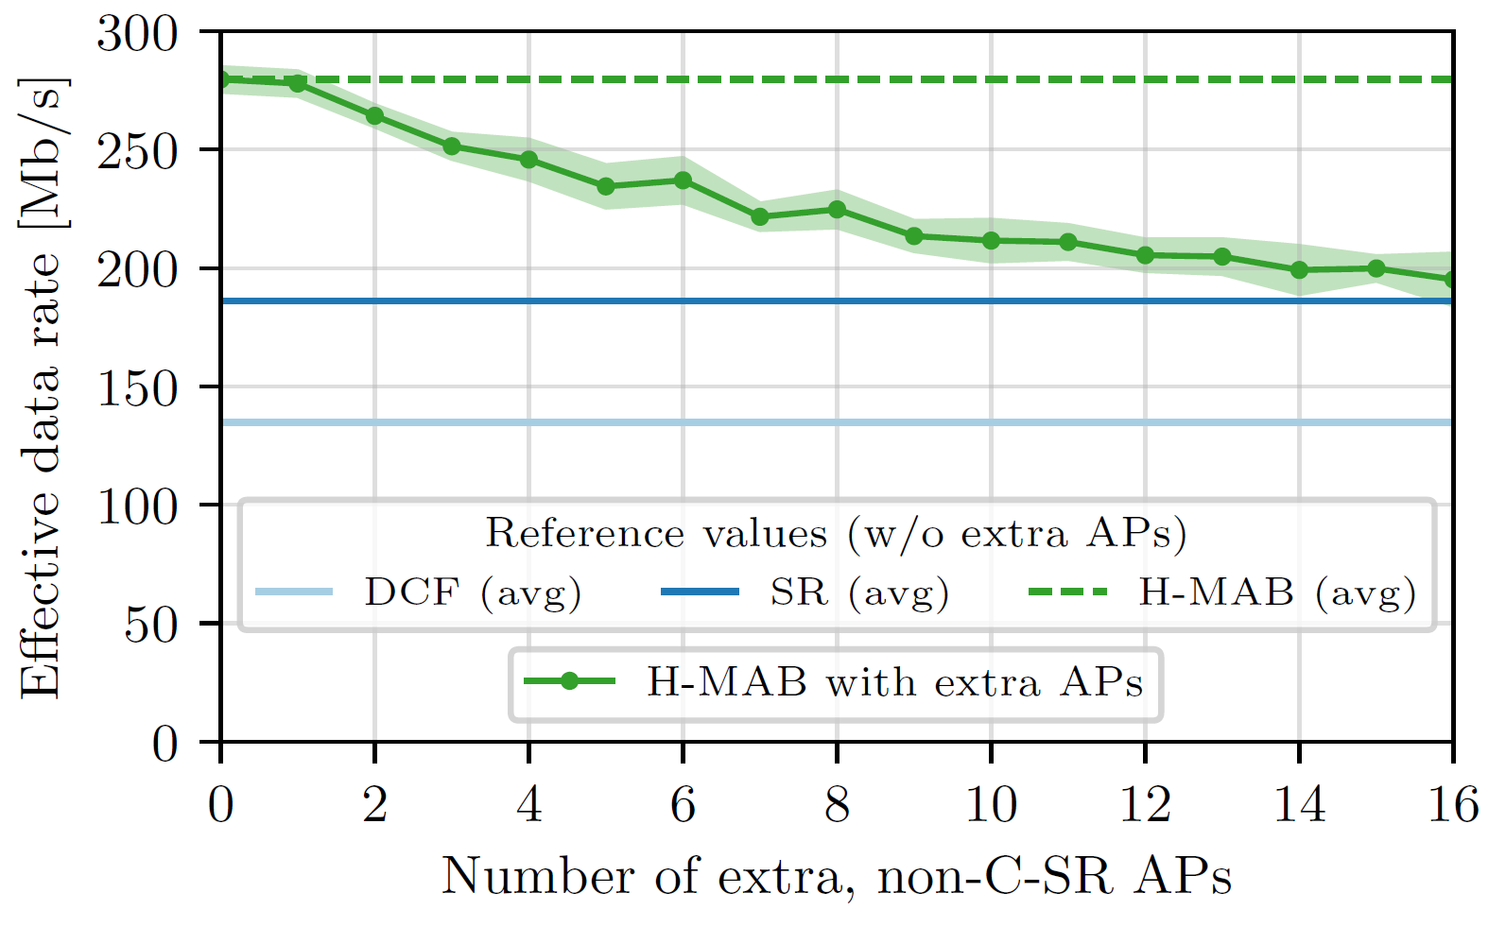
Impact of Legacy Devices
2x2 multi-room topology
Uniformly add legacy (non-Co-SR) APs to contend with one of the four Co-SR Aps
Effective data rate when one of the Co-SR APs wins channel access
Collisions cause performance deterioration
Still gains wrt DCF and SR

Slide 17
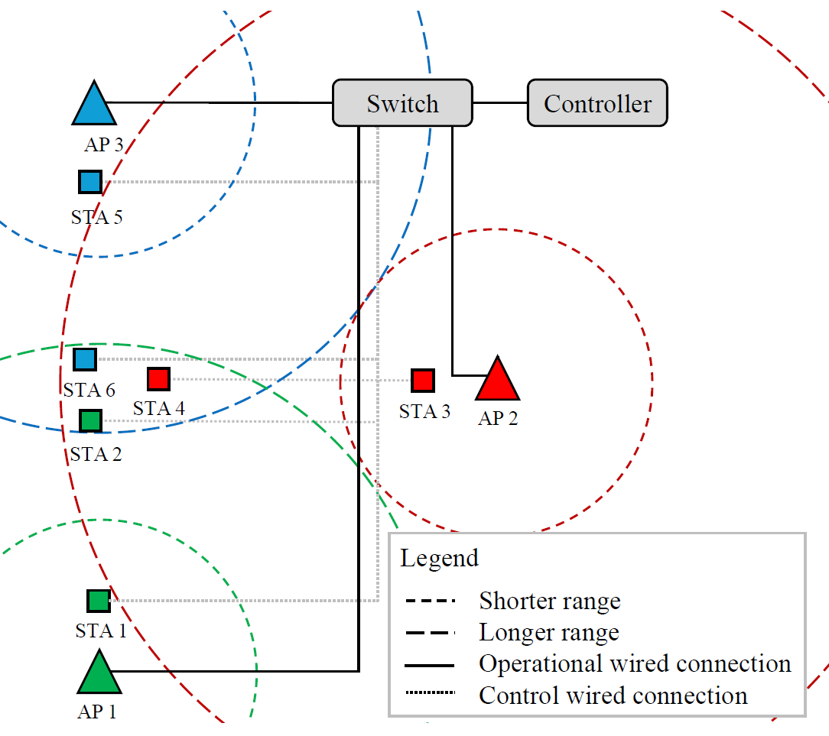
Experimental Testbed
openwifi [7]
  Linux mac80211 compatible full-stack IEEE802.11/Wi-Fi design based on SDR
  Supports MAPC [8]
Network controller sends transmission configurations to APs
Each AP has two STAs
  Near and far
MAB/H-MAB hyperparameters optimized in testbed’s digital-twin

Slide 18
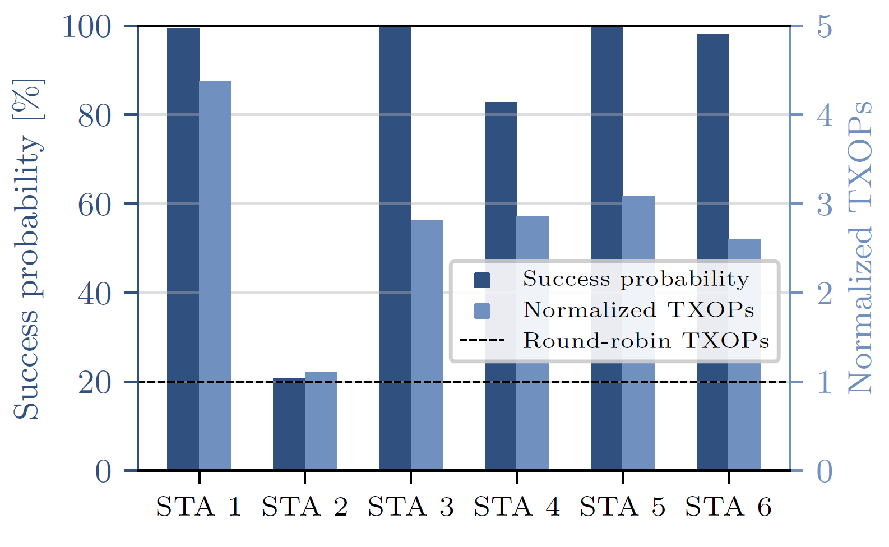
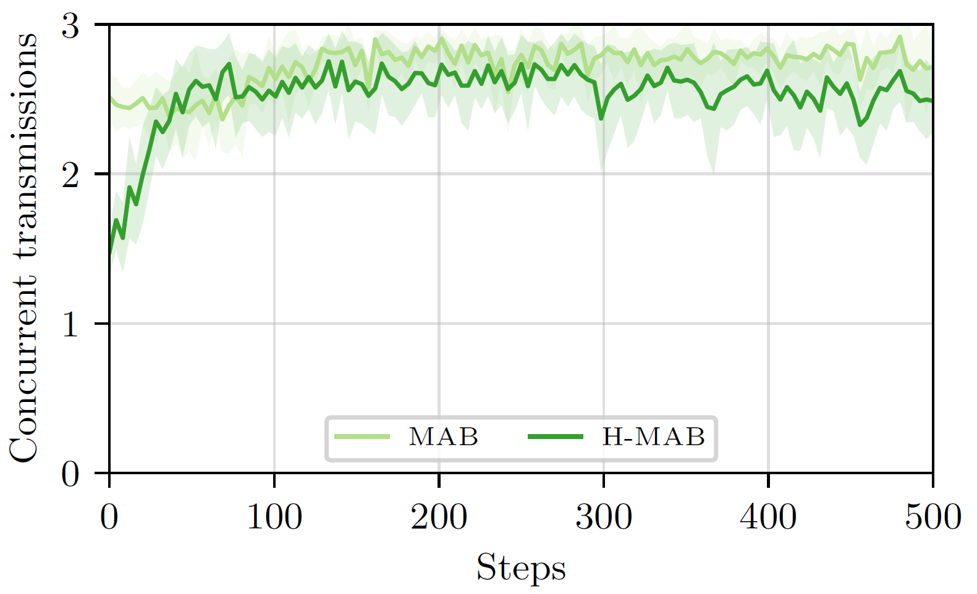
Experimental Validation
Despite symmetric topology, varying TX success probability
  STA 2 has worse channel conditions
  Receives fewer TXOPs
  No less than under perferctly fair RR
Rapid convergence
Small topology so flat MABs slightly outperform H-MABs

Slide 19
Bonus: Upper Bound Model
To assess the upper bound of Co-SR operation, we develop a MILP optimization model [2]
  Based on the column generation optimization method
Maximizes
  Aggregate network throughput – Co-SR TXOPs typically allocated to best-placed STAs
  OR
  Fairness – maximize throughput of least served STA (max-min optimization)
Independent of MABs – can be used for any Co-SR setting as a baseline
  Python code available [3]

Slide 20
Conclusions on H-MABs for Co-SR
Good performance (high throughput, low convergence time for small and medium-sized networks)
Resilience to abrupt topology changes and legacy STAs
Large-scale networks require clusterization
Easy to deploy in hardware (lightweight, no training)
Future work
  Joint MCS selection
  Fully distributed operation
  Dynamic cluster selection
  Larger dynamics (station churn, non-full buffers) → coldspares approach
  Applying a similar probing-based approach for Co-BF

Slide 21
References
[1] S. Szott et al. "MAPC C-SR Scheduling with Multi-Armed Bandits", IEEE 802.11-24/0640r1.
[2] M. Wojnar et al. "Coordinated Spatial Reuse Scheduling With Machine Learning in IEEE 802.11 MAPC Networks", arXiv preprint, http://arxiv.org/abs/2505.07278, accessed on 2025-05-13.
[3] Coordinated Spatial Reuse Scheduling with Machine Learning in IEEE 802.11 MAPC Networks, https://github.com/ml4wifi-devs/csr, accessed on 2025-05-05.
[4] Ross Jian Yu, "Specification Framework for TGbn", IEEE 802.11-24/0209r14.
[5] L.-H. Shen, Y. Ho, K.-T. Feng, L.-L. Yang, S.-H. Wu, and J.-M. Wu, “Hierarchical Multi-Agent Multi-Armed Bandit for Resource Allocation in Multi-LEO Satellite Constellation Networks,” in 2023 IEEE 97th Vehicular Technology Conference (VTC2023-Spring), 2023, pp. 1–5.
[6] M. Wojnar et al., "IEEE 802.11bn Multi-AP Coordinated Spatial Reuse With Hierarchical Multi-Armed Bandits," in IEEE Communications Letters, vol. 29, no. 3, pp. 428-432, March 2025, doi: 10.1109/LCOMM.2024.3521079.
[7] openwifi, https://github.com/open-sdr/openwifi, accessed on 2025-05-05.
[8] J. Haxhibeqiri et al. "Bringing time-sensitive networking to wireless professional private networks: Filling gaps and bridging the innovation." Wireless Personal Communications 121 (2021): 1255-1271.

