Slide 1
MAPC C-SR Scheduling with Multi-Armed Bandits Revisited
Authors:
Date: 2025-05-13

Slide 2
Abstract
TGbn is developing Co-SR (Coordinated Spatial Reuse), a variant of MAPC (Multi-AP Coordination)
Co-SR configuration (AP selection etc.) remains an open challenge
We apply reinforcement learning to learn best Co-SR configurations
Solution related to the AIML TIG Technical Report use case for MAPC
Major extension of previous AIML SC presentation [1]
Detailed explanation of all results in preprint [2]
Code available as open source [3]

Slide 3
Background
Fully random access insufficient for dense deployments
TGbn is introducing multi-AP coordination (MAPC) w/ several modes:
Coordinated Spatial Reuse (Co-SR), Coordinated Beamforming (Co-BF), etc.
TGbn SFD [4]
"TGbn defines a multi-AP Coordinated Spatial Reuse (Co-SR) at TXOP-level with power control."
"A sharing AP that intends to initiate a Coordinated Spatial Reuse transmission shall transmit a Trigger frame to initiate concurrent Co-SR transmissions with one (whether to allow more is TBD) other AP within its obtained TXOP."
In Co-SR, APs transmit simultaneously, on the same channel, with adjusted Tx power to avoid interference
Co-SR != 802.11ax OBSS_PD SR

Slide 4
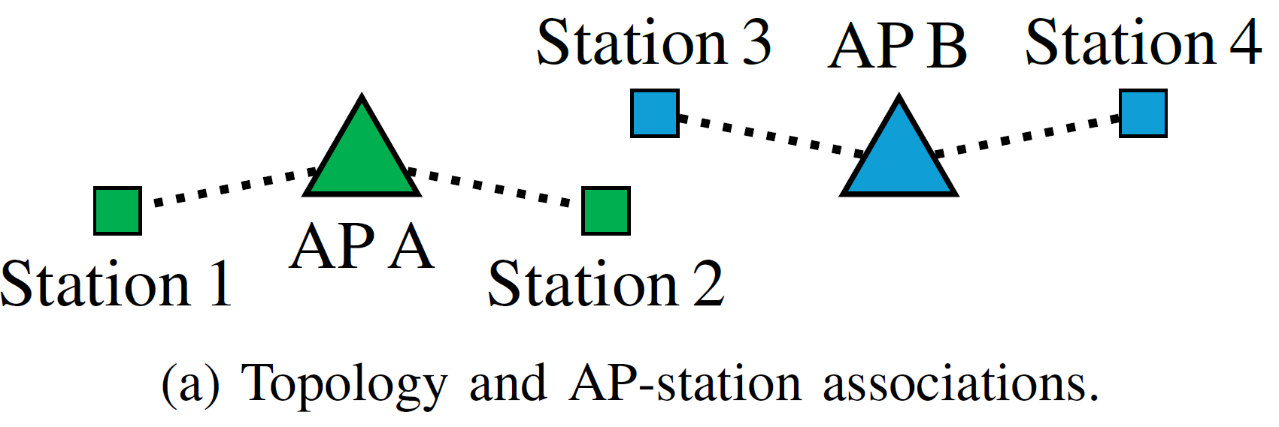
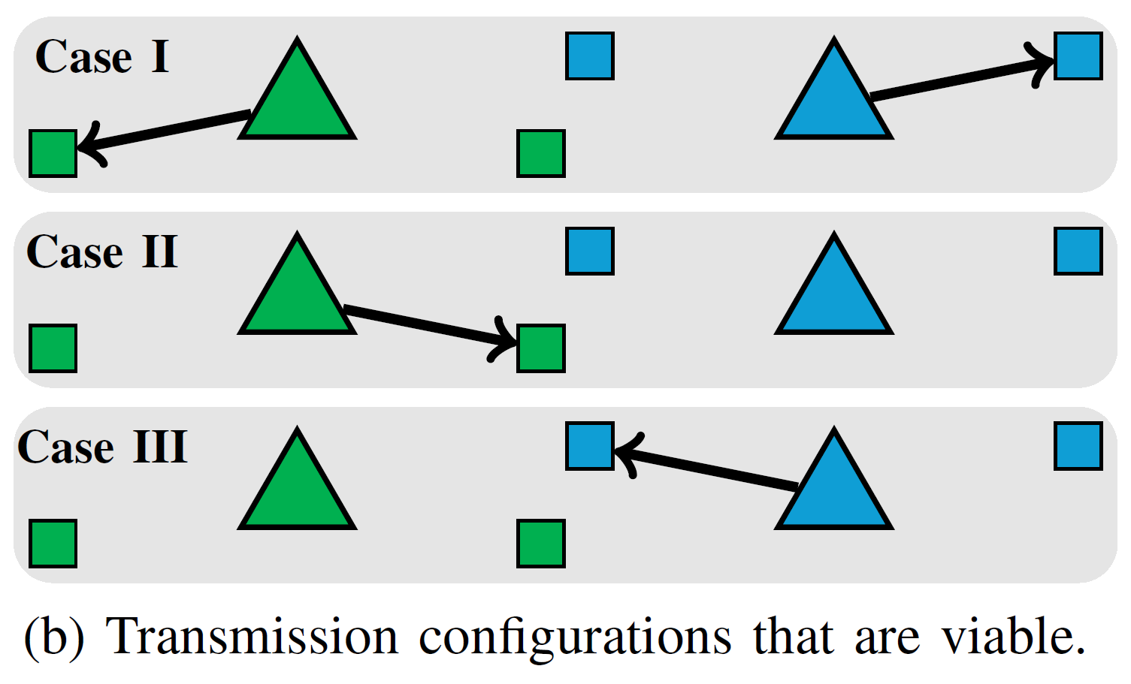
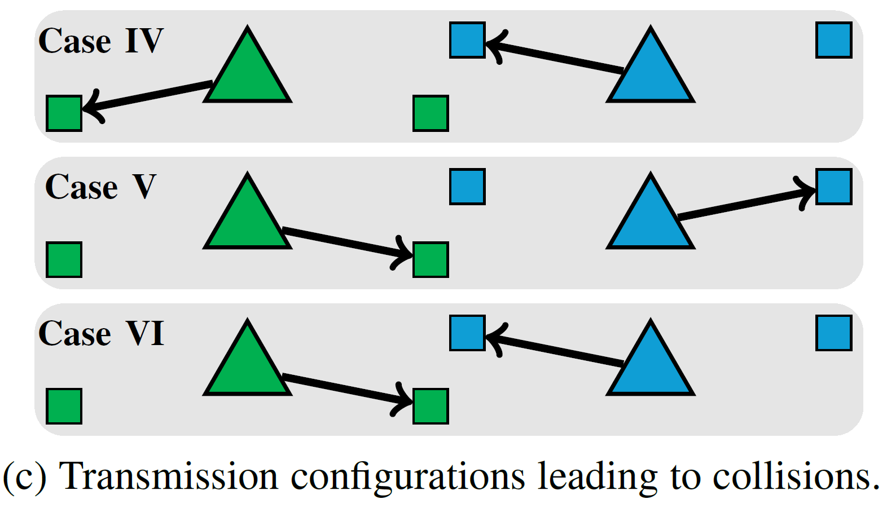
C-SR Example
Downlink
Omnidirectional antennas
Tx power levels omitted for clarity

Slide 5
Problem Statement
Which APs should transmit?
Which STAs can be the receivers?
What should be the Tx power levels?
Selecting such transmission configurations is the C-SR scheduling problem.

Slide 6
Solutions
Measurements: RSS or CSI
Problems
Measurements needed between each pair of devices (scalability issues)
RSS overhead – RSS measurements at STAs from AP beacons, need to be reported upstream
RSS unreliability – high variance
CSI – even more overhead, more processing power, frame exchange between AP and non-associated STAs
Alternative: probing-based approach
Try-and-find out what works
No extra signalling
Similar problem: rate selection
Many measurement-based solutions proposed
Current solutions (e.g., Minstrel) are probing-based

Slide 7
Our Proposal – MABs
Machine learning (ML) → Reinforcement learning (RL) → Multi-armed bandits (MABs)
MABs
No a priori knowledge
Online learning
Adaptable to randomness of 802.11 topologies
Research questions
How quickly can MABs learn which C-SR transmission configurations to use?
How close to optimal are the transmission configurations found?

Slide 8
Flat and Hierarchical MABs
Traditional (flat) MABs: each configuration is an independent action
Configuration = {transmitting APs, recipient STAs, tx power levels}
Explosion of no. actions – exploration becomes time-consuming
Hierarchical MAB architecture – reduces the large search space [5]
Level 1 agents select APs
Level 2 agents select STAs
Level 3 agents select TX power levels

Slide 9
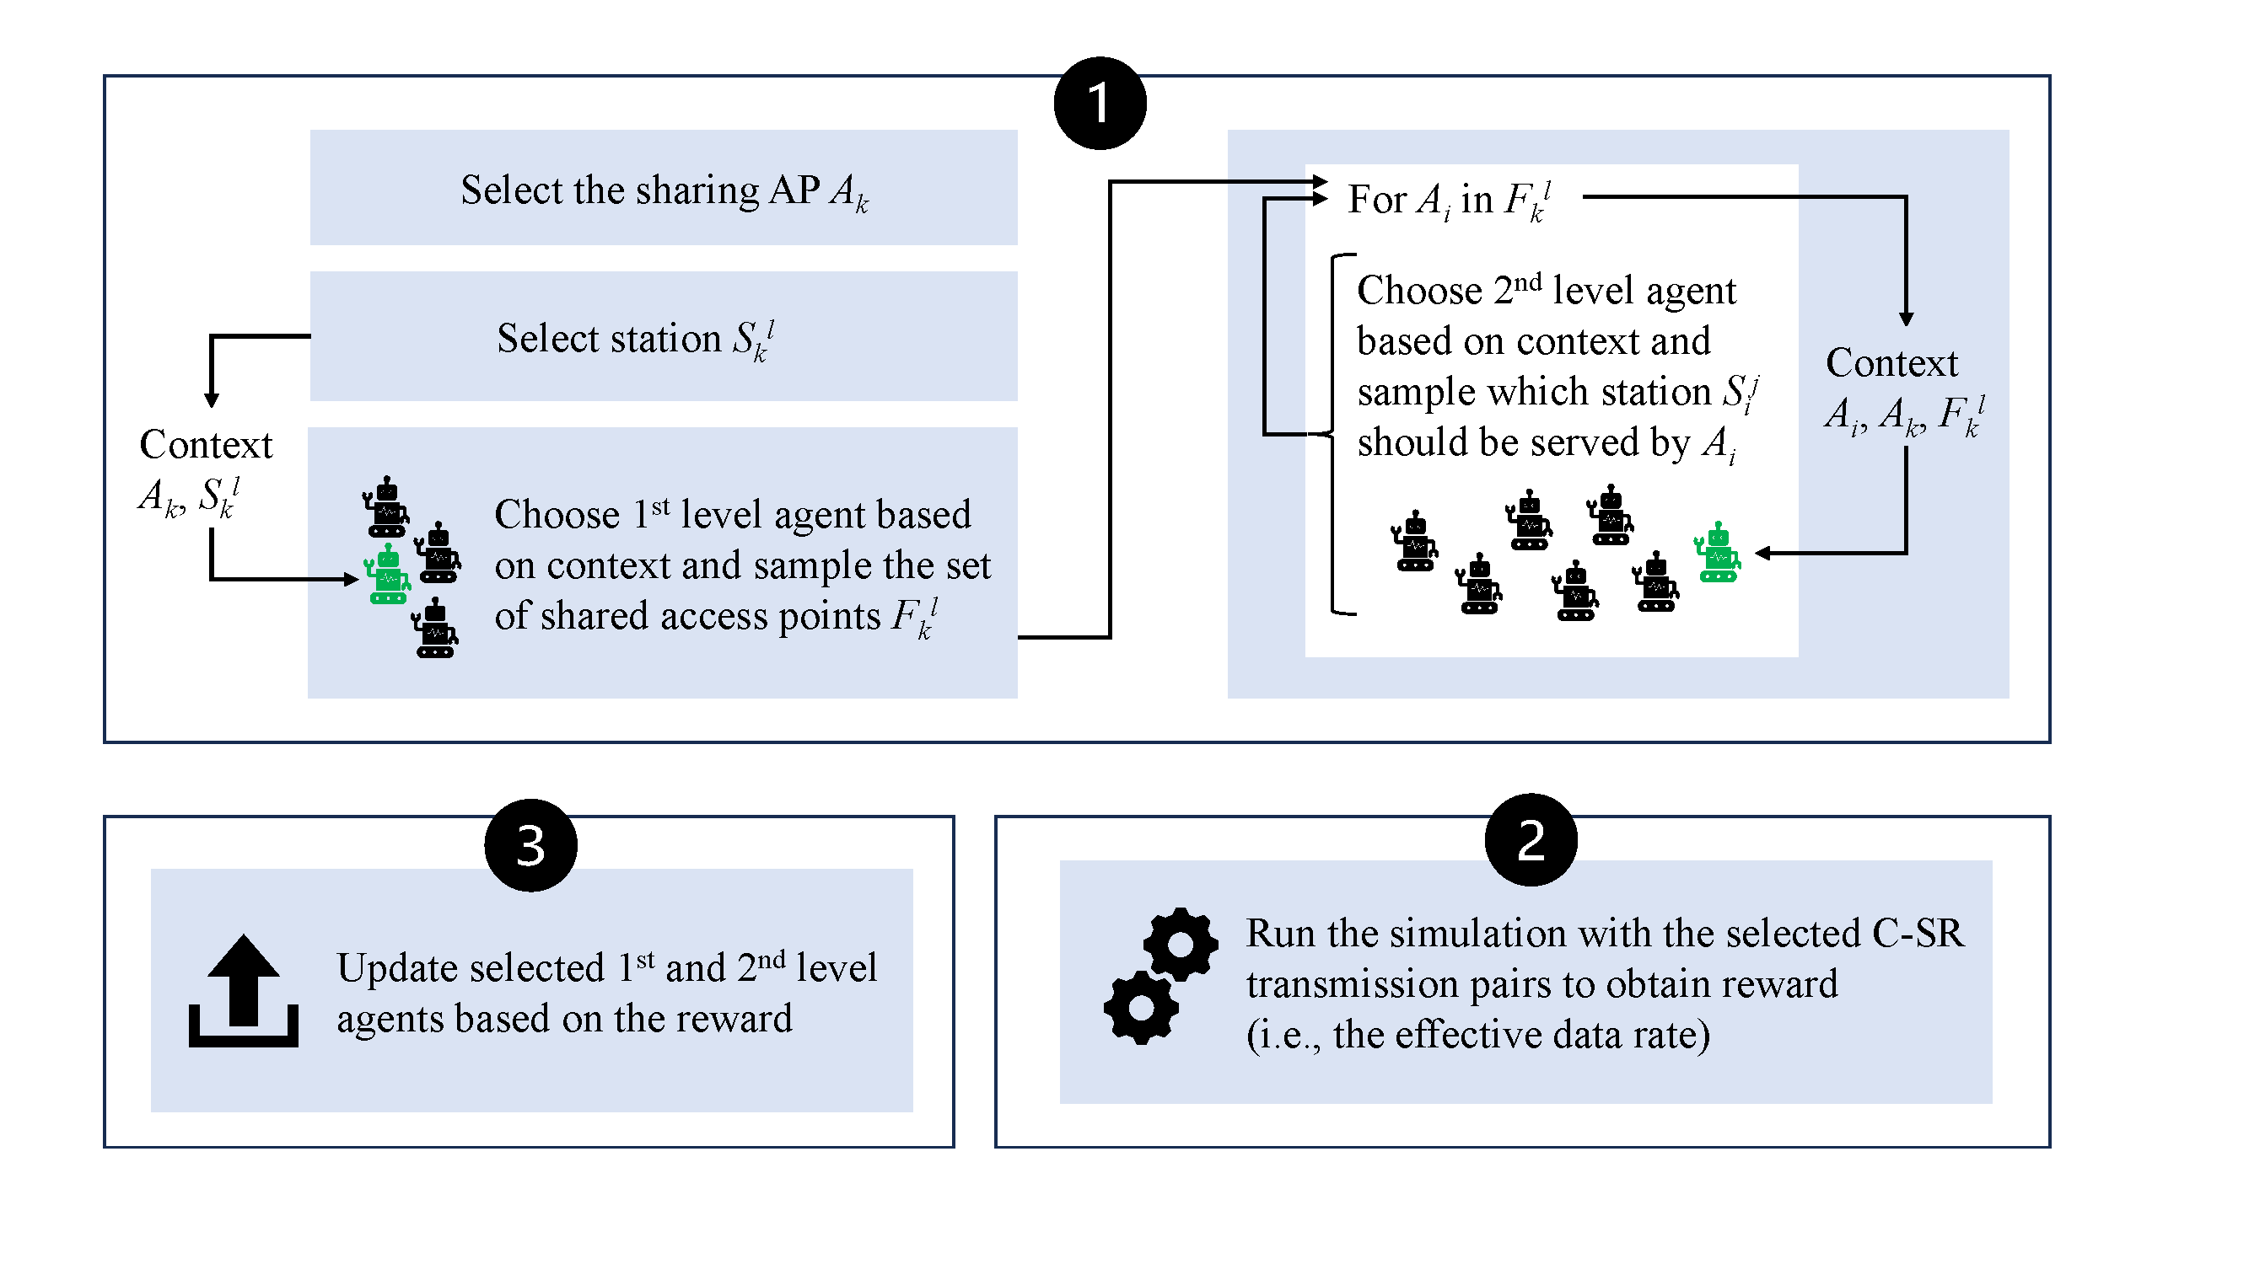
H-MABs
Diagram for 2 levels [6]
Since then, we’ve added a 3rd level (TX power selection)
Run the selected Co-SR transmission pairs to obtain reward (i.e., the effective data rate)

Slide 10
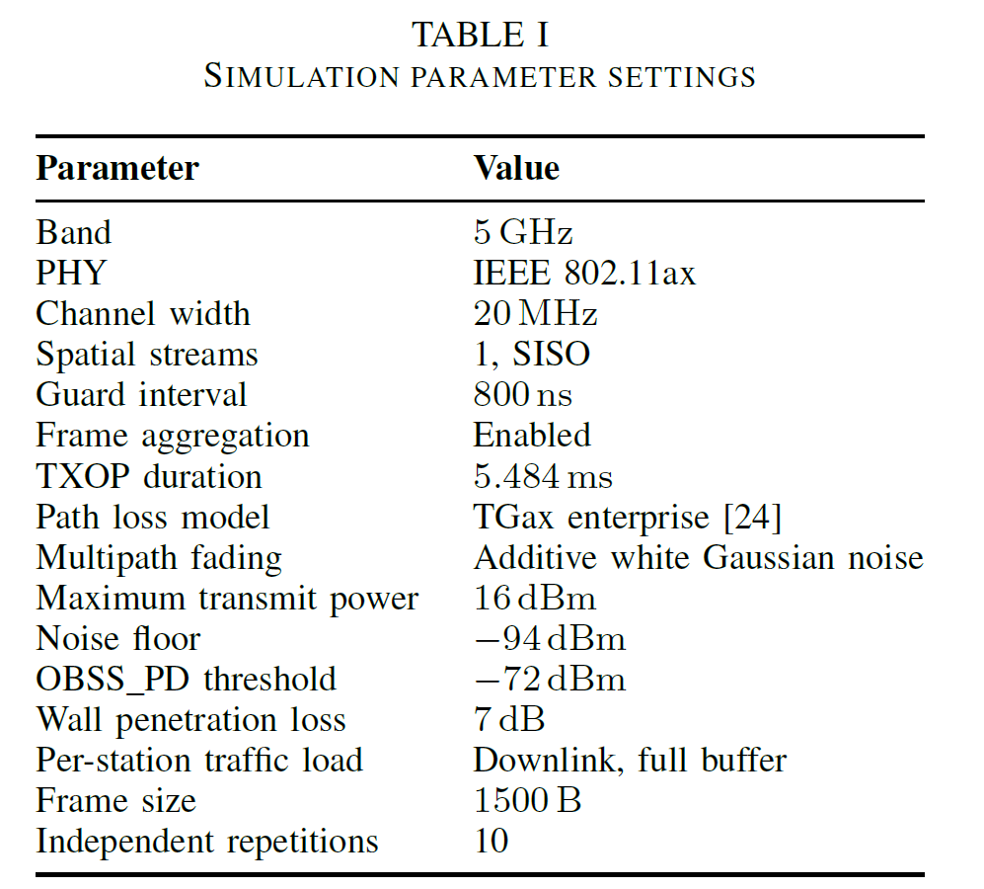
Simulation Setup
Baselines
DCF
SR
Upper bounds (cf slide 19)
Throughput: T-Optimal
Fairness: F-Optimal
Our proposals
MABs
H-MABs
Frequency reuse = 1

Slide 11
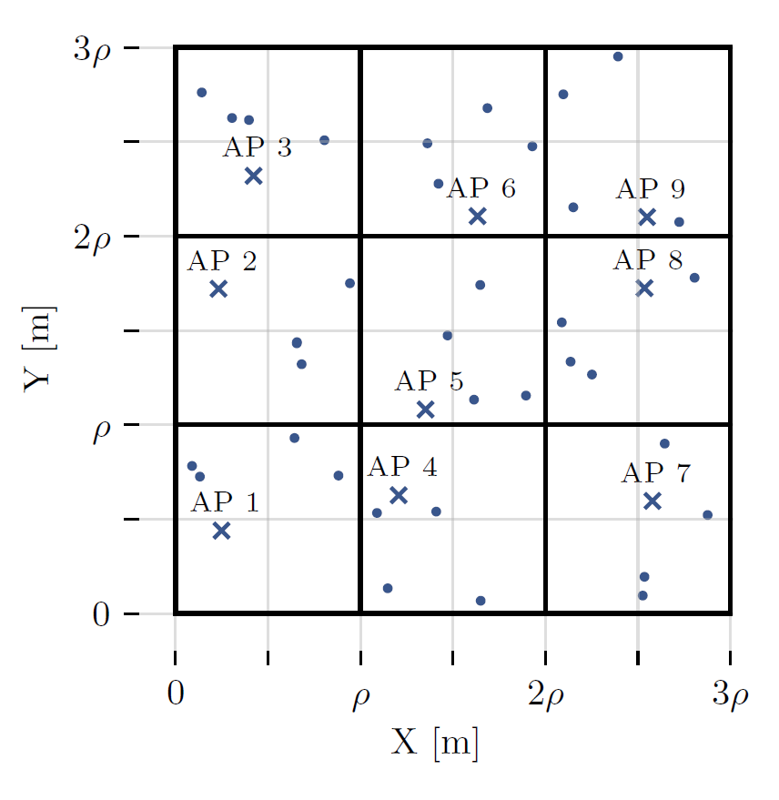
Transient Performance
Rapid convergence
Effective data rate
H-MAB > MAB
Impact of nomadic mobility
Both MABs quickly converge

Slide 12
Steady-State Performance
H-MABs significantly outperform MABs and baselines
Except 3x4 and 4x4
Throughput distribution in 2x3 topology
Fairness-throughput tradeoff

Slide 13
Benefits of Clusterization
For the 3x4 and 4x4 cases
Separate agent in each cluster
Clustered versions show much better performance
Also in terms of convergence times

Slide 14
Symmetrical Enterprise Scenario
Inspired by TGax enterprise scenario
Best-case topology for Co-SR
In 4x4, MABs close to both optimal baselines

Slide 15
Random Open Space Topologies
Topology change halfway through the simulation
Both MABs better than DCF on average by 80%
Only H-MABs consistenly outperform DCF

Slide 16
Impact of Legacy Devices
2x2 multi-room topology
Uniformly add legacy (non-Co-SR) APs to contend with one of the four Co-SR Aps
Effective data rate when one of the Co-SR APs wins channel access
Collisions cause performance deterioration
Still gains wrt DCF and SR

Slide 17
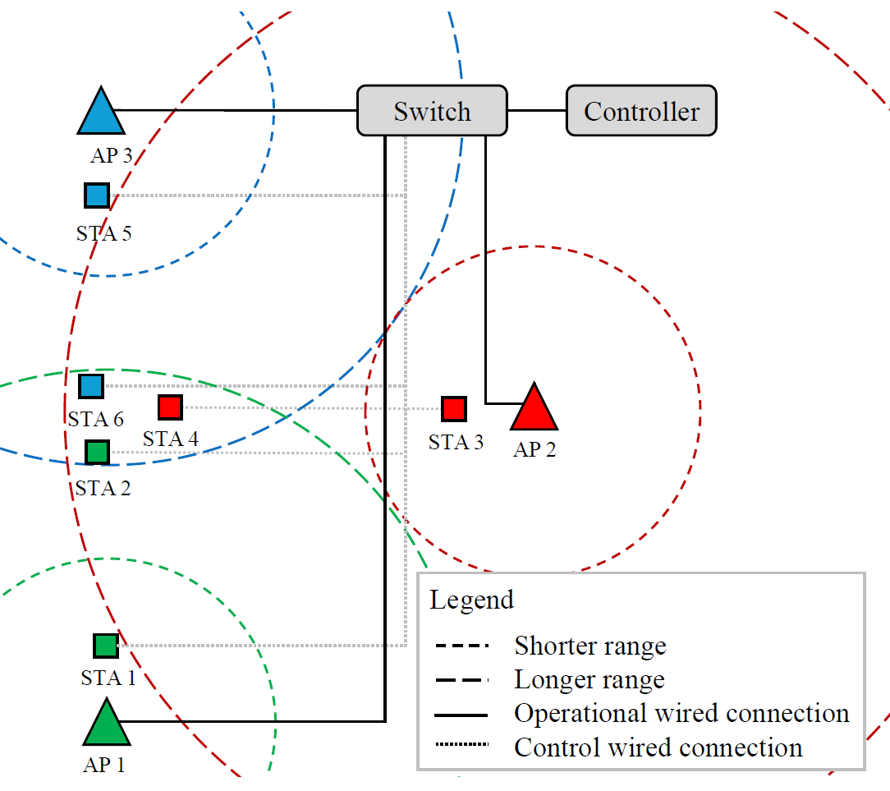
Experimental Testbed
openwifi [7]
Linux mac80211 compatible full-stack IEEE802.11/Wi-Fi design based on SDR
Supports MAPC [8]
Network controller sends transmission configurations to APs
Each AP has two STAs
Near and far
MAB/H-MAB hyperparameters optimized in testbed’s digital-twin

Slide 18
Experimental Validation
Despite symmetric topology, varying tx success probability
STA 2 has worse channel conditions
Receives fewer TXOPs
No less than under perferctly fair RR
Rapid convergence
Small topology so flat MABs outperform H-MABs

Slide 19
Bonus: Upper Bound Model
To assess the upper bound of Co-SR operation, we develop a MILP optimization model [2]
Based on the column generation optimization method
Maximizes
Aggregate network throughput – Co-SR TXOPs typically allocated to best-placed STAs OR
Fairness – maximize throughput of least served STA (max-min optimization)
Independent of MABs – can be used for any Co-SR setting as a baseline
Python code available [3]

Slide 20
Conclusions on H-MABs for Co-SR
Good performance (high throughput, low convergence time for small and medium-sized networks)
Resilience to abrupt topology changes and legacy STAs
Large-scale networks require clusterization
Easy to deploy in hardware (no training)
Future work
Joint MCS selection
Fully distributed operation
Larger dynamics (station churn, non-full buffers) → coldspares approach
Probing for Co-BF

Slide 21
References
[1] S. Szott et al. "MAPC C-SR Scheduling with Multi-Armed Bandits", IEEE 802.11-24/0640r1.
[2] M. Wojnar et al. "Coordinated Spatial Reuse Scheduling With Machine Learning in IEEE 802.11 MAPC Networks", arxiv preprint.
[3] Coordinated Spatial Reuse Scheduling with Machine Learning in IEEE 802.11 MAPC Networks, https://github.com/ml4wifi-devs/csr, accessed on 2025-05-05.
[4] Ross Jian Yu, "Specification Framework for TGbn", IEEE 802.11-24/0209r14.
[5] L.-H. Shen, Y. Ho, K.-T. Feng, L.-L. Yang, S.-H. Wu, and J.-M. Wu, “Hierarchical Multi-Agent Multi-Armed Bandit for Resource Allocation in Multi-LEO Satellite Constellation Networks,” in 2023 IEEE 97th Vehicular Technology Conference (VTC2023-Spring), 2023, pp. 1–5.
[6] M. Wojnar et al., "IEEE 802.11bn Multi-AP Coordinated Spatial Reuse With Hierarchical Multi-Armed Bandits," in IEEE Communications Letters, vol. 29, no. 3, pp. 428-432, March 2025, doi: 10.1109/LCOMM.2024.3521079.
[7] openwifi, https://github.com/open-sdr/openwifi, accessed on 2025-05-05.
[8] J. Haxhibeqiri et al. "Bringing time-sensitive networking to wireless professional private networks: Filling gaps and bridging the innovation." Wireless Personal Communications 121 (2021): 1255-1271.

