Slide 1
BPE AP MLD as Part of Large Network
Date: 2025-04-24
Authors:

Slide 2
Abstract
This submission is related to CIDs #760 and 761 (See annex for CID details).
Normative text is provided in submission 11-25-709.
This submission defines BPE AP MLD as part of larger networks.
Currently, a STA may associate with a BPE AP MLD only if the STA has preshared BPE AP parameters. This prevents efficient use of the BPE AP MLDs in many network topologies.
This submission enables an associated BPE capable STA to receive BPE AP MLD discovery information from protected unicast frames through the associated AP. This operation enables STA to (re)associate with the BPE AP MLD in the ESS.

Slide 3
Background: BPE AP MLDs
A BPE AP MLD transmits only encrypted frames
  BPE AP MLD transmits Privacy Beacons, 10.71.8.2 (BPE AP MLD Beaconing)
  A scanning STA can detect whether it is preconfigured with BPE AP MLD parameters by using the Transmitter Address and Identity Hash of the MAC Headers
If the BPE AP MLD parameters are not preshared with a STA:
  The STA cannot identify the BPE AP MLD, its parameters, and ESS
  This prevents STAs from associating with a BPE AP MLD, even if the STA possesses the authentication keys of the AP

Slide 4
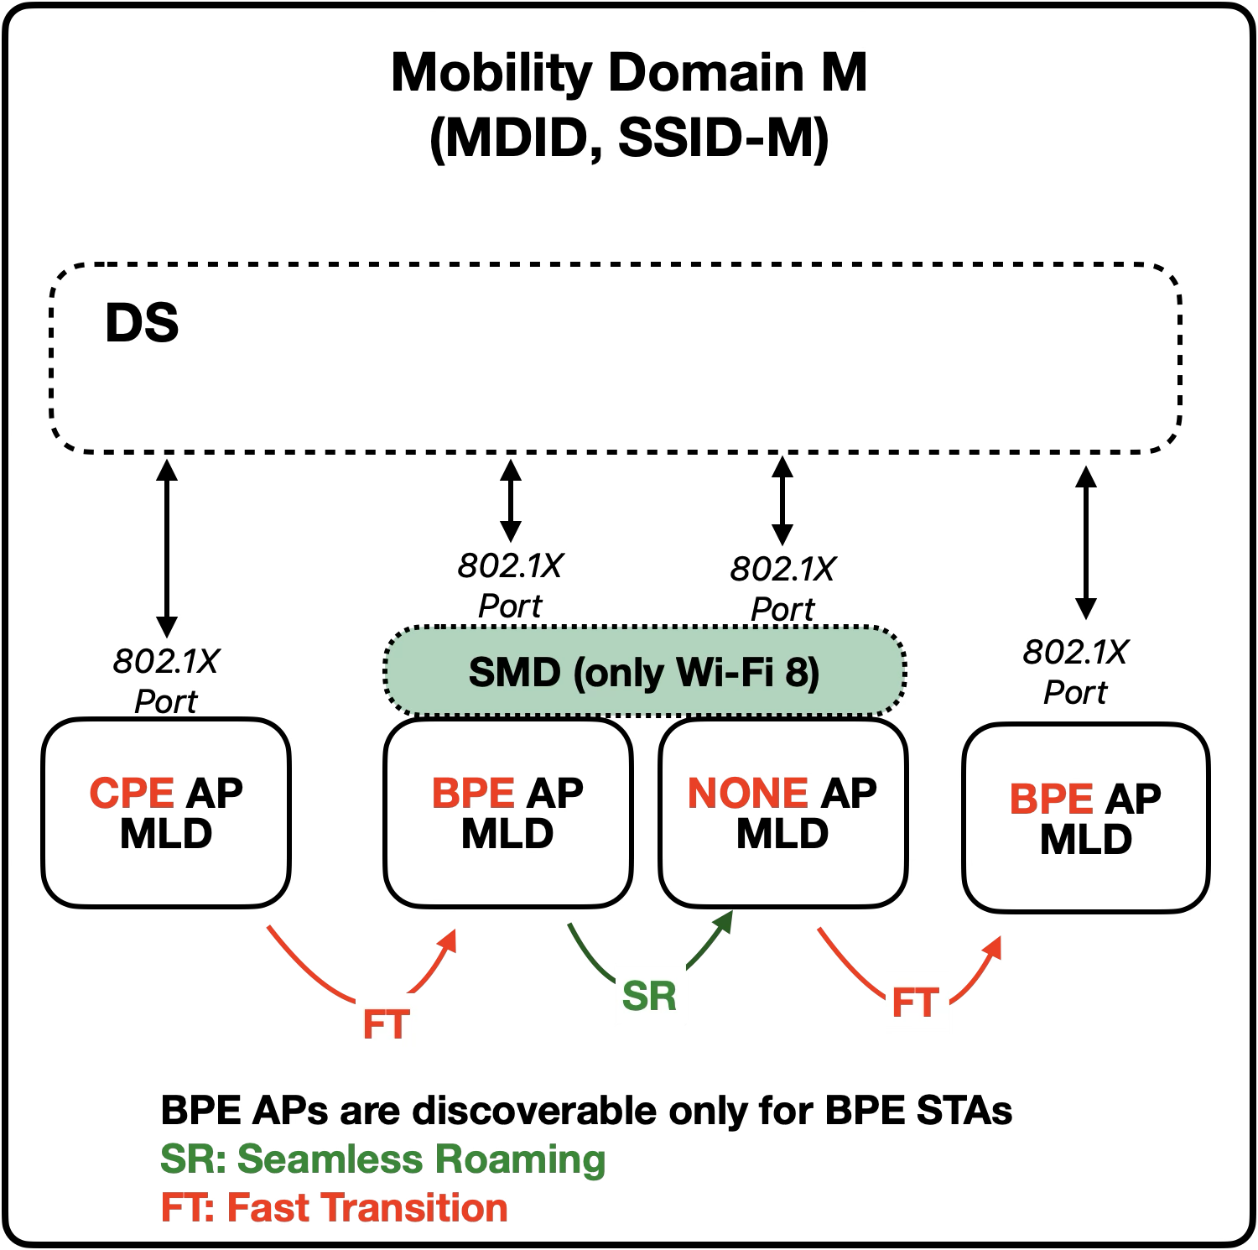

Proposal: ESS with Legacy, CPE, and BPE AP MLDs
An ESS, MD, or SMD may contain AP MLDs of all privacy levels
  BPE APs are available only for BPE capable STAs
BPE APs offer the best privacy
  Individual frames are anonymized
  Group frames are anonymized
  BPE APs parameters are not sent clear OTA
  BPE APs and STAs addresses are anonymized
802.11bi privacy support level (NONE / CPE / BPE) is shown for each AP MLD

Slide 5
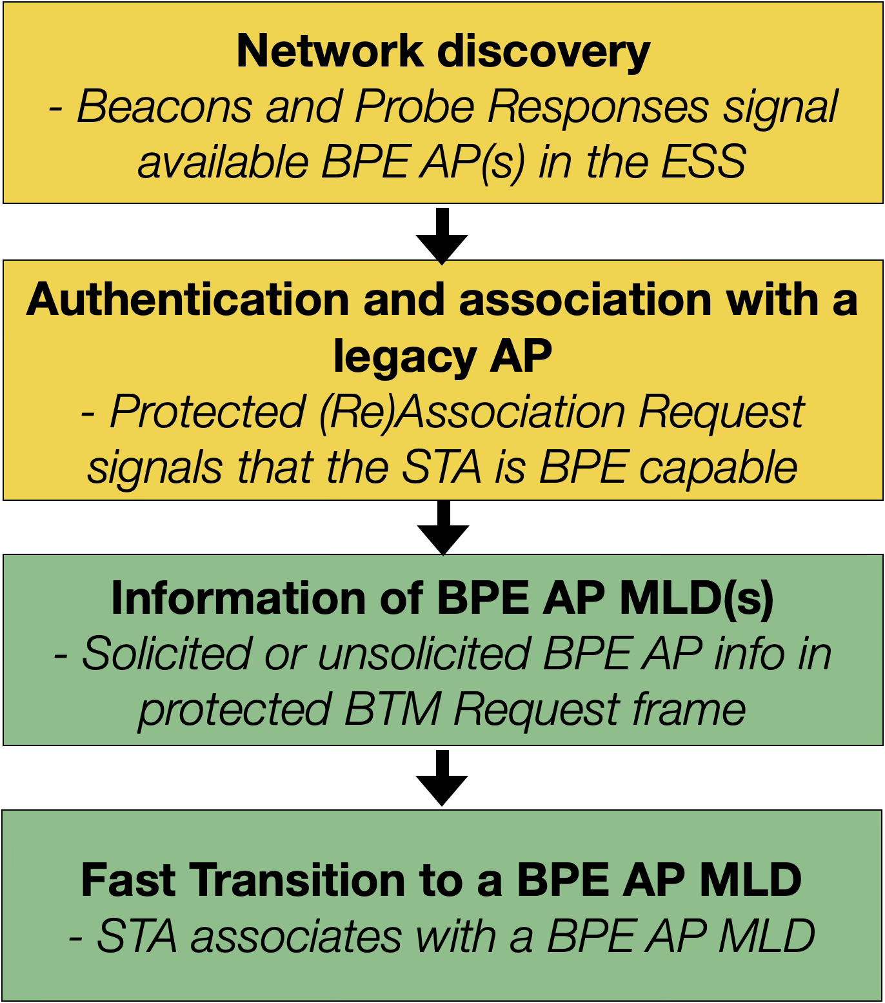
Proposal: Assisted Discovery of BPE AP MLDs
A CPE or non-privacy enhanced AP signals that ESS | MD has available BPE or CPE AP MLDs
  A capability bit signals that ESS has BPE APs available
  STA knows that it may query BPE AP MLD parameters
Protected association or authentication signaling has fields to indicate whether:
  The AP MLD is capable to provide discovery information of BPE AP MLDs in ESS | MD
  The Non-AP MLD is capable to receive unsolicited BPE AP MLD information
An associated STA may request BPE AP MLD information by sending a protected BTM Query frame
  An associated AP may provide BPE AP MLD information by sending individually addressed protected BTM Request frames

Slide 6
Proposal: Shared BPE AP MLD Parameters
A BPE AP MLD can discoverable by providing the BSSID of the AP MLD for the current and the following epochs
  The STA may discover, authenticate and associate with the BPE AP during these Epochs
  The STA obtains the BPE AP MLD identity key during 4-way handshaking. The identity key enables AP discovery during the lifetime of the BPE AP
At least the following BPE AP capabilities and operation elements shall be shared:
  Elements to estimate the BPE AP performance and congestion level (BW, NSS, BSS Load for all Links)
  Elements to identify the BPE AP and select the roaming mechanism (SMD ID, MD ID, BSSIDs, SSID)
  Elements to authenticate and associate with BPE AP (RSNE and RSNXE)

Slide 7
Authentication and Association with the BPE AP
A discovered BPE AP MLD is part of the same ESS as the associated AP
  The discovered BPE AP and the currently associated AP may use the same authentication keys
  The RSNE and RSNXE of the discovered BPE AP MLD ensure that all security related settings and parameters are known
The complete set of BPE AP MLD parameters is obtained during the protected (re)association signaling

Slide 8
Benefits
The BPE AP MLDs may become essential part of larger networks
  Network operators can offer the best privacy for their customers, while keeping the networks easily discoverable and legacy compatible
  Residential networks can steer BPE capable devices to BPE AP MLDs supporting maximum privacy
Steering signaling is simple
  The Identity key of the BPE AP MLD conveyed by the protected individually addressed BTM Request frame
  Standard compatible steering signaling is used to avoid interoperability issues

Slide 9
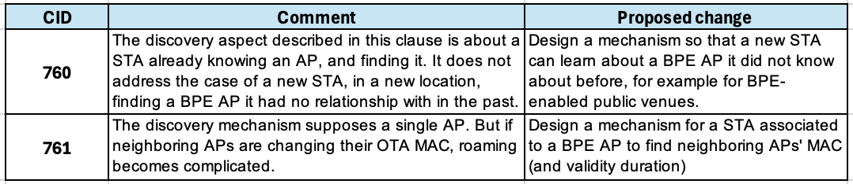
ANNEX – Related CIDs

