Slide 1
Design and Procedure for DSO, follow up
Date: 2025-04-20

Slide 2
Background and Problem Statement
Recap of DSO:
DSO feature enables the AP to schedule narrower BW STAs within its larger BW to improve the spectrum efficiency
AP initiates the TXOP with an ICF with enough padding to allow the STAs to switch channel outside of current operating BW (secondary channel) to continue the TXOP
This frequency resource allocation is on per-TXOP basis
This proposal discusses some details on DSO frame exchange rule

Slide 3
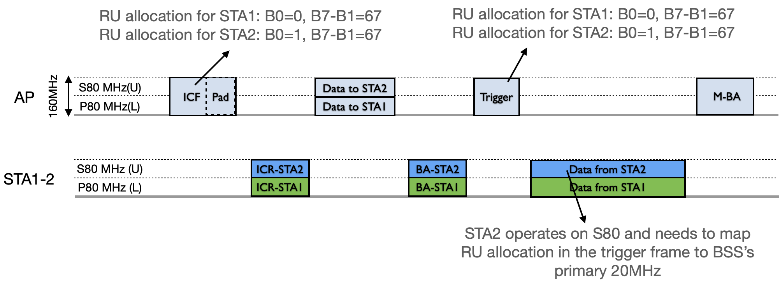
RU Allocation in DSO Frame Exchange (1)
AP follows the current rule for RU allocation to the DSO STAs
UL BW subfield, PS160, and RU Allocation subfield (B0 and B7-B1) can indicate the size and location of RU
B0 and PS160 indicates the secondary 80MHz and 160MHz channels
After ICF/ICR exchange, AP shall allocate RU index in DSO Subband(s) with reference to BSS primary channel
When a DSO STA switches to DSO Subband, it needs to map the RU allocation in the triggering frames (any trigger frame during the TXOP) with reference to BSS primary channel to derive its allocated RU

Slide 4
RU Allocation in DSO Frame Exchange (2)
AP shall allocate the RU for DSO STA to be within the DSO subband to which the DSO STA has switched to after receiving the ICF/ICR in all triggering frames and DL MU PPDUs
MU-RTS cannot be used as trigger frame
MU-RTS requires additional changes in spec to support DSO mode RU allocation on DSO subband

Slide 5
Summary
In this presentation we discussed the next level of details on how the DSO AP allocates the RU in a DSO frame exchange

Slide 6
Straw Polls
Do you support that after ICF/ICR exchange and until the DSO non-AP STA switches back for a DSO non-AP STA, the DSO AP shall:
indicate the RU allocations for the DSO non-AP STA with reference to the BSS primary channel in all triggering frames, and
indicate the RU allocations for the DSO non-AP STA to be within the DSO sub-band to which the DSO non-AP STA has switched in all triggering frames and DL MU PPDUs, and
not use the MU-RTS as the trigger frame.

