Slide 1
An Analysis of SYNC Field for Downlink PPDU
Date: 2025-05-11
Authors:

Slide 2
Abstract
It was previously discussed about SYNC field for the downlink of active transmitters. Several options were considered with some advantages/disadvantages in terms of both performance and implementation complexity/energy consumption.
In this contribution we provide some more analysis of 802.11ba like SYNC field for simple implementation receivers.

Slide 3
Preface
In [4], it was suggested to use a single sequence of 16 Manchester encoded bits for SYNC field, and to signal the rate using the SIG field.
In addition, in [1-3] performance simulations were conducted for several SYNC sequences for DL of active TX AMP STA using the 802.11ba approach.
It was shown that 64us non-Manchester encoded SYNC (repetition of 16 bits) is sufficient, while 32us (repetition of 8 bits) was too short.
We ratify this conclusion and also find that 64us Manchester encoded SYNC (repetition of 8 encoded bits for 802.11ba approach) is sufficient.

Slide 4
Example of Link Budget for AMP
Active TX devices are expected to work at lower sensitivity compared to close range backscatter devices
RF-harvesting active TX devices are expected to operate with a simple ED receiver due to its significanly lower power compared to IF receiver
 | EIRP [STA] | Sensitivity [STA] | EIRP [AP] | Sensitivity [AP] | Link-budget UL | Link-budget DL | Power Consumption
IF-RX, active TX | 0 dBm | -76 dBm | 20 dBm | -96 dBm | 96 dB | 96 dB | <5mW
ED-RX, active TX | -20 dBm | -56 dBm | 20 dBm | -96 dBm | 76 dB | 76 dB | <50uW
backscatter (close range) | -30 dBm | -25 dBm | 20 dBm | -75 dBm | 45 dB | 45 dB | <5uW
Focus of
this contribution

Slide 5
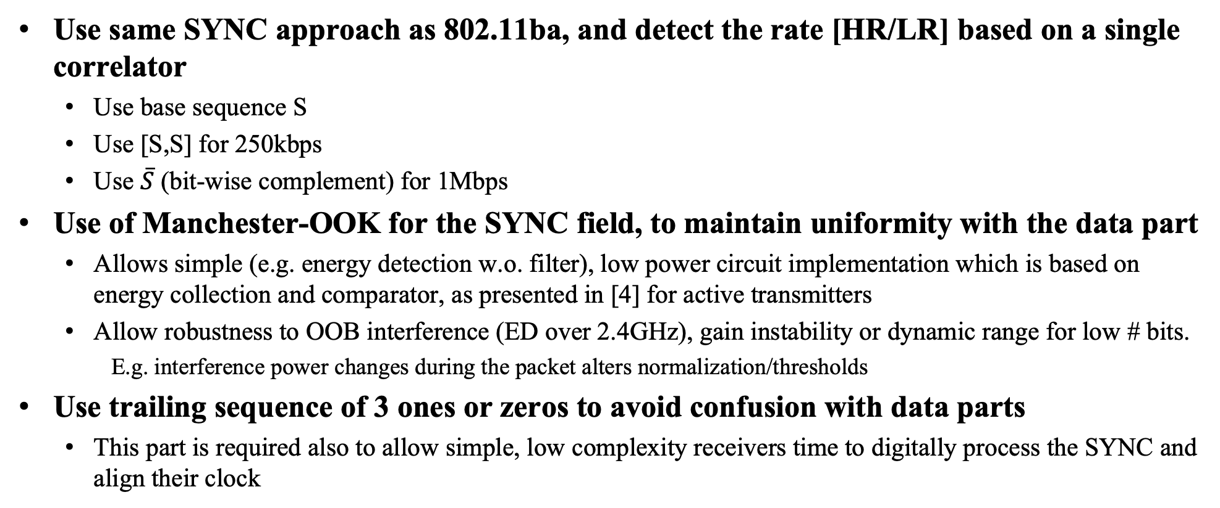
Considerations and Assumptions for SYNC Field Selection
Use same SYNC approach as 802.11ba, and detect the rate [HR/LR] based on a single correlator
  Use base sequence S
  Use [S,S] for 250kbps
  Use $\overline{S}$ (bit-wise complement) for 1Mbps
Use of Manchester-OOK for the SYNC field, to maintain uniformity with the data part
  Allows simple (e.g. energy detection w.o. filter), low power circuit implementation which is based on energy collection and comparator, as presented in [4] for active transmitters
  Allow robustness to OOB interference (ED over 2.4GHz), gain instability or dynamic range for low # bits.
    E.g. interference power changes during the packet alters normalization/thresholds
Use trailing sequence of 3 ones or zeros to avoid confusion with data parts
  This part is required also to allow simple, low complexity receivers time to digitally process the SYNC and align their clock

Slide 6
Example Implementation for the Analysis
Using the assumptions of [4], detection is performed over the power jump of the legacy preamble, to wakeup the clock and the circuitry and start looking for SYNC field
Thus the SYNC field is then used by the receiver for:
  For 250Kbps:
    First cross correlator peak detects rate and rough sync to symbol time
    Second cross correlation peak is combined with the first to sync to the symbol time
  For 1Mbps:
    Cross correlation peak is used for both rate and symbol time detection
Both IF-RX and ED-RX options
Trailing 1’s or 0’s for separation with data

Slide 7
Analysis Scope
In order to compare analysis with [1-3], we propose the following analysis of RX
Considers both analog based ED-RX and digital based IF-RX
  IF-RX has higher SNR compared to ED-RX, including filtering, mixer, LNA, etc.
    For the same received power, the SNR of the ED-RX will be much lower compared to the SNR of the IF-RX. But for a given SNR, the performance will be close.
  IF-RX uses digital computations (quantization noise), ED-RX uses analog calculation (thermal noise + nonlinearities)
    Both the digital quantization noises (for IF-RX) and the analog thermal noises + NL (for ED-RX) are implementation dependent and thus emitted from analysis
Receiver assumptions
  Uses either fully digital (IF-RX) or combined digital analog (ED-RX)
  Has cross correlator using same path as data path
    For ED-RX, the cross correlation is done over the outputs of the Manchester demapper bits
  Analysis for both is done with simulation resolution of Fs=8MHz

Slide 8
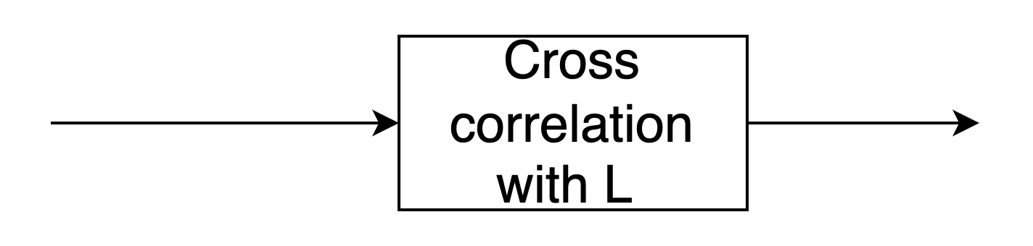
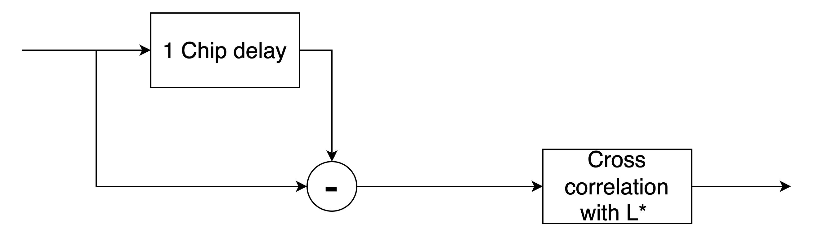
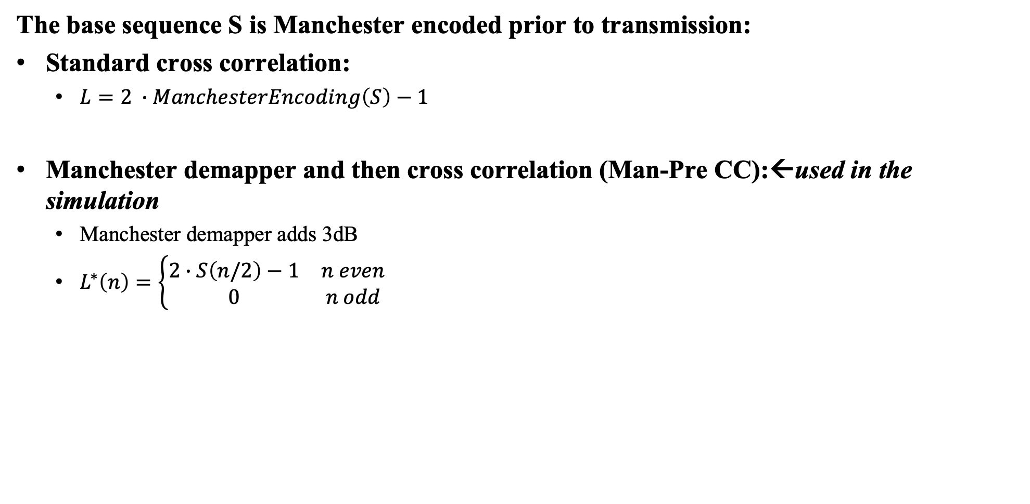
Example Implementation [cont.]
The base sequence S is Manchester encoded prior to transmission:
Standard cross correlation:
  $L=2 ∙ManchesterEncoding\left(S\right)−1$
Manchester demapper and then cross correlation (Man-Pre CC):←used in the simulation
  Manchester demapper adds 3dB
  $L^{∗}\left(n\right)=\left\{\begin{matrix}2∙S\left(n/2\right)−1 & n even \\ 0 & n odd\end{matrix}\right.$

Slide 9
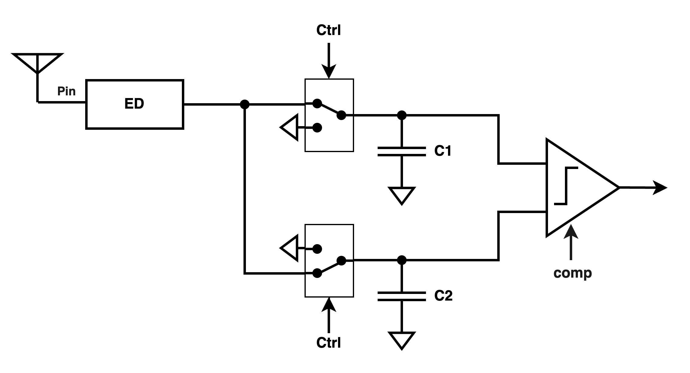
Possible Implementation of Manchester Demapper
The correlator is working over Manchester demapper – avoiding the need for normalization/relying on some unknown gains
Avoids the need for AGC: only difference between energies is measured. No absolute energy is used for detection
Use multiple time hypotheses in order to
detect the right timing

Slide 10
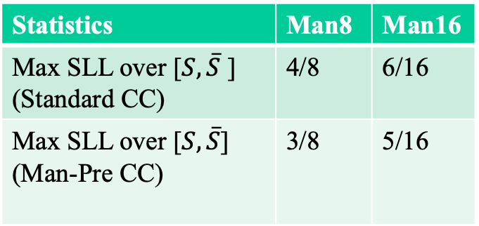

Example Manchester Sequence
Search for Manchester sequences according to their SLL levels:
Selected sequence for the example:
S=[0 0 0 1 1 0 1 0]
Has SLL with Man-Pre CC= 3
Statistics | Man8 | Man16
Max SLL over [$S,\overline{S}$ ] (Standard CC) | 4/8 | 6/16
Max SLL over [$S,\overline{S}$] (Man-Pre CC) | 3/8 | 5/16
$$S$$
$\overline{S}$

Slide 11
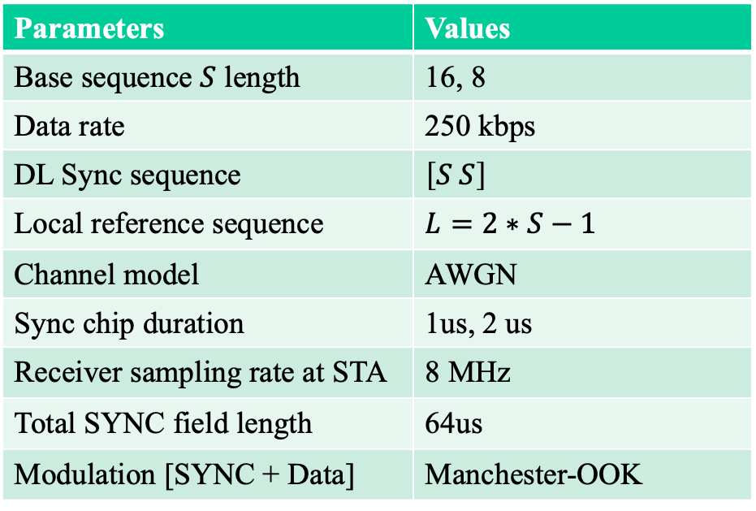
Simulation Assumptions
Parameters | Values
Base sequence $S$ length | 16, 8
Data rate | 250 kbps
DL Sync sequence | $\left[S S\right]$
Local reference sequence | $$L=2∗S−1$$
Channel model | AWGN
Sync chip duration | 1us, 2 us
Receiver sampling rate at STA | 8 MHz
Total SYNC field length | 64us
Modulation [SYNC + Data] | Manchester-OOK

Slide 12
MD Performance Analysis for 250Kbps
SYNC performance of base sequence of 8
→ if Manchester encoded, provides
sufficient margin to data part
Using Manchester removes the need
for AGC/normalization in the receiver
Compare results to [1] | Base length=8 T_{chip}=2us | Base length=16 T_{chip}=1us
1e-1 | +1dB improve | +1.5dB improve
1e-2 | -1.1dB degrade | -0.6dB degrade

Slide 13
Distinguish M-OOK Data from SYNC
Eventhough we do not foresee such need at this point, in order to compare with alternatives, we provide the analysis as in [1],[5]
Some degradation is noticed with 8-Manchester instead of 16 non-Manchester for normalized peak
16-Man (T_{chip}=1us) is very close to 16 non-Man (T_{chip}=2us) SYNC sequence

Slide 14
Distinguish M-OOK Data from SYNC [cont.]
In addition to the mechanism from prev. slide out of [1],[5], we propose alternative mechanism based on the trailing zeros
From [1] slide #9, it seems target data confusion of interest is > 0.3 (Threshold=0.5, blue line) for high SNR
Alternative example for using the trailing zero approach:
  Immidiatly after synchronization, a threshold is measured as the mean
  value between 0 and 1
  Then 3 consecutive zeros are compared to this threshold
  Using this approach, we reach data confusion <0.3 for all data over SNR>10dB and no MD performance impact. Better resiliance for lower SNR→ some degradation in MD performance
Last bit → averaged
into a thershold
Actual chips
over the air
1 | 0 | 1 | 0 | 1 | 0 | 0 | 1 | 0 | 1 | 1 | 0 | 0 | 1 | 1 | 0 | 1 | 0 | 1 | 0 | 1 | 0 | 0 | 1 | 0 | 1 | 1 | 0 | 0 | 1 | 1 | 0 | 0 | 0 | 0
SYNC
Y/N

Slide 15
Summary
An approach with Manchester encoding and 802.11ba complimentary based SYNC, for active transmitters was presented.
Eventhough lower performance compared to non repetitioned 16 bit Manchester encoded SYNC as presented in [4], it seems that as long as the 64us SYNC length is maintained, the performance are sufficient, whether using repetition of base sequence of 8 manchester encoded symbols with Tchip=2us or using base sequence of 16 manchester encoded symbols with Tchip=1us.
It is suggested to add an additional trailing zeros or ones to distinguish data portions and to allow time for simple receivers to sync to the symbol timing.

Slide 16
References
[1] 11-25/0315r1 “Further Discussion on Downlink Sync Field Design”, Huawei,
[2] 11-25/0321r0 “Follow-up on sync field for AMP PPDU”, OPPO
[3]11-25/0042r0 “AMP Downlink Sync Field Study”, Qualcomm
[4] 11-24/1982r0 “Considerations For Sync Sequence Selection”, Wiliot
[5] 11-18/1201r0 “concerns-about-sync-detector-false-alarms”, Qualcomm

