Slide 1
Simultaneous CoBF ACK Transmission
Date: 2025-05-11
Authors:
Name | Affiliations | Address | Phone | email
Genadiy Tsodik | Huawei |  |  | Genadiy.tsodik@huawei.com
Shimi Shilo
Arik Klein
Oded Redlich

Slide 2
Recap
Coordinated BF was accepted as one of the TXOP based M-AP Cooperation schemes in 802.11bn
Several contributions discussed the principles of the CoBF scheme and introduced the design of CoBF procedures and PPDU format [1]-[5]
In this contribution we want to discuss the modes of ACK transmission for CoBF DL PPDU

Slide 3
Main Issue in CoBF UL Transmission
As shown in contributions [4], [5] CoBF scheme is mainly relevant when mutual interference between the overlapping BSSs in DL transmission is high or medium
Based on reciprocity we may assume that mutual interference in UL transmission is also dominant and may degrade the UL signal detection at the participating APs
Thus APs need to coordinate the UL ACK transmission, i.e. UL resources should be divided between Sharing AP and Shared AP
In the next slides we review several options for how to divide the resources between the participating APs for an UL transmission
AP1
STA1
STA2
AP2

Slide 4
Assumptions
UHR Non-AP STAs that participate in CoBF shall support reception of new UHR DL MU PPDU with modified U-SIG (two BSS colors and etc.)
Currently more that single Acknowledgement method is supported by 802.11 specification (for all pre-UHR STAs)
Implicit BAR – TF is part of DL PPDU, ACK/BACK response is transmitted within SIFS
Explicit BAR – using MU-BAR TF (with ACK/BACK carried in TB PPDU, OFDMA or non-OFDMA), or a BAR frame soliciting sequential SU response
AP1
STA1
STA2
AP2

Slide 5
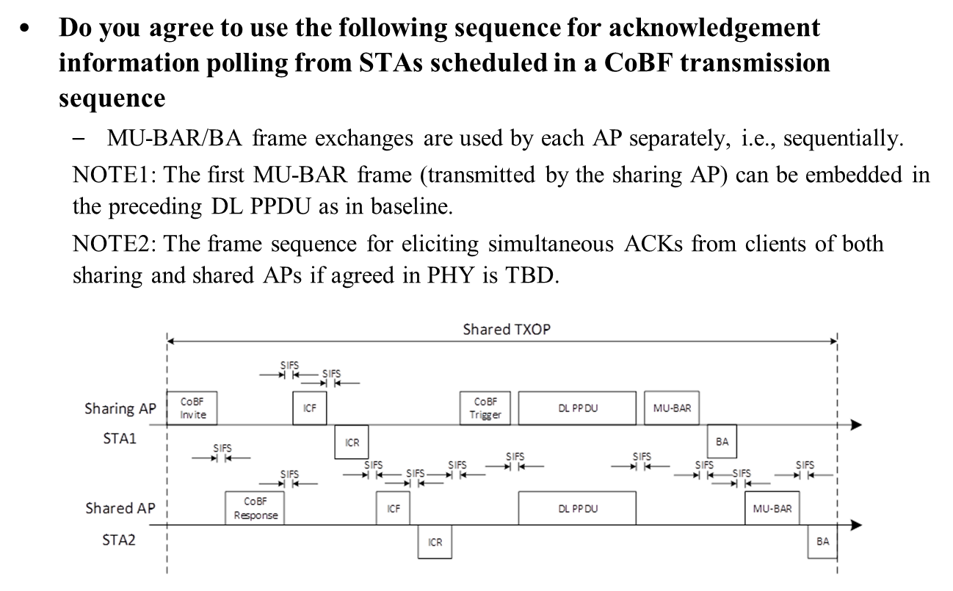
CoBF ACK Discussion Recap
Sequential ACK transmission method was presented in Joint session [6]
The following SP was proposed (deferred during March F2F)
It is also mentioned in the SP that simultaneous ACK is TBD based on PHY group discussion
Therefore we want to discuss the simultaneous ACK transmission

Slide 6
Simultaneous ACK
Transmitting ACK simultaneously by all the STAs that participate in CoBF DL PPDU transmission can be more efficient in terms of number of frames and time overhead
Thus we propose to use TB PPDU OFDMA format for ACK transmission where the STA of both APs are allocated with different RUs and transmit in parallel
Each AP triggers its STAs independently by the TF transmitted within CoBF DL PPDU
Sharing AP
Invite
Sync
CoBF PPDU
STA1
ACK/BACK
Shared AP
Response
CoBF PPDU
STA2
ACK/BACK

Slide 7
Simultaneous ACK Parameters
BW Allocation
Option 1: Sharing AP and Shared AP may negotiate RU allocation in Invite/Response frames of CoBF DL PPDU – some new fields might be defined
Option 2: Constant allocation – for example, Sharing AP will be allocated with lower half of the BW and Shared AP with the upper half of the BW, in this case no need for further info exchange
Transmit Parameters Alignment
Sharing AP and Shared AP need to align transmit parameters during the Invite/Response frames to make sure all the STAs transmit TB PPDU correctly as in single BSS case (details are TBD)
U-SIG content alignment is required (BSS Color)
Option 1: Use BSS Color 0 (simple for implementation)
Option 2: Use 2 BSS Colors in U-SIG – requires minor design modifications similar to CoBF DL PPDU (will be implemented only by STAs that support CoBF)

Slide 8
Summary
CoBF ACK transmission should be coordinated between the participating APs
We want to follow current spec principle that allows several ACK transmission methods which may be selected by the AP for the relevant scenario
In order to reduce the overhead and increase the efficiency we propose to allow to transmit ACK simultaneously by all the STAs using TB PPDU OFDMA format
APs need to agree on the TB PPDU parameters before starting the CoBF DL PPDU transmission – Sharing AP shall include agreed parameters in CoBF Sync frame

Slide 9
Straw Poll #1
Do you support the following:
The simultaneous ACK/BACK transmission corresponding to a CoBF DL PPDU is allowed
Simultaneous ACK/BACK is transmitted by all the STAs associated with both Sharing AP and Shared AP using TB PPDU OFDMA format
The content of the preamble of the TB PPDU shall be same for all the STAs

Slide 10
Straw Poll #2
Which option do you prefer:
Option 1: RU allocation for simultaneous ACK based on TB PPDU OFDMA format may be negotiated by Sharing AP and Shared AP before CoBF DL PPDU transmission using Invite/Response frames
Option 2: RU allocation for simultaneous ACK based on TB PPDU OFDMA format is constant (e.g. Sharing AP is always allocated with lower half of the entire BW and Shared AP is always allocated with the upper half of the entire BW)

Slide 11
Straw Poll #3
Which option do you prefer for U-SIG content alignment in CoBF simultaneous ACK:
Option 1: All the STAs use BSS Color 0
Option 2: All the STAs use BSS Color of Sharing AP
Option 3: All the STAs use two BSS Colors of Sharing AP and Shared AP (second BSS Color is indicated using disregards bits)

Slide 12
References
[1] 11-23-1871-02-00bn-m-ap-coordinated-transmission-framework
[2] 11-24-1542-04-00bn-sounding-schemes-for-coordinated-beamforming
[3] 11-24-1822-03-00bn-cobf-design-for-uhr
[4] 11-23-0776-01-0uhr-performance-of-c-bf-and-c-sr
[5] 11-24-1211-01-00bn-coordinated-bf-goodput-discussion
[6] 11-25-0412-03-00bn-cobf-frame-sequences-and-signaling-details.pptx

