Slide 1
Roaming Without Data Forwarding
Date: 2025-04-22
Authors:
Name | Affiliation | Address | Phone | Email
Yaoshen Cui | TP-Link Systems Inc. |  |  | cuiyaoshen@tp-link.com.hk
Yunpeng Yang |  |  |  | yangyunpeng@tp-link.com.hk
Yingjie Yan
Renfang Zhou
Qingwei Fu
Junbin Chen
Shuyu Shi
Yu Zhu

Slide 2
Introduction
During seamless roaming, DL data forwarding between AP MLDs within same SMD is proposed to improve reliability [1].
However, DL data forwarding may lead to bad experience for some time-sensitive traffics.
Data forwarding may bring additional delay especially when wireless backhaul between AP MLDs.
For some specific traffic that new data from DS is more valuable to transmit than the old data pending in current AP MLD’s buffer, data forwarding is unnecessary.
In this presentation, we show the scenarios where DL data forwarding may be a burden on roaming performance, and propose that non-AP MLD can request current AP MLD not to forward DL data to target AP MLD during roaming.

Slide 3
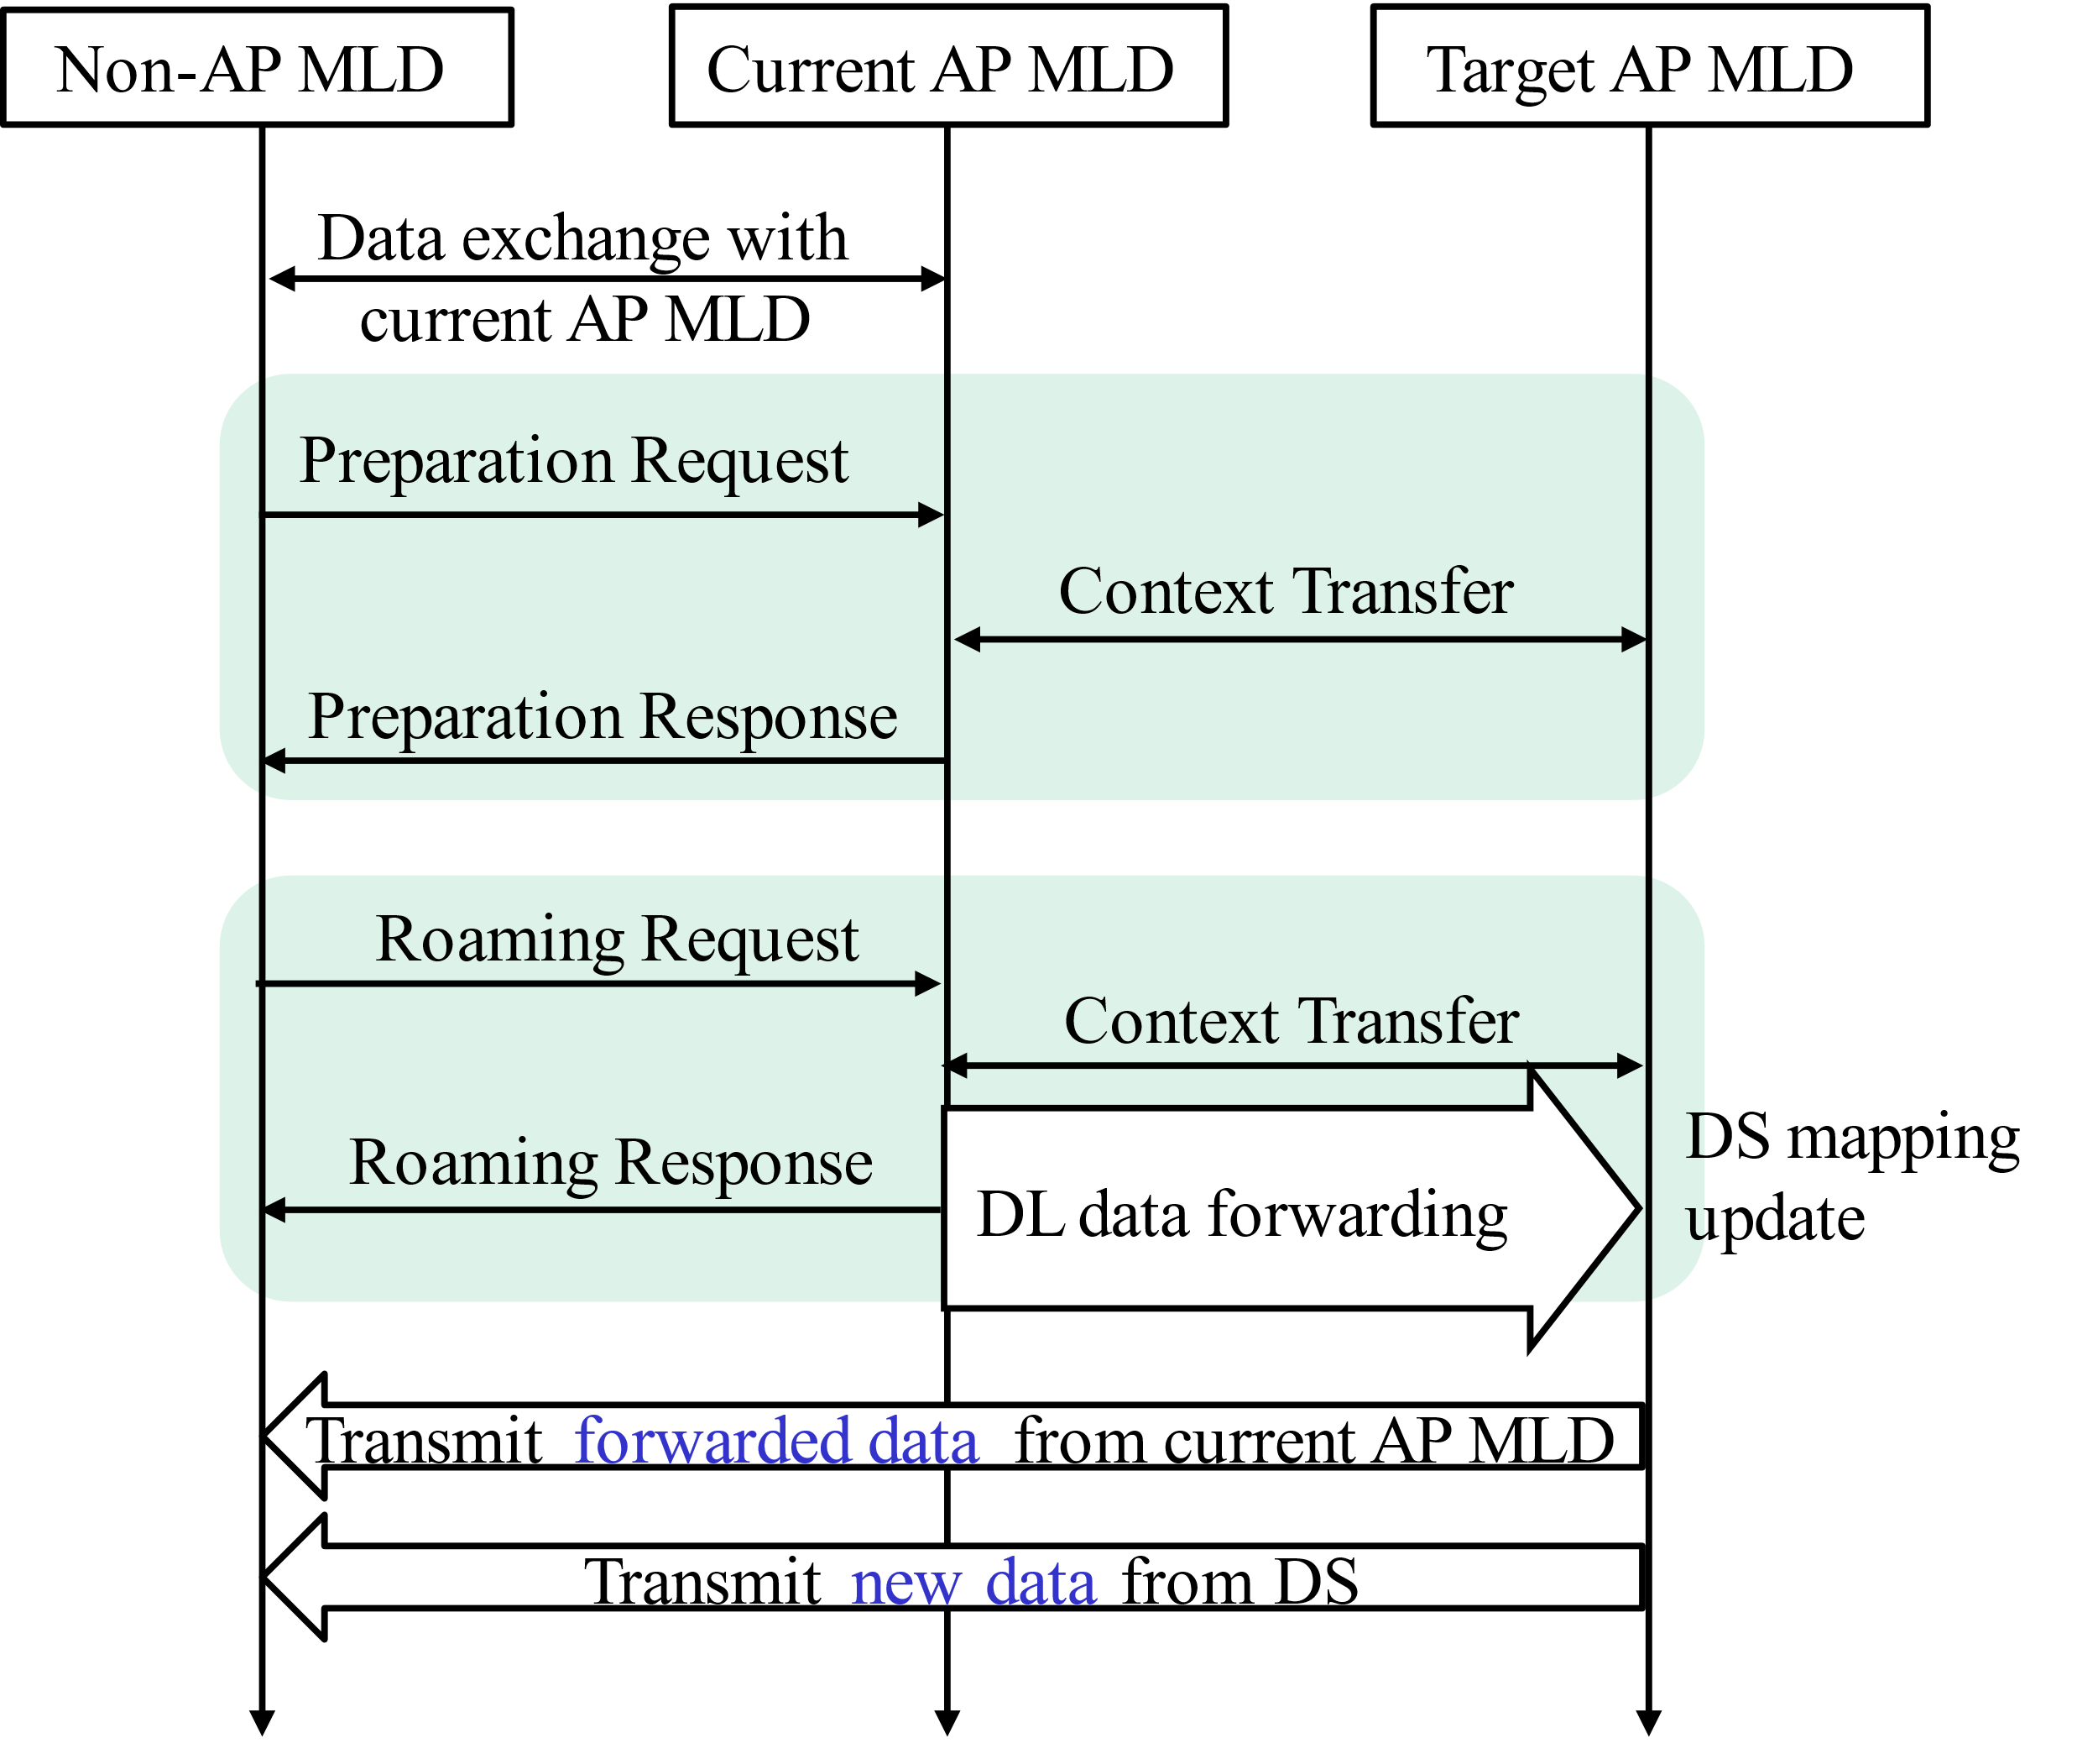
Recap: Data Forwarding in Seamless Roaming
During seamless roaming, current AP MLD can forward buffered DL data of non-AP MLD to target AP MLD.
The forwarded data can be transmitted to non-AP MLD by target AP MLD only after roaming response.
If DS mapping update is complete, new data from DS arrives at target AP MLD. The new data is transmitted after the forwarded data.

Slide 4
Potential Impact of Data Forwarding
AP MLD1
AP MLD2
Poor link
Additional delay caused by data forwarding
The link quality between AP MLDs is poor.
The latency-sensitive data at AP MLD1 will timeout if forwarded to AP MLD2.
Forwarding
buffer
buffer
timeout
Specific traffic that does not require data forwarding
Vehicles on the road get nearby road conditions from roadside AP (also known as road side unit).
When a vehicle moves, its serving AP switches from AP MLD1 to AP MLD2.
The information from AP MLD2 is more important than that in AP MLD1, such that data forwarding is unnecessary.
AP MLD1
AP MLD2
Road conditions around AP MLD1
move
Road conditions around AP MLD2
Thus, data forwarding is not necessary in seamless roaming. We analyze the roaming procedure without data forwarding below.

Slide 5
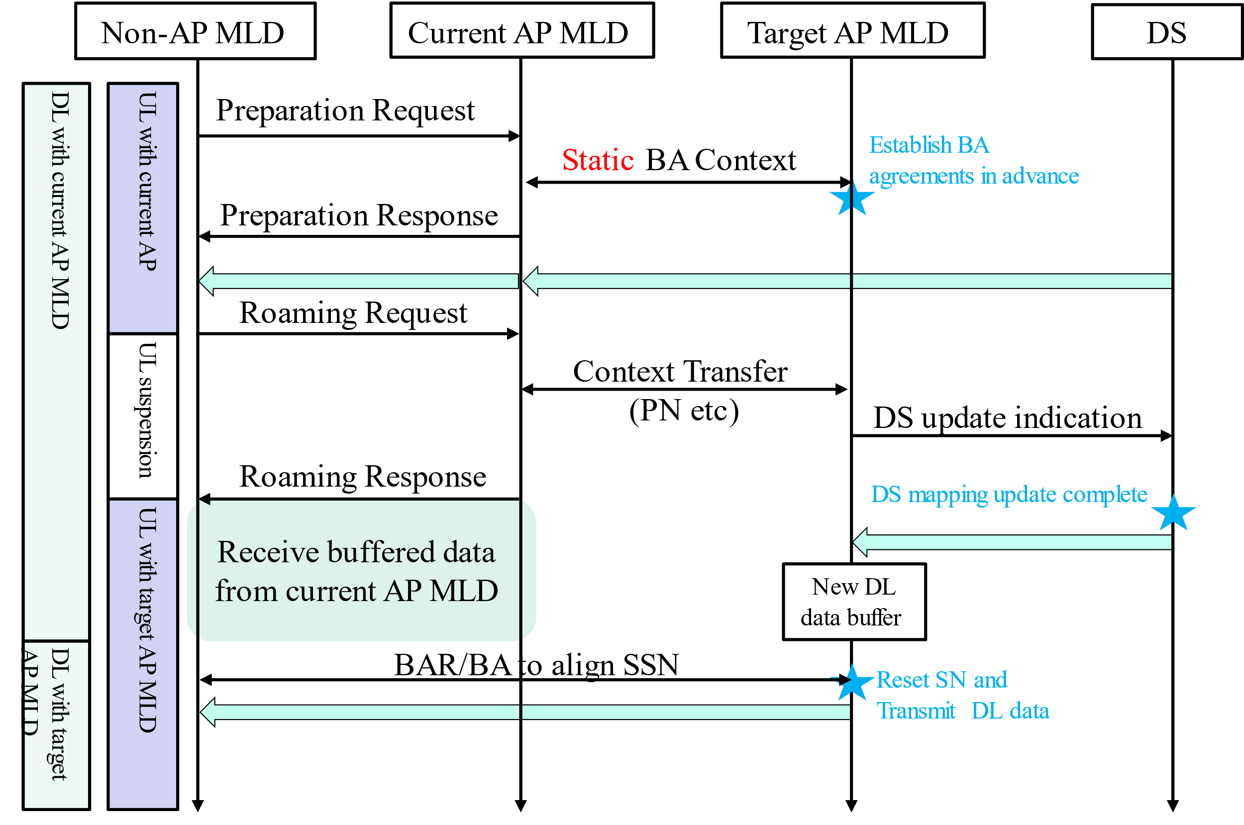
Data Flows Analysis Without Data Forwarding
When receiving roaming request, current AP MLD transmits dynamic context (including PN etc. but not Next SN) to target AP MLD.
Current AP MLD may keep its transmission until the time indicated by roaming response.
During the period of current AP MLD’s transmission, if DS mapping update completes, new data from DS enters target AP MLD’s buffer and pends for transmission.
When current AP MLD ends transmission (timeout or signaled), target AP MLD resets BA operation by a BAR/BA exchange to align SSN, and starts transmitting DL data from aligned SSN.

Slide 6
Dynamic Decision in Roaming Procedure
Although roaming without data forwarding is beneficial for time-sensitive traffic, it cannot meet the requirements of high reliability.
We propose that non-AP MLD can decide whether data forwarding is needed for specific TIDs according to the capabilities of candidate target AP MLDs and the requirements of current traffic.
Thus, the discovery procedure before roaming should be improved to provide more information related to non-AP MLD’s roaming decisions.
The reporting AP provides the necessary and latest information of neighbor AP MLDs [4].
SMD level parameters: data forwarding support, etc.
MLD level parameters: security capabilities in RSNE, power save capabilities, etc.
Dynamic parameters: link state between reporting AP and reported AP, real-time load on reported AP

Slide 7
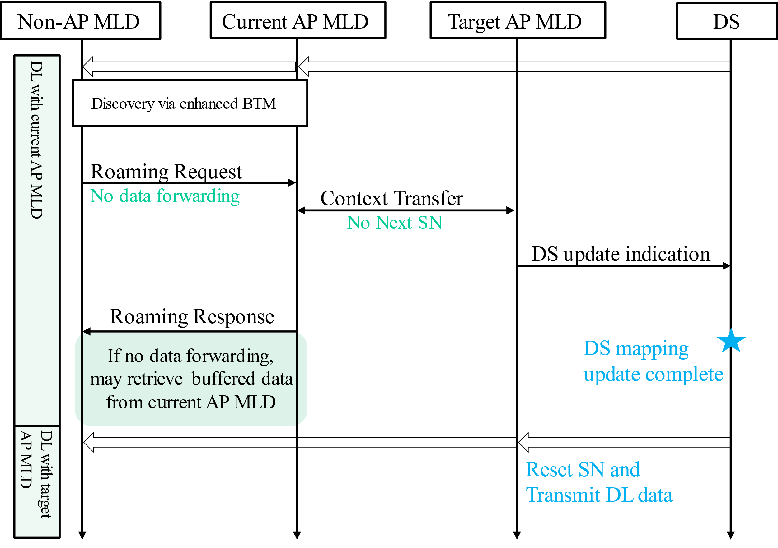
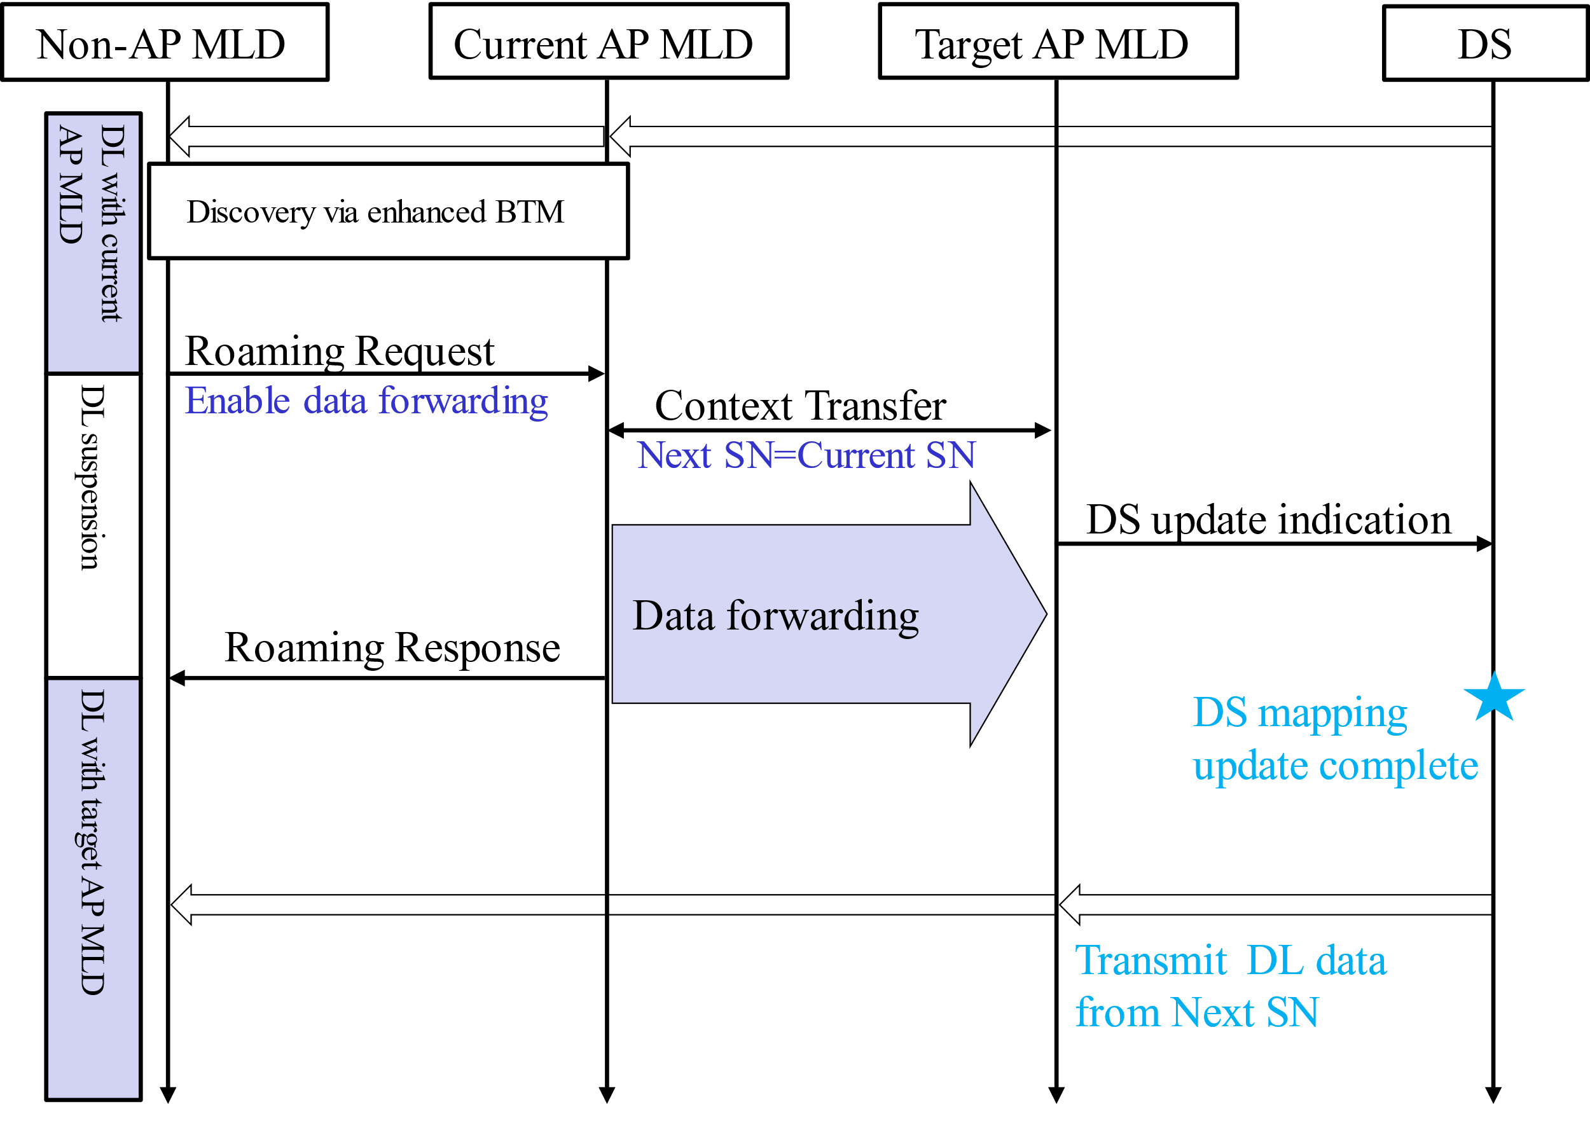
Examples for Dynamic Decision in Roaming Procedure
According to the information acquired in discovery, we illustrate the cases where data forwarding is enabled/disabled.
Case1: Data forwarding is not needed.
Real-time live streaming traffic.
Non-AP needs new data from DS as soon as possible, rather than the blocked data in current AP MLD’s buffer
Case2: Data forwarding is needed.
Non-AP MLD suffers from poor link with current AP MLD.
Non-AP MLD has high reliability requirements.
High-speed link is available between current AP MLD and target AP MLD.

Slide 8
Summary
Data forwarding between AP MLDs may impede the performance of time-sensitive traffic during roaming.
The link between AP MLDs may be poor, leading timeout of these forwarded data.
For specific traffic, new data from DS is more important than the old data pending in current AP MLD’s buffer.
Non-AP MLD can decide whether data forwarding is enabled according to its traffic requirements and the information acquired by discovery stage.
The information acquired by discovery may include the SMD level parameters, MLD level parameters, and dynamic parameters.
The data forwarding decision is made for per TID.

Slide 9
Reference
[1] 11-24/0209 Specification Framework for TGbn
[2] 11-24/1898 Low Latency Roaming Flow Pooya Monajemi et.al., Apple
[3] 11-24/1528 Details on Data Forwarding for Seamless Roaming Ryuichi Hirata et. al., Sony Corporation
[4] 11-24/1879 Proposals for Expeditious Discovery of APs for Initial Association and Roaming Neel Krishnan et.al., Apple

Slide 10
SP1
Do you agree that non-AP MLD can request not to forward buffered DL data of specific TID to target AP MLD?

