Slide 1
Data Flow Analysis for Seamless Roaming
Date: 2025-04-22
Authors:
Name | Affiliation | Address | Phone | Email
Yaoshen Cui | TP-Link Systems Inc. |  |  | cuiyaoshen@tp-link.com.hk
Yunpeng Yang |  |  |  | yangyunpeng@tp-link.com.hk
Yingjie Yan
Renfang Zhou
Qingwei Fu
Junbin Chen
Shuyu Shi
Yu Zhu

Slide 2
Introduction
During seamless roaming, context related to non-AP MLD can be transferred to target AP MLD during roaming preparation and/or execution procedure [1].
Preparation – Transfer or renegotiation of the context to a target AP MLD
Execution – Transfer the context that is required for enabling operations with the target AP MLD
Non-AP MLD can request to the current AP MLD what context needs to be transferred from the current AP MLD to the target AP MLD [1].
Non-AP MLD decides whether dynamic parameters of BA session per TID need to be transferred.

Slide 3
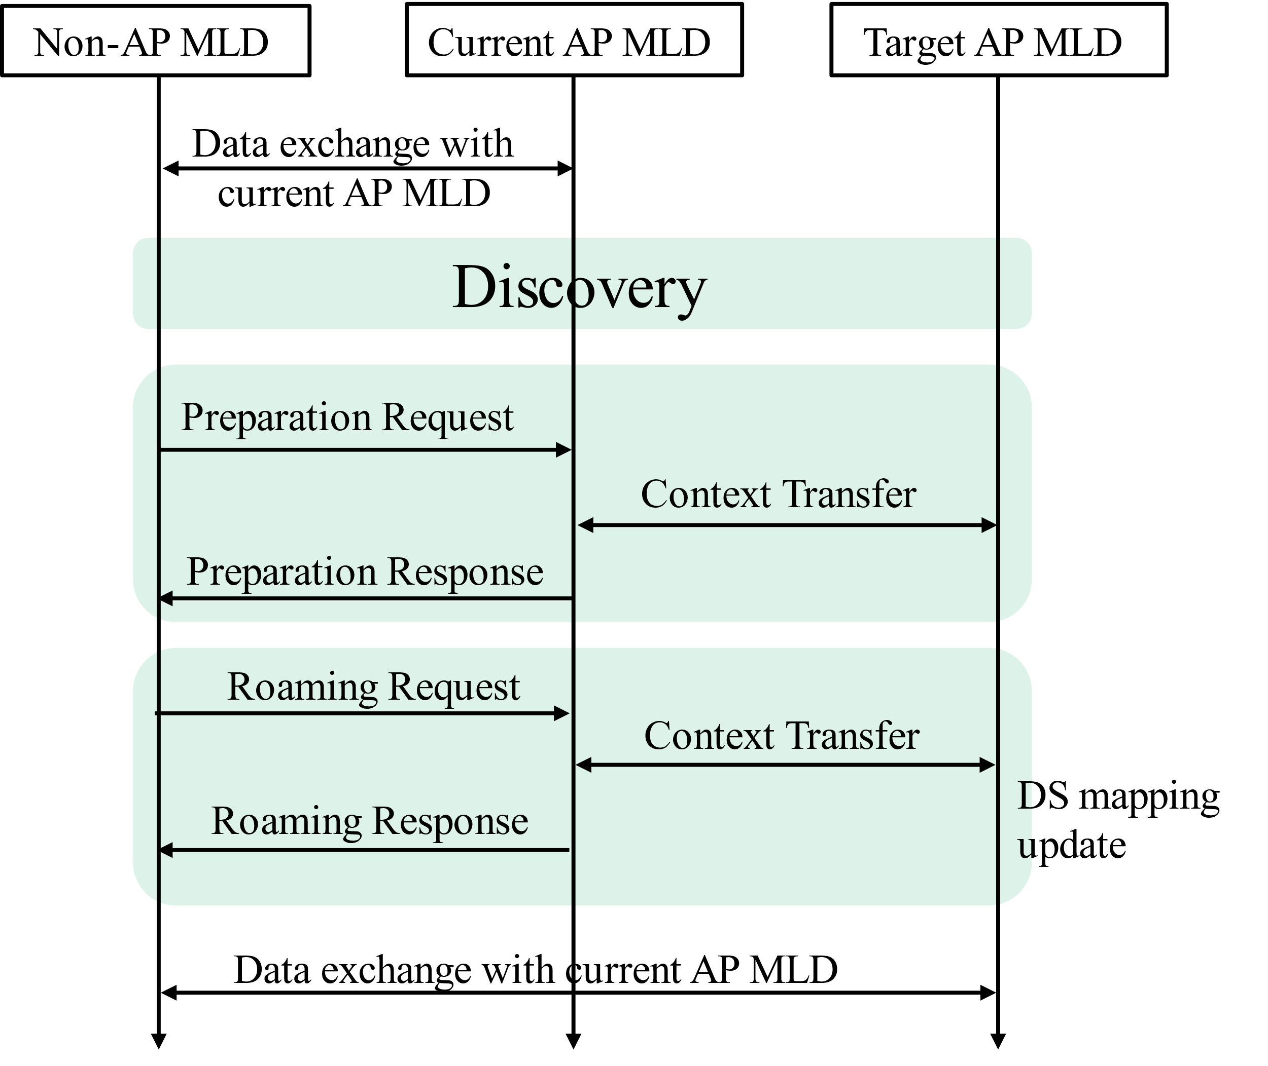
Recap: Seamless Roaming Procedures
SMD Discovery
Non-AP MLD collects neighbor AP MLDs’ capabilities via current AP MLD for better roaming decisions.
Capabilities including MLD level capabilities and SMD level capabilities.
Roaming preparation
Non-AP MLD send preparation request(s) to current AP MLD
Current AP MLD assists non-AP MLD in completing:
Setup links with candidate target AP MLD(s)
Static context transfer to candidate target AP MLD(s)
Roaming execution
Notification of DS mapping update.
Dynamic context transfer to maintain data exchange continuity.

Slide 4
Motivation
TGbn has agreed context transfer and data forwarding between AP MLDs during roaming procedures to maintain the consistency of BA operation.
To keep consecutive BA operation from current AP MLD to target AP MLD,
Data forwarding is necessary to avoid packet drop at L1/L2 layers.
Both static and dynamic BA context transfer during preparation and execution, respectively.
Target AP MLD keeps consecutive BA operation from current AP MLD after roaming response.
In this presentation, we provide detailed data flows analysis for seamless roaming combining dynamic BA context transfer and data forwarding.

Slide 5
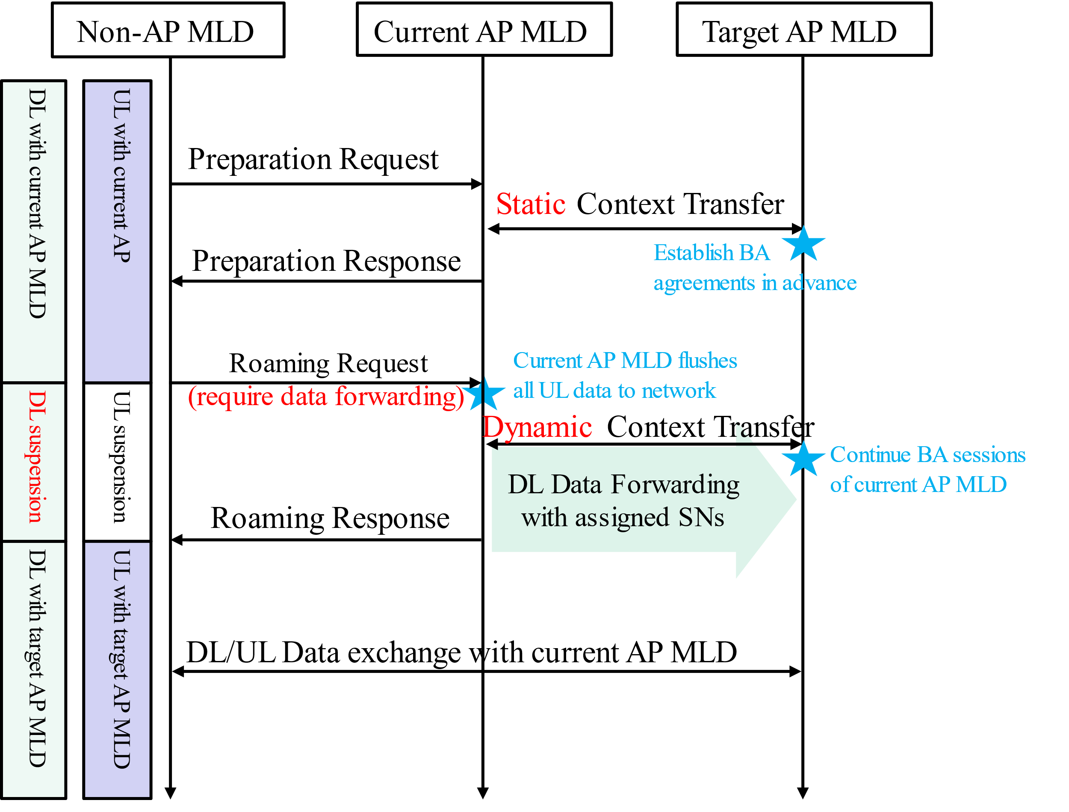
Roaming Behaviours per TID
After successful preparation, target AP MLD establishes BA agreements with non-AP MLD in advance.
Non-AP MLD sends a roaming request with DL data forwarding and dynamic BA context transfer requirements for specific TIDs.
For those TIDs with above requirements, there is an DL suspension to froze and transfer dynamic parameters of current BA sessions. Target AP MLD continues a consistent BA operation after roaming response.
For those TIDs without above requirements, current AP MLD continues transmitting until roaming response, and then discards the remaining data. Target AP MLD resets a new BA operation after roaming response.
(* Current AP MLD flushes all UL data to network when receiving roaming request [2].)
Notes:
对于没有数据转发的TIDs，response之后还能不能发送数据呢？
1、 单link，不能，否则会耽误与target AP的上下行
2、双link，从current AP和Target AP通过不同的link获取DL数据？

Slide 6
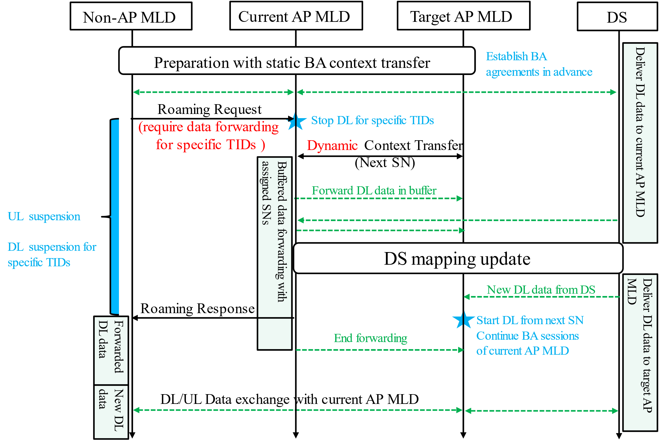
Data Flow Analysis for Consecutive BA Operation (1/2)
When receiving roaming request, current AP MLD stops DL (for specific TIDs) to freeze the dynamic BA status (Next SN, etc.).
Dynamic context transfer is executed to transition the dynamic BA status to target AP MLD. Meanwhile, data forwarding is initiated, with assigned SN of each MSDU or A-MSDU.
Target AP MLD transmits DL data from next SN on after roaming response.
When finishing forwarding, there is an end indication (i.e. more data=0). After receiving which, target AP MLD can assign SNs to new DL data from DS.
An example of detailed data flows and context transfer is illustrated below.

Slide 7
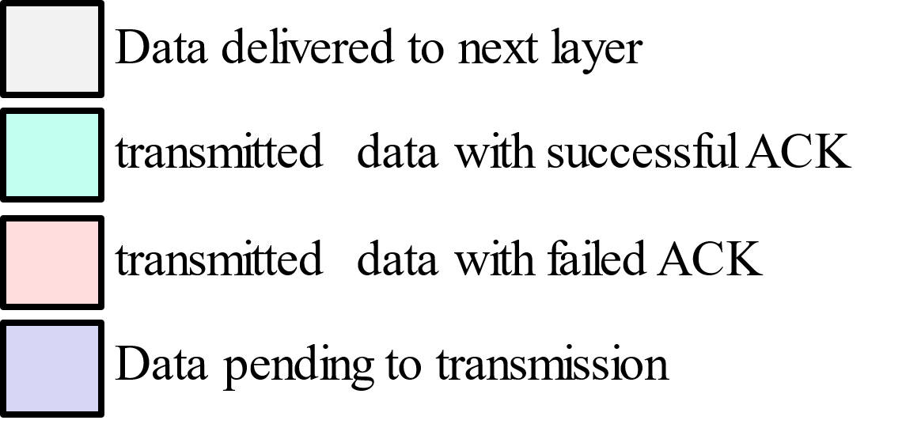
Data Flow Analysis for Consecutive BA Operation(2/2)
When receiving roaming request, current AP MLD’s most recently received BA shows that #SN=6 is missing and others (before #SN=10) are successfully received by non-AP MLD.
Current AP MLD forwards remainder data (including pending data when roaming request and new data from DS before DS mapping update) to target AP MLD. Meanwhile, context transfer is executed including ‘Next SN=6’ and Tx status of current AP MLD.
After roaming response, target AP MLD transmits DL data forwarded data from current AP MLD and new data from DS

Slide 8
Summary
Dynamic BA context transfer and data forwarding are used to maintain the consistency of BA operation before and after roaming.
Non-AP MLD provides data forwarding and dynamic context transfer requirements for specific TIDs in roaming request. Detailed data flows are analyzed in roaming execution procedure.
For the TIDs without data forwarding, current AP MLD continues transmitting until roaming response is send. The pending data will be discarded.
For the TIDs enabling data forwarding, dynamic BA parameters are transferred to keep the consistency of BA operation from current AP MLD to target AP MLD.
DL suspension occurs in execution procedure when consecutive BA operation is needed.

Slide 9
Reference
[1] 11-24/0209 Specification Framework for TGbn
[2] 11-24/1898 Low Latency Roaming Flow Pooya Monajemi et.al., Apple

