Slide 1
Considerations on Security of TDLS Direct Link Establishment in Roaming
Date: April 17, 2025
Authors:
Name | Affiliations | Address | Phone | Email
Xuwen Zhao | TCL | Building G1, TCL International-E City, Shenzhen, Guangdong, China. |  | zhaoxuwen123@outlook.com
Pei Zhou | TCL
Zhanjin Bao

Slide 2
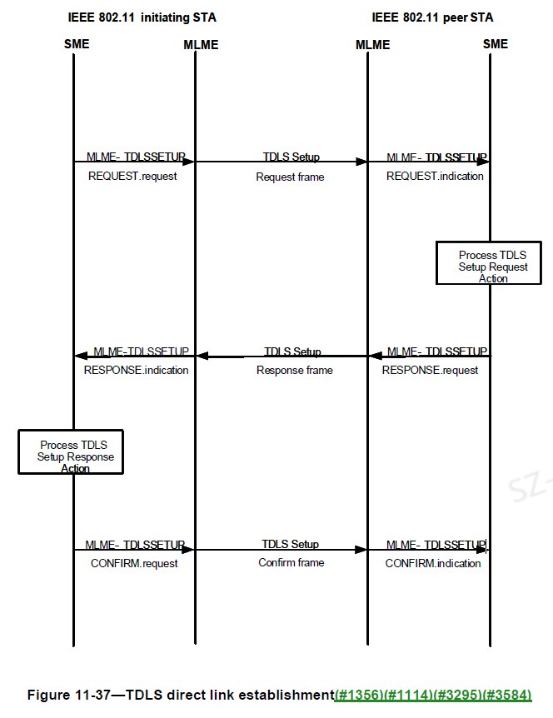
Recap of TDLS Direct Link [1] [2]
Draft P802.11REVme_D7.0
11.20 Tunneled direct link setup states the following:
To set up and maintain a TDLS direct link, both TDLS peer STAs shall be associated with the same infrastructure BSS.
11.20.5 TDLS direct link teardown states the following:
A TDLS Teardown frame with Reason Code LEAVING_NETWORK_DEAUTH shall be transmitted to all TDLS peer STAs (via the AP or via the direct path) prior to reassociation with a different AP, deauthentication, disassociation, or association. After receiving a Deauthentication frame or a Disassociation frame from the AP, a Deauthentication frame with Reason Code LEAVING_NETWORK_DEAUTH shall be transmitted via the direct path to all TDLS peer STAs that are in the awake state, if management frame protection has not been negotiated on the TDLS direct link.
12.7.8 TDLS Peer Key (TPK) security protocol states the following:
The TPK handshake occurs as part of the TDLS direct link(#1356) setup procedure. The TPKSA is the result of the successful completion of the TPK handshake protocol, which derives keys for providing confidentiality and data origin authentication.
In order to maintain (#6395)TPK transient key confidentiality, both the TDLS initiator STA and the TDLS responder STAs establish an RSNA with their common AP prior to executing the TPK handshake.
Draft P802.11be_D7.0
Figure AH-42 (Transmission of TDLS Setup Request frame from one non-AP MLD to another) and Figure AH-43 (Transmission of TDLS Setup Response frame from one non-AP MLD to another) illustrate the case where a single link TDLS direct link is set up between two non-AP MLDs that have performed ML setup with the same AP MLD.

Slide 3
Motivation
Currently, a proposal is being discussed on how to establish TDLS connections during seamless roaming.[3] However, each AP MLD and its associated non-AP MLD may belong to different BSSs. Since in the baseline, the TPK derivation formula includes only one BSSID and AP MLD MAC (Shown as follow).
TPK-Key-Input = Hash(min (SNonce, ANonce) || max (SNonce, ANonce))
When the frames transmitted during the TPK handshake by at least one of the STAs do not include a TDLS Multi-Link element：
TPK = KDF-Hash-Length(TPK-Key-Input, “TDLS PMK”, min (MAC_I, MAC_R) || max (MAC_I, MAC_R) || BSSID)
When the frames transmitted during the TPK handshake by both peers include a TDLS Multi-Link element and the setup is for a single link TDLS：
TPK = KDF-Hash-Length(TPK-Key-Input, “TDLS PMK”, min (MAC_I, MAC_R) || max (MAC_I, MAC_R) || BSSID|| AP MLD MAC)
As shown in the figure below, the non-AP MLD1 and non-AP MLD2 may derive TPK based on different BSSID and AP MLD MAC , leading to inconsistent TPK and causing the TDLS security handshake to fail.
Therefore, this proposal provides some updates to the existing TDLS procedure to solve the above security issue.

Slide 4
Proposal #1: TPK Derivation Based on The Same SMD ID
To address the identified security issue, this proposal introduces the TDLS setup signaling update for SMD based roaming :
0. TDLS Link Establishment Prior to Roaming
A TDLS link is established between non-AP MLD_I and non-AP MLD_R via AP MLD_I prior to roaming. Both non-AP MLD_I and non-AP MLD_R belong to BSS_I.
1. Roaming Event
After roaming, non-AP MLD_R and AP MLD_R belong to BSS_R.
2-4. TDLS Setup Request Transmission
non-AP MLD_I sends a TDLS Setup Request to non-AP MLD_R. The request is forwarded via AP MLD_I and AP MLD_R without being parsed or modified. The TDLS Setup Request includes SMD ID.
5. TPK Derivation by non-AP MLD_R
Upon receiving the TDLS Setup Request, non-AP MLD_R derives a new TPK based on MAC_I, MAC_R and SMD ID, for example, as the follows:
TPK-Key-Input = Hash(min (SNonce, ANonce) || max (SNonce, ANonce))
TPK = KDF-Hash-Length(TPK-Key-Input, “TDLS PMK”, min (MAC_I, MAC_R) || max (MAC_I, MAC_R) || SMD ID)
6-8. TDLS Setup Response Transmission
Non-AP MLD_R sends a TDLS Setup Response to non-AP MLD_I. The response includes SMD ID.
9. TPK Derivation by non-AP MLD_I
Upon receiving the TDLS Setup Response, non-AP MLD_I derives the TPK using the same method as non-AP MLD_R.
10-12. TDLS Setup Confirmation
Non-AP MLD_I sends a TDLS Setup Confirm message to non-AP MLD_R to confirm the completion of the TDLS link establishment.

Slide 5
Proposal #2 : TPK Derivation Based on BSSIDs and AP MLD MACs of Both Parties
To address the identified security issue, this proposal introduces the TDLS setup signaling update for SMD based roaming :
0-1. TDLS Link Establishment and Roaming
2-4. TDLS Setup Request Transmission
non-AP MLD_I sends a TDLS Setup Request to non-AP MLD_R. The request is forwarded via AP MLD_I and AP MLD_R without being parsed or modified. The TDLS Setup Request includes BSSID_I and AP MLD MAC_I.
5. TPK Derivation by non-AP MLD_R
Upon receiving the TDLS Setup Request, non-AP MLD_R derives a new TPK based on MAC_I, MAC_R, BSSID_I and BSSID_R, for example, as the follows:
TPK-Key-Input = Hash(min (SNonce, ANonce) || max (SNonce, ANonce))
When the frames transmitted during the TPK handshake by at least one of the STAs do not include a TDLS Multi-Link element：
TPK = KDF-Hash-Length(TPK-Key-Input, “TDLS PMK”, min (MAC_I, MAC_R) || max (MAC_I, MAC_R) || BSSID_I || BSSID_R)
When the frames transmitted during the TPK handshake by both peers include a TDLS Multi-Link element and the setup is for a single link TDLS：
TPK = KDF-Hash-Length(TPK-Key-Input, “TDLS PMK”, min (MAC_I, MAC_R) || max (MAC_I, MAC_R) || BSSID_I || BSSID_R || AP MLD MAC_I || AP MLD MAC_R)
6-8. TDLS Setup Response Transmission
Non-AP MLD_R sends a TDLS Setup Response to non-AP MLD_I . The response includes BSSID_R and AP MLD MAC_R.
9. TPK Derivation by non-AP MLD_I
Upon receiving the TDLS Setup Response, non-AP MLD_I derives the TPK using the same method as non-AP MLD_R.
10-12. TDLS Setup Confirmation

Slide 6
Summary
This proposal addresses the security issues in TDLS direct link establishment in roaming by introducing some updates to the existing TDLS procedure . To ensure TDLS peer non-AP MLDs use the same BSSID information to derive the same TPK, this proposal introduces the following major updates to the TPK derivation algorithm:
the input parameters of TPK derivation shall include the SMD ID involved in the roaming.
or, the input parameters of TPK derivation shall include the BSSIDs and AP MLD MACs of both parties involved in the roaming.

Slide 7
Straw Poll #1
Do you agree to add the following text to the TGbn SFD:
TDLS procedure shall be updated in the security-related steps to support TDLS direct link setup between non-AP MLDs that have set up links with different AP MLDs within the same SMD.
Y/N/A

Slide 8
Straw Poll #2
Do you agree to add the following text to the TGbn SFD:
For SMD based Roaming
When the frames transmitted during the TPK handshake by at least one of the STAs do not include a TDLS Multi-Link element：
the TDLS setup request shall contain the BSSID of the TDLS initiator non-AP MLD or SMD ID of the SMD that covers AP MLDs affiliated by the TDLS initiator non-AP MLD and the TDLS responder non-AP MLD.
the TDLS setup response shall contain the BSSID of the TDLS responder non-AP MLD or SMD ID of the SMD that covers AP MLDs affiliated by the TDLS initiator non-AP MLD and the TDLS responder non-AP MLD.
the TDLS peer non-AP MLDs shall derive a new TPK based on MAC_I, MAC_R, BSSIDs of the TDLS initiator non-AP MLD and the TDLS responder non-AP MLD or SMD ID of the SMD that covers AP MLDs affiliated by the TDLS initiator non-AP MLD and the TDLS responder non-AP MLD.
When the frames transmitted during the TPK handshake by both peers include a TDLS Multi-Link element and the setup is for a single link TDLS：
the TDLS setup request shall contain the BSSID of the TDLS initiator non-AP MLD, MLD MAC address of the AP MLD affiliated by the TDLS initiator non-AP MLD, or SMD ID of the SMD that covers AP MLDs affiliated by the TDLS initiator non-AP MLD and the TDLS responder non-AP MLD.
the TDLS setup response shall contain the BSSID of the TDLS responder non-AP MLD, MLD MAC address of the AP MLD affiliated by the TDLS responder non-AP MLD, or SMD ID of the SMD that covers AP MLDs affiliated by the TDLS initiator non-AP MLD and the TDLS responder non-AP MLD.
the TDLS peer non-AP MLDs shall derive a new TPK based on MAC_I, MAC_R, BSSIDs of the TDLS initiator non-AP MLD and the TDLS responder non-AP MLD, MLD MAC addresses of the AP MLDs affiliated by the TDLS initiator non-AP MLD and the TDLS responder non-AP MLD, or SMD ID of the SMD that covers AP MLDs affiliated by the TDLS initiator non-AP MLD and the TDLS responder non-AP MLD.
Y/N/A

Slide 9
References
[1] Draft P802.11REVme_D7.0
[2] Draft P802.11be_D7.0
[3] 11-25-0664-00-00bn-considerations-on-tdls-direct-link-in-roaming

