Slide 1
Spatial Reuse Discussion
Date: 2025-04-09
Authors:

Slide 2
Introduction
The description of “spatial reuse” subfield in UHR-SIG, UHR TB PPDU and trigger frame is TBD in 802.11bn 0.1[1].
Keep as it is or set to PSR_AND_NON_SRG_OBSS_PD_PROHIBITED or remove this field?
According to the SR condition defined in 802.11ax. One of the conditions to allow OBSS PD based SR is only applied when the spatial reuse subfield is present:
Therefore, UHR device is also allowed to do OBSS PD-based SR over ELR PPDU if all other conditions defined in [11meD7.0P4164] are met[2].

Slide 3
Summary of SR in UHR and potential issue on ELR PPDU
UHR devices perform SR on HE/EHT, UHR MU, UHR TB, UHR ELR PPDU
PPDU type |  | Receiver | OBSS PD_based SR
HE/EHT |  | UHR | SR is allowed if the SR field of the received inter-BSS PPDU is not set to be PSR_AND_NON_SRG_OBSS_PD_PROHIBITED
UHR | MU/TB PPDU |  | Description of SR field is kept as it is: SR is allowed if the SR field of the received inter-BSS PPDU is not set to be PSR_AND_NON_SRG_OBSS_PD_PROHIBITED SR is not allowed if the SR field of the received inter-BSS PPDU is set to be PSR_AND_NON_SRG_OBSS_PD_PROHIBITED | Description of SR field is fixed to “PSR_AND_NON_SRG_OBSS_PD_PROHIBITED” SR is not allowed over UHR MU or TB PPDU | Remove SR field and disable SR in UHR
 | ELR PPDU |  | SR is allowed over the received ELR PPDU with current SR rules.

Slide 4
Proposal to disallow UHR device to perform SR on ELR PPDU
In 802.11bn OBSS PD-based Spatial reuse operation, a UHR STA follows the rules defined in EHT (35.10.2) except that the condition 5) [11meD7.0P4164] below
is updated as following
as
The received PPDU is one of the following:
For non-EHT PPDU, the SPATIAL_REUSE subfield (if present) is not set to PSR_AND_NON_SRG_OBSS_PD_PROHIBITED.
For other PPDUs, the SPATIAL_REUSE subfield shall be present and is not set to PSR_AND_NON_SRG_OBSS_PD_PROHIBITED.

Slide 5
Summary of our preference
The description of “spatial reuse” subfield in UHR-SIG, U-SIG of UHR TB PPDU and trigger frame will be kept the same as it is in EHT
Update condition 5) defined in [11meD7.0P4164]
as
in 802.11bn to disable SR from UHR device over ELR PPDU.
The received PPDU is one of the following:
For non-EHT PPDU, the SPATIAL_REUSE subfield (if present) is not set to PSR_AND_NON_SRG_OBSS_PD_PROHIBITED.
For other PPDUs, the SPATIAL_REUSE subfield is present and is not set to PSR_AND_NON_SRG_OBSS_PD_PROHIBITED.

Slide 6
References
Draft P802.11bn_D0.1.pdf
https://mentor.ieee.org/802.11/dcn/24/11-24-1861-00-00bn-discussion-on-spatial-reuse-and-elr-transmission.pptx

Slide 7
SP1
Do you agree to include the following into the 11bn SFD?
Remove the “TBD” in the current “spatial reuse” subfield in UHR-SIG of UHR MU PPDU, U-SIG of UHR TB PPDU, Common Info and Special User Info Field of the trigger frame.
Note: Remove the “TBD” means SR subfield will be kept the same as that in EHT.

Slide 8
SP2
Do you agree to include the following into the 11bn SFD?
Add the following paragraph in 11bn OBSS PD-based Spatial reuse operation subclause:
A UHR STA follows the rules defined in 35.10.2 (OBSS PD-based spatial reuse operation), except that the condition 5 defined in 26.10.2.2 (General operation with non-SRG OBSS PD level) is updated as follows:
The received PPDU is one of the following:
For non-EHT PPDU, the SPATIAL_REUSE subfield (if present) is not set to PSR_AND_NON_SRG_OBSS_PD_PROHIBITED.
For other PPDUs, the SPATIAL_REUSE subfield is present and is not set to PSR_AND_NON_SRG_OBSS_PD_PROHIBITED.
NOTE — A UHR STA is not allowed to use OBSS PD-based spatial reuse when the received PPDU is a UHR ELR PPDU or a value of PHY Version Identifier field in U-SIG is one of Validate values.

Slide 9
SP3
Do you agree to add the non-EHT PPDU definition in REVmf as following?
non-extremely-high-throughput (non-EHT) physical layer (PHY) protocol data unit (PPDU): [non-EHT
PPDU] A PPDU that is transmitted using a PPDU format defined in Clause 15 (DSSS PHY specification for
the 2.4 GHz band designated for ISM applications), Clause 16 (High rate direct sequence spread spectrum
(HR/DSSS) PHY specification), Clause 17 (Orthogonal frequency division multiplexing (OFDM) PHY
specification), Clause 18 (Extended Rate PHY (ERP) specification), Clause 19 (High Throughput (HT)
PHY specification(#2297)), Clause 21 (Very high throughput (VHT) PHY specification) or Clause 27 (High Efficiency (HE) PHY specification).
Notes:
P124L21 in Draft P802.11be_D7.0 has used “non-EHT PPDU”

Slide 10
SP4
Do you agree to include the following into the 11bn SFD?
Fix the Spatial Reuse subfield to ‘PSR_AND_NON_SRG_OBSS_PD_PROHIBITED’ in the Co-SR transmission?

Slide 11
Backup

Slide 12
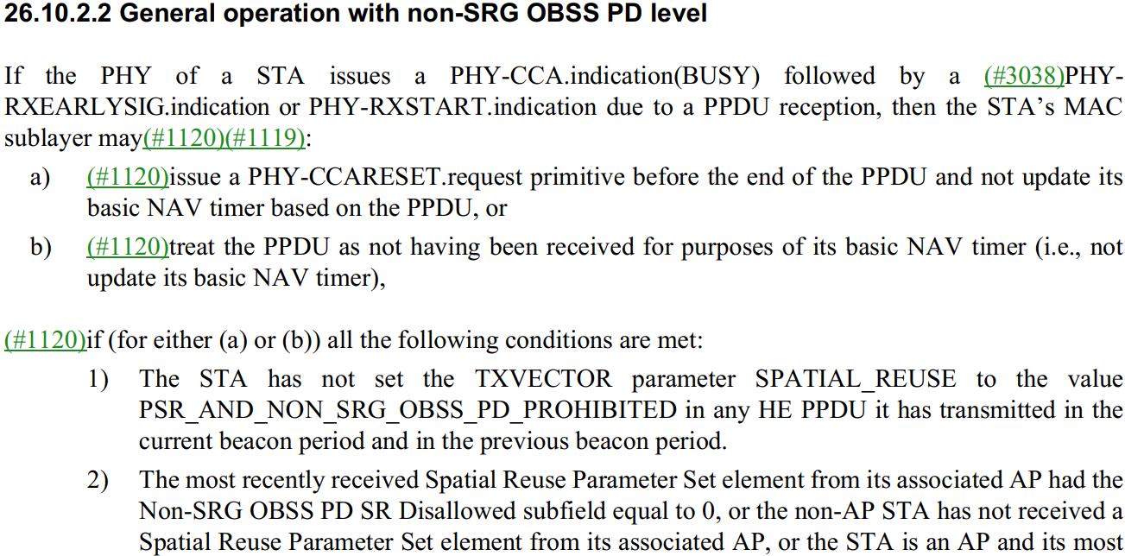
OBSS PD-based spatial reuse operation
→Related to the STA itself
→Related to the associated AP

Slide 13
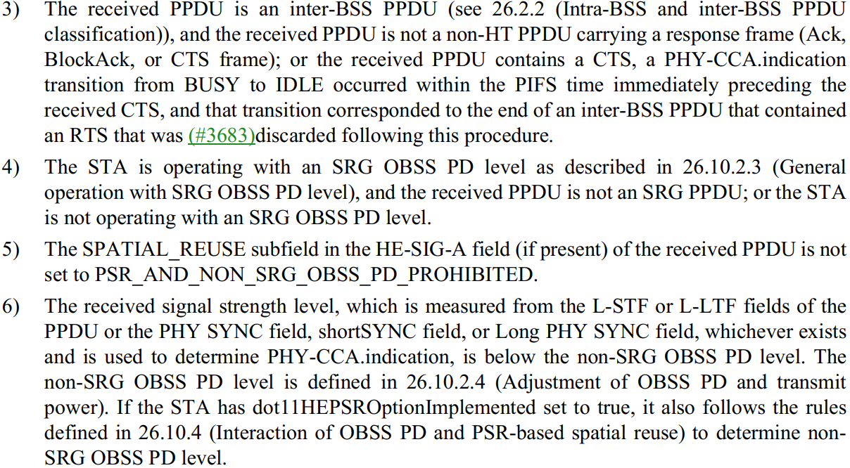
OBSS PD-based spatial reuse operation (cont.)
→Related to the STA itself
→ not applied if SR is not present

Slide 14
OBSS PD-based spatial reuse operation (cont.)

