Slide 1
Preamble Puncturing during NPCA TXOP
Date: 2025-04-17
Authors:
Name | Affiliation | Address | Phone | Email
Junbin Chen | TP-Link Systems Inc. |  |  | chenjunbin@tp-link.com.hk
Yunpeng Yang |  |  |  | yangyunpeng@tp-link.com.hk
Renfang Zhou |  |  |  | zhourenfang@tp-link.com.hk
Yaoshen Cui |  |  |  | cuiyaoshen@tp-link.com.hk
Haozheng Li |  |  |  | lihaozheng@tp-link.com.hk
Qingwei Fu |  |  |  | fuqingwei@tp-link.com.hk
Shuyu Shi |  |  |  | shishuyu@tp-link.com.hk
Yu Zhu |  |  |  | zhuyu@tp-link.com.hk

Slide 2
Introduction
The NPCA mechanism [1-3] provides STAs an extra access opportunity to the medium and would be beneficial for low latency traffics.
Currently it remains TBD about whether a frame that does not solicit TB PPDUs can puncture 20 MHz subchannels not indicated as punctured in the Disabled Subchannel Bitmap subfield of the EHT Operation element [4-5] .
In this presentation, we’d like to discuss about the preamble puncturing rules for the STAs who has switched to the NPCH and initiate an NPCA TXOP.

Slide 3
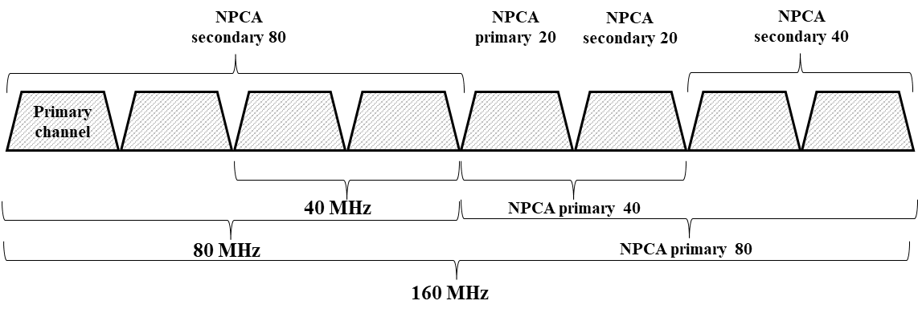
The bandwidth indication for NPCA
Previously, there have been some contributions focusing on the bandwidth indication for NPCA.
For example, the contribution [6] suggests to define the NPCA primary N MHz and NPCA secondary N MHz
The contribution [7] suggests that the NPCA AP shall signal the RU index considering the NPCA Primary channel as the reference primary channel when soliciting an UL TB PPDU on the NPCA Primary channel, which is approved with unanimous consent in the motion #128 [4].

Slide 4
Motivation
According to the Draft [5], we agree that:
An NPCA STA shall initiate a TXOP on the NPCA Primary channel following the rules defined in 10.23.2.2 (EDCA backoff procedure) and 10.23.2.4 (Obtaining an EDCA TXOP) with a several exception.
In the baseline [8],
An transmission that contains an MPDU soliciting an immediate response shall not puncture 20 MHz subchannels that are not indicated to be punctured in the Disabled Subchannel Bitmap subfield in the EHT Operation element, unless:
The transmission is EHT SU transmission and contains a trigger soliciting a TB PPDU, or
The transmission is EHT MU transmission and including a trigger frame.
The primary 20MHz subchannel can not be indicated as punctured.
However, for NPCA, the puncturing of 20MHz subchannels that are not indicated to be punctured in the Disabled Subchannel Bitmap subfield is quite necessary for the efficient use of wireless medium.

Slide 5
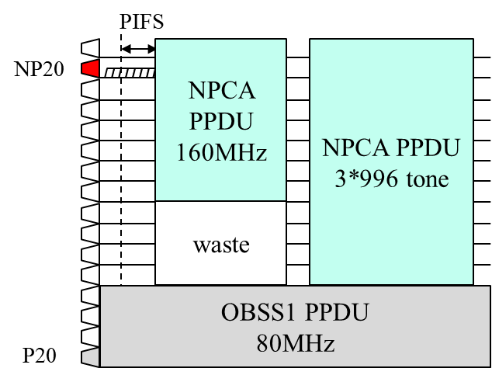
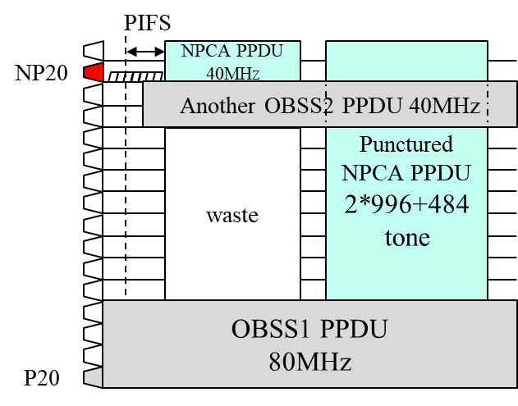
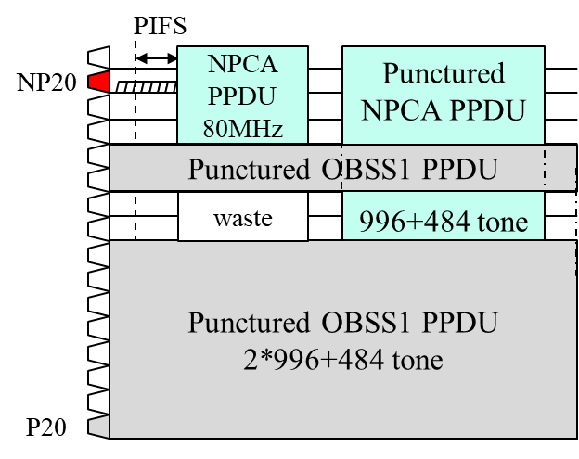
Problem statement - cases analysis
Assuming a BSS with 320MHz bandwidth, the locations of P20 and NP20 subchannels are illustrated as follows.
No subchannel is indicated as punctured in the Disabled Subchannel Bitmap field of the EHT Operation element.
Then, an OBSS1 PPDU is detected in PCH and the STA initiates the NPCA procedure.
After an NPCA switch delay and the necessary back-off, the STA starts to transmit NPCA PPDUs.
Considering the bandwidth of the NPCA PPDUs:
If the puncturing is not allowed, there might be significant waste of idle frequency resource.
In contrast, the medium efficiency can be greatly enhanced by taking advantage of the puncturing mode transmission.
Case 1
Case 2
Case 3

Slide 6
Proposal
The AP shall announces a puncturing mode in the ICF for NPCA.
The puncturing mode can be indicated as a Temporal Disabled Subchannel Bitmap field or TBD.
The puncturing mode shall be treated as valid only during the NPCA TXOP start with that ICF.
Or, the puncturing mode shall be treated as valid before the AP switch back to the PCH.
For simplicity, the announced puncturing mode shall be any one of the puncturing mode that is already defined in 11be or other 802.11 standards.
The PPDUs following the ICF shall indicate the puncturing pattern of itself in the U-SIG field.
The subchannels occupied by the OBSS can be also included in the bandwidth field, and indicated as punctured subchannels in the Punctured Channel Information subfield.

Slide 7
Examples
PIFS
NPCA TXOP
Higher frequency
1111
1111
NP20
ICF
ICR
PPDU to STA1
(non-OFDMA)
PPDU to STA2~4
(OFDMA)
PPDU to STA5
(no puncturing)
S80
1111
1111
Response
1111
1111
Preamble
Response
1111
Response
1111
S40
0011
0011
S20
OBSS
P20
Lower frequency
The announced BSS’s bandwidth is 160MHz and the puncturing mode is [x x 1 1 1 1 1 1];
The ICF itself shall be a non-HT DUP PPDU.
In U-SIG, the value of bandwidth field shall be set to 3(160MHz); and the value of Punctured Channel Information subfield shall be set to 0011 for each 20MHz subchannels in S40 and set to 1111 for each 20MHz subchannels in S80, respectively.
In U-SIG, the value of bandwidth field shall be set to 2(80MHz); and the value of Punctured Channel Information subfield shall be set to 1111 for each 20MHz subchannels.
In U-SIG, the value of bandwidth field shall be set to 3(160MHz); and the value of Punctured Channel Information subfield shall be set to 9 ([x x 1 1 1 1 1 1]
(996+484-tone MRU 1))

Slide 8
Conclusion
The preamble puncturing is quite beneficial to the medium efficiency.
The subchannels occupied by the OBSS activity that cause the STA to initiate a NPCA procedure can be regarded as the subchannels that shall be punctured during the NPCA TXOPs.
We suggest to allow the NPCA STA to puncture a subchannel that is not announced to be punctured in the Disabled Subchannel Bitmap subfield in the beacon or other frames (e.g., the probe response/the association response, etc.).
The NPCA TXOP shall be started with a ICF indicating the temporal preamble puncturing mode.
The PPDUs transmitted during the NPCA TXOP shall indicate the bandwidth and Punctured Channel Information in the U-SIG field.
For simplicity, the temporal preamble puncturing mode shall be any one of the existing mode that has been defined in 11be or other 802.11 standards.

Slide 9
References
[1] 23/2005 Non-primary channel access (NPCA), Minyoung Park (Intel Corp.)
[2] 24/1699 Considerations on NPCA, Hirohiko Inohiza(Canon)
[3] 24/1762 PDT-MAC-NPCA, Matthew Fischer (Broadcom)
[4] 24/0209 Specification Framework for TGbn, Ross Jian Yu (Huawei)
[5] Draft P802.11bn D0.2
[6] 24/0426 EDCA for Non Primary Channel Access, Dongju Cha (LG Electronics)
[7] 24/1218 NPCA – Next level discussions, Gaurang Naik (Qualcomm)
[8] IEEE 802.11 REVme D7.0

