Slide 1
Improvements for NPCA and Seamless Roaming Interoperability
Date: 2025-09-10
Authors:

Slide 2
Abstract
In this contribution, we discuss the behavior of non-AP Multi-Link Devices (MLDs) during SMD BSS Transition (ST) operations when the Non-Primary Channel Access (NPCA) mechanism is concurrently enabled.
  Each feature targets independent performance improvements in 802.11—SMD BSS Transition improves mobility, while NPCA enhances spectrum usage under congestion.
  However, interoperability challenges exist when these features operate concurrently.
Three mechanisms that aim to improve the robustness and efficiency of ST under NPCA conditions are introduced.
The goal is to define a consistent and interoperable behavior for MLDs using ST in NPCA-enabled networks.

Slide 3
Introduction
Without timely exchange of NPCA-related information, ST operations may be disrupted by NPCA channel switching, or the target AP may lack awareness of the non-AP MLD’s NPCA state or capability [10].
While both features provide benefits, their concurrent operation can lead to undesired behaviors, particularly during link transition phases, e.g., the non-AP MLD may not receive critical management frames, downlink data may be interrupted, the AP may assume the MLD is reachable via NPCA when it's not.
In this contribution, we focus on the non-AP MLD behavior and decision logic during roaming, regardless of the NPCA-related information exchange mechanisms.

Slide 4
Problem Statement
Identified Issues
When the two features are concurrently operated, this can lead to disruptions during roaming due to unexpected and non-deterministic switching behavior and also lead to underutilization of resources.
Issue 1: Ambiguity in behavior when roaming to AP MLD with different NPCA status or primary channel.
Issue 2: A non-AP MLD may roam to a target AP MLD operating on an NPCA primary channel without prior awareness, causing communication gaps.
Issue 3: Target AP MLD may not be aware of the non-AP MLD's NPCA capabilities, affecting how it schedules transmissions post-roaming.

Slide 5
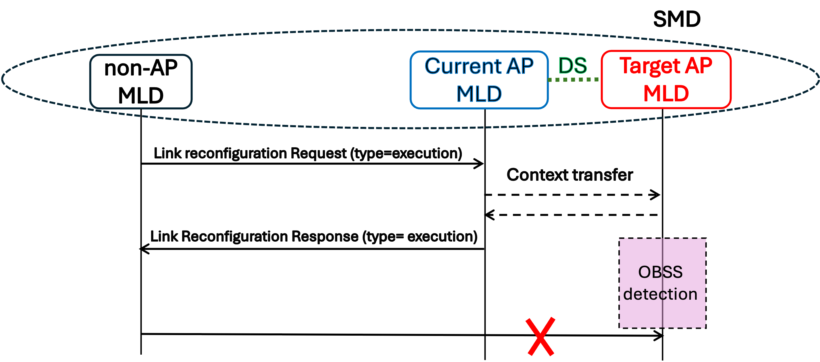
Handling of NPCA Transitions During ST
During ST preparation or execution, target AP MLD may switch to NPCA primary channel due to OBSS detection and this non-AP MLD is not aware of this switch.
The goal is to define robust STA behavior to handle these transitions

Slide 6
Handling of NPCA Transitions During ST
Option A: NPCA Status Update Before Roaming Completion
Target AP MLD sends its NPCA status (Enablement, NPCA operation parameters, NAV) to non-AP MLD before roaming is finalized (e.g., Link reconfiguration response)
Can be done reactively (at roam request) or periodically (status update).
Ensures accurate context for roaming behavior.
Pro: Improves decision-making by informing the STA of NPCA state early. Con: Depends on timely and reliable signaling from the target AP.
Option B: Post-Switch NPCA Channel Check
Non-AP MLD switches to target AP’s primary channel.
If no OBSS detected and AP not heard, the STA:
  Optionally switches to target’s NPCA primary to probe for activity,
    Optionally, if low-latency traffic is pending for the non-AP MLD, the target AP MLD may send NPCA Initial Control Frames (ICFs) periodically in its NPCA primary channel, and/or repeat them until a transmission from the non-AP MLD is received.
Pro: Enables discovery of target AP activity even if it's on the NPCA channel. Con: Further implementation required. Less efficient due to switching delays associated to it.
Option C: RU index-based Detection
If both current AP’s primary and NPCA primary overlap with target AP’s NPCA bandwidth,
  Non-AP MLD may detect a wideband transmission from the target.
  STA extracts RU index to infer channel activity and target AP state.
Pro: Passive method that requires no additional signaling. Con: Limited to overlapping channels and may not apply universally.

Slide 7
Conclusions
Seamless roaming and NPCA mechanisms can be operated concurrently and a baseline behavior from a non-AP STA point of view is needed to define in which particular primary channel a non-AP STA shall operate upon roaming.
We discuss improvement options on how to more optimally handle the NPCA transitions while using ST.

Slide 8
Straw Polls
SP1: Do you agree that further mechanisms are needed to properly handle the case when while the current AP MLD operates on the primary channel, the target AP MLD has switched to the NPCA primary channel and vice versa?

Slide 9
References
[1] PDT MAC Seamless Roaming Part 1, IEEE 802.11-25/0566r10.
[2] PDT-CR MAC Seamless Roaming Part 2, IEEE 802.11-25/0736r8.
[3] PDT MAC Seamless Roaming Part 3, IEEE 802.11-25/0753r9.
[4] PDT-CR MAC Seamless Roaming Part 4, IEEE 802.11-25/1020r0.
[5] PDT MAC Seamless Roaming Part 5, IEEE 802.11-25/1101r8.
[6] PDT-CR MAC NPCA CC50, IEEE 802.11-25/0936r15.
[7] TGbn Motion List - Part 1, v26.
[8] TGbn Motion List - Part 2, v35.
[9] IEEE P802.11bn™/D1.0.
[10] Thoughts on Seamless Roaming and NPCA , Ning Gao (Oppo).

