Slide 1
Improvements for NPCA and Seamless Roaming Interoperability
Date: 2025-04-15
Authors:

Slide 2
Reference to Comment Resolution
This contributions proposes a resolution for the following comment [7]:
2693 | Salvatore Talarico | 37.8.2.5.2 | 75.61 | Roaming procedure should include behavior for NPCA capable non-AP STAs | Procedure on how to ensure seamless roaming for an NPCA capable non-AP STA is missing including related information which should be part of the context transfer and STA behaviour. | MAC

Slide 3
Abstract
In this contribution, we discuss the behavior of non-AP Multi-Link Devices (MLDs) during seamless roaming operations when the Non-Primary Channel Access (NPCA) mechanism is concurrently enabled.
Each feature targets independent performance improvements in 802.11—roaming improves mobility, while NPCA enhances spectrum usage under congestion.
However, interoperability challenges exist when these features operate concurrently.
Two baseline behavioral approaches are provided together with some additional mechanisms that aim to improve the robustness and efficiency of roaming under NPCA conditions.
The goal is to define a consistent and interoperable behavior for roaming MLDs in NPCA-enabled networks.

Slide 4
Introduction
Without timely exchange of NPCA-related information, roaming operations may be disrupted by NPCA channel switching, or the target AP may lack awareness of the non-AP MLD’s NPCA state or capability [6].
While both features provide benefits, their concurrent operation can lead to undesired behaviors, particularly during link transition phases, e.g., the non-AP MLD may not receive critical management frames, downlink data may be interrupted, the AP may assume the MLD is reachable via NPCA when it's not.
In this contribution, we focus on the non-AP MLD behavior and decision logic during roaming, regardless of the NPCA-related information exchange mechanisms.

Slide 5
Problem Statement
Identified Issues
When the two features are concurrently operated, this can lead to disruptions during roaming due to unexpected and non-deterministic switching behavior and also lead to underutilization of resources.
Issue 1: Ambiguity in behavior when roaming to AP MLD with different NPCA status or primary channel.
Issue 2: A non-AP MLD may roam to a target AP MLD operating on an NPCA primary channel without prior awareness, causing communication gaps.
Issue 3: Target AP MLD may not be aware of the non-AP MLD's NPCA capabilities, affecting how it schedules transmissions post-roaming.

Slide 6
What Should the Default Behavior Be? (1/2)
During seamless roaming preparation or execution, current AP MLD and non-AP MLD may switch to NPCA primary channel based on the switching conditions. In this case, which channel should a STA affiliated with the non-AP MLD use for the link with the target AP MLD?

Slide 7
What Should the Default Behavior Be? (2/2)
Option 1 (preferred):
After non-AP MLD receives the Link Reconfiguration Response (execution), STA affiliated with non-AP MLD shall always switch to the primary channel of the AP affiliated with the target AP MLD to complete seamless roaming, for link setup and data path establishment.
Option 2:
Non-AP MLD uses the NPCA decision logic during roaming:
If the non-AP STA operates on the NPCA primary, an this is the same for both current and target AP MLDs, it shall follow OBSS NAV from current AP upon roaming.
If the non-AP STA operates on the BSS primary, it uses the target AP’s primary to decide whether to switch to target NPCA primary.
Pro: Simple with little spec impact.
Cons: Not fully optimized as a non-AP STA may be subject to latencies and communication discontinuities due to possible mismatch in primary used between current and target AP MLDs.
Pro: Consistent with NPCA logic.
Con: Same as option 1, but enforces a non-AP STA to retain the decision of switching based on inter-BSS transmissions relative to the current AP MLD

Slide 8
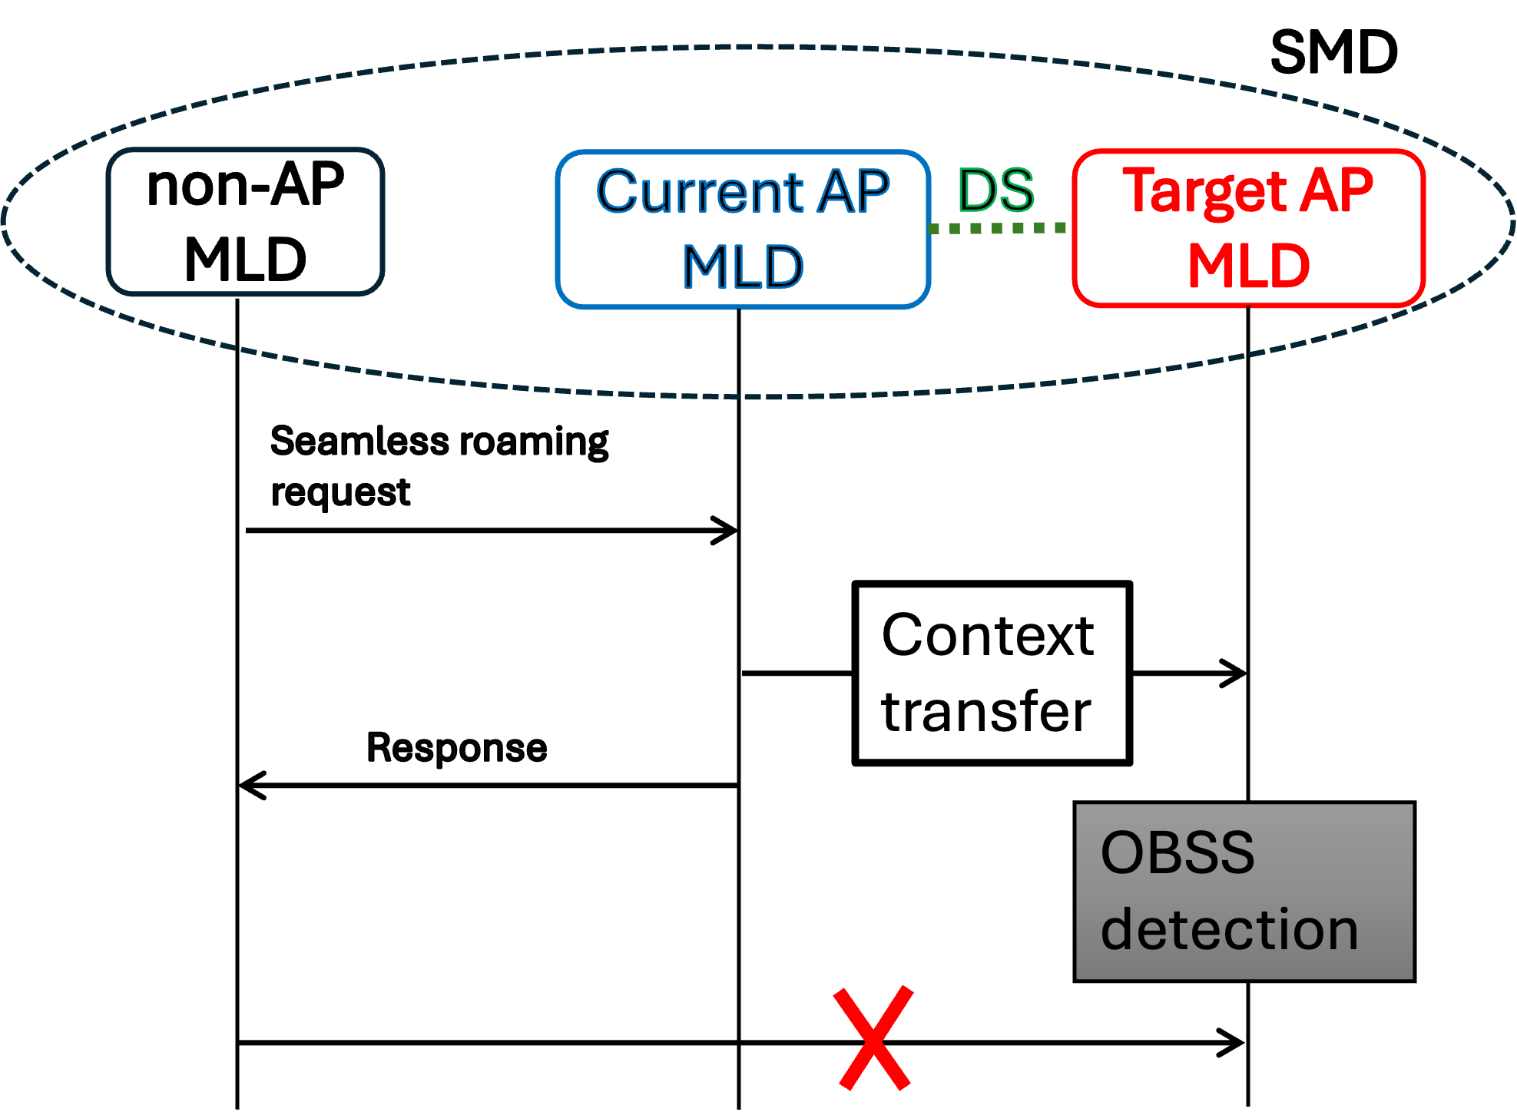
Handling of NPCA Transitions While Roaming
During seamless roaming preparation or execution, target AP MLD may switch to NPCA primary channel due to OBSS detection and non-AP MLD is not aware of this switch.
The goal is to define robust STA behavior to handle these transitions

Slide 9
Handling of NPCA Transitions While Roaming
Option A: NPCA Status Update Before Roaming Completion
Target AP MLD sends its NPCA status (channel, NAV, etc.) to non-AP MLD before roaming is finalized (e.g., Link reconfiguration response)
Can be done reactively (at roam request) or periodically (status update).
Ensures accurate context for roaming behavior.
Pro: Improves decision-making by informing the STA of NPCA state early. Con: Depends on timely and reliable signaling from the target AP.
Option B: Post-Switch NPCA Channel Check
Non-AP MLD switches to target AP’s primary channel.
If no OBSS detected and AP not heard, the STA:
Optionally switches to target’s NPCA primary to probe for activity,
Optionally, if low-latency traffic is pending for the non-AP MLD, the target AP MLD may send NPCA Initial Control Frames (ICFs) periodically in its NPCA primary channel, and/or repeat them until a transmission from the non-AP MLD is received.
Pro: Enables discovery of target AP activity even if it's on the NPCA channel. Con: Further implementation required. Less efficient due to switching delays associated to it.
Option C: RU index-based Detection
If both current AP’s primary and NPCA primary overlap with target AP’s NPCA bandwidth,
Non-AP MLD may detect a wideband transmission from the target.
STA extracts RU index to infer channel activity and target AP state.
Pro: Passive method that requires no additional signaling. Con: Limited to overlapping channels and may not apply universally.

Slide 10
Conclusions
Seamless roaming and NPCA mechanisms can be operated concurrently and a baseline behavior from a non-AP STA point of view is needed to define in which particular primary channel a non-AP STA shall operate upon roaming.
We proposed two options for a baseline behavior and we also discuss further options on how to more optimally handle the NPCA transitions while roaming.

Slide 11
Straw Polls
SP1: Do you agree that upon roaming a STA affiliated with a non-AP MLD shall always switch to the primary channel of the AP affiliated with the target AP MLD for link setup and data path establishment with the AP affiliated with the target AP MLD (Option 1)?

Slide 12
Straw Polls
SP2: Do you agree that further mechanisms are needed to properly handle the case when while the current AP MLD operates on the primary channel, the target AP MLD has switched to the NPCA primary channel and vice versa?

Slide 13
References
[1] PDT MAC Seamless Roaming, IEEE 802.11-25/0566r0.
[2] PDT MAC NPCA, IEEE 802.11-24/1762r23.
[3] TGbn Motion List - Part 1, v26.
[4] TGbn Motion List - Part 2, v14.
[5] IEEE P802.11bn™/D0.2.
[6] Thoughts on Seamless Roaming and NPCA , Ning Gao (Oppo).
[7] IEEE 802.11bn CC50 comments on D0.1, IEEE 802.11-25/0296r17.

