Slide 1
R-TWT operation with NPCA
Date: 2025-08-25
Authors:

Slide 2
Abstract
In TGbn, there were discussions for non-primary channel access(NPCA) operation
In the current NPCA operation, a TXOP truncation rule for an ongoing R-TWT SP on an NPCA primary channel is not clarified
  For a proper R-TWT operation, the R-TWT SP should be respected on the NPCA Primary channel.
  In other words, the TXOP should be ended prior to the starting of the R-TWT SP.
This contribution discusses how to manage R-TWT SP in the NPCA Primary Channel

Slide 3
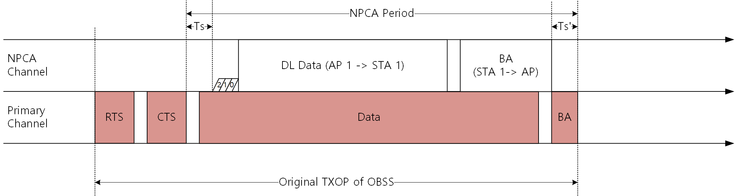
Background: NPCA Operation
When the BSS primary channel is known to be busy due to an OBSS’s TXOP, an AP and its associated STAs can switch their operating channel to the NPCA primary channel.
In the NPCA primary channel, the AP and the STAs can continue communication during the OBSS’s TXOP

Slide 4
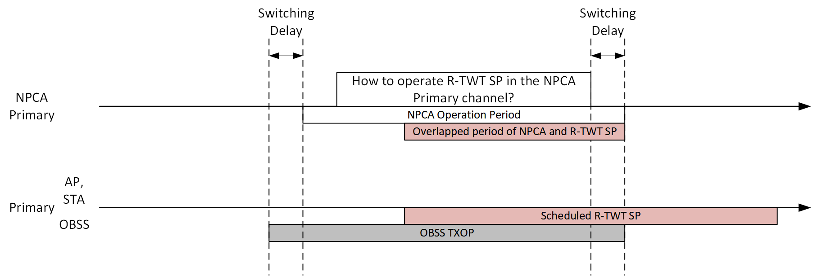
Problem:
R-TWT SP in the NPCA Primary Channel
While an R-TWT SP is scheduled, an OBSS may occupy the BSS primary channel.
Current 11bn draft does not clarify such case:
  How the R-TWT operation is performed on the NPCA Primary channel is not clarified.
  Because of the NPCA switching delay and switch back delay, ongoing R-TWT SP may be shortened, and low-latency traffics cannot be properly transmitted in the ongoing R-TWT SP.
  Therefore, TXOP truncation, before the R-TWT SP on the NPCA Primary channel, should be considered.
The current 11bn draft should clarify the R-TWT operation on the NPCA primary channel.

Slide 5
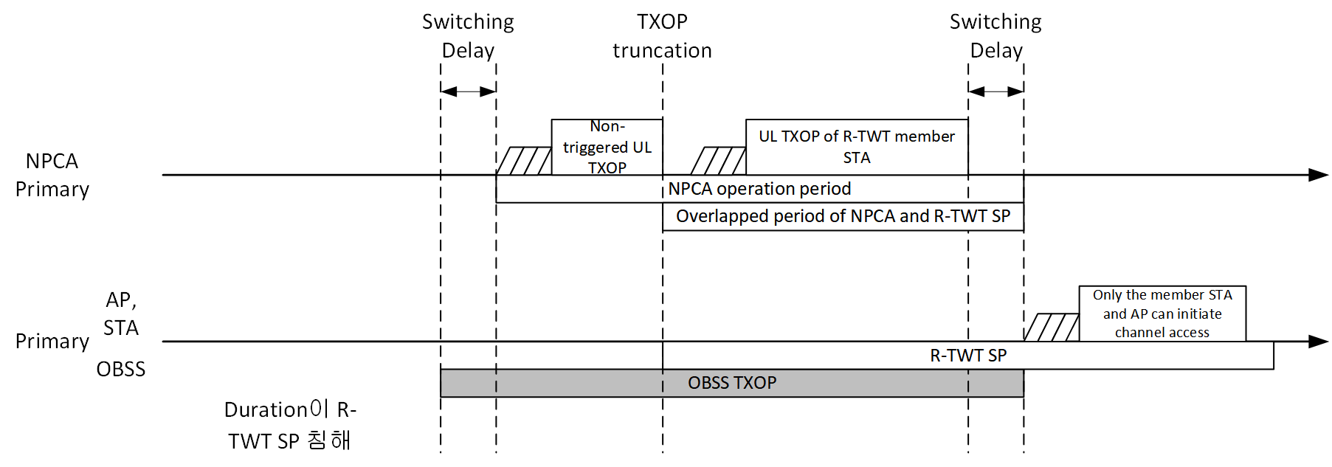
Clarification for the 11bn draft:
Respect ongoing R-TWT SP
Ongoing R-TWT SP should be respected on the NPCA Primary channel
  A TXOP of NPCA STAs shall be truncated on the NPCA Primary channel before the start time of the R-TWT SP.
  A clarifying text for this case for 11bn draft is required.

Slide 6
Conclusion
The current 11bn draft does not clarify the R-TWT channel access operation on the NPCA Primary channel
  Because of the NPCA delays, ongoing R-TWT SP may be shortened and R-TWT operation may not be utilized.
This submission proposes clarification for the R-TWT operation on the NPCA Primary channel
  TXOP of STAs shall be truncated on the NPCA Primary channel before the start time of R-TWT SP
  We should add the clarification for the next version of 11bn draft.
With this submission, the R-TWT operation on the NPCA Primary channel can be clarified.
  Therefore, low-latency traffic can be suitably transmitted in the R-TWT SP on the NPCA Primary channel.

Slide 7
Straw poll
SP #1: Do you support to add the following text to the 11bn SFD?
3.4 NPCA operation
  Before starting transmission of any PPDU in the TXOP obtained on the NPCA primary channel, an NPCA STA should complete its frame exchange prior to the start of the R-TWT SP, as defined in subclause 35.8.4.1(TXOP and backoff procedure rules for R-TWT SPs). If there is not enough time to complete its frame exchange prior to the start of the R-TWT SP, then the NPCA STA should defer transmission.

