Slide 1
TWT-Based AP Power Save
Date: 2024-11-11
Authors:

Slide 2
Abstract
AP power save: scheduled, unscheduled, dynamic [1-17]
Scheduled AP power save based on TWT [1-4, 12-17]
  Inside of TWT SPs: AP is in active state
  Outside of TWT SPs: AP is in doze state
This submission, as a follow-up of [14, 15, 18]
  Inside of TWT SPs: AP is in active state
  Outside of TWT SPs: AP is in low capability mode or in doze state
  May have option for reverse scheme: AP in low capability inside of TWT SPs and in high capability outside of TWT SPs

Slide 3
Outside of TWT SPs
AP in doze state outside of TWT SPs (existing submissions [1-4, 12, 14, 15])
  AP is not able to receive or respond outside of TWT SPs
  Legacy STAs assume AP is always available and may try to do frame exchanges outside of TWT SPs. Same for STAs that do not know AP is in doze state
AP in low capability mode outside of TWT SPs (this submission and [14, 15, 18])
  AP may receive and respond
  AP may switch to high capability mode, upon receiving requests from upper layer or from other STAs
  Can reuse the high and low capability modes used for unscheduled/dynamic AP power save
  Can coexist with unscheduled/dynamic AP power save, both inside and outside of TWT SPs

Slide 4
Inside of TWT SPs
AP in active state inside of TWT SPs
  AP is operating in normal/high capability mode
  Pre-UHR STAs can operate in their normal/high capability mode as usual
  UHR STAs operating in normal/high capability mode
    do not need to send/receive mode switch request in ICF,
    do not need to switch between high/low capability modes,
    and do not need extra padding

Slide 5
AP PUO Mode: 11bn D1.0 Baseline vs. Proposed Changes
Baseline: AP in sleep state outside of TWT SPs
The AP is unavailable and not able to receive or transmit
For legacy non-AP STAs: not supported, connection/performance/efficiency degradation
For other non-AP STAs, MAPC/SMD APs and AP(s) affiliated with the same AP MLD: extra complexity and reduced performance
  need certain scheduling, queuing, and transmitting policy to track the start/stop time of broadcast TWT SPs and the availability/unavailability status of the AP
  need to account for unpredictable queueing and channel access delay and potential TSF/SP/status misalignments with the AP
Proposed changes: AP can operate in lower capability mode outside of TWT SPs
The AP is able to receive and transmit:
  may transmit Beacons and critical updates
  may receive and respond from/to non-AP STAs, e.g., Probe Request/Response and ICF/ICR
  may receive and respond from/to other AP(s), e.g., MAPC frames and seamless roaming frames
  may enable DPS to allow transition to higher capability mode after reception of ICF
For legacy non-AP STAs: can be supported
For other non-AP STAs, MAPC/SMD APs and AP(s) affiliated with the same AP MLD:
  do not need special scheduling, queueing, or transmitting policy or strict timing/SP/status alignments with the AP
  may check the current status of the AP, e.g., by ICF/ICR, Probe Request/Response, MAPC frames

Slide 6
Adjustment of TWT Duration/Interval/Persistence
The AP may adjust the TWT Duration/Interval/Persistence to change how long/often for the AP operating in low capability and high capability
It can coexist with dynamic/unscheduled AP power save and enhance each other
For low traffic/channel load, or low performance requirement, or high power save requirement
  Longer duration for AP in low capability mode, or AP in low capability by default
  Mode switch requests in ICF from AP/STA to let the AP switch to high capability mode when needed
For high traffic/channel load, high performance requirement, low power save requirement, or too many/frequent capability switch requests
  Longer duration for AP in high capability mode, or AP in high capability by default
  Reduce overhead from mode switch requests, mode switch operations, and extra padding

Slide 7
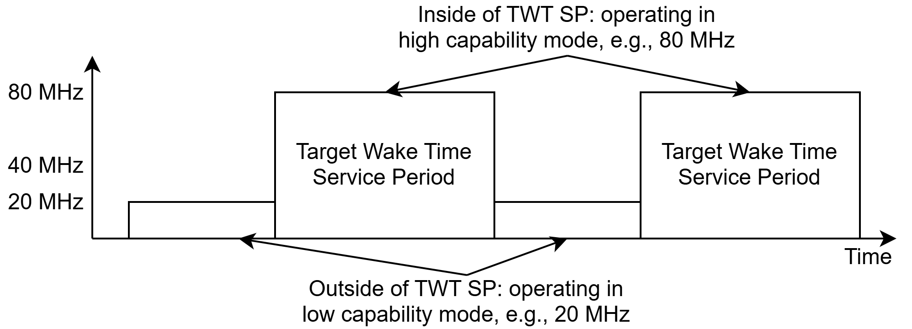
Example 1
AP in low capability mode outside of TWT SPs
  Enhancement of Motion #161 on PUO for AP (Scheduled periodic power save on AP side with Broadcast TWT ID = 0 and Responder PM Mode = 1):
    AP has the option to be in low capability mode outside of TWT SPs, in addition to the Power Save mode of the current AP PUO mode of D0.1

Slide 8
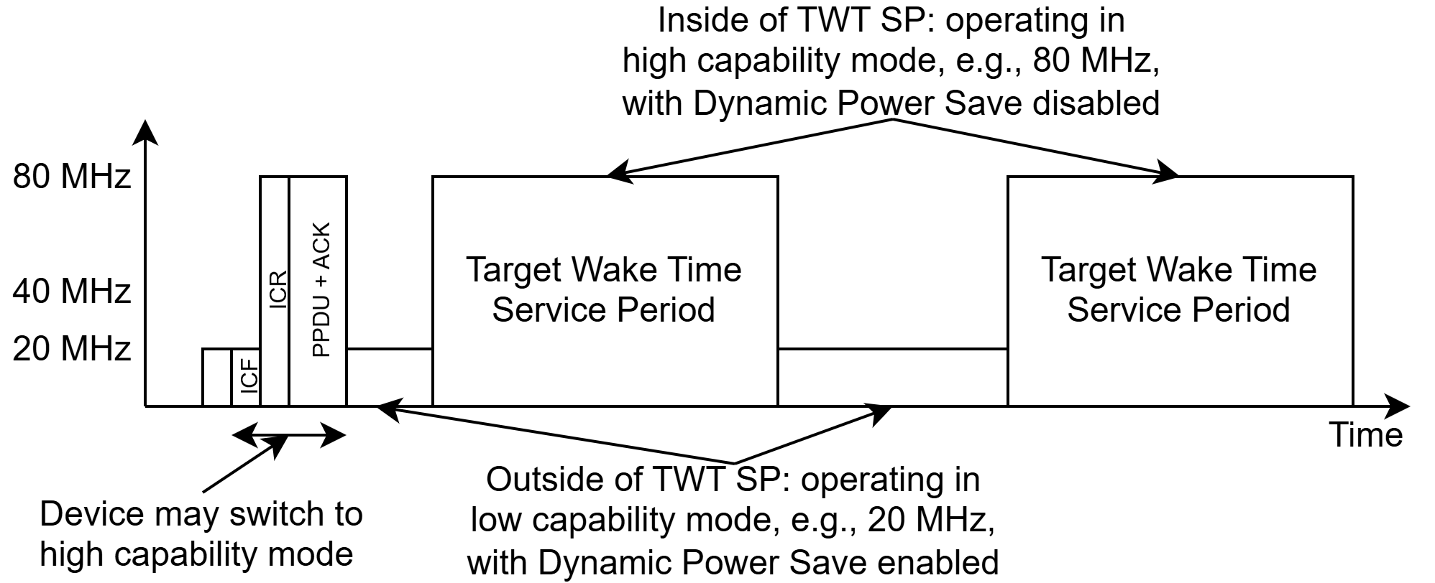
Example 2
AP in low capability mode with DPS enabled outside of TWT SPs
  Enhancement of Motion #9 on DPS for Mobile-AP/non-AP STA (transition from a lower capability mode to a higher capability mode upon reception of an initial control frame):
    STA has the option to transition between lower capability mode and higher capability mode based on TWT, in addition to relying on ICF/ICR/IFCS/padding of DPS mode of D0.1.
    Combination of scheduled periodic power save and DPS enablement/disablement.

Slide 9
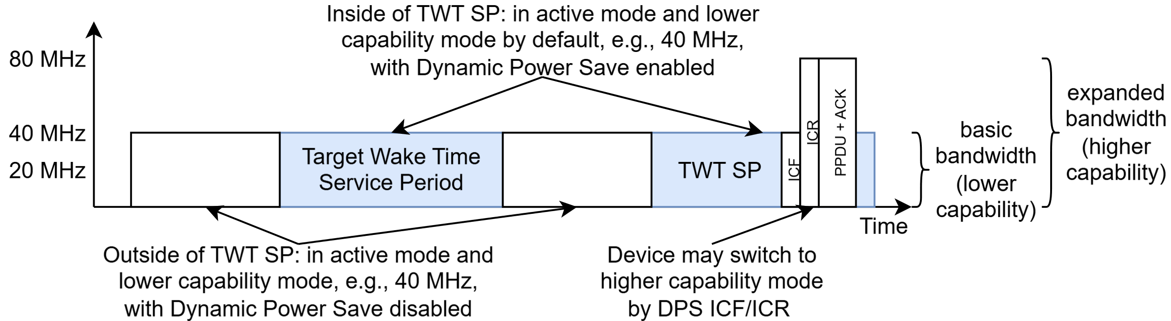
Example 3: Bandwidth Expansion by AP PUO and DPS, 25/1448 [19]
For UHR AP and associated UHR non-AP STAs that support PUO and DPS:
  Operating in lower capability/bandwidth by default
  DPS disabled outside of broadcast TWT SPs
  DPS enabled inside of broadcast TWT SPs, and may switch to higher capability/bandwidth mode after transmitting/receiving DPS ICF
For legacy non-AP STAs and UHR non-AP STAs that do not support PUO or DPS:
  Operating as normal, following the AP’s default capability/bandwidth, inside and outside of TWT SPs

Slide 10
Conclusions
This submission presents a mechanism for scheduled AP power save
  Inside of TWT SPs: AP is in active state
  Outside of TWT SPs: AP is in low capability mode or in doze state
  May have option for reverse scheme: AP in low/high capability inside/outside of TWT SPs, and may also apply to non-AP STAs
It enhances PUO and DPS
  It extends the PUO mechanism to allow AP/non-AP STA to operate in low capability mode outside of TWT SPs, in addition to sleep state of PUO.
  It extends the DPS mechanism to allow AP/non-AP STA to transition between low capability mode and high capability mode based on TWT SPs, instead of relying on ICF/ICR/IFCS/padding for each TXOP of DPS.
  It can be used to enhance the enablement/disablement operations for DPS

Slide 11
References
[1] 23/0010r0, Considerations for enabling AP power save, Alfred Asterjadhi (Qualcomm Inc.)
[2] 23/2040r1, Enabling AP power save_follow up, Alfred Asterjadhi (Qualcomm Inc.)
[3] 23/0015r0, AP MLD power management, Liwen Chu (NXP)
[4] 23/1936r0, AP MLD power save follow up, Liwen Chu (NXP)
[5] 23/0225r0, Considering Unscheduled AP Power Save, Guogang Huang (Huawei)
[6] 23/1420r0, Expedited Wake-up in Unscheduled AP MLD Power Saving, Juseong Moon (KNUT)
[7] 24/0451r0, AP state transitions in DPS mode, Vishnu Ratnam (Samsung Electronics)
[8] 24/0833r0, Dynamic Power Saving for AP, Geonhwan Kim (LG Electronics)
[9] 24/0671r0, Enhancements on AP Power Save, Sanghyun Kim (WILUS)
[10] 24/1146r0, Considerations on AP Power Save Mode, Jerome Gu (Clourney Semiconductor)
[11] 24/0782r1, AP power saving, Chaoming Luo (OPPO)
[12] 24/0659r1, Thoughts on AP Power Save, Binita Gupta (Cisco Systems)
[13] 24/0589r1, Dynamic TID-To-Link Mapping for AP MLD Power Save, Yongsen Ma (Samsung)
[14] 24/0813r0, Discussions on AP Power Save, Yongsen Ma (Samsung)
[15] 24/0097r0, AP Power Management - Follow up, Yongsen Ma (Samsung)
[16] 23/1835r0, AP Power Management, Yongsen Ma (Samsung)
[17] 24/1611r0, Power Save Capabilities, Manasi Ekkundi(Samsung Electronics)
[18] 25/1140r1, PDT MAC CR for AP PUO, Yongsen Ma (Samsung)
[19] 25/1448r0, Bandwidth Expansion by AP PUO and DPS, Yongsen Ma (Samsung)

Slide 12
Straw Polls
SP1: Do you support the proposed changes in 25/1140:
An APPUO AP may operate in a lower capability mode with reduced bandwidth or limited capability outside of broadcast TWT SPs.
If an APPUO AP is also a DPS AP, the AP may operate in lower capability mode with DPS enabled outside of broadcast TWT SPs.
Results: Y: , N: , A:

Slide 13
Backup

Slide 14
Recap: AP Power Save
AP power save in PPDU/TXOP/SP/BI levels by different options [14]
Focus of this submission: scheduled AP power save by TWT [1-4, 12, 14, 15]
  AP in awake state during TWT SPs and in power save mode outside of TWT SPs
Timing Information |  | Timing Type and Pattern |  | Example
When, how long and how often | Start time, duration, interval, stop time | Long-term | repeatable/periodic | Using TWT
 | Start time, duration, interval (persistent) | Long-term | repeatable/periodic | Using TWT with Persistence subfield = 255
When and how long | Start time, duration (long) | Long-term | one-time/on-demand | Using TTLM
 | Start time, duration (short) | Short-term | one-time/on-demand | Using TWT in SP level or ICF in TXOP level
When | Start time (w/o duration or stop time, persistent until explicitly terminated) | Long-term | one-time/on-demand | Using OMI/OMN
 |  | Short-time | one-time/on-demand | Using ICF/CF-END in TXOP level

Slide 15
TWT-Based and Unscheduled/Dynamic AP Power Save (1/2)
Unscheduled/dynamic power saving has three aspects
  capability information;
  enablement/disablement;
  capability switch request/response and I-FCS/padding in ICF/ICR.
Pre-UHR STAs do not understand these new signaling/procedure. So when there are pre-UHR STAs present, the AP may
  enable unscheduled/dynamic power save: pre-UHR STAs would operate in low capability
  disable unscheduled/dynamic power save: reduced power save benefit, or frequent enablement/disablement actions with increased complexity when pre-UHR STAs come and go. Many IoT devices would be pre-UHR STAs for a long time.

Slide 16
TWT-Based and Unscheduled/Dynamic AP Power Save (2/2)
TWT-based AP power save can be used to enhance the enablement/disablement operations for unscheduled/dynamic AP power save.
  Pre-UHR STAs can understand the enablement/disablement (indirectly by reusing TWT), so they can operate in normal/high capability within TWT SPs.
  UHR and post-UHR STAs can also operate in normal/high capability within TWT SPs without capability switch request/response and I-FCS/padding.
  The enablement/disablement operations can be more efficient, smooth and flexible.
It is aligned with TGbn Motion #161 (Scheduled periodic power save on AP side with Broadcast TWT ID = 0 and Responder PM Mode = 1), and the only difference is that the AP may operate in low/high capability outside/inside of TWT SPs.
It can be enabled by scheduled periodic power save and DPS enablement/disablement.

Slide 17
Options for Signaling: Reuse Existing Frame/Element
To indicate that AP operates in low capability mode outside of TWT SPs
  AP needs to indicate that a TWT is associated with certain capability modes
  The indication can be in existing frame/element or in a new frame/element
Reuse existing frame/element
  Option 1: TWT element: Broadcast TWT Recommendation field value: 5-7 are reserved
  Option 2: TWT Information Extension element: Control field: B1-B7 are reserved; B-TWT Info field: B5-B7 are reserved
  Other options
  May not be needed if another field/element already contains the indication

Slide 18
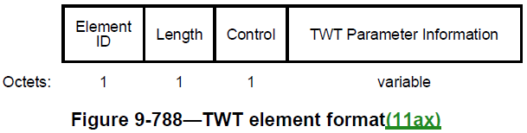
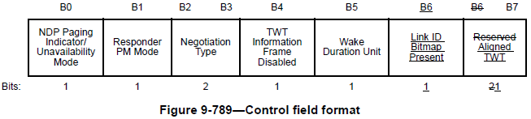
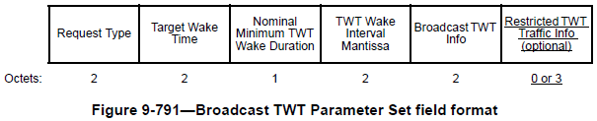
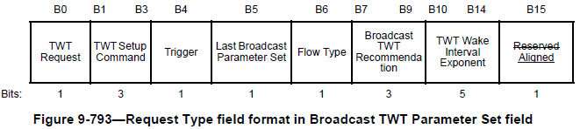
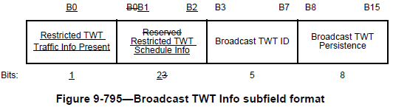
Reuse TWT Element for Signaling
Option 1: Use Broadcast TWT Recommendation field to indicate that the TWT is associated with certain capability mode. Values 5-7 are reserved
Notes:
9.4.2.13 Power Capability element
9.4.2.25 Extended Capabilities element
9.4.2.33 QoS Capability element
9.4.2.54 HT Capabilities element
9.4.2.70 Nontransmitted BSSID Capability element
9.4.2.76 QoS Traffic Capability element
9.4.2.96.8 Mesh Capability
9.4.2.126 DMG Capabilities element
9.4.2.146 Relay Capabilities element
9.4.2.156 VHT Capabilities element
9.4.2.247 HE Capabilities element
9.4.2.323 EHT Capabilities element

Slide 19
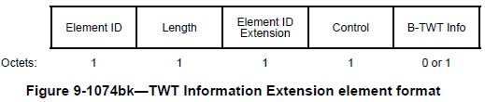
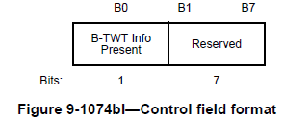
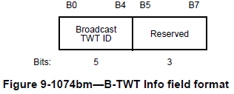
Reuse TWT Information Extension Element for Signaling
Option 2: Use Control field or B-TWT Info field to indicate that the TWT is associated with certain capability mode.
  More freedom/flexibility than reusing TWT Element, but with higher overhead
Notes:
9.4.2.13 Power Capability element
9.4.2.25 Extended Capabilities element
9.4.2.33 QoS Capability element
9.4.2.54 HT Capabilities element
9.4.2.70 Nontransmitted BSSID Capability element
9.4.2.76 QoS Traffic Capability element
9.4.2.96.8 Mesh Capability
9.4.2.126 DMG Capabilities element
9.4.2.146 Relay Capabilities element
9.4.2.156 VHT Capabilities element
9.4.2.247 HE Capabilities element
9.4.2.323 EHT Capabilities element

Slide 20
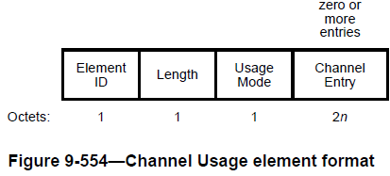
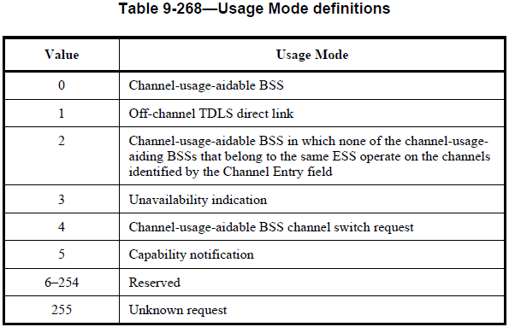

Slide 21
Options for Signaling: Define New Frame/Element
To indicate that AP operates in low capability mode outside of TWT SPs
Define new frame/element
  Option 1: Define in UHR Capabilities element, may use two UHR Capabilities elements
  Option 2: Define a capabilities element to indicate high and low capability modes
  Other options
  Need to indicate that the capabilities element is used together with a certain TWT
  May send OMI/OMN together with a certain TWT
  May reuse the definition of high and low capability modes from unscheduled/dynamic AP power save, which can be announced in Beacons or ICF [8, 10, 12]

