Slide 1
WG11 Opening Report Snapshot Slides May 2025
Date: 2025-05-11
Authors:

Slide 2
Abstract
This presentation contains the IEEE 802.11 WG snapshot slides for the May 2025 session:
Editors Meeting
ANA
AIML SC (AI and ML)
ARC SC (Architecture)
Coex SC (Coexistence)
PAR Review SC
WNG SC (Wireless Next Generation)
JTC1 802 SC
TGmf (Maintenance)
TGbf (WLAN Sensing)
TGbi (Enhanced Data Privacy)
TGbk (320 MHz Positioning)
TGbn (Ultra High Reliability)
TGbp (Ambient Power)
TGbq (Integrated mmWave)
TGbr (Enhanced Light Communications)
PQC SG (Post Quantum Cryptography)
AUTO TIG (Automotive)

Slide 3
May 2025 Editors’ Meeting Agenda and Report
Roll Call / Contacts / Reflector
Brief status report
Amendment alignments and draft development snapshot
Review publication process
Publication review committees and status
802.11bh-2024 publication review
Editorial Style guide updates and issues for feedback
ANA number spaces

Slide 4
ANA Status
The latest database is 11-11/0270r78 (April 2025)
Changes since January 2025:
  Updated table numbering to match P802.11-2024
  TGbk assignment with new extension
Pending changes (10 day review):
  None

Slide 5
May 2025 AIML SC Snapshot
Date: 2025-05-10
Authors:

Slide 6
IEEE 802.11 AIML SC – May 2025
Artificial Intelligence and Machine Learning
May 2025 meeting goals
  Minutes approval
    March 2025 Atlanta Plenary session minutes: 11-25/606r0
  Technical submissions and discussions:
    One technical contributions: MAPC Co-SR
    Additional AIML use cases
    Additional feasibility and technical studies on existing and new use cases
    technical and technical report presentations
May 2025 Interim session:
  One meeting slot:
    Tuesday PM1
  Agenda: 11-25/591

Slide 7
ARC (Architecture) – May 2025
    Will have three meetings this week: Monday AM2; Tuesday PM2; Wednesday AM2
    Agenda is here: 11-25/0609r1, topics:
    Annex G: Discussion of way forward – Monday and Tuesday
    New topic: Review MIB attribute conventions (11-25/0780r0) – Wednesday
    IEEE Std 802 revision project update effects on 802.11 – Wednesday
      Continue technical discussions on next slide (if/as there is time)
    On hold, pending contribution:
    MLME-RESET, versus MLME-JOIN, MLME-START, MLME-SCAN and MLME-END
      One aspect is how MAC address is set/controlled – related to IEEE 1609/TGbd
      Liaison from WBA on QoS, and L4S – Deferred until TGbn and REVmf consider this topic

Slide 8
ARC (Architecture) – May 2025
  Related to IEEE Std 802 updates:
    EPD and LPD terms are going away – we need to update 802.11 to align
    Review MAC address ordering discussion, and 802.11 assumptions
    802.1AC mapping from ISS to 802.11 MAC SAP interface
    Consider any changes to remove 802.2/LLC terms?
    802.11’s “Portal”, and mapping to/usage of IEEE Std 802 terminology
    Access Domains: “802 Access Domains”?
    What if we make the DS a bridge (small ‘b’)?
    Consider adding something about VLANs (just informational?) into 802.11? Relationship (if we talk about it) to security domains (e.g. Authenticator relationship)? VLAN-aware STAs? What about GLK/non-GLK STAs? (cf 11-08/0114r0)

Slide 9
Coex SC Snapshot May 2025
Date: 2025-05-11
Authors:

Slide 10
Abstract
Snapshot for the Coexistence Standing Committee (Coex SC) for the May 2025 meeting

Slide 11
Coex SC (Coexistence) – May 2025
This week (detailed agenda, please see: 11-25/0617)
Meeting slot(s) 802.11 Coex SC:
  Monday 13:30 – 15:30h (PM 1)
  Wednesday 16:00 – 18:00h (PM 2)
Meeting slot(s) 802.11 Coex SC / 802.15.4 Joint:
  Tuesday 19:30 – 21:30h (EVE 1) t.b.c.
  Joint meeting to be confirmed by Monday (subject on confirmed submissions uploaded to mentor)
Topics
  ETSI BRAN Update
  802.15.4ab NB Status Update
  Other topics – please respond to the call for submissions / contact the chair

Slide 12
PAR Review SC – May 2025 Snapshot
Chair: Jon Rosdahl
Not meeting this week
Will meet in July 2025 to review proposed PAR documents.
Upcoming Submission deadlines are
  WG PAR submission to 802 EC for July Plenary Session: 27 June 2025
  WG PAR Submission to NesCom:
    31 July 2025 for Sept 2025 Virtual Mtg
    12 Sept 2025 for Oct 2025 Telecon
    20 Oct 2025 for Dec 2025 Mtg
    12 Dec 2025 for Jan 2026 Telecon

Slide 13
802.11 WNG – May 2025
13 May 2025, 0800-1000 Central European Summer Time
Announcements
Approval of Previous meeting minutes
  Minutes from March:
    https://mentor.ieee.org/802.11/dcn/25/11-25-0463-00-0wng-wng-meeting-minutes-2025-march-atlanta-meeting.docx
Presentations
  “Field measurements of EDCA characteristics,” Jim Lansford, Jimmy Nolan, Ben Nowatny (University of Colorado)
Plans for July 2025
  Chair will make a call for presentations in advance
Adjourn
Current agenda is document 11-25/0605r0

Slide 14
IEEE 802 JTC1 SC will meet once on Tue, 13 May 2025 @ 4 pm CET
Agenda items (ec-25-0090r02) will include “the usual”:
Review of status of PSDO process
  Review liaisons & notifications of projects to SC 6
  Review status of ballots
But also
Restarting submission of IEEE 802.11 standards
Document updates for how to use the PSDO process

Slide 15
A large number of IEEE 802 submissions are in the PSDO balloting process – but…
  Waiting for 60-day ballot
    IEEE 802.15.4-2024
    IEEE 802.19.1
    IEEE 802.11ba
  In 60-day ballot
    IEEE 802.1Qdy
    IEEE 802-REVc
  Passed 60-day ballot
  (resolutions req)
    IEEE 802.11ax
  Failed 60-day ballot
    IEEE 802.11ay
  Waiting for FDIS
    IEEE 802.1Qdx
    IEEE 802.1ASdm
    IEEE 802.1ASdn
    IEEE 802.3-2022
    IEEE 802.15.3-2023
  In FDIS
    IEEE 802.15.7-2018
    IEEE 802.1ASdr
    IEEE 802.1DC
    IEEE 802.1Qdj
  Passed FDIS ballot
  (resolutions req)
  Waiting for publication
    IEEE .1CS-2020/Cor1
    IEEE 802.15.4-2020
    IEEE 802.1Qcz
    IEEE 802.1AEdk
    IEEE 802.15.9
    IEEE 802.1Qcj
  Published
    IEEE 802f
    IEEE 802.1Qcw
IPR issues

Slide 16
IEEE 802 has sent 111 standards through the PSDO adoption process, with 29 in-process
WG | Completed | In-process
802.1 | 58 | 8
802.3 | 32 | 8
802.11 | 13 | 0
802.15 | 5 | 6
802.16 | 0 | 0
802.19 | 0 | 1
802.21 | 3 | 0
802.22 | 4 | 0
All | 111 | 29

Slide 17
TGmf (Maintenance) Summary
Status:
  IEEE 802.11-2024 has been published on April 28th
  P802.11bh and P802.11be are also in the process of being published as amendments – Targeted for later this month
Objectives:
  Discuss contributions on modifications to the REVme D7.0 draft – for consideration in the initial REVmf draft.
  Discuss contributions on topics involving other amendments under publication.
  Approve an initial working group letter ballot.
Meetings:
  Monday May 12, 4-6pm CET
  Wednesday May 14, 4-6pm CET
  Thursday May 15, 4-6pm CET

Slide 18
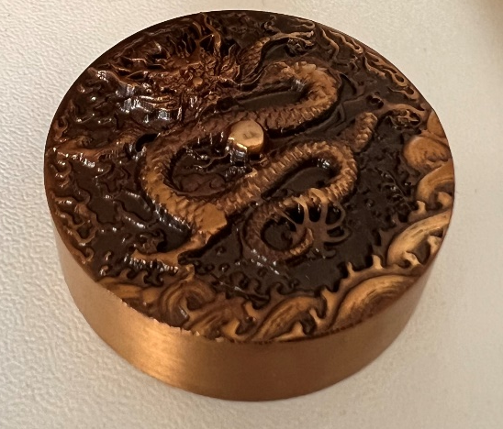
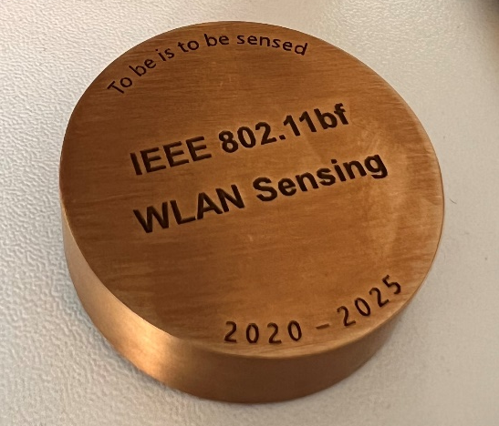
TGbf (WLAN Sensing)– May 2025
Progress since March 2025 session
  Held 0 teleconference calls
  The 4th SA Ballot Recirculation for P802.11bf is closed, and passed
    Open date 25 Mar 2025, close date 04 Apr 2025
    Approval rate: 98%
    Received 0 comments
Goals for May 2025 session
  0 slots scheduled for TGbf
  TGbf Work Completed — Thank You All!
  A personal gift for all TGbf members: Paperweight
    Some of you may have already received it during the last meeting in Atlanta
    If you haven’t received yours yet, please contact me☺

Slide 19
IEEE 802.11 TGbi – May 2025
We had 5 teleconferences as we keep working through our comments.
Current status is:
There are 5 meetings planned in the May Interim for TGbi.
      Monday PM1
      Tuesday PM1
      Wednesday AM1
      Thursday AM1
      Thursday PM1
We will discuss having an ad hoc between this session and the July session for comment resolution.
The agenda is available as 802.11-25/625r1.
Unassigned | Assigned | Ready for Motion | Resolution Approved
16 | 968 | 123 | 88

Slide 20
TGbk 320MHz Positioning
TG is charted to extend the Fine Timing Measurement (FTM) procedure to the 320MHz 802.11be waveforms and channelization.
2nd recirculation SA ballot closed Mar. 30th :
  Approval rate: 98%
  Returned ballots: 84%
  1 technical and 2 editorial comments received and resolved without changes to draft.
  On the agenda for May 7th REVcom meeting.
Last steps (IEEE week):
  Approve meeting minutes motions from March meeting and following telecon.
  SASB approval post REVcom recommendation.
  No planned meetings.

Slide 21
TGbn (Ultra High Reliability)
No report

Slide 22
IEEE 802.11 TGbp Snapshot for IEEE 802 May Interim 2025
Chair: Bo Sun (Sanechips)
Vice Chair: Steve Shellhammer (Qualcomm)
            Rakesh Taori (Infineon)
Secretary: Sebastian Max (Ericsson)
          Tech Editor: Yinan Qi (OPPO)

Slide 23
TGbp Snapshot for May 2025 IEEE 802 Interim
1 TGbp teleconfrence was held since Mar plenary session, focusing on review of updatd SFD and 11bp spec skeleton discussion, with agenda included in 11-25/0610r0 and meeting minutes included in 11-25/0630r1 .
8 TGbp meetings are planned during the IEEE 802 May interim session, with a full meeting agenda included in the latest revision of 11-25/0611.
  Notes, all TGbp meetings will be in Baltic II.
Goal for TGbp meetings in this week:
  open technical discussion and improve SFD documents based on consensus
 | Mon | Tue | Wed | Thu | Fri
AM1 (8:00~10:00) | 802.11 Opening Plenary |  | TGbp (MAC) | TGbp (WPT/SEC) | Closing Plenary
AM2 (10:30~12:30) | TGbp (Opening/FR/PHY) | TGbp (PHY) | TGbp (MAC)
PM1 (13:30~15:30) |  | TGbp (PHY/MAC) | Mid-week Plenary | TGbp (SP/Motions/Closing)
PM2 (16:00~18:00) | TGbp (PHY)
EVE (19:30~21:30)

Slide 24
TGbp Timeline till May 2025 interim
  PAR approved Mar 2024
  First TG meeting May 2024
  D0.1 (ready for CC) Jul, 2025
  D1.0 Letter Ballot Feb, 2026
  D2.0 LB recirculation Nov, 2026
  Form SA Ballot Pool Mar 1 to Mar 31, 2027
  Initial SA Ballot (D4.0) Aug, 2027
  Final 802.11 WG approval Jan 2028
  802 EC approval Mar 2028
  RevCom and SASB approval May 2028

Slide 25
TGbq (Integrated mmWave) Summary
Status:
  Officer positions were elected and reaffirmed in the March 2025 plenary.
  4 teleconference calls were held in April 2025. 7 technical presentations were received.
Objectives:
  Confirm timeline for the task group
  Confirm selection procedure for draft development
  Discuss technical contributions
Meetings:
  Monday PM3, Tuesday PM1, Tuesday PM3, Thursday PM1
  For details, please refer to the agenda 25/0515

Slide 26
TGbr (Enhanced Light Communications)
No report

Slide 27
PQC SG – May 2025 Snapshot
    Will have two meetings this week: Tuesday AM2; Thursday AM2
    Goal is to approve the PAR and CSD
    Agenda: 11-25/0861r1
    PAR and CSD:
    PQC Draft proposed PAR, Juan Carlos Zuniga (Cisco) (11-25/0597r2)
    PQC Draft Proposed CSD, Juan Carlos Zuniga (Cisco) (11-25/0598r2)
    Motion to approve PAR and CSD
New submissions:
    ML-KEM in 802.11, Jay Yang (ZTE) (11-25/0722r0)
    A PQC PAKE, Dan Harkins (HPE) (11-25/0770r1)

Slide 28
802.11 Automotive TIG – May 2025
12 May, 1600-1800 Central European Summer Time
Call to order
IEEE-SA policies and procedures
Approval of minutes from March
  https://mentor.ieee.org/802.11/dcn/25/11-25-0489-00-auto-minutes-2025-03-10-auto-tig-meeting-atlanta.docx
Presentation of submissions
  “Location Information Assisted AP Discovery,” Hitoshi Morioka (SRC Software)
  “Thoughts on Throughput Improvement for high-mobility STAs,” Azin Neishaboori (General Motors)
  “Follow-up on proposed IEEE 802.11 Automotive TIG Technical Report Text,” Jing Ma (Toyota)
Call for submissions - July 2025
Timeline review
Any other business
Current agenda is 11-25/0604r0

