Slide 1
Co-SR Power Control
Date: 2025-03-26
Authors:

Slide 2
Introduction
TGbn defines multi-AP Coordinated Spatial Reuse (Co-SR) at TXOP-level with power control [1].
There have been discussions on power control methods, but no consensus have been reached yet on this topic.
  In [2], The Trigger frame that initiates the Co-SR transmission indicates the TX power limit of the shared AP.
  In [3] and [4], ICF and ICR are porposed for exchanging control information between APs to support power control.
In this contribution, we introduce a power control solution for Co-SR with some shared information using Co-SR invite/response exchange.

Slide 3
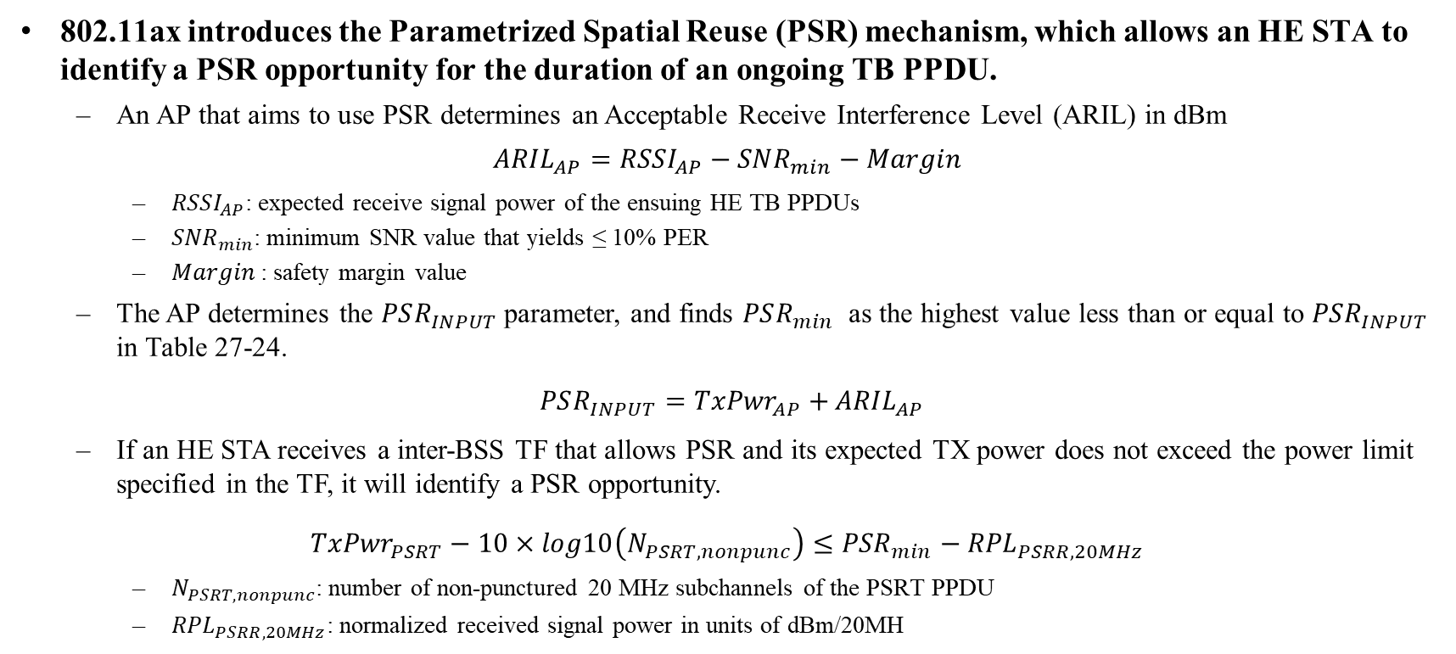
Recap: Power Limitation in PSR
802.11ax introduces the Parametrized Spatial Reuse (PSR) mechanism, which allows an HE STA to identify a PSR opportunity for the duration of an ongoing TB PPDU.
  An AP that aims to use PSR determines an Acceptable Receive Interference Level (ARIL) in dBm
$${ARIL}_{AP}={RSSI}_{AP}−{SNR}_{min}−Margin$$
    ${RSSI}_{AP}$: expected receive signal power of the ensuing HE TB PPDUs
    ${SNR}_{min}$: minimum SNR value that yields ≤ 10% PER
    $Margin$: safety margin value
  The AP determines the $PSR_{INPUT}$parameter, and finds $PSR_{min}$ as the highest value less than or equal to $PSR_{INPUT}$ in Table 27-24.
$PSR_{INPUT}={TxPwr}_{AP}+$ ${ARIL}_{AP}$
  If an HE STA receives a inter-BSS TF that allows PSR and its expected TX power does not exceed the power limit specified in the TF, it will identify a PSR opportunity.
${TxPwr}_{PSRT}−10×log10\left(N_{PSRT,nonpunc}\right)≤{PSR}_{min}−$ ${RPL}_{PSRR,20MHz}$
    $N_{PSRT,nonpunc}$: number of non-punctured 20 MHz subchannels of the PSRT PPDU
    ${RPL}_{PSRR,20MHz}$: normalized received signal power in units of dBm/20MH

Slide 4
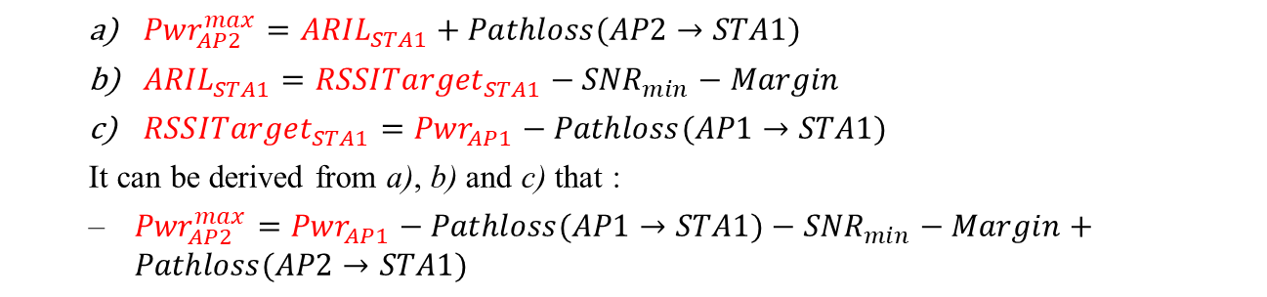
Power Limitation in Co-SR
Unlike PSR, Co-SR involves simultaneous DL transmissions. When AP1 utilizes Co-SR for delivering DL PPDU to STA1, it shall determine the TX power limit of AP2:
  ${Pwr}_{AP2}^{max}={ARIL}_{STA1}+Pathloss(AP2→STA1)$
  ${ARIL}_{STA1}={RSSITarget}_{STA1}−{SNR}_{min}−Margin$
  ${RSSITarget}_{STA1}={Pwr}_{AP1}−Pathloss(AP1→STA1)$
  It can be derived from a), b) and c) that :
  ${Pwr}_{AP2}^{max}={Pwr}_{AP1}−Pathloss(AP1→STA1)−{SNR}_{min}−Margin+Pathloss(AP2→STA1)$
The same way is used for AP2 to determine the TX power limit of AP1.
Based on the above equation, we can draw the following conclusion:
  Except for the AP TX power, the other items on the right side of the equation are semi-static parameters related to the STA, and the AP can obtain these parameters through the measurement procedure.
  The TX power limit of OBSS AP solely depends on the AP’s TX power with a linear relationship.

Slide 5
Power Control for Co-SR (1/3)
In this contribution, we assume that the APs have completed both the MAP negotiation and the Co-SR measurement procedure, and have already obtained measurement results related to their STAs (i.e., Pathloss, minimum SNR and other TBD parameters).
Information required for power control at an AP:
  Expected TX power: The expected TX power of the AP .
  TX power limit of OBSS AP: Determined by the expected TX power and the measurement results.
  Power headroom (or Maximum TX power): The gap between the expected and the maximum TX power of the AP in units of dB.
  Minimum TX power: The minimum TX power by the AP, ensuring that its STA is available to decode the PPDU without interference from OBSS AP.
How to use the above information:
  Step1: Sharing AP and shared AP calculate their own power control information.
  Step2: Shared AP shares its power control information to sharing AP.
  Step3: Sharing AP can decide whether to do Co-SR or not and perform STA selection.
  Step4: Sharing AP informs shared AP if there is a change in the TX power parameters.

Slide 6
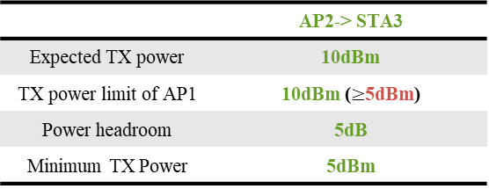
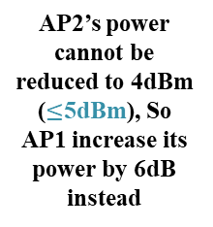
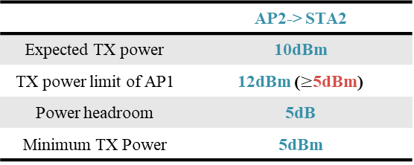
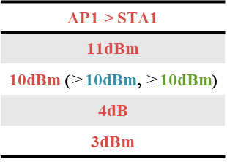
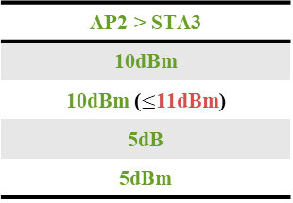
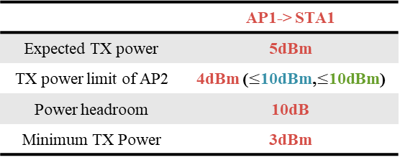
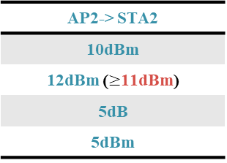
Power Control for Co-SR (2/3)
Example: Sharing AP with knowledge of global power control information can adjust parameter values to meet the power requirements of both APs.
 | AP1-> STA1
Expected TX power | 5dBm
TX power limit of AP2 | 4dBm ($≤$10dBm,$≤$10dBm)
Power headroom | 10dB
Minimum TX Power | 3dBm
AP2’s power cannot be reduced to 4dBm ($≤$5dBm), So AP1 increase its power by 6dB instead
AP1-> STA1
11dBm
10dBm ($≥$10dBm, $≥$10dBm)
4dB
3dBm
Expected TX power of AP1
 | AP2-> STA2
Expected TX power | 10dBm
TX power limit of AP1 | 12dBm ($≥$5dBm)
Power headroom | 5dB
Minimum TX Power | 5dBm
AP2-> STA2
10dBm
12dBm ($≥$11dBm)
5dB
5dBm
Adjusted TX power of AP1
 | AP2-> STA3
Expected TX power | 10dBm
TX power limit of AP1 | 10dBm ($≥$5dBm)
Power headroom | 5dB
Minimum TX Power | 5dBm
AP2-> STA3
10dBm
10dBm ($≤$11dBm)
5dB
5dBm
AP2 discards STA3 because it cannot meet the requirements no matter how the power is adjusted.
Slide 6

Slide 7
Power Control for Co-SR (3/3)
The benefits of sharing AP gathering global power control information before performing Co-SR:
  It can overcome the limitation of recommending power limit for shared AP based solely on its own information. For example:
    By using TX power limit of sharing AP, sharing AP can know if the OBSS STA can tolerant its interference. So it can adjust its own TX power by the linear relationship of the two parameters.
    By using power headroom and minimum TX power of shared AP, sharing AP can either reduce one AP’s TX power, or increase another AP’s TX power, and make sure they are not out of range.
  Therefore, the power negotiation can prevent transmission failure before initiating Co-SR.
  Sharing AP can also perform STA selection from more than one candidate STAs.

Slide 8
Co-SR Power Control Negotiation
The power control is done by Co-SR invite/response exchange Before Co-SR transmission.
  Whether to allow more than one candidate shared AP is TBD.
(Adjusted) power limit of AP2 and selected STAs
AID
(Adjusted) TX power limit of AP2
…
  Pre-transmission: AP1 and AP2 select one or more candidate STAs.
  Co-SR response: If AP2 is willing to participate, the Co-SR response includes the shared power control information of its candidate STAs.
  Co-SR trigger: If AP1 decide they cannot do Co-SR, it will not send the Co-SR trigger. But If AP1 decides to initiate Co-SR, it performs STA selection, and:
    If AP1 decide the power of itself needs to be changed, the Co-SR trigger includes the adjusted TX power limit of AP2.
    Or it includes the original TX power limit of AP2.
Shared power control information list of AP2 for candidate STAs
AID
Expected TX power
…
TX power limit of AP1
Power headroom
Minimum TX power

Slide 9
Summary
This contribution introduces a power control solution based on shared power control information for Co-SR.
  Power control signaling based on Co-SR invite/response exchange is proposed.

Slide 10
Straw Poll
SP: Do you support to include the following text to 11bn SFD?
  In UHR Co-SR, Sharing AP needs to obtain global power control information before Co-SR transmissions. The following shared power control information shall be carried in the Co-SR response frame:
    Expected TX power
    TX power limit of sharing AP
    Power headroom (or Maximum TX power)
    Minimum TX power
  The original or adjusted TX power limit for shared AP shall be carried in the trigger frame that initiates Co-SR.
Huixuan Zhou, OPPO

Slide 11
References
[1] 11-24-0209-12-00bn-specification-framework-for-tgbn
[2] 11-25-0254-00-00bn-co-sr-power-control-considerations
[3] 11-24-1514-01-00bn-multi-ap-framework-for-c-sr
[4] 11-25-0343-00-00bn-consideration-on-multi-ap-framework-for-co-sr

