Slide 1
Details on the unified MAPC framework
Date: 2025-04-20
Authors:
Name | Affiliation | Address | Phone | Email
Junbin Chen | TP-Link Systems Inc. |  |  | chenjunbin@tp-link.com.hk
Yunpeng Yang |  |  |  | yangyunpeng@tp-link.com.hk
Renfang Zhou |  |  |  | zhourenfang@tp-link.com.hk
Yaoshen Cui |  |  |  | cuiyaoshen@tp-link.com.hk
Haozheng Li |  |  |  | lihaozheng@tp-link.com.hk
Qingwei Fu |  |  |  | fuqingwei@tp-link.com.hk
Shuyu Shi |  |  |  | shishuyu@tp-link.com.hk
Yu Zhu |  |  |  | zhuyu@tp-link.com.hk

Slide 2
Recap: MAP framework
In 11bn D0.2 [1-2] we have agreed that the MAP shall be defined in a unified framework:
[M50] 11bn defines a common framework of a Multi-AP Coordination for various coordination schemes.
  Note - Coordination schemes such as (but not limited to): Co-SR (TXOP-based with power control), Co-BF, Co-TDMA, Co-RTWT, etc.
[M51] 11bn defines a common framework of a Multi-AP Coordination that can enable the following procedures:
  Multi-AP Coordination Discovery procedure
  Multi-AP Coordination agreement negotiation procedure
  Note: Details of the procedures and whether the above procedures are mandatory/optional - TBD

Slide 3
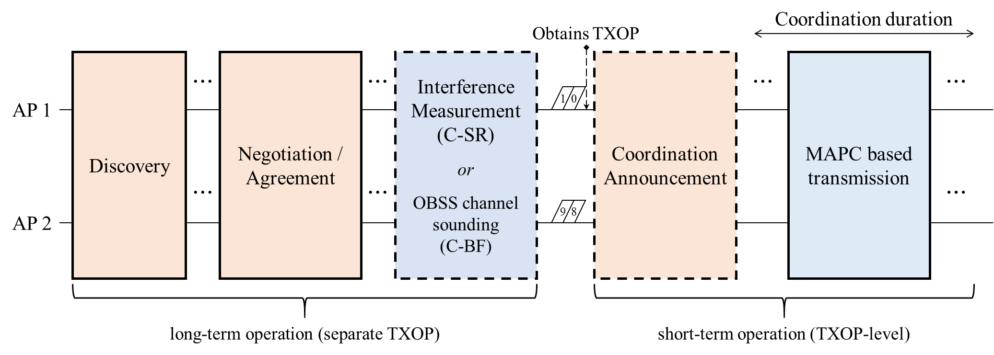
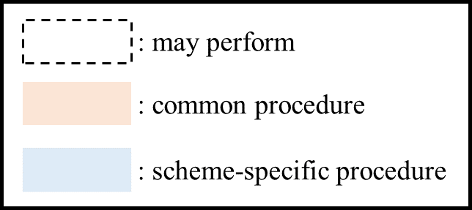
Recap: unified MAPC framework
The unified MAPC framework has been discussed a lot.
Specifically, the MAPC framework is divided into the long-term and short-term operations in [3].
  The long-term operation is composed of Discovery, Negotiation, and some feature-specific long-term phase.
  The short-term operation is composed of MAPC announcement and feature-specific MAPC transmission.

Slide 4
A timeline of the MAPC framework
[Unified, Discover phase] The APs shall announce their MAPC capability in the discovery phase.
  A natural way is to announce via the MAPC discovery action frame exchanges between APs.
[Unified, Negotiation phase] The APs negotiate for one or more MAPC agreements if they are discovered by each other.
  Here we shall define a unified frame exchange for the negotiation of different MAPC features.
  The unified negotiation had better to be able to setup more than one agreements via only a round of frame exchange.
  E.g., assume that AP1 sends a MAPC Req frame requesting for both the C-SR and C-BF agreements.
  The agreement(s) is valid until it has been renegotiated or deleted.
MAP Discovery
MAPC agreement is valid for period 1
MAPC agreement is renegotiated
Discovery request
TXOP1
TXOP2 of AP1
TXOP3 of AP2
TXOP4
TXOP5 of AP1
AP1
Negotiation phase
e.g., C-SR & C-BF
Polling ICF
Transmission phase w/ or w/o MAPC
e.g., C-SR
Polling ICR
Transmission phase w/ or w/o MAPC
e.g., C-BF
Negotiation phase
e.g., C-SR & C-BF
& C-TDMA
Polling ICF
Transmission phase w/ or w/o MAPC
e.g., C-TDMA
Discovery response
Polling ICR
Polling ICF
Polling ICR
AP2

Slide 5
A timeline of the MAPC framework
[Unified, Polling phase] The sharing AP initiate a polling phase to query for the MAPC intention of candidate APs.
  The AP who has negotiated a least one MAPC agreement and wins TXOP is the sharing AP.
  The polling procedure can be an ICF-ICR frame exchange, indicating the specific MAPC feature to be used in this TXOP.
  The candidate APs respond with ICR indicating their intention to participate in the MAPC transmission in this TXOP.
[Per-scheme specific, Transmission phase] The sharing AP and shared APs perform the specific MAPC operations.
  The specific MAPC transmission would be scheduled by the sharing AP at any time during the TXOP (after the polling phase).
  E.g., the sharing AP may communicate with its own associated STAs first and then trigger the MAPC transmission later.
MAP negotiation is valid until updated negotiation
MAPC agreement is renegotiated
TXOP1
TXOP2 of AP1
TXOP3 of AP2
TXOP4
TXOP5 of AP1
AP1
Negotiation Req
Polling ICF
Transmission for BSS1
MAPC Transmission
e.g., C-SR
Polling ICR
Transmission phase
e.g., C-BF
Negotiation Resp
Polling ICF
Transmission phase
e.g., C-TDMA
Negotiation Resp
Negotiation Request
Polling ICR
Polling ICF
Transmission for BSS2
Transmission for BSS2
Polling ICR
AP2

Slide 6
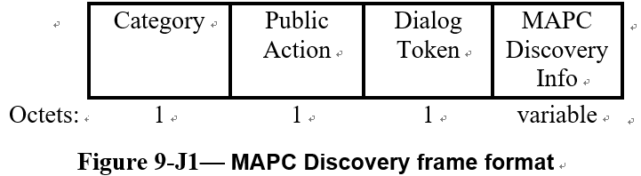
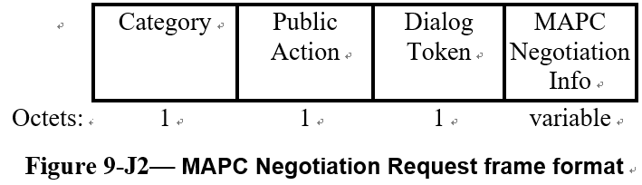
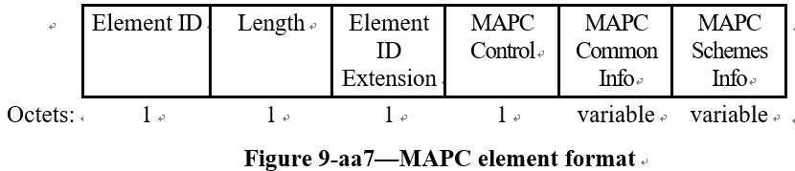
The MAPC discovery and negotiation phase
In 25/0599r5, several action frames have been defined for MAPC discovery and negotiation.
The MAPC Discovery Info field carries a Discovery MAPC element and the MAPC Negotiation Info field carries a Negotiation MAPC element, respectively.
In one negotiation phase, a requesting AP can setup more than one MAPC agreements with a specific responding AP.
  E.g., Co-TDMA & Co-SR & Co-BF at the same time.
Therefore, at the beginning of each TXOP, the polling AP shall initiate a polling phase to the polled APs, indicating which specific MAPC scheme would be used in this TXOP (if MAPC is scheduled to be executed).
*The MAPC Schemes Info field carries information specific to one or more MAPC schemes.

Slide 7
The MAPC polling phase
At the beginning of each TXOP, the TXOP holder may initiate an ICF/ICR exchange to query for the intention of participating MAPC transmission.
Generally the ICF can be a trigger frame (e.g., the BSRP GI3), then the ICR can be multi-STA BA with feedback information.
In the common info (or special user info), the TXOP holder shall indicate that which specific MAPC scheme is going to be executed in this TXOP.
  We suggest to indicate such information in the Trigger dependent User Info subfield of the Special User info field.
  The presence of such a trigger dependent user info field can be identified by the tuple {Trigger type, PHY Version identifier}.
  A example is shown as follows, the Query type subfield distinguish the BSRP GI3 for unavailability query and that for MAPC intention query.
Octets: 2 2 6 6 8 or more variable variable variable 4
Frame control
Duration
RA
TA
Common Info
Special User Info
User Info List
Padding
FCS
AID12
PHY Version Identifier
…
Trigger dependent User Info
Query type
MAPC feature bitmap
…

Slide 8
Summary
We review the unified MAPC framework, and present some considerations on the details of the unified MAPC framework.
The MAPC framework shall be divide into the long-term operation and short-term operation.
The MAPC negotiation shall be a long-term operation.
  A unified MAPC negotiation frame format is discussed, and APs may setup one or more MAPC agreements via only a round of such negotiation frame exchange.
We suggest that the short-term MAPC operation shall be initiated by a unified MAPC polling phase.
  An ICF format is proposed and sharing AP may use it to query for the MAPC intention of candidate APs.

Slide 9
References
[1] 802.11bn-D0.2
[2] 24/0171 TGbn Motions List - Part 1
[3] 24/1514 Multi-AP framework for C-SR, Geonhwan Kim (LG Electronics)
[4] 25/0599 PDT MAC MAPC Signaling and Protocol Aspects, Giovanni Chisci (Qualcomm Technologies Inc.)

Slide 10
Straw Poll 1
Do you support the following:
The TXOP earned by sharing AP can be divided into several phases, including:
  the MAPC negotiation phase, wherein the sharing AP initiate, update or tear down one or more MAPC agreements with shared AP(s);
  the MAPC polling phase, wherein the sharing AP announce a specific MAPC scheme and query with shared APs for the intention of participating MAPC;
  the exclusive transmission phase, wherein the sharing AP may occupy the wireless medium and serve the STAs belong to its own BSS;
  the MAPC transmission phase, wherein the sharing AP cooperates with shared AP(s) to transmit data at the same time, or shares TXOP with shared AP(s);

Slide 11
Straw Poll 2
Do you agree that a sharing AP may initiate, update or tear down one or more MAPC agreements with a shared AP during one MAPC negotiation phase?
One MAPC negotiation phase is composed of a TBD negotiation request frame and a TBD negotiation response frame.
The established MAPC agreements are valid for multiple TXOPs until it is explicitly updated or teared down.

Slide 12
Straw Poll 3
Do you agree that during each TXOP the sharing AP earned, a sharing AP shall query with shared AP(s) for the intention of participating MAPC, if the sharing AP wants to perform MAPC in that TXOP?
The sharing AP shall announce a specific MAPC scheme, which might be performed by the sharing AP in that TXOP, in the MAPC query frame.
  The details of the MAPC query frame and its response are TBD.
If the sharing AP decide not to perform any MAPC in this TXOP, the MAPC query phase can be omitted.

