Slide 1
Dynamic SCS – follow up
Authors:
Date: 02-24-2025

Slide 2
Recap: Fast QoS Switch (Dynamic SCS)
  The SCS with QoS Characteristics procedure defined in IEEE 802.11be is for Quasi-static traffic flow, i.e., the underlying assumption is that the traffic characteristics do not change very frequently. However, there are many scenarios where the users’ traffic patterns change much more frequently.
  We propose to enhance the current SCS mechanism which may allow for a non-AP STA to dynamically change QoS expectation or QoS flow with the associated AP.
  For the scenario where a non-AP STA sends to an AP a D-SCS request, where the D-SCS request contains X number of SCS or QoS profiles corresponding to the request, if the AP accepts the request, then it would indicate that the non-AP STA can request to dynamically switch from one QoS profile to another.
Yue Qi, Samsung Electronics

Slide 3
Abstraction
  We received some questions on the use case and motivation of the dynamic QoS, in this contribution, we provide some use cases with measured data.
Yue Qi, Samsung Electronics

Slide 4
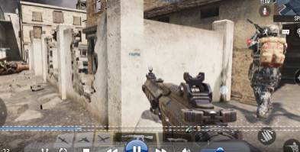

Use case 1: online gaming COD (1/2)
COD: 20240417_IP.csv
Data points: 4044:4463, cod-mg_5G_int0
Frequency: 5G
Sampling: every 500ms.
Observations on traffic patterns:
High UL traffic:
Short Shooting Bursts: Quick, isolated shooting actions generate brief UL spikes with minimal sustained impact.
Massive Shooting (Sustained Combat): Prolonged firefights with continuous aiming, shooting, and intense player movements lead to longer UL bursts with high network demand.
UL Spikes during respawn events: When a player respawns, the game client upload assets information, refreshes map-related information, leading to UL spikes.
Low UL traffic for exploration: Passive actions such as walking, wandering, and exploring the map result in low, stable UL throughput since fewer real-time updates are needed.
High DL spikes for map loading (death & respawn): On death and respawn, the server updates the player’s status and environment, triggering large DL spikes due to playback video from the killer, new map loading, and asset refresh.
User respawn (real-time)
Death & respawn
Walking
Massive shooting
Walking
Yue Qi, Samsung Electronics

Slide 5
Use case 1: online gaming COD (2/2)
Considerations:
Instead of resetting SCS configuration for every shooting, kill, or respawn event, the Dynamic SCS (D-SCS) approach pre-negotiates multiple QoS priority levels in advance.
This enables seamless, real-time QoS switching based on game states.
D-SCS dynamically adapts between short and massive shooting bursts, ensuring latency-sensitive UL actions are prioritized while avoiding excessive reconfiguration delays.
Shooting
(UL high priority)
Respawn
(DL-heavy)x
Wandering
(low-priority)
Normal
gameplay
Game Phase | Static SCS | Dynamic SCS
Wandering | Wastes priority resources | Efficiently maintains low-priority mode
Shooting | Delayed UL prioritization, possible lag | Immediate UL priority switch, avoids reset
Respawn | Potential DL congestion | Pre-negotiated DL-heavy mode
Notes:
COD: 20240419_IP.csv
Data points: 2062:2535, 2536:3010
Frequency: 2G & 5G
Normal gameplay no operations.

Slide 6

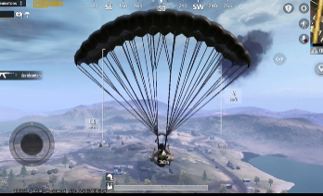

Use case 2: Online gaming PUBG (1/2)
Observations on traffic patterns:
UL traffic spikes:
UL high Tput bursts: Shooting operations such as bullet trajectory, hit registration, and movements.
prolonged high Tput UL burst: parachuting from Aircraft such as velocity, descent path, and landing coordination.
Low UL traffic: Walking & passive movement tend to be stable, low UL as only minor position updates are sent.
DL traffic spikes:
DL peaks: new map areas loaded as textures, buildings, and objects are streamed dynamically.
Sustained DL high Tput burst: enemy appearance, due to position updates, animations, and movement data.
Low DL traffic: loading new weapons, etc.
Notes:
PUBG: 20240416_IP.csv
Data points: 2071: 2544
Frequency: 5G
PUBG: 20240419_IP.csv
Data points: 3010: 3486
Frequency: 2G

Slide 7
Use case 2: Online gaming PUBG (2/2)
Considerations:
Static SCS struggles with rapid transitions, leading to delayed QoS adjustments and inefficient resource allocation.
D-SCS pre-negotiates multiple QoS, dynamically switching between different phases/events within games.
Predictive QoS switching ensures smooth transitions, reducing input lag, game desync, and excessive reconfigurations.
Game Event | Data flow type | static SCS | D-SCS benefit
Shooting | UL high Tput bursts | May not prioritize fast enough | Instant UL prioritization
Parachuting | prolonged high Tput UL burst | Delayed adjustment | Predictive UL increase
Enemy appears | Sustained DL high Tput burst | Delayed priority switch | Pre-classified DL boost
Map loading new area | DL peak | Treat as background traffic | Switch to DL optimization
Yue Qi, Samsung Electronics

Slide 8

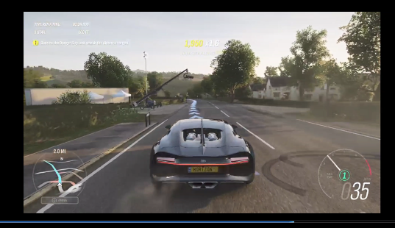
Use case 3: Cloud gaming Forza (1/2)
Trigger story/dialog
Observations on traffic patterns:
DL traffic:
High and fluctuating due to continuous video gaming.
Noticeable Spikes: Some spikes observed due to preloads assets/video/CG downloads.
Low DL traffic:
Switch from dynamic real-time asset streaming to a static pre-rendered sequence.
High stable UL traffic: driving mode. Gamer constantly sends inputs.
Low stable UL traffic: temporary dips occur in non-interactive moments.
Yue Qi, Samsung Electronics
Notes:
0305 Forza forza_5G_80mhz_logcat_6111014fe6c1448e

Slide 9
Use case 3: Cloud gaming Forza (2/2)
Considerations:
Compared classic SCS which treats all cloud gaming traffic the same, D-SCS allows smarter resource allocation.
DL traffic is not uniform. D-SCS can priories critical preloading vs. background streaming dynamically. UL responsiveness is key in racing where D-SCS helps ensure instantaneous player input.
D-SCS could allocate resources dynamically based on asset preloading vs. real-time rendering or background streaming.
Yue Qi, Samsung Electronics

Slide 10
Conclusion
Clear traffic patterns across games
Need for Dynamic SCS
Static SCS struggles with rapid, short-lived transitions in network demand.
D-SCS pre-negotiates QoS profiles and dynamically switches between different QoS profiles without frequent resets.
Benefits for scheduler: even if all gamers require high-priority traffic simultaneously, the AP can still differentiate their needs based on pre-negotiated QoS profiles, and thus helps distributed network resources efficiently.
Future Implications
D-SCS can be generalized across multiple traffic types to enhance real-time responsiveness. As games evolve (VR, cloud gaming), adaptive QoS management will be critical for seamless performance.
Yue Qi, Samsung Electronics

Slide 11
Q&A (1/3)
Why “change” in SCS is not enough?
Requires re-negotiation. The STA cannot guarantee that the AP will accept the new parameters in the re-negotiation phase, especially under high network load. Frequent renegotiations introduce delays and uncertainty.
Such pre-negotiated profile information benefits the scheduler. The AP can use the QoS information ahead of time to efficiently allocate resources without constantly re-evaluating the network and QoS parameters, leading to a more predictable and optimized scheduling process. Otherwise, the STA does not know if the AP will accept the new QoS, which add unpredictability.
Yue Qi, Samsung Electronics

Slide 12
Q&A (2/3)
Why not always request for the highest QoS profile?
Inefficient resource utilization. Not all STAs require the highest-priority profile at all times. Allocating maximum resources to every STA would waste resources.
Reduces unnecessary AP overhead. If a STA is using a lower QoS profile, the AP does not need to send trigger frames as frequently, leading to lower signaling overhead and better efficiency.
Minimizes unnecessary packet drops. If the AP is forced to meet stringent delay constraints of the highest profile (using highest QoS for all packets) but cannot do so, it may make trade-offs such as discard packets. However, if the STA had dynamically downgraded its QoS profile with a more relaxed delay bound, the AP could have adjusted scheduling instead of dropping packets, improving overall service reliability.
Yue Qi, Samsung Electronics

Slide 13
Q&A (3/3)
Why not using BSR instead?
Improving scheduling assurance. With DSCS, the AP receives advance negotiation and can pre-allocate resources, which provide STAs with higher assurance that the data will be served as agreed.
BSR alone may be too late. BSR is triggered based on the AP’s approaching, by then, it may be too late to meet the latency needs. E.g., a if the game is about to enter a battle, DSCS can pre-alert the AP (e.g., at the app/game or middle layer) to reallocate resources before the burst begins.
Reduce AP overhead. By having DSCS, the STA will report the QoS ahead of time such that the AP does not have to constantly perform BSRP/BSR, which can be efficient for low latency traffic with semi-predictable bursts (e.g., predictable by app).
These two are complementary and target on different focus. DSCS is targeting on the low latency sensitive traffic.
Yue Qi, Samsung Electronics

Slide 14
SP
  Do you agree to enhance the existing SCS framework in 11bn to enable a non-AP STA to dynamically switch from one QoS profile to another QoS profile for an SCS stream?
  • The new QoS profile is selected from one of the previously accepted QoS profiles for that SCS stream.
  • TBD on the mechanism for QoS profile switch indication which may include STA-driven triggers (e.g., application state changes or power mode transitions).
Yue Qi, Samsung Electronics

Slide 15
Appendix

Slide 16
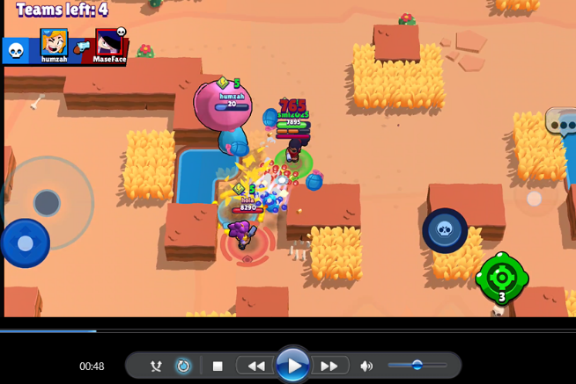
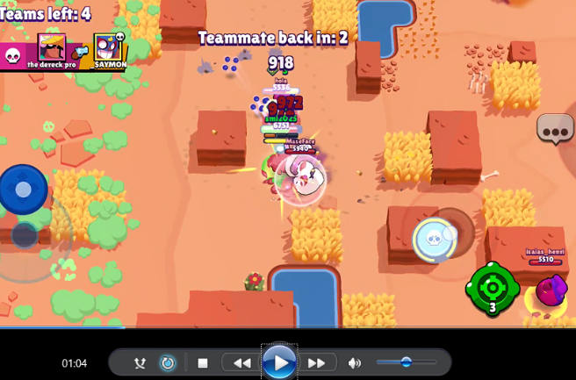
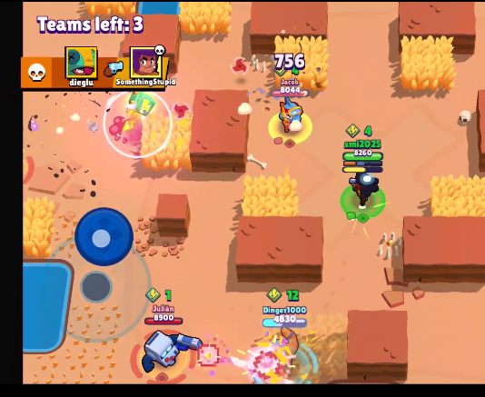
Other use case: Online gaming BrawlStars
BrawlStars: 20240416_IP.csv
Data points: 1: 692
Frequency: 5G
Two games. ~1.5min each
Observations:
Normal throughput with small range fluctuation: wanders, explore maps.
higher throughputs: multiple gamers with intense requests/operations, high demand of map refresh.
multiple gamers with intense requests
Considerations:
multiplayer online battle arena (MOBA) game is more stable compared to first-person shooter games like COD. While fluctuations are smaller, they still reflect distinct gameplay phases (wondering vs. combat phase.)
User respawn, countdown pauses UL

Slide 17
Other use cases: Cloud gaming Short Hike and Tomb Raider

