Slide 1
EDCA Enhancement Follow-Up (Part 1)
Idle Period Assessment
Date: 2025-06-11
Authors:
Name | Affiliation | Address | Phone | Email
Ja-Shun Wan | MediaTek
Yonggang Fang | MediaTek |  |  | yonggang.fang@mediatek.com
James Yee | MediaTek
Kaiying Lu | MediaTek
Li-Hsiang Sun | MediaTek
Frank Hsu | MediaTek
Gabor Bajko | MediaTek

Slide 2
Introduction
  This contribution discusses issues of P-EDCA in draft 802.11bn D1.0 [1] in satisfying the requirements of the idle period assessment of ETSI BRAN HS [2].

Slide 3
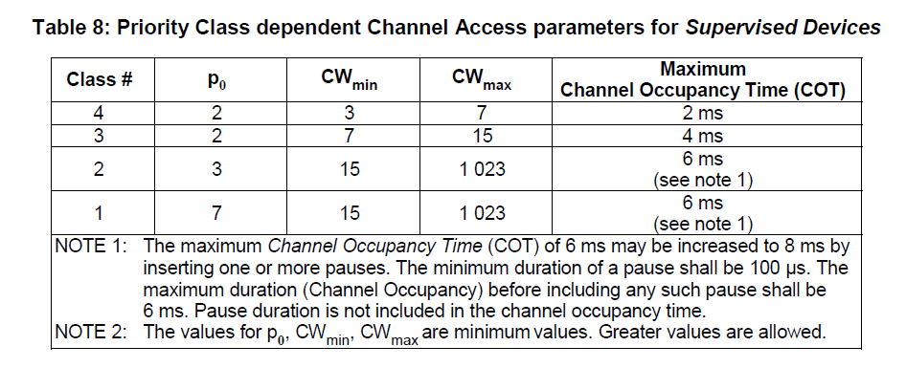
  ETSI BRAN Rule (1)
  Idle Period Assessment Rules
  4.2.7.3.2.4 Priority Classes [2]
    The transmission shall start from p₀ + randomized backoff
3

Slide 4
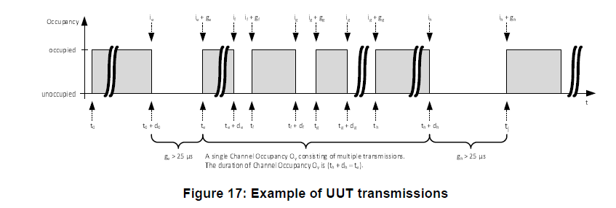
  ETSI BRAN Rule (2)
  Idle Period Assessment Rules
  5.4.9.3.2.4 Channel Access Mechanism [2]
    An Idle Period is defined as any period g_y that has a duration greater than 27 μs.
    The definition for the Idle Period is adjusted from 25 μs defined in clause 4.2.7.3.2.6 step 6 to 27 μs to account for measurement inaccuracies
    Bin[0] = [0, 32[ us; Bin[1] = [32, 41[ us, etc. for priority class 4
    If the Priority Class used, each cumulative probability p(n) of all Idle Periods recorded in bins Bin[n] shall not exceed maximum probability, e.g., p(0) <= 0.05, p(1) < = 0.30, etc., for priority class 4.
    Figure 17 above is used as FES for the idle period assessment test [2]
  Issues: the contributions [4][6] proposed adding DS-CTS as Short Control Signal (SCS) prior to a regular channel access procedure. However, if P-EDCA is enabled, DS-CTS transmitted prior to every LL transmission is part of a testing frame exchange sequence and shall meet the idle period assessment requirement p(n) of Bin[n] for each n.
4

Slide 5
  ETSI BRAN Rule (3)
  Analysis of Idle Period for P-EDCA
  Assume
    K times of AC-VO traffic use P-EDCA
    M times of AC_VO traffic use legacy EDCA
    Pxy(B1) is the number of B[1] using xy signal
    The error tolerance of the idle period distribution is less than 0.05
  In legacy EDCA, AC_VO, AIFSN=2, CW=3,
    P(B1) = 0.25 * M
  Each P-EDCA
    DS uses AIFSN=2, CW=0. Pds(B1) = 1 * K
    RTS uses AIFSN=2 and CW=7. Prts (B1) = 0.18 * K
    Total P(B1) = Pds(B1) + Prts(B1) = 1.18 * K
  To meet the idle period assessment requirement on Bin[1] for AC_VO traffic, the error of the probability of Bin[1] to be 0.25 is
    (1.18 K + 0.25M)/(2*K+M) - 0.25 < 0.05
    Solve it: K < 0.086 M. The ratio N = M/K = 11.6
    On average, one DS-CTS of P-EDCA is allowed for every 11.6 channel accesses using legacy EDCA if no additional restriction of using DS after P-EDCA.
      Note: K includes the number of acquired TXOPs using DS-CTS and DS-CTS retries.
5

Slide 6
  ETSI BRAN Rule (4)
  Fairness of Equal Access
  Legacy EDCA in 802.11 provides an equal access fairness mechanism among STAs.
  ETSI BRAN standards define rules to verify the equal access fairness.
  As a P-EDCA STA uses high priority DS-CTS transmission to reserve the medium for AC-VO traffic, it would create unfairness issue to other STAs not using P-EDCA for channel acquisition.
6

Slide 7
  Summary
This contribution
  Discussed the idle period assessment requirement and fairness issue of P-EDCA to satisfy the requirement from ETSI BRAN.
7

Slide 8
  References
Draft P802.11bn_D1.0
ETSI EN 301 893 v2.2.1
11-24-0864-01-00bn-EDCA enhancement for low latency traffic
11-24-1144-01-00bn-hip-edca-proposal_followup
11-25-0014-05-00bn-tgbn-motions-list-part-2
11-24-1918-02-00bn-hip-edca-sp2-tbd-resolution
11-25-0627-014-00bn-pdt-mac-cc50_p-edca
11-24-0209-19-00bn-specification-framework-for-tgbn
8

Slide 9
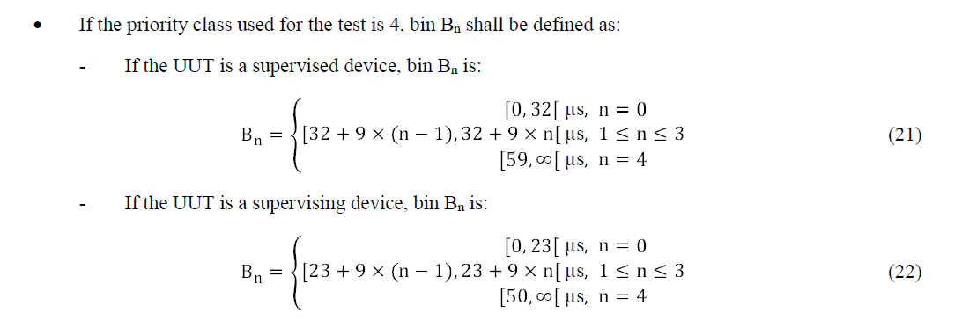
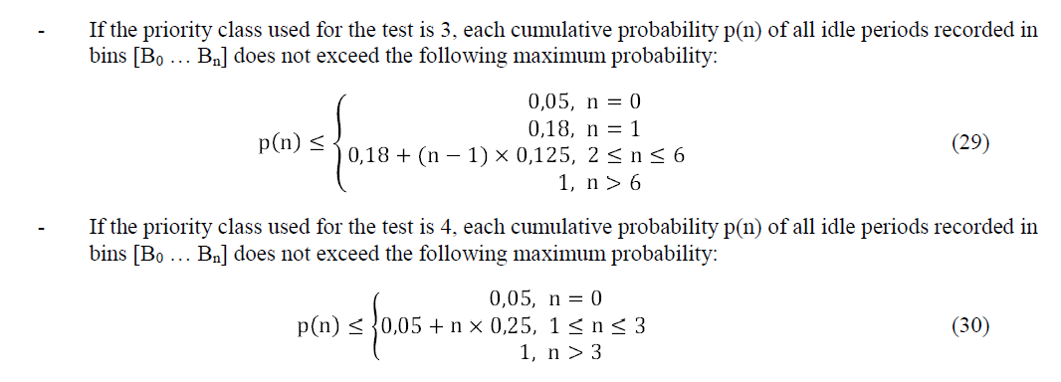
  Backup: Idle Period Assessment Rules from [2]
9

