Slide 1
EDCA Enhancement Follow-Up (Part 1) Idle Period Assessment & DS TX Synchronization
Date: 2025-06-11
Authors:
Name | Affiliation | Address | Phone | Email
Ja-Shun Wan | MediaTek
Yonggang Fang | MediaTek |  |  | yonggang.fang@mediatek.com
James Yee | MediaTek
Kaiying Lu | MediaTek
Li-Hsiang Sun | MediaTek
Frank Hsu | MediaTek
Gabor Bajko | MediaTek

Slide 2
Introduction
There are big concerns about the P-EDCA in the 802.11bn D0.3 [1]
Satisfying the requirements of the idle period assessment of ETSI BRAN HS [2]
Defer Signal transmission synchronization
As a way to mitigate these issues in [1], this contribution suggests adding the following rules to the 802.11bn draft
The rules of using P-EDCA to meet the ETSI BRAN idle period assessment requirements
The rule of an optional DS transmission synchronization
The rules of P-EDCA contention retry

Slide 3
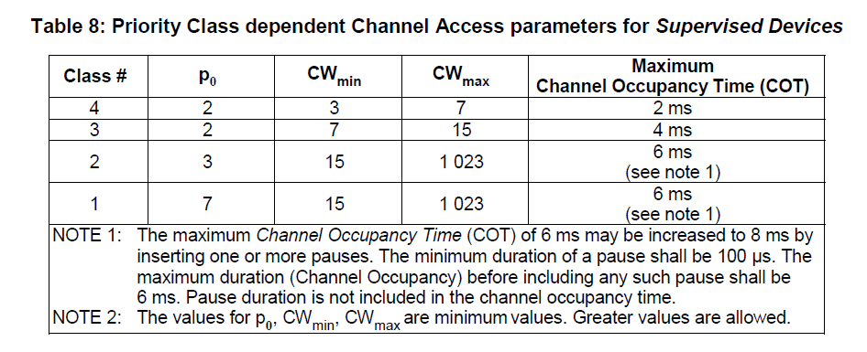
ETSI BRAN Rule (1)
Idle Period Assessment Rules
4.2.7.3.2.4 Priority Classes [2]
The transmission shall start from p₀ + randomized backoff
3

Slide 4
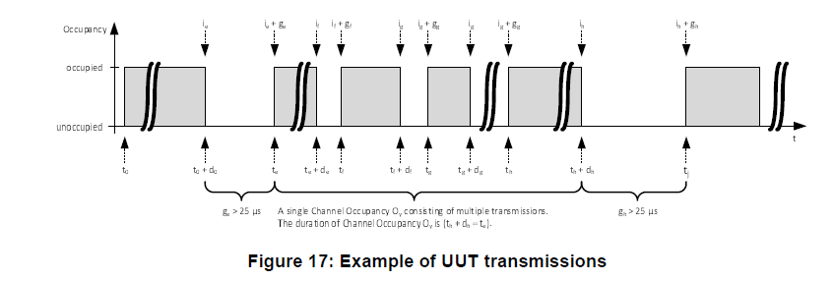
ETSI BRAN Rule (2)
Idle Period Assessment Rules
5.4.9.3.2.4 Channel Access Mechanism [2]
An Idle Period is defined as any period g_y that has a duration greater than 27 μs.
The definition for the Idle Period is adjusted from 25 μs defined in clause 4.2.7.3.2.6 step 6 to 27 μs to account for measurement inaccuracies
Bin[0] = [0, 32[ us; Bin[1] = [32, 41[ us, etc. for test 4
If the Priority Class used, each cumulative probability p(n) of all Idle Periods recorded in bins Bin[n] shall not exceed maximum probability, e.g., p(0) <= 0.05, p(1) < = 0.30, etc., for test 4.
Figure 17 above is used as FES for the idle period assessment test [2]
Issues: the contributions [4][6] proposed adding DS as SCS prior to a regular channel access procedure. However, if P-EDCA is enabled, DS transmitted prior to every LL transmission is part of a testing frame exchange sequence and shall meet the idle period assessment requirement p(n) of Bin[n] for each n.
4

Slide 5
ETSI BRAN Rule (3)
Analysis of Idle Period for P-EDCA
Assume
K times of AC-VO traffic use P-EDCA
M times of AC_VO traffic use legacy EDCA
Pxy(B1) is the number of B[1] using xy signal
The error tolerance of the idle period distribution is less than 0.05
In legacy EDCA, AC_VO, AIFSN=2, CW=3,
P(B1) = 0.25 * M
Each P-EDCA
DS uses AIFSN=2, CW=0. Pds(B1) = 1 * K
RTS uses AIFSN=2 and CW=7. Prts (B1) = 0.18 * K
Total P(B1) = Pds(B1) + Prts(B1) = 1.18 * K
To meet the idle period assessment requirement on Bin[1] for AC_VO traffic, the error of the probability of Bin[1] to be 0.25 is
(1.18 K + 0.25M)/(K+M) - 0.25 < 0.05
Solve it: K < 0.057 M. The ratio N = M/K = 17.54
On average, one P-EDCA using DS is allowed for every 17.54 channel accesses using legacy EDCA
Note: K includes the number of acquired TXOPs using DS and DS retries.
5

Slide 6
ETSI BRAN Rule (4)
As the idle period prior to DS is contributed to Bin[1], a rule of DS transmission for P-EDCA shall be added to meet the ETSI BRAN idle period assessment requirement and provide fairness to other STAs.
Proposal 1:
If the STA acquired the TXOP using the P-EDCA initiated via DS, the STA should not use initial backoff counter (BC) = 0 for subsequent channel access via P-EDCA for at least N transmissions.
Note: N depends on the P-EDCA frame exchange sequence and the CW of AC_VO.
6

Slide 7
Synchronized DS Transmission (1)
Purpose of DS
DS is used to start a protected short contention period to allow P-EDCA STAs to contend the medium and prevent non-P-EDCA STAs from access to the channel during this period.
CTS DS relies on the Duration field to be decoded by other STAs to set NAV to protect the short contention
Unsynchronized DS transmission issue
3rd party STAs cannot decode the MAC header of the overlapping DS correctly and set NAV.
Significantly reduce the protected short contention period, which is unable to prevent 3rd party STAs from contending the medium.
Significantly limit the number of P-EDCA STAs to use P-EDCA, especially in a dense deployment scenario.
Synchronized DS transmission
Provides longer protected contention period.
Reduces the impact on idle period assessment test.
Reduces unnecessary overhead for starting a P-EDCA contention
7

Slide 8
Synchronized DS Transmission (2)
Issues in PDT
In the current draft [1], the protected P-EDCA contention duration is set to 97us
NOTE 1— The NAV set by the Duration field of the DS-CTS frame protects the medium for the maximum P-EDCA contention duration: aSifsTime + (AIFSN + CWMax) * aSlotTime. Hence, the default values relate as follows: 97 µs = 16 µs + (2 + 7) × 9 µs
NOTE 2—The value of the P-EDCA contention duration is fixed and is not advertised by the AP
This is based on the assumption that the other STAs can decode the DS-CTS preamble and MAC header correctly and set the NAV.
However, if DS transmissions are not synchronized and collide, the protected P-EDCA contention duration may significantly reduce from 97 µs to DIFS, i.e., 34 µs because the other STAs would not be able to decode the overlapping DS. This would cause
A non-P-EDCA STA may transmit packet after DIFS time
A P-EDCA STA may lose a chance to transmit an RTS
8

Slide 9
Synchronized DS Transmission (3)
Proposal 2: TX Sync Requirements
A STA should compensate for carrier frequency offset (CFO) error and symbol clock error with respect to the last frame received before transmission of the Defer Signal:
Note1: The Defer Signal and the RTS frame are transmitted in non-HT PPDU, or non-HT duplicate PPDU and follow the existing synchronization requirements of non-HT PPDU (+-2KHz and +-0.4us) in the clause 36.3.16.3 of 802.11be.
9

Slide 10
Synchronized DS Transmission (4)
Benefits of Synchronized DS transmission
Provide better reliability
NAV protection: the non-transmitted STAs can set NAV to protect the short contention period if the MAC header is decoded
EIFS protection: if only preamble can be decoded correctly, the EIFS rules can still be applied to non-transmitted STAs to prevent them from the channel access in the short contention period.
Better protection coverage
20dB difference between PDT and EDT provides better protection coverage for synchronized DS transmissions and subsequent RTS transmissions.
Resolve the collisions of DS and RTS transmission quickly
Help to reduce un-decoded overlapping DS transmissions
Help to reduce the channel acquisition time and E2E latency tail.
Reduce the possibility of false alarm of DS
Other STAs can use PD to detect and decode the synchronized DS transmissions
Otherwise, other STAs have to use ED to detect unsynchronized overlapping DS transmissions and cannot decode them.
10

Slide 11
FES of P-EDCA (1)
Issues in PDT
The current text in the draft [1] does not distinguish the P-EDCA attempt retry from the P-EDCA contention (i.e., RTS) retry during the P-EDCA contention period.
The P-EDCA attempt retry during the P-EDCA contention adds a new contention into the un-resolved P-EDCA contention collisions in the subsequent contention period. This causes the P-EDCA contentions to not converge!
The P-EDCA attempt retry blocks the RTS retry during the P-EDCA contention which does not align with the 802.11bn specification framework [8].
“Define High Priority (HIP) EDCA in UHR where a STA with LL traffic may be allowed, based on TBD conditions, to send a Defer Signal (it is TBD whether CTS or RTS is used) to start a protected short contention for pending LL data
Conditions to be allowed to send a Defer Signal is TBD
STA in HIP EDCA always use RTS/CTS as initial frame exchange and retry.”
The P-EDCA attempt retry adds the unnecessary overhead and the extra delay to P-EDCA.
Please refer to the following frame exchange sequences
11

Slide 12
FES of P-EDCA (2)
An example FES (A)
Synchronized DS/RTS can provide NAV and EIFS protection.
DS transmission attempt triggers one or more P-EDCA contentions
Only the idle period of one DS in the channel acquisition period will contribute to Bin[1]. i.e., N = 17.54
P-EDCA Attempt
P-EDCA
Attempt Retry
CW=0
AIFSN
Initial RTS
STA4
(AC3)
DS
RTS
DS
CW=0
AIFSN
RTS retry
STA3
(AC3)
DS
RTS
RTS
DS
CW=0
AIFSN
STA2
(AC3)
DS
RTS
RTS
RTS
PPDU
P-EDCA
contention
period (NAV)
CTS
BA
P-EDCA
contention period (EIFS)
Remaining
BC=3
Remaining
BC=3
STA1
Busy
Channel Acquisition Time
12

Slide 13
FES of P-EDCA (3)
An example FES (B)
Synchronized DS/RTS can provide NAV and EIFS protection.
DS transmission attempt triggers only one P-EDCA contention
The idle period of every DS in the channel acquisition period will contribute to Bin[1], i.e., N = 17.54 * PSRC threshold.
A DS prior to every RTS of P-EDCA contention adds the unnecessary overhead and the extra delay.
CW=0
AIFSN
P-EDCA Attempt
P-EDCA
Attempt Retry
P-EDCA
Attempt Retry
Initial RTS
STA4
(AC3)
DS
RTS
DS
DS
CW=0
AIFSN
RTS retry
P-EDCA
Attempt Retry
STA3
(AC3)
DS
RTS
DS
RTS
DS
CW=0
AIFSN
RTS retry
STA2
(AC3)
DS
RTS
DS
RTS
DS
RTS
PPDU
P-EDCA
contention
period (NAV)
CTS
BA
P-EDCA
contention period (EIFS)
P-EDCA
contention period (EIFS)
Remaining
BC=3
Remaining
BC=3
STA1
Busy
Channel Acquisition Time
13

Slide 14
FES of P-EDCA (4)
An example FES (C)
DS transmission attempt triggers only one P-EDCA contention (Issue in D0.3 [1])
The idle period of every DS in the channel acquisition period will contribute to Bin[1], i.e., N = 17.54 * PSRC threshold.
P-EDCA Attempt Retry will add a new contention in the un-resolved contentions in the next contention period. This causes the P-EDCA contentions to not converge!
CW=0
AIFSN
P-EDCA Attempt
P-EDCA
Attempt Retry
P-EDCA
Attempt Retry
STA4
(AC3)
DS
DS?
RTS?
DS
CW=0
AIFSN
Initial RTS
RTS retry
STA3
(AC3)
DS
RTS
DS
RTS
P-EDCA
Attempt Retry
RTS retry
CW=0
AIFSN
STA2
(AC3)
DS
RTS
DS
RTS
DS
RTS
PPDU
P-EDCA
contention
period (NAV)
CTS
BA
P-EDCA
contention period (EIFS)
P-EDCA
contention period (EIFS)
Remaining
BC=3
Remaining
BC=3
STA1
Busy
Channel Acquisition Time
14

Slide 15
FES of P-EDCA (5)
Proposal 3
Revise the following text of P-EDCA in 802.11bn D0.3 [1]
from
A P-EDCA STA that participated in a P-EDCA contention but did not initiate a TXOP (see 10.23.2.4) during the P-EDCA contention or that initiated a TXOP but did not receive the CTS frame in response to the RTS frame used to initiate the TXOP may start another P-EDCA contention by sending the DS-CTS frame at DSAIFSN[AC_VO] slot boundary if the STA's CS mechanism (see 10.2.3.1 (CS mechanism)) determines that the medium is idle, for up to dot11PEDCAConsecutiveAttempt.
To:
A P-EDCA STA that participated in a P-EDCA contention but did not initiate a TXOP (see 10.23.2.4) during the P-EDCA contention shall not start another P-EDCA attempt or another P-EDCA contention until the current TXOP initiated by other P-EDCA STA completes.
A P-EDCA STA that participated in a P-EDCA contention or that and initiated a TXOP but did not receive the CTS frame in response to the RTS frame used to initiate the TXOP may start another P-EDCA contention to obtain a TXOP (see 10.23.2.4) by sending the DS-CTS frame at DSAIFSN[AC_VO] slot boundary if the STA's CS mechanism (see 10.2.3.1 (CS mechanism)) determines that the medium is idle.
A P-EDCA STA shall not perform consecutive P-EDCA attempts for up to dot11PEDCAConsecutiveAttempt.
15

Slide 16
Conclusion
This contribution
Discussed the Idle period assessment requirement for P-EDCA
Described DS-CTS transmission synchronization issue
Proposed a resolution for DS and subsequent RTS transmission synchronization
16

Slide 17
References
Draft P802.11bn_D0.3
ETSI EN 301 893 v2.2.1
11-24-0864-01-00bn-EDCA enhancement for low latency traffic
11-24-1144-01-00bn-hip-edca-proposal_followup
11-25-0014-05-00bn-tgbn-motions-list-part-2
11-24-1918-02-00bn-hip-edca-sp2-tbd-resolution
11-25-0627-014-00bn-pdt-mac-cc50_p-edca
11-24-0209-14-00bn-specification-framework-for-tgbn
17

Slide 18
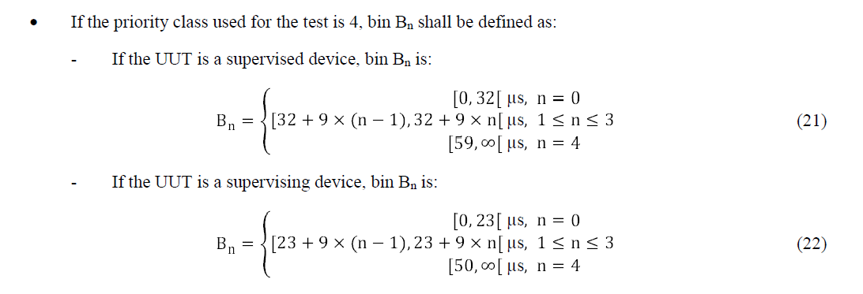
Backup: Idle Period Assessment Rules from [2]
18

