Slide 1
DS MAC Collision Warning
Date: 2025-03-10
Authors:

Slide 2
Abstract
Why an OTA MAC cannot collide with more than same-link STAs

Slide 3
Background
OTA MAC is used by the non-AP MLD on the radio link
  The STA/non-AP MLD may also express a DS MAC, for the AP to represent the STA/non-AP MLD over the DS
Question asked during D1.0 comment collection:
Can OTA collision occur with a MAC beyond the local link?

Slide 4
IEEE 802.11 is under IEEE 802 Rules
802-2014 recommends uniqueness of MAC addresses in a LAN, i.e. a network consisting of one or more interconnected networks each using a medium access control (MAC) protocol specified in an IEEE 802 standard.
In short: you should not have the same MAC for 2 devices that can talk to each other using the MAC as SA/DA
Failure to do so is particularly problematic for devices performing forwarding functions – the AP is one of them (4.3.5.1), forwarding between WMs and DSM
  In some cases, the AP/DS forwarding function implements 802.1Q, which also forbids duplication of MACs

Slide 5







How MACs Are Learned
The forwarding device (call it bridge for simplicity) learns MAC from hearing SA values on an interface
The bridge updates its forwarding table accordingly
Radio0 | Radio1 | Radio2 | Eth0
a.b.c
radio2
radio1
Eth0
SA/TA: a.b.c
radio0

Slide 6
How MACs Are Learned
The forwarding device (call it bridge for simplicity) learns MAC from hearing SA values on an interface
The bridge updates its forwarding table accordingly
Radio0 | Radio1 | Radio2 | Eth0
a.b.c
radio2
radio1
Eth0
SA/TA: a.b.c
radio0

Slide 7
How MACs Are Learned
The forwarding table is used to forward (or not) incoming frames
Radio0 | Radio1 | Radio2 | Eth0
a.b.c
radio2
DA: a.b.c
Eth0
radio1
radio0

Slide 8
How Fwd Tables are Updated
The forwarding table is usually CAM, and can be updated
Radio0 | Radio1 | Radio2 | Eth0
a.b.c | a.b.c
radio2
SA/TA: a.b.c
Eth0
radio1
radio0

Slide 9
What Happens When a MAC is on 2 Interfaces
The forwarding table is updated as the MAC moves
Radio0 | Radio1 | Radio2 | Eth0
 | a.b.c |  | a.b.c
radio2
2. SA: a.b.c
1. SA/TA: a.b.c
Eth0
radio1
radio0

Slide 10
What Happens When a MAC is on 2 Interfaces
The forwarding table is updated as the MAC moves
Radio0 | Radio1 | Radio2 | Eth0
 | a.b.c
radio2
a.b.c
Eth0
a.b.c
radio1
radio0
Need to go to yahoo: DA: a.b.c

Slide 11

What Happens When a MAC is on 2 Interfaces
The forwarding table is updated as the MAC moves
Radio0 | Radio1 | Radio2 | Eth0
 |  |  | a.b.c
radio2
Eth0
a.b.c
radio1
radio0
Need to go to watch: DA: a.b.c

Slide 12
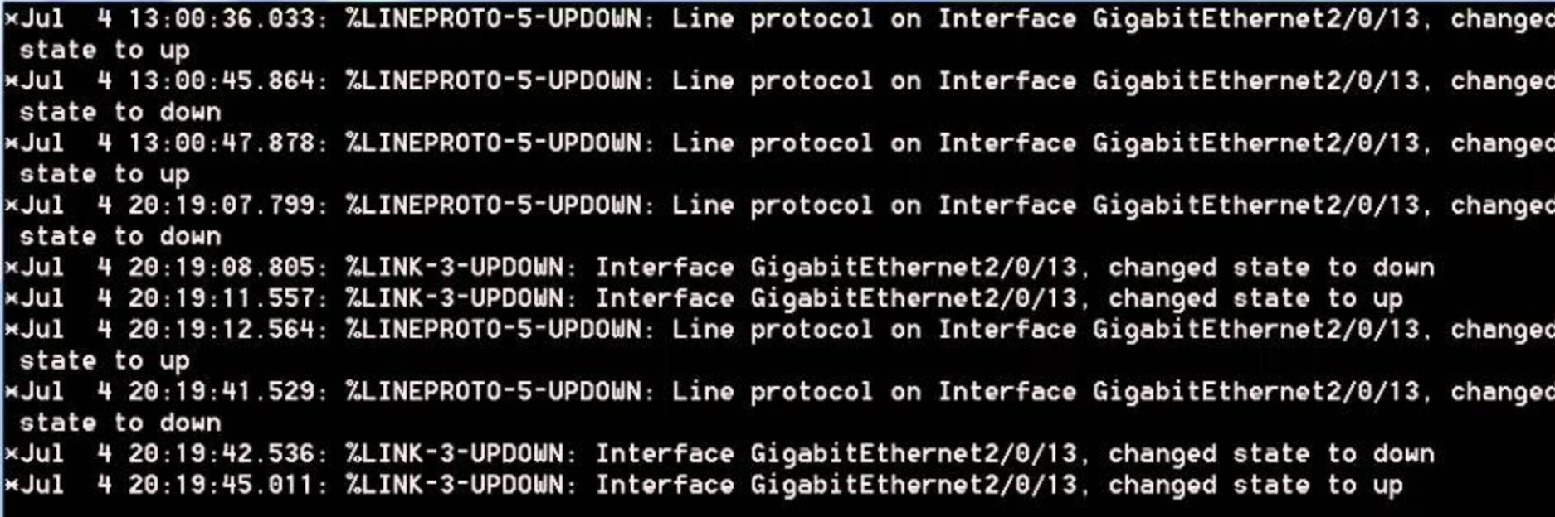
How Many Times Can a MAC Move?
Implementation-dependent, but usually “not too often”
Beyond some hysteresis, the MAC, or the entire interface, may get blocked
radio2
I am a.b.c
radio1
Eth0
radio0
I am a.b.c

Slide 13
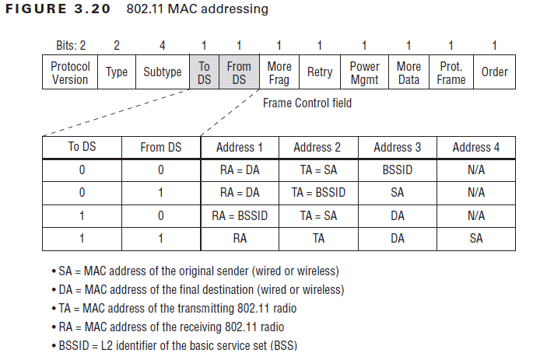
What The CPE Mechanism Protects
For the MAC address, CPE only protects the Address 1 field (on the downlink), or the Address 2 field (on the uplink) (802.11bi-d1.0 10.71.1)
OTA: a.b.c, DS 1.2.3
radio2
radio1
Eth0
radio0
OTA: d.e.f, DS 4.5.6

Slide 14
What The CPE Mechanism Protects
STAs talking through an AP only see each other’s DS-MAC (the same process is also true if both STAs are on the same link)
OTA: a.b.c, DS 1.2.3
DA:4.5.6, SA a.b.c
radio2
radio1
Eth0
radio0
DA:d.e.f., SA 1.2.3
OTA: d.e.f, DS 4.5.6

Slide 15
What if?
A STA OTA MAC may be the same as another STA’s DS MAC, resulting in silly-looking, but functional headers
OTA: a.b.c, DS 1.2.3
DA:a.b.c, SA a.b.c
radio2
radio1
Eth0
radio0
DA:d.e.f., SA 1.2.3
OTA: d.e.f, DS a.b.c

Slide 16
What if?
Things collapse only when 2 STAs have the same OTA MAC on the same link
OTA: a.b.c, DS 1.2.3
DA:x.y.z., SA a.b.c
radio2
radio1
Eth0
Who is sending?
1.2.3 or 4.5.6?
radio0
OTA: a.b.c, DS 4.5.6

Slide 17
Conclusion
A MAC cannot exist for multiple devices on the same link
A STA OTA MAC should not collide with another OTA MAC on the same link, DS MACs are irrelevant

