Slide 1
Discussion on Coordinated NPCA Operation
Date: 2025-02-11
Authors:

Slide 2
Abstract
Coordinated non-primary channel access (Co-NPCA) have been discussed in multiple TGbn contributions [1-3].
In this presentation, we will discuss how to signal Co-NPCA operation to mitigate OBSS interference.

Slide 3
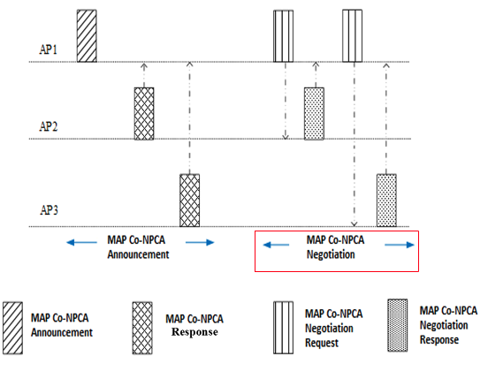
Recap
In Co-NPCA access to the NPCA primary channel can be coordinated so there are no multiple APs contending to access it if OBSS is detected in the primary channel.
NPCA primary channels (BW and location) are negotiated during MAP negotiation phase [1,2].
Enabled Co-NPCA APs and associated STAs operate following the negotiated parameters.
Co-NPCA TXOP Sharing [1]: Once a participating AP obtains a TXOP, it signals the rest of the APs in the Co-NPCA group to move to the primary NPCA.
SP-Based NPCA [3]: Once any of the participating APs access the NPCA primary channel, it operates there until the end of a SP (e.g., TWT SP).
Notes:
Emphasize my contribution is about coordination

Slide 4
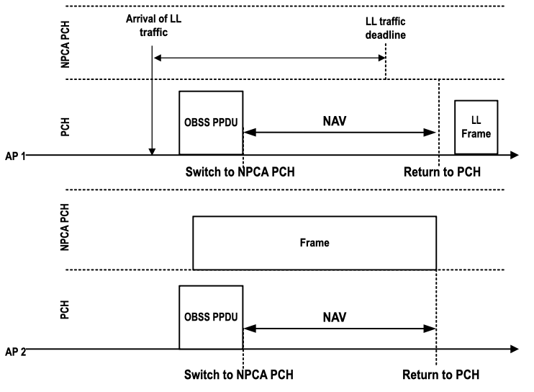
NPCA operation in dense AP MLD deployments may cause multiple APs to contend for access to the NPCA primary channel.
AP 1 and AP 2 are NPCA enabled but not coordinated.
AP 1 and AP 2 operate using the same primary channel (PCH) and NPCA primary channel.
Low latency (LL) traffic arrives at AP 1.
Shortly after, OBSS interference appears in the primary channel (PCH).
Both AP 1 and AP 2 switch to the NPCA primary channel and contend for access.
AP 2 wins the channel and blocks the AP 1 LL traffic.
AP 1 fails to send LL traffic before LL traffic deadline
Notes:
Change figure → Switch to NPCA PCH is confusing.

Slide 5
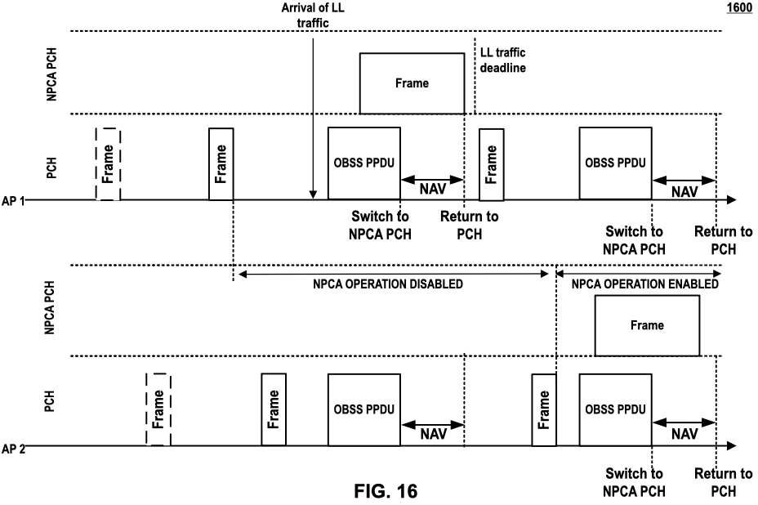
Coordinated Enabling/Disabling NPCA Operation
During MAP negotiation phase, AP 1 requests AP 2 to disable NPCA operation, permanently or following an agreed upon schedule.
During Co-NPCA operation, AP 1 may request AP 2 to disable NPCA permanently or for a time duration.
Disabling NPCA operation AP 2 allows LL traffic be served in AP 1 before the LL deadline in presence of OBSS interference in the PCH.
MAP Negotiation
phase
Co-NPCA
Co-NPCA
Notes:
Add R-TWT in figure – Focus on time period.

Slide 6
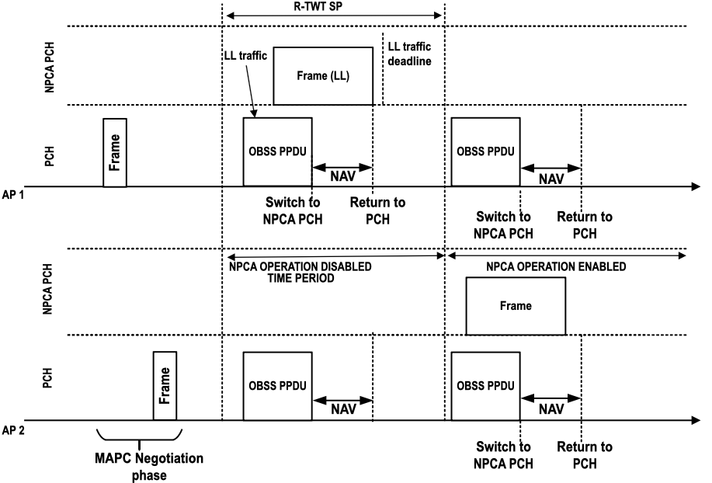
Coordinated Enabling/Disabling NPCA Operation
During MAP negotiation phase, AP 1 requests AP 2 to disable NPCA operation following an agreed upon schedule.
Example: AP 1 may negotiate with AP 2 (an associated STAs) to temporarily disable NPCA during AP 1 R-TWT SPs.
Notes:
Add R-TWT in figure – Focus on time period.

Slide 7
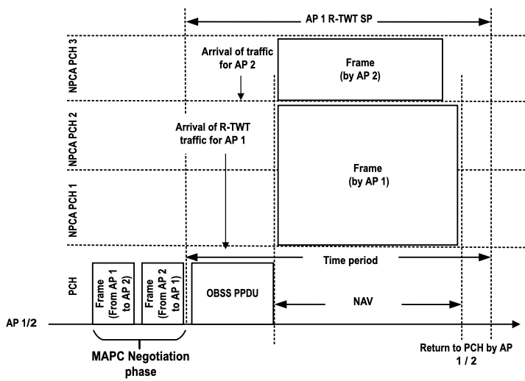
Temporal Coordinated NPCA Configuration
During MAP negotiation phase, AP 1 and AP 2 agree to operate with coordinated NPCA parameter sets, e.g.,
  AP 1 → NPCA PCH 1, BW = 20 MHz
  AP 2 → NPCA PCH 2, BW = 40 MHz
Additionally, AP 1 may request AP 2 to change its NPCA parameter sets during the AP 1 R-TWT SP, e.g.,
  AP 1 → NPCA PCH 1, BW = 40 MHz
  AP 2 → NPCA PCH 3, BW = 20 MHz
Notes:
Tie this R-TWT

Slide 8
Conclusions
NPCA operation in dense AP MLD deployments may cause multiple APs to contend for access to the NPCA primary channel.
Coordination between APs may be necessary to take advantage of the benefits associated with NPCA operation.
We propose a dynamic configuration of NPCA operation between coordinated APs.
Our proposed approach enables better use of the spectrum, dynamically accommodating for the needs of each participating AP MLD when OBSS interference occurs (e.g., latency, BW, ..).

Slide 9
References
[1] 11-24/1838r0, Considerations on Coordinated NPCA (Mahmoud Hasabelnaby, Huawei)
[2] 11-24/1596r1 Consideration of MAP Coordination on NPCA Channel (Yan Li, ZTE)
[3] 11-24/1259r0, SP-Based Non-primary Channel Access Follow-Up (Yue Zhao, Huawei)
[4] 11-24/2089r1, NPCA Primary Channel Selection (Yuxin Lu, TCL industries)
Notes:
1838, Huawei

