Slide 1
Discussion on Coordinated NPCA Operation
Date: 2025-02-11
Authors:

Slide 2
Abstract
Coordinated non-primary channel access (Co-NPCA) have been discussed in multiple TGbn contributions [1-3].
In this presentation, we will discuss how to signal Co-NPCA operation to mitigate OBSS interference.

Slide 3
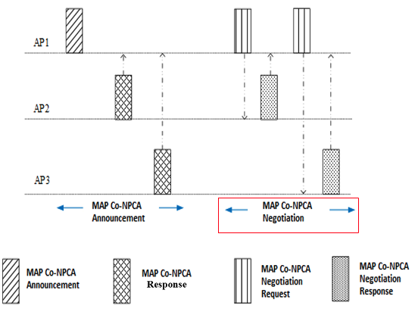
Recap
In Co-NPCA access to the NPCA primary channel can be coordinated so there are no multiple APs contending to access it if OBSS is detected in the primary channel.
NPCA primary channels (BW and location) are negotiated during MAP negotiation phase [1,2].
Enabled Co-NPCA APs and associated STAs operate following the negotiated parameters.
Co-NPCA TXOP Sharing [1]: Once a participating AP obtains a TXOP, it signals the rest of the APs in the Co-NPCA group to move to the primary NPCA.
SP-Based NPCA [3]: Once any of the participating APs access the NPCA primary channel, it operates there until the end of a SP (e.g., TWT SP).
Notes:
Emphasize my contribution is about coordination

Slide 4
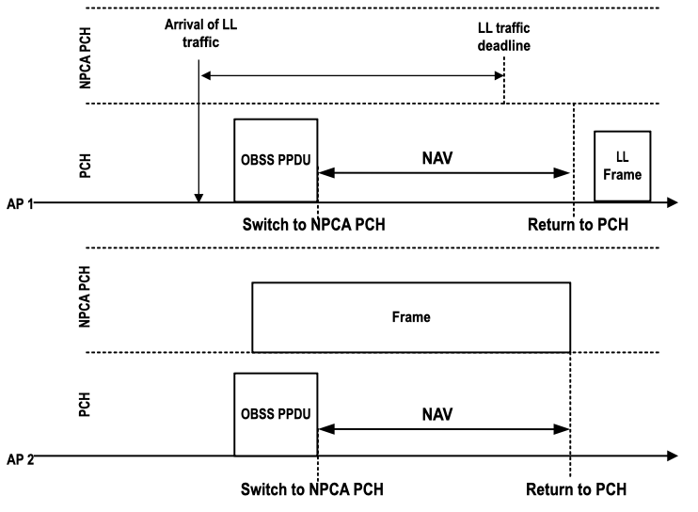
NPCA operation in dense AP MLD deployments may cause multiple APs to contend for access to the NPCA primary channel.
AP 1 and AP 2 are NPCA enabled but not coordinated.
AP 1 and AP 2 operate using the same primary channel (PCH) and NPCA primary channel.
Low latency (LL) traffic arrives at AP 1.
Shortly after, OBSS interference appears in the primary channel (PCH).
Both AP 1 and AP 2 switch to the NPCA primary channel and contend for access.
AP 2 wins the channel and blocks the AP 1 LL traffic.
AP 1 fails to send LL traffic before LL traffic deadline
Notes:
Change figure → Switch to NPCA PCH is confusing.

Slide 5
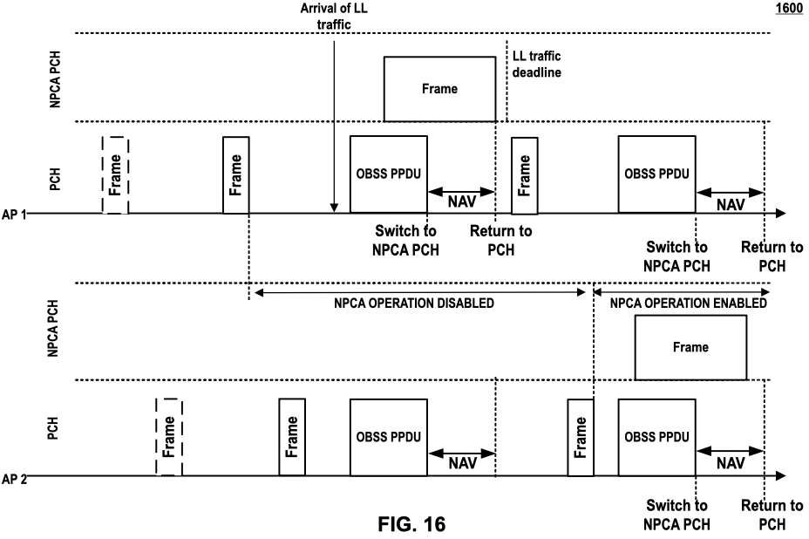
Coordinated Enabling/Disabling NPCA Operation
During MAP negotiation phase, AP 1 (coordinating AP) requests AP 2 (coordinated AP) to enable NPCA operation.
AP 1 requests AP 2 to disable NPCA operation, permanently, for a time duration, or following an agreed upon schedule.
AP 1 does not provide any details on how to configure NPCA operation in AP 2. Only specifies its status (enabled/disabled).
Disabling NPCA operation AP 2 allows LL traffic be served in AP 1 before the LL deadline in presence of OBSS interference in the PCH.
MAP Negotiation
phase
Co-NPCA
Co-NPCA
Notes:
Add R-TWT in figure – Focus on time period.

Slide 6
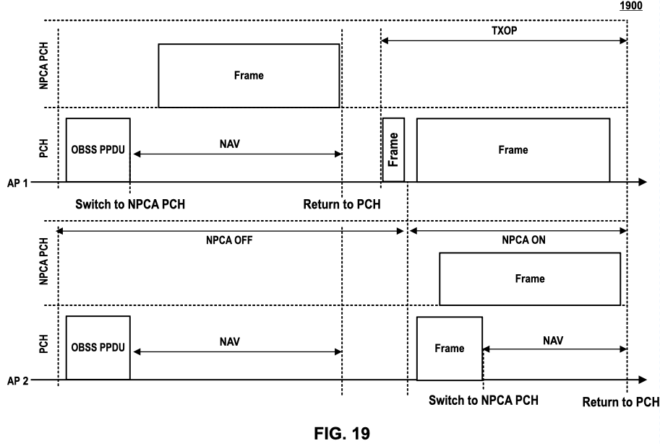
NPCA Enabling/Disabling based on Coordinating AP PCH Access
Option 1: AP 1 indicates AP 2 it can enable NPCA (if disabled) operation if AP 1 access the PCH.
Option 2: AP 1 requests AP 2 through ICF frame to disable NPCA operation and enable it only if AP 1 access the PCH channel.
Upon detecting OBSS interference, AP 1 access the NPCA primary channel with no contention from AP 2 (AP 2 NPCA disabled).
AP 2 detects access of AP 1 to the PCH and enables NPCA operation (during NAV).
ICF
(by AP 1)
(by AP 1)
Notes:
Mention ICF idea

Slide 7
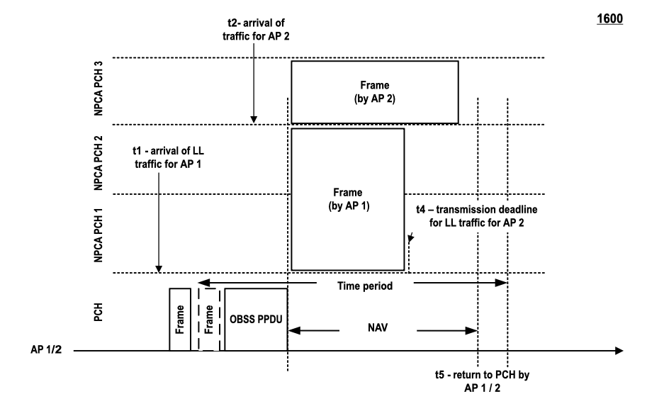
Temporal Coordinated NPCA Configuration
During MAP negotiation phase, AP 1 and AP 2 agree to operate with coordinated NPCA parameter sets, e.g.,
  AP 1 → NPCA PCH 1, BW = 20 MHz
  AP 2 → NPCA PCH 3, BW = 20 MHz
During Co-NPCA operations, AP 1 may have stringent latency requirement for LL traffic.
For a time period, AP 1 may request AP 2 to change its NPCA parameter sets to ensure successful transmission of LL traffic by AP 1, e.g.,
  AP 1 → NPCA PCH 1, BW = 40 MHz
  AP 2 → NPCA PCH 3, BW = 20 MHz
After time period expires, AP 2 may return to use the pre negotiated NPCA parameter set as described above.
Co-NPCA
Notes:
Tie this R-TWT

Slide 8
Conclusions
NPCA operation in dense AP MLD deployments may cause multiple APs to contend for access to the NPCA primary channel.
Coordination between APs may be necessary to take advantage of the benefits associated with NPCA operation.
We propose a dynamic configuration of NPCA operation between coordinated APs.
Our proposed approach enables better use of the spectrum, dynamically accommodating for the needs of each participating AP MLD when OBSS interference occurs (e.g., latency, BW, ..).

Slide 9
References
[1] 11-24/1838r0, Considerations on Coordinated NPCA (Mahmoud Hasabelnaby, Huawei)
[2] 11-24/1596r1 Consideration of MAP Coordination on NPCA Channel (Yan Li, ZTE)
[3] 11-24/1259r0, SP-Based Non-primary Channel Access Follow-Up (Yue Zhao, Huawei)
[4] 11-24/2089r1, NPCA Primary Channel Selection (Yuxin Lu, TCL industries)
Notes:
1838, Huawei

