Slide 1
MLO-based Scheduling for IMMW
Date: 2025-03-10
Authors:
Name | Affiliation | Address | Phone | Email
Insun Jang | LG Electronics | 19, Yangjae-daero 11gil, Seocho-gu, Seoul 137-130, Korea |  | insun.jang@lge.com
Eunsung Park |  |  |  | esung.park@lge.com
Jinsoo Choi |  |  |  | js.choi@lge.com
Dongju Cha |  |  |  | dongju.cha@lge.com
Insik Jung |  |  |  | insik0618.jung@lge.com
HanGyu Cho |  |  |  | hg.cho@lge.com
Sanggook Kim |  | 10680 Treena St, San Diego CA 92131 , USA |  | sanggook.kim@lge.com

Slide 2
Introduction
Generally, 11bq focuses on an MLD with which at least one STA operating on a mmWave bands is affiliated
As is widely known, Beamforming Training (BFT) on mmWave bands is necessary due to their characteristics (e.g., directional TX) and thereby Data is exchanged, which requires proper schedules and mechanisms to be enabled
In this contribution, we share our thoughts on them for IMMW based on multi-link operation (MLO)
  For convenience, we call STAs (or APs) operating on mmWave bands mSTA (or mAPs) and also call STAs (or APs) operating on sub-7GHz bands sSTA (or sAPs)

Slide 3
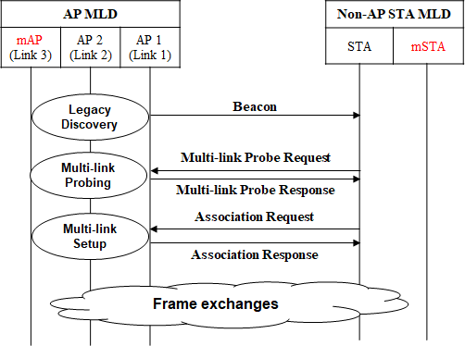
Recap: Multi-link Operation in 11be [1]
Basically, Multi-link Operation provides significantly efficient operations in terms of discovery, association, authentication….
Non-AP MLD can find the existence of mAP and its basic info (through RNR IE, Basic ML IE)
Non-AP MLD can obtain the complete profile of mAP
Non-AP MLD can setup links including the link between mSTA and mAP (on mmWave link)
Non-AP MLD can disable/enable and delete/add the mmWave link through Reconfiguration ML IE
Note: Some procedures are omitted (e.g., authentication)

Slide 4
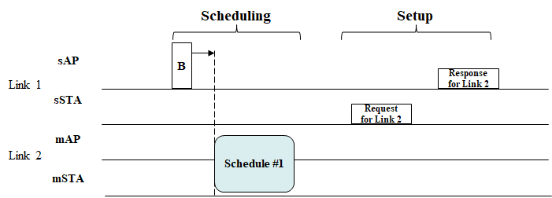
Recap: MLO for IMMW [1]
A lot of management mechanisms based on MLO were well-defined in 11be
  Multi-link-assisted- TWT, TIM, Critical Update, TID-to-link mapping, Reconfiguration, ….
  Thanks to the efforts, necessary mechanisms (e.g., beamforming training) in mmWave bands can designed based on MLO

Slide 5
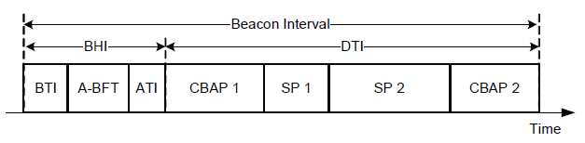
Scheduling-based Approach
Generally, during (determined) Beacon Intervals to be repeated, beamforming training and data exchanges are performed according to requirements of each access period [2]
  Per-beacon interval, each access periods can be scheduled and adjusted in several frames such as DMG Beacon (e.g., using (EDMG) Extended Schedule IE), SPR frame, Grant frame…, and pseudo-static SP may be configured
We think that the schedule-based approach still can work in IMMW to manage BFT and directional TX properly (e.g., even for latency traffic) and reduce power consumption (e.g., [8])
  Therefore, we need to discuss how to configure such schedules with the aid of sub-7GHz APs/links

Slide 6
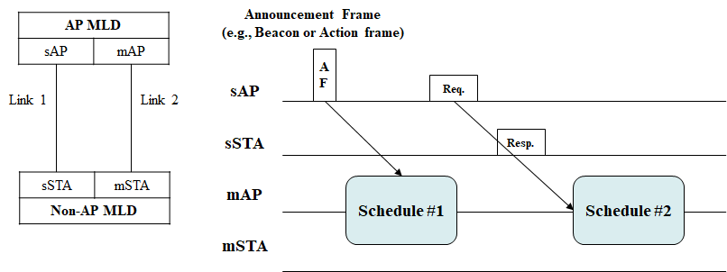
Potential Directions in IMMW
Assume to start with no Beacon on mmWave bands to reduce management overhead and power consumption in mmWave bands
  Basically, no need to announce most of ((semi)-static) capabilities and operating parameters, which can be identified/negotiated during multi-link discovery/setup
    If it is updated, it would be notified (e.g., by ML critical update)
Schedules for BFT and (data) frame exchanges can be announced on sAP(s) or negotiated between sAP and associated sSTA

Slide 7
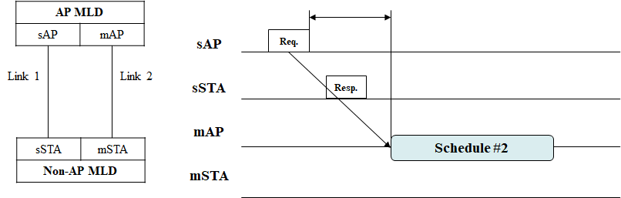
Several Issues on IMMW Scheduling
sAP would indicate the information of the schedule period
Time Synchronization
  Non-AP MLD needs to understand schedule start time in reference to TSF of mAP through the timing information (e.g., gap, start time/duration, …)
    However, TSF may not be signaled on mmWave bands
  Instead, we already have TSF offset (from TSF of sAP) that would be used to identify mAP’s TSF, while mAP’s TSF might be considered as the same as one of sAPs or an independent one

Slide 8
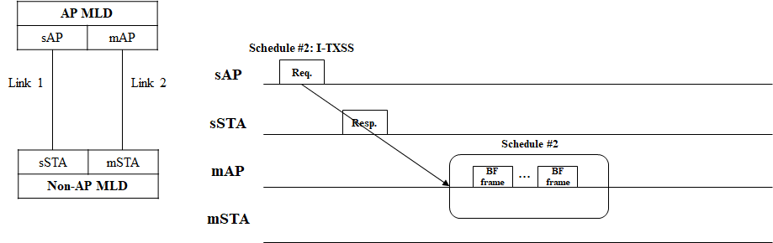
Several Issues on IMMW Scheduling (Cont’d)
Beamforming Training
  We can have dynamic BFT schedule(s) between when sAP/sSTA intends to initiate the BFT
    E.g., through Request/Response frame exchanges or an announced frame by assigning BFT type (e.g., TXSS, RXSS) and its relevant BFT Parameters
Periodicity
  We can have periodic schedules to enable periodic low latency traffic (e.g., based on SCS agreements) and (semi-) static BFT (see next slide)

Slide 9
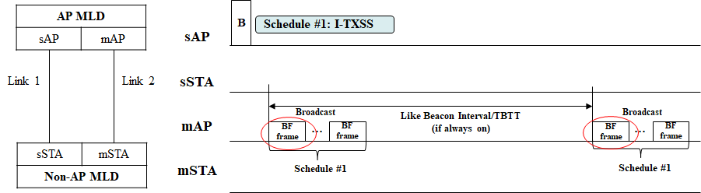
Discussion on Periodic Schedules
In terms of periodic schedule based on MLO, TWT framework can be used as a powerful candidate of scheduling mechanism
  TWT already had MLO function from 11be
(Semi-) Static BFT
  It would be similar to broadcast I-TXSS, which may be ON and OFF
    If always on, could consider TBTT and Beacon Interval on mAP
  Clearly, the frame should be light if present
  It can be useful to reduce I-TXSS overhead of mAP, but rather it may lead to management overhead on Sub-7GHz band (Beacon) and mmWave band (BF frame), for which we need to discuss about necessity and balance

Slide 10
Conclusion
In this contribution, we provided some considerations on IMMW using Multi-link Operation, especially in terms of schedule
  Assume no Beacon on mmWave while schedules for BFT and (data) frame exchanges can be announced on sAP(s) or negotiated between sAP and associated sSTA
We discussed Several issues on IMMW Scheduling
  Time Synchronization
  Dynamic BFT
  Periodicity
Especially, we discussed about Periodic Schedules for periodic LLT and (Semi-) Static BFT

Slide 11
Straw Poll 1
Do you support the following text in TGbq?
  A non-AP STA affiliated with a non-AP MLD and operating on a link in mmWave band shall not transmit the following Management frames:
    Probe Request frame
    (Re)Association Request frame
    Authentication frame
  An AP affiliated with an AP MLD and operating on a link in mmWave band shall not transmit the following Management frames:
    Beacon frame
    Probe Response frame
    (Re)Association Response frame
    Authentication frame

Slide 12
Straw Poll 2
Do you support the following text in TGbq?
  TGbq defines a mechanism for an MLD to allow an access the WM to exchange frames in a mmWave band, through an affiliated STA in sub-7GHz band
    Detail is TBD

Slide 13
Straw Poll 3
Do you support the following text in TGbq?
  TGbq defines a mechanism where a STA, that is affiliated with an MLD and operating in a Sub-7GHz band, indicates a dedicated period to its associated STA affiliated with another MLD for exchanging frames (e.g., beamforming training) on a link in a mmWave band
    Frame exchange is performed between two other STAs that are affiliated with the MLD and that another MLD, respectively and operating the link in the mmWave band

Slide 14
Straw Poll 4
Do you support the following text in TGbq?
  A TSF of an AP affiliated with an AP MLD and operating on mmWave is derived from a TSF of another AP affiliated with the same AP MLD as the AP operating on Sub-7GHz band
    The TSF will be derived from TSF offset and is not announced by the AP

Slide 15
Straw Poll 5
Do you support the following text in TGbq?
  11bq reuses or enhances TWT mechanisms for mmWave bands with the aid of Sub-7GHz bands
    NOTE: Any TWT setup/management mechanisms (e.g., setup/update/tear-down/announcement) are not performed on mmWave bands

Slide 16
References
[1] 24/459, Multi-link Operation for IMMW
[2] IEEE P802.11-REVme™/D7.0
[3] 24/1312, Draft P802.11bq PAR
[4] 24/549, IMMW Draft Proposed CSD
[5] 11-23/1905, High Level Thoughts on IMMW
[6] 11-23/1819, Integrated mmWave Design Considerations
[7] 11-23/1968, Discussion on general direction of integrated mmWave
[8] 11-25/433, Channel Access for IMMW

