Slide 1
Spatial Reuse for NPCA Capable STAs
Date: 2025-03-08
Authors:
Name | Affiliations | Address | Phone | Email
Salvatore Talarico | Nokia |  |  | salvatore.talarico@nokia.com
Klaus Doppler
Mika Kasslin
Okan Mutgan
Prabodh Varshney
Behnam Dezfouli
Behnam Dezfouli
Mikhail Liubogoshchev
Mika Kasslin
Eda Genc
Juhyung Lee
Juhyung Lee
Kerstin Johnsson
Oleg Chistyakov
Mario Costa
Enrico Rantala

Slide 2
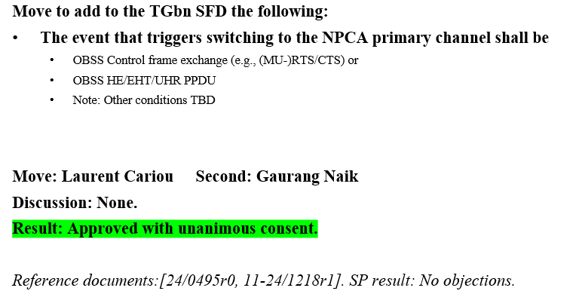
Introduction
During the past IEEE 802.11 Interim and Ad-Hoc meetings, NPCA has been agreed ([1-10]) and the following motion was approved:
This motion does not indicate any restrictions about the received power of the OBSS: the received power must be higher than -82 dBm for PD. However, this value may change if Spatial Reuse (SR) is used.
During the Warsaw IEEE 802.11 Interim Meeting, it was agreed to disable the parametrized SR (PSR), when NPCA is enabled [11], and to further discuss the interoperability between OBSS-PD SR and NPCA.

Slide 3
Recap: 802.11ax Spatial Reuse
In 802.11ax,
  The concept of BSS coloring was introduced which assigns a unique label to each BSS
    AP randomly selects a color (1-63) and mentions it in the HE Operation element in the beacon or probe responses, which is indicated in the SIG-A field of the PHY header for any frames sent in the BSS.
    If collision is detected (STAs belonging to an OBSS are using same color), a collision is reported through an Event Report Frame where an AP disables its own color (BSS Color Disabled bit in the HE Operation element) and then sends a BSS Color Change Announcement or a specific HE BSS Color Change announcement action frame.
  Some interference mitigation techniques are introduced with two flavors:
    OBSS Packet Detection (PD)-based SR: used mainly for untriggered transmissions and to allow to ignore the transmissions of the OBSS system thereby by choosing properly an OBSS PD thresholds, and consequently reducing the transmit power to minimize the disruptions to the neighboring OBSS when transmitting concurrently
    Parametrized SR (PSR): used for trigger-based transmissions and aims to inform STAs in the neighboring OBSSs how much they can transmit without affecting the reference AP’s ability to properly decode the uplink frames from its own associated STAs

Slide 4
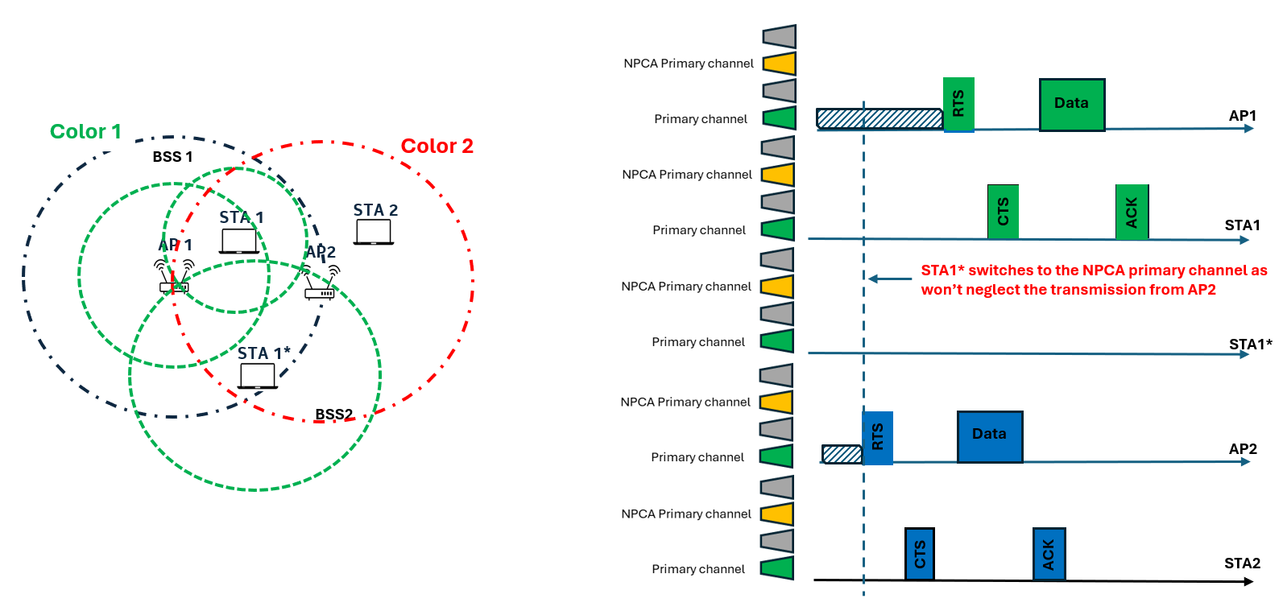
Problem Statement
When NPCA is jointly enabled with SR, based on the OBSS PD thresholds that STAs may select the ambiguity that NPCA creates when it comes to determining when to switch to the NPCA primary channel is exacerbated.
  In the example below, SR with non-SRG OBSS PD is jointly enabled with NPCA, and within BSS1 all the STAs will accordingly select their OBSS PD values so that to reduce footprint and impact on BSS2. However, while AP1 and STA1 select their non-SRG OBSS PD so that they can ignore transmissions from AP2, STA1* cannot. So this would lead AP1 and STA1 to continue to stay on the primary channel, while STA1* will switch to NPCA primary channel.

Slide 5
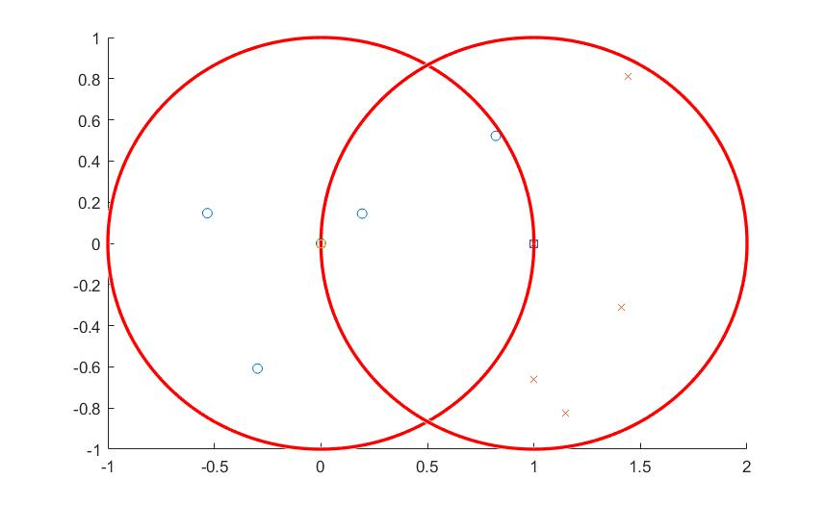
Evaluations – Simulation Parameters
Deployment
Assumptions
1 Reference AP and 1 OBSS AP with R=1
4 associated non-AP STAs per each AP
TxOP-Based NPCA with TxOP length of 1.5 ms
BSS and OBSS operate on the same primary channel
Same Tx power and noise figure across all STAs
BSS BW of 160 MHz
  Primary 80 MHz when primary is used
  Secondary 80 MHz when NPCA primary is used
No link adaptation (for simplicity)
  Tx is done with typical MCS 7 (64-QAM and 5/6 coding rate)
    MCS 5 is used when Tx power is reduced due to SR
STAs having full buffer
Omnidirectional antennas at both AP and non-AP STA
All STAs have same switching delay: [128us]
Ref AP
OBSSAP
D
OBSS non-AP STA
Ref non-AP STA
R

Slide 6
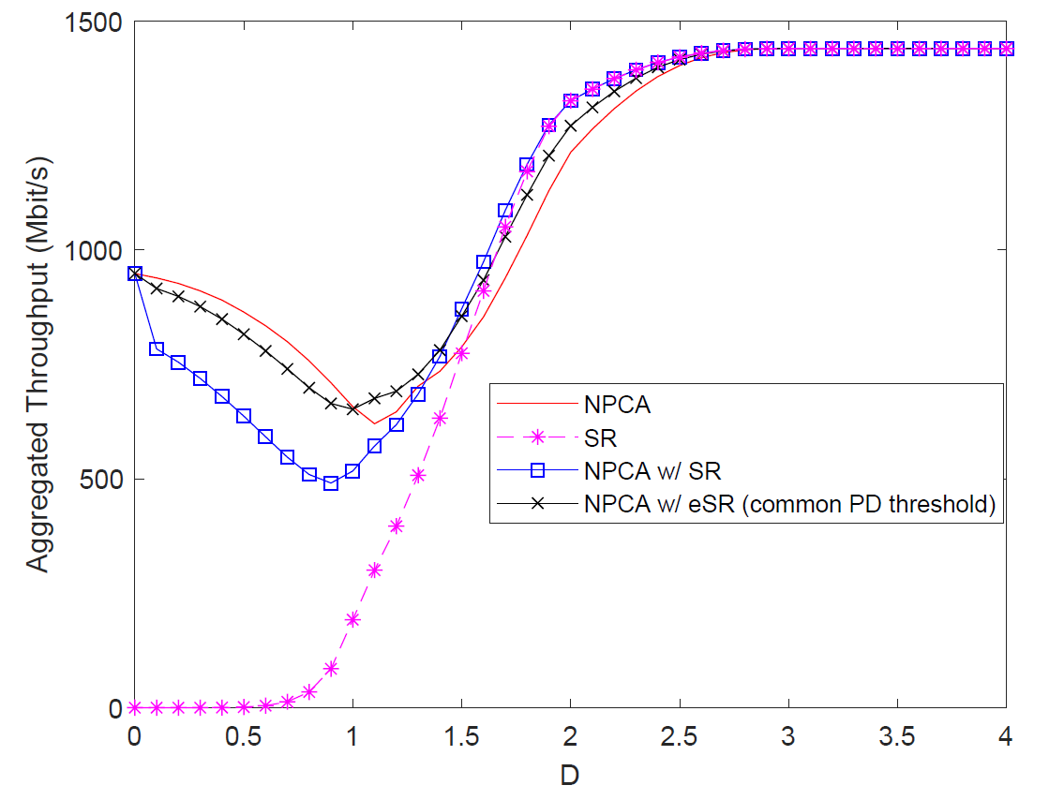
Evaluations – Results
Observations:
NPCA allows to achieve higher aggregated throughput when the OBSS is closer, while OBSS-PD based SR is preferred when the distance among BSS and OBSS is larger.
When NPCA and OBSS-PD based SR are jointly used, more STAs will end up having different perspective on whether an OBSS transmission shall or shall not trigger a switch to the NPCA primary channel, which leads to high degradation in terms of aggregated throughput especially as the distance between BSS and OBSS is smaller.
In order to have a more homogeneous behavior across all STAs, when operating NPCA and SR jointly, SR could be enhanced by introducing a common PD threshold that is announced by the AP and used by all the non-AP STAs (eSR).
  This allows to mitigate the ambiguity across STAs in terms of which primary channel to use
  Allows STAs to avoid more frequently to switch to the NPCA primary channel, which leads to spectral efficiency loss due to the related switching delays.

Slide 7
Proposal
In order to mitigate the issue highlighted in this deck of slide:
  Option 1: NPCA is never used jointly with OBSS-PD based SR
    Since these two features address the same issue (i.e., overlapping of OBSS transmissions), these are used orthogonally based on TBD conditions
  Option 2 (Preferred): NPCA can be jointly used with OBSS PD-based SR
    A common OBSS PD threshold is defined to mitigate the ambiguity in switching among devices belonging to the same BSS
    NPCA primary channel is triggered by the detection of OBSS Control frame exchange (e.g., (MU-)RTS/CTS) or OBSS HE/EHT/UHR PPDU with a power level higher than the common OBSS PD threshold
    SR transmit power constraints are applied regardless of whether a STA operate on primary or NPCA primary channel

Slide 8
Summary
In this contributions, we discussed the negative impact of SR on NPCA, when these two features are used together.
To address this issue two options are provided:
  Option 1: NPCA is never used jointly with OBSS-PD based SR
  Option 2 (Preferred): NPCA can be jointly used with OBSS PD-based SR
    A common OBSS PD threshold is defined to mitigate the ambiguity in switching among devices belonging to the same BSS
    NPCA primary channel is triggered by the detection of OBSS Control frame exchange (e.g., (MU-)RTS/CTS) or OBSS HE/EHT/UHR PPDU with a power level higher than the common OBSS PD threshold
    SR transmit power constraints are applied regardless of whether a STA operate on primary or NPCA primary channel

Slide 9
Straw Poll #1
Do you agree that when NPCA and OBSS PD based SR are operated jointly, an AP indicates in the SR Parameter Set element a common PD threshold that all its associated STAs shall use?
  Yes
  No
  Abstain

Slide 10
References
[1] IEEE 802.11-23/34, “Non-primary channel utilization”, Sindhu Verma
[2] IEEE 802.11-23/631, “Secondary channel usage and secondary 20MHz channel backoff”, Liwen Chu
[3] IEEE 802.11-23/797, “Non-primary channel access”, Yongho Seok
[4] IEEE 802.11-23/961, “UHR secondary channel access”, Minyoung Park
[5] IEEE 802.11-23/1112, “Thoughts on secondary channel access”, Insun Jang
[6] IEEE 802.11-23/1365, “Discussions on non-primary channel access”, Sanghyun Kim
[7] IEEE 802.11-23/1891, “Nonprimary Channel Access Follow-Up”, Gaurang Naik
[8] IEEE 802.11-23/1911, “Secondary channel access and frame transmission”, Dongju Cha
[9] IEEE 802.11-23/1951, “Concurrent CCA for non-primary channel access”, Leonardo Lanante
[10] IEEE 802.11-24/1762, “PDT-MAC-NPCA”, Matthew Fischer
[11] IEEE 802.11-24/0757, “CC50 CR for CID 2697 - Spatial Reuse for NPCA Capable STAs”, Salvatore Talarico

Slide 11
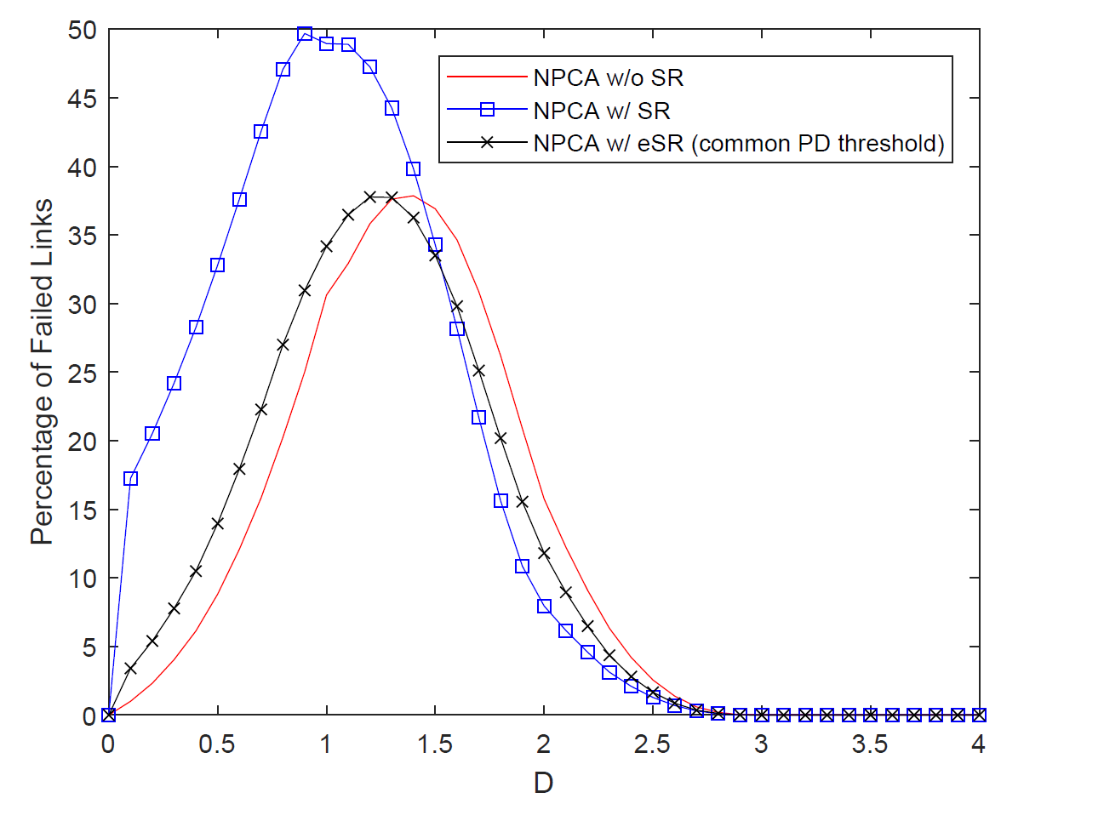
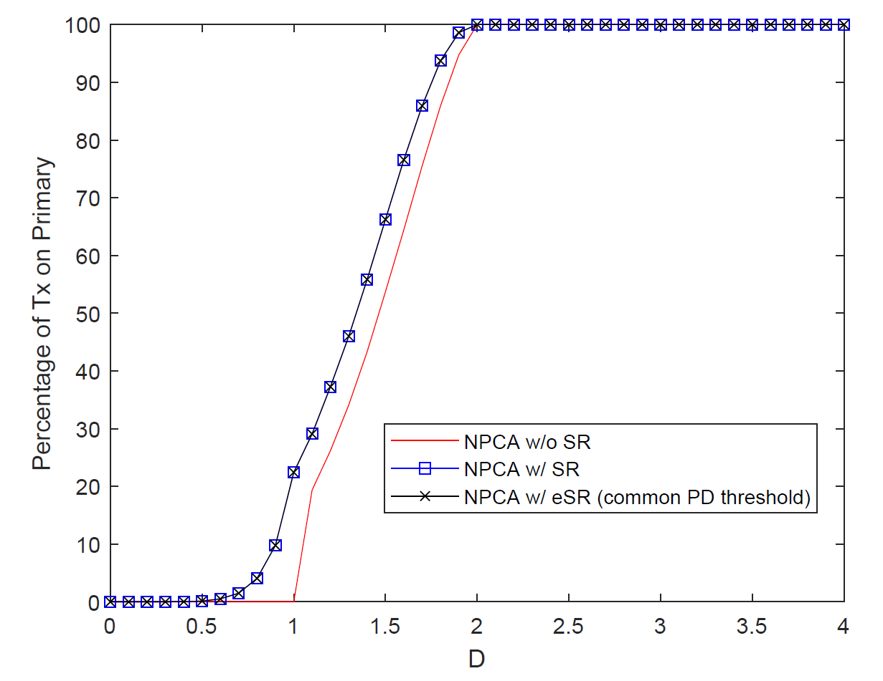
Appendix

