Slide 1
NPCA Operation with TxOP based MAPC Schemes
Date: 2025-03-05
Authors:
Name | Affiliations | Address | Phone | Email
Salvatore Talarico | Nokia |  |  | salvatore.talarico@nokia.com
Klaus Doppler
Kerstin Johnsson
Okan Mutgan
Prabodh Varshney
Behnam Dezfouli
Behnam Dezfouli
Mika Kasslin
Mika Kasslin
Eda Genc
Juhyung Lee
Juhyung Lee
Mikhail Liubogoshchev
Oleg Chistyakov
Mario Costa
Enrico Rantala

Slide 2
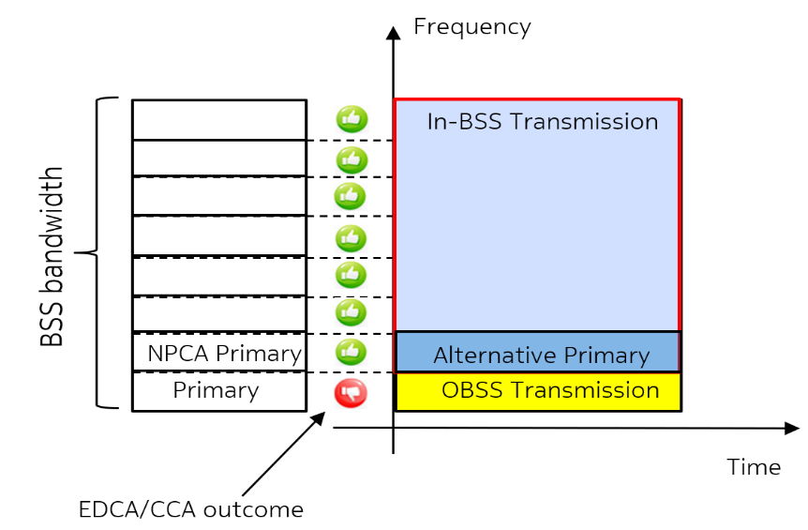
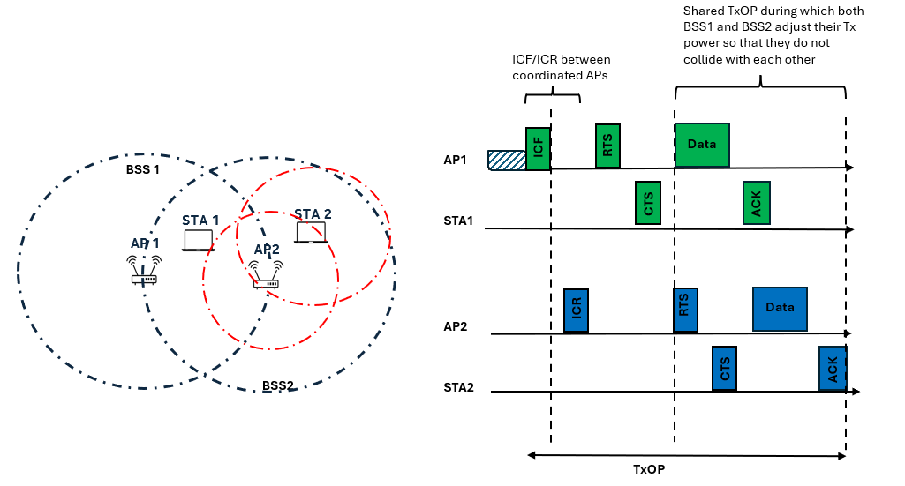
Introduction
During the past IEEE 802.11 Interim and Ad-Hoc meetings, the following features have been agreed, and their design has been individually discussed ([1-13]) leading to several motions and their related PDT ([10-13]):
  Non-primary channel access (NPCA) [1-10]: The basic concept is to temporarily utilize an idle alternative channel as a primary channel, called here NPCA primary channel, when the BSS’s primary channel is occupied by OBSS or other conditions (bottom left figure).
  Multiple AP schemes that are based upon TxOP sharing such as for example coordinated Spatial Reuse (Co-SR), where the basic concept is by means of coordination among multiple APs and by leveraging a coordinated power control management, it is possible to protect each other schedules within a shared portion of the TxOP that is hold by one of the coordinated APs and to avoid that overlapping transmissions may negatively impact each other reception.

Slide 3
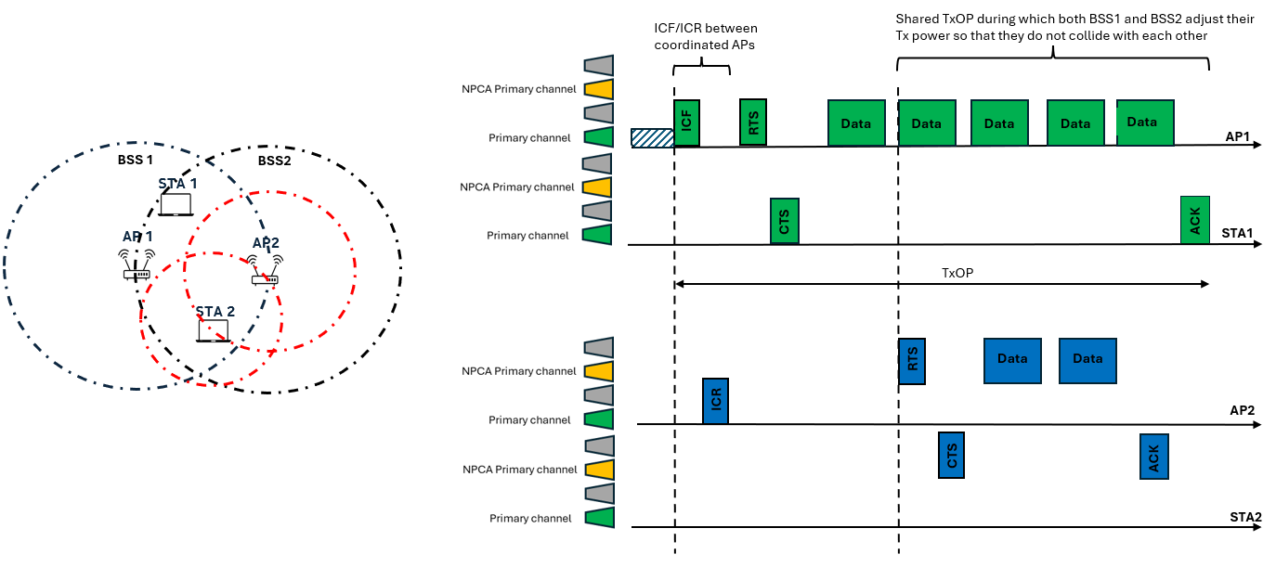
Problem Statement (1/3)
While it is important to focus on the individual design of these features, it is also important to focus on the interoperability between them:
  When NPCA and co-SR are operated jointly, after ICF/ICR exchange between AP1 and AP2, where it is announced and negotiated the power to use during a shared amount of time so that they can both transmit without interfering with each other, STA2 may switch to an NPCA primary channel since it sees a transmission overlapping with its primary. However, in this case, switching should not have happened since the overlapping transmission comes from the coordinating AP. Notice this same issue arise in other coordinated schemes that are based upon TxOP sharing (e.g., co-TDMA, or co-BF)
  .

Slide 4
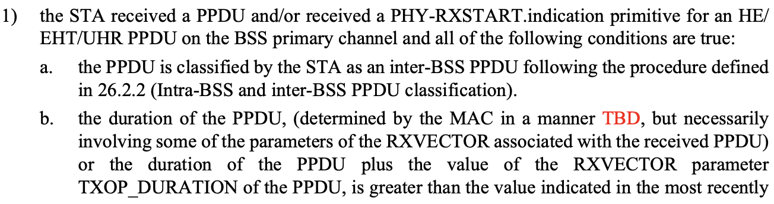
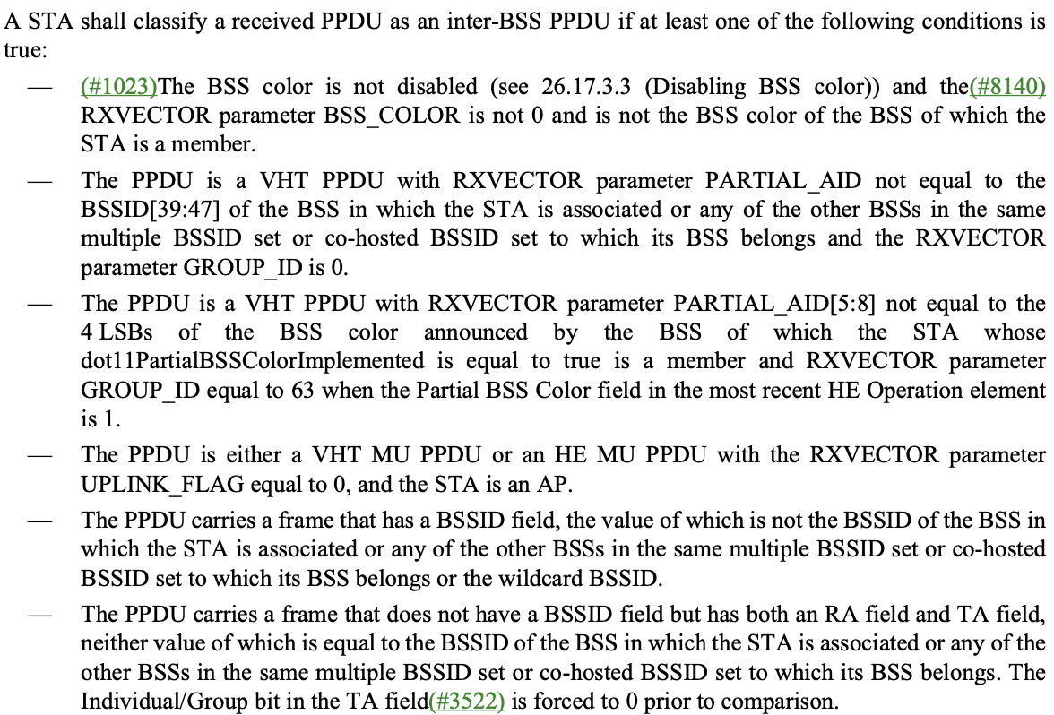
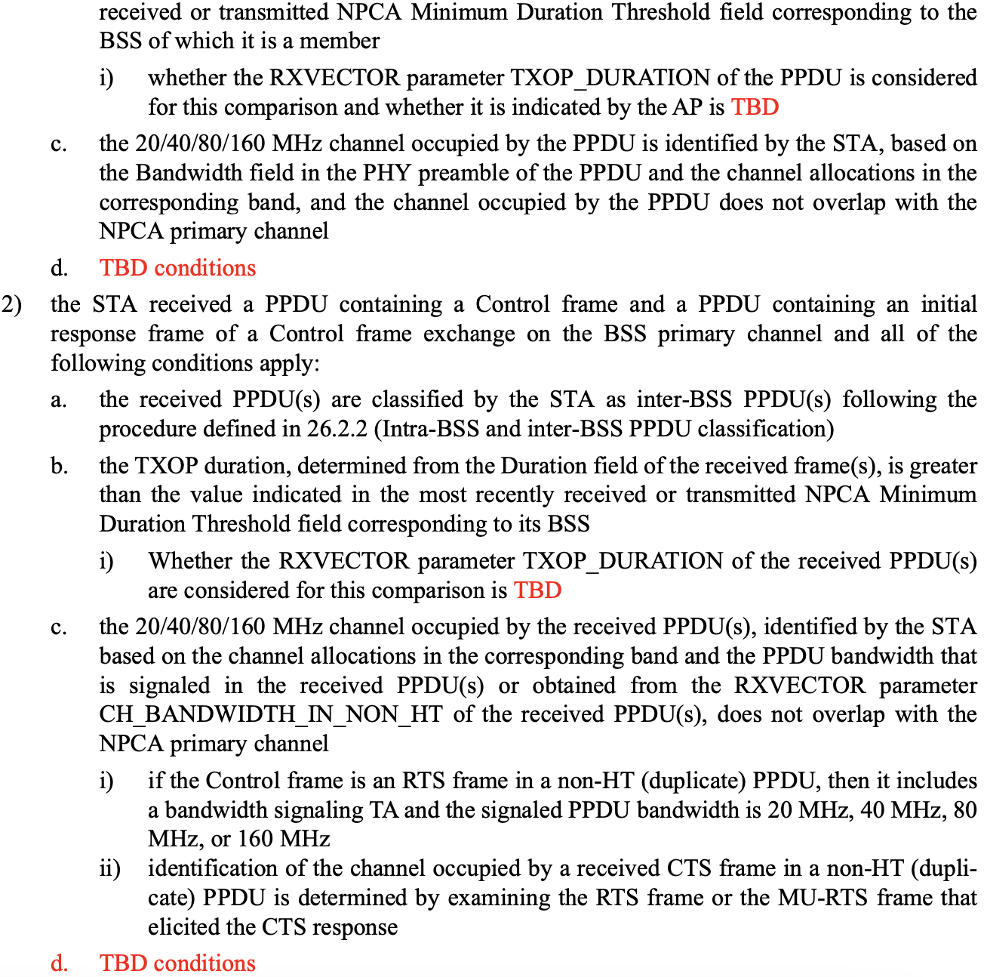
Problem Statement (2/3)
  NPCA switching Conditions from Section 37.11
  Definition of inter-BSS PPDU from Section 26.2.2

Slide 5

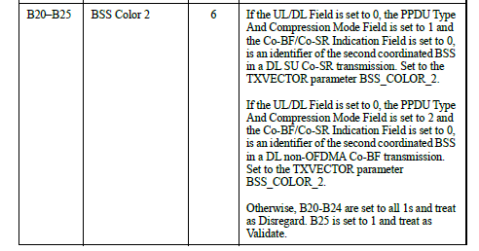
Problem Statement (3/3)
  802.11bn introduced the “BSS Color 2” field in the U-SIG for UHR MU PPDU to carry an identifier of the coordinated BSS
  No field is introduced for UHR TB PPDU
  No mechanism is introduced in 37.11 to classify transmissions from a coordinating BSS occurring in a shared TxOP as inter-BSS transmissions.

Slide 6
Proposals
For coordinated schemes, that are based upon TxOP sharing, such as co-SR, co-TDMA and co-BF, NPCA may be jointly enabled.
When NPCA is jointly enabled with a coordinate scheme that is based upon TxOP sharing, such as co-SR or co-TDMA, a shared or sharing AP and its associated non-AP STAs shall not switch to NPCA primary channel if the OBSS transmission overlapping with the primary channel that triggered the switch belongs to the shared or sharing AP or any of its associated STAs.
  APs can announce the BSS color of the coordinating APs, and within a shared TxOP a shared (and sharing) AP and its associated STAs shall switch to the NPCA primary channel only when receiving the OBSS packets from BSS(s) whose BSS color is different than that of the sharing (and shared) AP.

Slide 7
Summary
In this contributions we discussed a fundamental issue that arise when operating NPCA with one of the multiple AP schemes that are based upon TxOP sharing (e.g., co-SR, co-TDMA and co-BF) as a coordinating STA may switch during a TxOP due to OBSS transmissions from other coordinating STA belonging to a different BSS.
In order to properly operate these features jointly, it is necessary that a shared or sharing AP and its associated non-AP STAs shall not switch to NPCA primary channel if the OBSS transmission overlapping with the primary channel that triggered the switch belongs to the shared or sharing AP or any of its associated STAs.

Slide 8
Straw Poll #1
Do you agree that NPCA and any TxOP Based MAPC scheme (i.e., Co-TDMA, Co-SR, and co-BF) may be operated jointly ?
  Yes
  No
  Abstain

Slide 9
Straw Poll #2
Do you agree that when NPCA is jointly enabled with either co-SR, co-TDMA or co-BF, a shared or sharing AP and its associated non-AP STAs shall not switch to NPCA primary channel if the OBSS transmission overlapping with the primary channel that triggered the switch belongs to the shared or sharing AP or any of its associated STAs?
  Yes
  No
  Abstain

Slide 10
Straw Poll #3
Do you agree that APs shall announce their BSS colors, and within a shared TxOP a shared (and sharing) AP and its associated STAs shall switch to the NPCA primary channel only when receiving the OBSS packets from BSS(s) whose BSS color is different that that of the sharing (and shared) AP?
  Yes
  No
  Abstain

Slide 11
References
[1] IEEE 802.11-23/34, “Non-primary channel utilization”, Sindhu Verma
[2] IEEE 802.11-23/631, “Secondary channel usage and secondary 20MHz channel backoff”, Liwen Chu
[3] IEEE 802.11-23/797, “Non-primary channel access”, Yongho Seok
[4] IEEE 802.11-23/961, “UHR secondary channel access”, Minyoung Park
[5] IEEE 802.11-23/1112, “Thoughts on secondary channel access”, Insun Jang
[6] IEEE 802.11-23/1365, “Discussions on non-primary channel access”, Sanghyun Kim
[7] IEEE 802.11-23/1891, “Nonprimary Channel Access Follow-Up”, Gaurang Naik
[8] IEEE 802.11-23/1911, “Secondary channel access and frame transmission”, Dongju Cha
[9] IEEE 802.11-23/1951, “Concurrent CCA for non-primary channel access”, Leonardo Lanante
[10] IEEE 802.11-24/1762, “PDT-MAC-NPCA”, Matthew Fischer
[11] IEEE 802.11-24/2031, “PDT MAC Coordinated-Spatial-Reuse”, Jason Yuchen Guo
[12] IEEE 802.11-24/86, “PDT MAC C-TDMA”, Sanket Kalamkar
[13] IEEE 802.11-24/8, “PDT MAC Coordinated-Beamforming”, Jason Yuchen Guo

