Slide 1
Enhancements to critical updates procedure – gen indication
Date: 2025-06-06
Name | Affiliation | Address | Phone | Email
Abhishek Patil | Qualcomm Inc. |  |  | appatil@qti.qualcomm.com
Gaurang Naik
George Cherian
Alfred Asterjadhi
Duncan Ho
Giovanni Chisci
Sanket Kalamkar
Sherief Helwa

Slide 2
Motivation
Up until now, the mechanism to indicate critical updates has been common across generations.
  The Check Beacon field in the TIM frame is incremented each time there is an update to an element listed in clause 11.2.3.14
  The common framework does not differential updates for a certain generation
    Each new generation adds more elements to the critical updates set, thereby increasing the frequency of an update.
    As a result, it is more likely that a client device belonging to an earlier generation burns power to read the entire beacon (or probing the AP) only to find no change to the parameters that matter to it (i.e., the update occurred for parameters belong to a later gen)
      For example, a 11n device that is in power-save and only monitoring TIM frames, will wake-up during TBTT to receive the Beacon frame when the Check Beacon field is incremented due to an update to a 11ax element.
EHT extended the critical updates framework to include multi-link which further aggravates the issue.
  EHT added an early indication to signal an update to any link of the AP MLD, a change sequence counter for each link, and an indication of whether all the updates for another link are included in the Beacon itself etc.
TGbn aims to address beacon bloating by limiting the inclusion of new elements defined by UHR and later gens in the Beacon frame
  However, such a scheme can lead to probe storm wherein multiple STAs poll the AP to retrieve a critical update.
Therefore, it would be beneficial, if there is a scheme to identify the generation for which an update has occurred (for any link).
  Clients belonging to an earlier generation can ignore the update if it is for a later generation
    Helps save power and reduce the number of clients that may query the AP to retrieve the updates

Slide 3
Solution summary
Identify the generation of the update(s)
  Allows a client to ignore updates belong to a later generation
  Also reduces the number of clients that could potentially poll the AP to retrieve the updates
Maintain backward compatibility while performing the above
  No change to existing critical updates signaling and the mechanisms to retrieve them
  Define signaling scheme that will be ignored by pre-11bn clients
  Client can determine AP’s gen during assoc.
    Assoc / Probe Resp required to carry all Op/Cap elements of the AP
    Beacon expected to carry (UHR) Op element of (UHR) AP

Slide 4
Terminology
CUF → critical updates flag (CUF) defined by TGbe (EHT)
  Set to 1, when a critical update occurs on any link, until and including the next DTIM beacon
Gen Update → a 3 bits field with the ability to indicate up to 7* generations (i.e., UHR and beyond)
  *Value 0 indicates no update or update to pre-UHR
  Value 1 = UHR/WiFi8, 2 = WiFi9 so on…
  In case of updates to multiple generations, indicates the earliest gen (UHR and beyond) for which the update exists
    This is because updates belonging to an earlier gen are of interest for STAs of later gens
  Valid until and including the next DTIM beacon when a critical update occurs on any link
BPCC → BSS Parameters Change Count (as defined by EHT).
  BPCC is link specific and is incremented each time there is an update for any pre-UHR generation
    Not incremented for updates post EHT
uBPCC → new BSS Parameters Change Count (applies to UHR and beyond)
  uBPCC is link specific and is incremented each time there is an update for any generation UHR and beyond
    Not incremented for updates pre-UHR
  Reused by gens beyond UHR – i.e., WiFi9 doesn’t need to define a new BPCC.

Slide 5
Summary of operation
CUF (EHT) | BPCC | Gen Update | uBPCC | Remark
1 | ++ | 000 | No change | Updates to pre-UHR parameters – follow EHT’s critical updates mechanism (appropriate link’s BPCC gets incremented)
0 | No change | nonzero | ++ | Updates to UHR or beyond – check Gen Update fields to determine the gen of the updates. (appropriate link’s uBPCC gets incremented)
When there is an update for UHR and beyond, the legacy CUF is not set and as a result, EHT STAs will not be woken-up
  Thus, EHT STAs are not impacted by updates that apply only to future gens (UHR and beyond)
  A separate BPCC (uBPCC) is incremented.
  Maintain a separate list for UHR and beyond (i.e., not added to 11.2.3.14)
In the event when there is an update to EHT and UHR (or later), the CUF, Gen Update and both BPCCs are affected.

Slide 6
Examples
Ex1: AP is WiFi9 and there is an update to the EHT params of the transmitting link:
  CUF (1), UHR AP (1), Gen Update (0), BPCC++ in basic ML IE. BPCC in RNR for the other links is not increment. uBPCC for any link is not incremented
Ex2: AP is WiFi8 and there is an update to EHT parameter of another link:
  CUF (1), UHR AP (1), Gen Update (0), BPCC++ in RNR corresponding to the affected link. BPCC in basic ML IE is not incremented. uBPCC for any link is not incremented.
Ex3: AP is WiFi10 and there is an update to the WiFi9 params of the transmitting link:
  CUF (0), UHR AP (1), Gen Update (2), uBPCC++ in basic ML IE. uBPCC in RNR for the other links is not increment. BPCC for any link is not incremented.
Ex4: AP is WiFi8 and there is an update to WiFi8 parameter of another link:
  CUF (0), UHR AP (1), Gen Update (1), uBPCC++ in RNR corresponding to the affected link. uBPCC in basic ML IE is not increment. BPCC for any link is not incremented.

Slide 7
Signaling options
For an AP that is a TxBSSID or has dot11MultiBSSID equals false:
  Having an indication in the early portion of the beacon frame can help a client device determine whether to look for the updates in the remaining portion of the beacon frame.
  Repurpose reserved bits from Capability Information field (9.4.1.4 / see appendix) or potentially set aside some bits from PVB of the TIM element
    Meaning of B6 (CUF) and B7 (nonTxBSSID CUF) in Capability Information field is preserved → i.e., EHT CUFs

Slide 8
Signaling options
For an AP corresponding to the nonTxBSSID:
  Repurpose reserved bit(s) from Capability Information field or set aside bit(s) from TIM to indicate a UHR or beyond update for nonTxBSSID
  Repurpose bits from Capabilities Information field (e.g., B2, B3, B14) within Nontransmitted BSSID Capability element (9.4.2.70 / see appendix)
    Meaning of B6 (CUF) is preserved.
    Note, B7 within Cap Info of NonTxBSSID Cap IE is reserved

Slide 9
Retrieving updates
TGbn aims to address beacon bloating by limiting the inclusion of new elements defined by UHR and later gens in the Beacon frame
  The omitted elements could be obtained via probing or during association.
  However, such a scheme can lead to probe storm wherein multiple STAs poll the AP to retrieve a critical update.
Various options to alleviate this (UHR AP may support more than one):
  Option 1: An AP may include the updated elements in the Beacon frame.
    This could be the case when the AP’s beacon is short (e.g., home scenario)
  Option 2: UHR AP transmits a broadcast response when it receives a query to retrieve updates
    Helps suppress queries from other non-APs that are trying to retrieve the updates.
  Option 3: UHR AP transmits a (broadcast) frame which provides the updates
    The frame could be a probe response frame
When the updates belong to a later generation, a client device may skip processing of the remainder of the Beacon frame or querying the AP to retrieve the latest parameters.
  In such case, the client can locally increment the sum of the BPCC value for each link.
    Since the client won’t know link which encountered an update and hence doesn’t know which BPCC(s) were increment.

Slide 10
Appendix

Slide 11
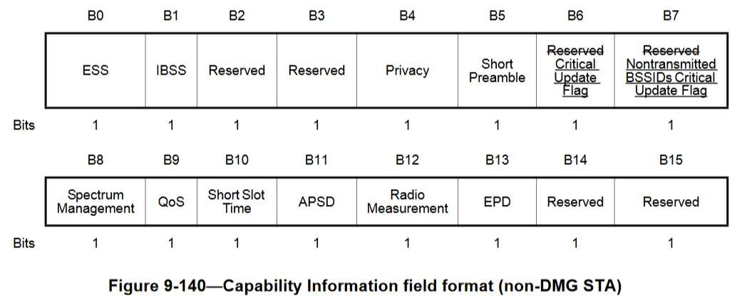
Format of Capability Information field [9.4.1.4]
BACK

Slide 12
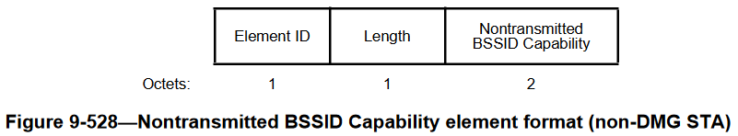
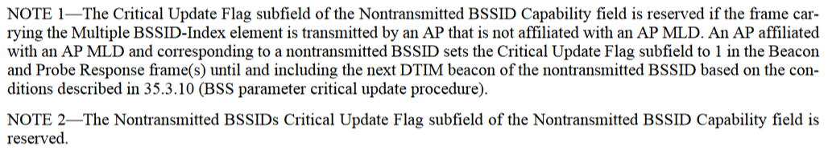
Format of NonTxBSSID Capabilities element [9.4.2.70]
BACK

