Slide 1
Discussion on Design of Interference Mitigation Pilots
Date: 2025-03-10
Authors:
Name | Affiliation | Address | Phone | email
Ke Zhong | Ruijie Networks Co., Ltd. |  |  | zhongke@ruijie.com.cn
Fachang Guo

Slide 2
Abstract
Introduction
Discussion on design of interference mitigation pilots
Conclusion

Slide 3
Introduction
In PAR of P802.11bn, the Ultra High Reliability (UHR) capability has been defined to improve Rate-vs-Range enhancement, reduce latency, and reduce power consumption for AP, compared to Extremely High Throughput (EHT) MAC/PHY operation [1].
Interference is one of the most detrimental factors limiting the performance of WLAN systems. To achieve the goal of UHR, the motion for interference mitigation was passed in the September 2024 Interim meeting [2]:
Several contributions [3]-[9] have been submitted to investigate the design of additional pilots for interference mitigation including its rationality, benefits, required number of additional pilots and impact on Tx block, as well as signalling etc.
A few more progress for Interference Mitigation (IM) was recently achieved in the January 2025 Interim meeting [2]:
Define a mode with additional pilots, located within the data portion of the PPDU, which are used for interference estimation and mitigation.
  Note: zero-energy pilots alternative to be considered as well
[Motion #35, [1] and [87]]
The Interference Mitigation feature is only defined with LDPC.
[Motion #245, [264] and [279]]
For each bandwidth, there is a fixed number of IM pilots (value TBD).
[Motion #246, [264] and [279]]
Within any transmission that uses IM pilots, they are used in every data OFDM symbol and in the same corresponding subcarriers positions, for a given BW.
[Motion #247, [264] and [279]]

Slide 4
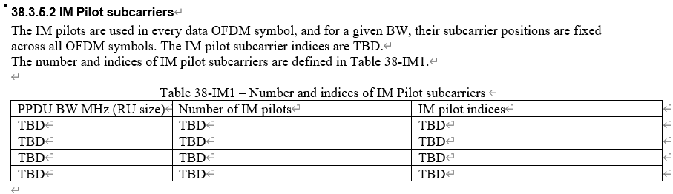
Current PDT PHY Interference Mitigation [10] - Recap
PPDU BW (RU size), number of IM pilots and IM pilots indices are TBD.
In this contribution, some thoughts on design of IM pilots are provided for discussion.

Slide 5
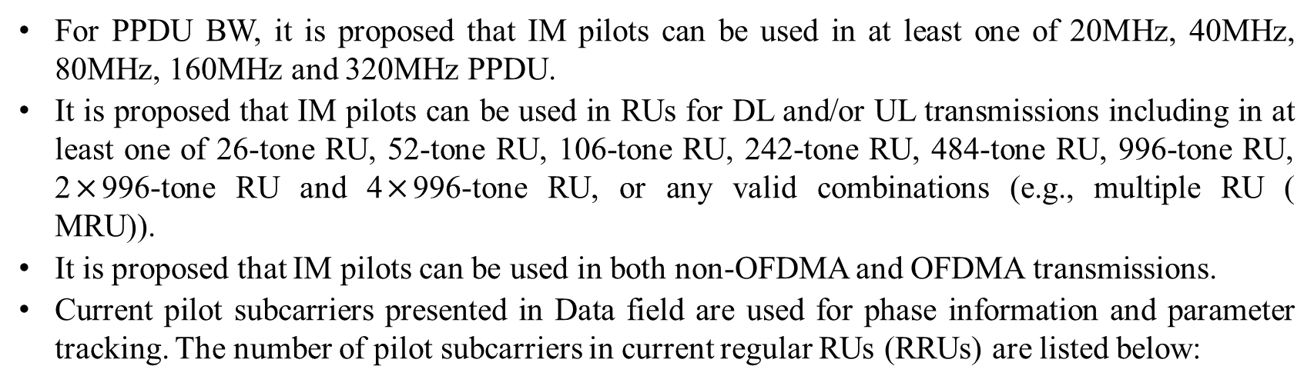
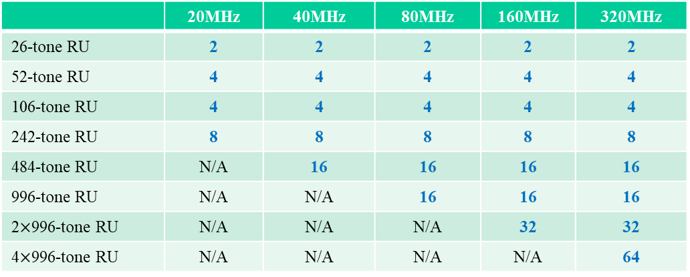
Discussion on design of interference mitigation pilots
For PPDU BW, it is proposed that IM pilots can be used in at least one of 20MHz, 40MHz, 80MHz, 160MHz and 320MHz PPDU.
It is proposed that IM pilots can be used in RUs for DL and/or UL transmissions including in at least one of 26-tone RU, 52-tone RU, 106-tone RU, 242-tone RU, 484-tone RU, 996-tone RU, 2$×$996-tone RU and 4$×$996-tone RU, or any valid combinations (e.g., multiple RU (
MRU)).
It is proposed that IM pilots can be used in both non-OFDMA and OFDMA transmissions.
Current pilot subcarriers presented in Data field are used for phase information and parameter tracking. The number of pilot subcarriers in current regular RUs (RRUs) are listed below:
 | 20MHz | 40MHz | 80MHz | 160MHz | 320MHz
26-tone RU | 2 | 2 | 2 | 2 | 2
52-tone RU | 4 | 4 | 4 | 4 | 4
106-tone RU | 4 | 4 | 4 | 4 | 4
242-tone RU | 8 | 8 | 8 | 8 | 8
484-tone RU | N/A | 16 | 16 | 16 | 16
996-tone RU | N/A | N/A | 16 | 16 | 16
2$×$996-tone RU | N/A | N/A | N/A | 32 | 32
4$×$996-tone RU | N/A | N/A | N/A | N/A | 64

Slide 6
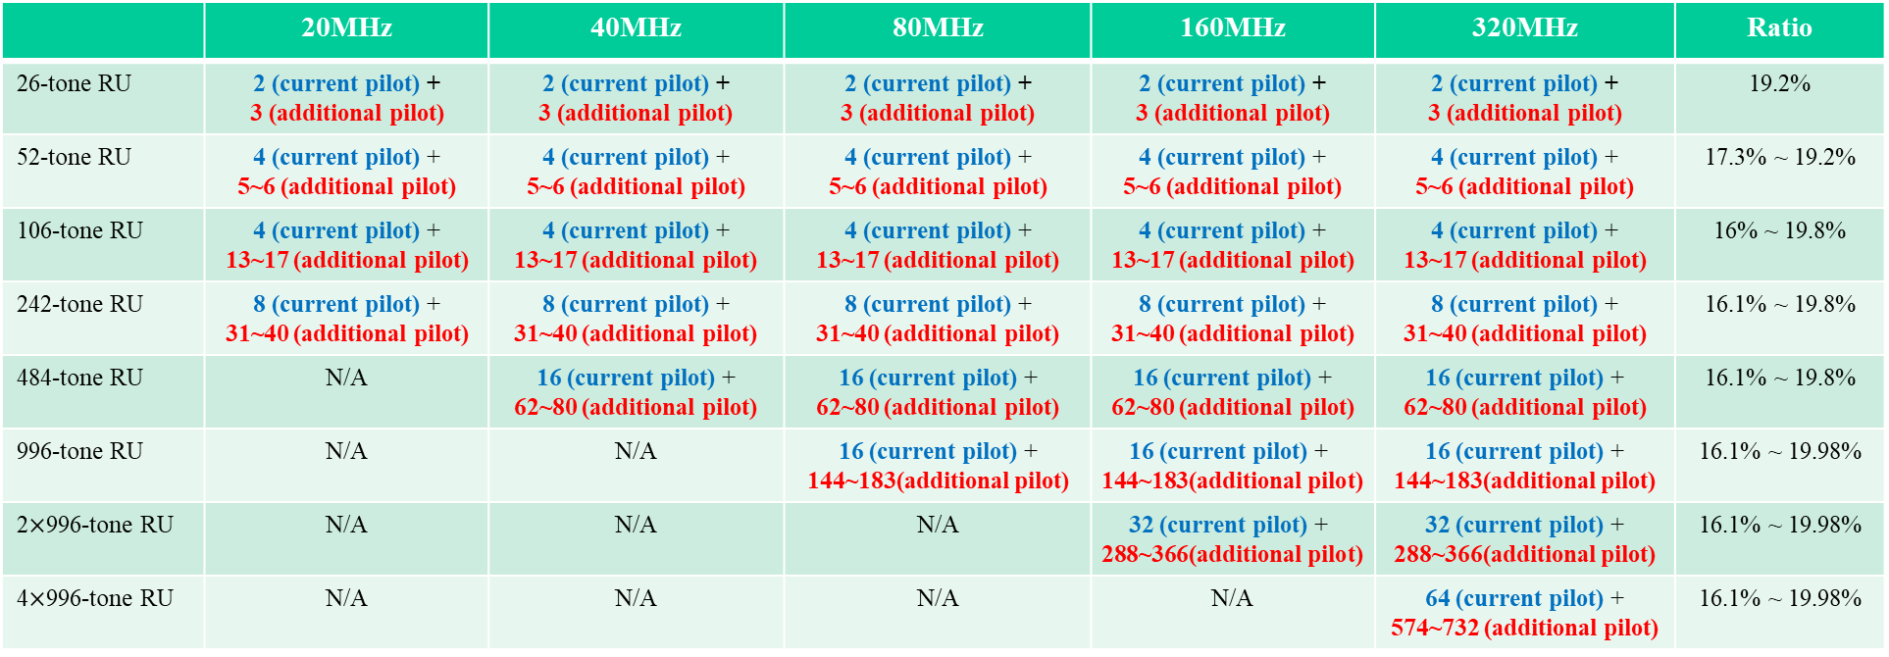
Discussion on design of interference mitigation pilots - method 1
IM pilots are additional pilots, located within the data portion of the PPDU, which are used for interference estimation. The number of IM pilot (current pilot + additional pilot) subcarriers in RRUs are suggested as shown below:
 | 20MHz | 40MHz | 80MHz | 160MHz | 320MHz | Ratio
26-tone RU | 2 (current pilot) + 3 (additional pilot) | 2 (current pilot) + 3 (additional pilot) | 2 (current pilot) + 3 (additional pilot) | 2 (current pilot) + 3 (additional pilot) | 2 (current pilot) + 3 (additional pilot) | 19.2%
52-tone RU | 4 (current pilot) + 5~6 (additional pilot) | 4 (current pilot) + 5~6 (additional pilot) | 4 (current pilot) + 5~6 (additional pilot) | 4 (current pilot) + 5~6 (additional pilot) | 4 (current pilot) + 5~6 (additional pilot) | 17.3% ~ 19.2%
106-tone RU | 4 (current pilot) + 13~17 (additional pilot) | 4 (current pilot) + 13~17 (additional pilot) | 4 (current pilot) + 13~17 (additional pilot) | 4 (current pilot) + 13~17 (additional pilot) | 4 (current pilot) + 13~17 (additional pilot) | 16% ~ 19.8%
242-tone RU | 8 (current pilot) + 31~40 (additional pilot) | 8 (current pilot) + 31~40 (additional pilot) | 8 (current pilot) + 31~40 (additional pilot) | 8 (current pilot) + 31~40 (additional pilot) | 8 (current pilot) + 31~40 (additional pilot) | 16.1% ~ 19.8%
484-tone RU | N/A | 16 (current pilot) + 62~80 (additional pilot) | 16 (current pilot) + 62~80 (additional pilot) | 16 (current pilot) + 62~80 (additional pilot) | 16 (current pilot) + 62~80 (additional pilot) | 16.1% ~ 19.8%
996-tone RU | N/A | N/A | 16 (current pilot) + 144~183(additional pilot) | 16 (current pilot) + 144~183(additional pilot) | 16 (current pilot) + 144~183(additional pilot) | 16.1% ~ 19.98%
2$×$996-tone RU | N/A | N/A | N/A | 32 (current pilot) + 288~366(additional pilot) | 32 (current pilot) + 288~366(additional pilot) | 16.1% ~ 19.98%
4$×$996-tone RU | N/A | N/A | N/A | N/A | 64 (current pilot) + 574~732 (additional pilot) | 16.1% ~ 19.98%
Note: [8] shows that 16% ~ 20% of the resources for IM pilots yield improved performance.

Slide 7
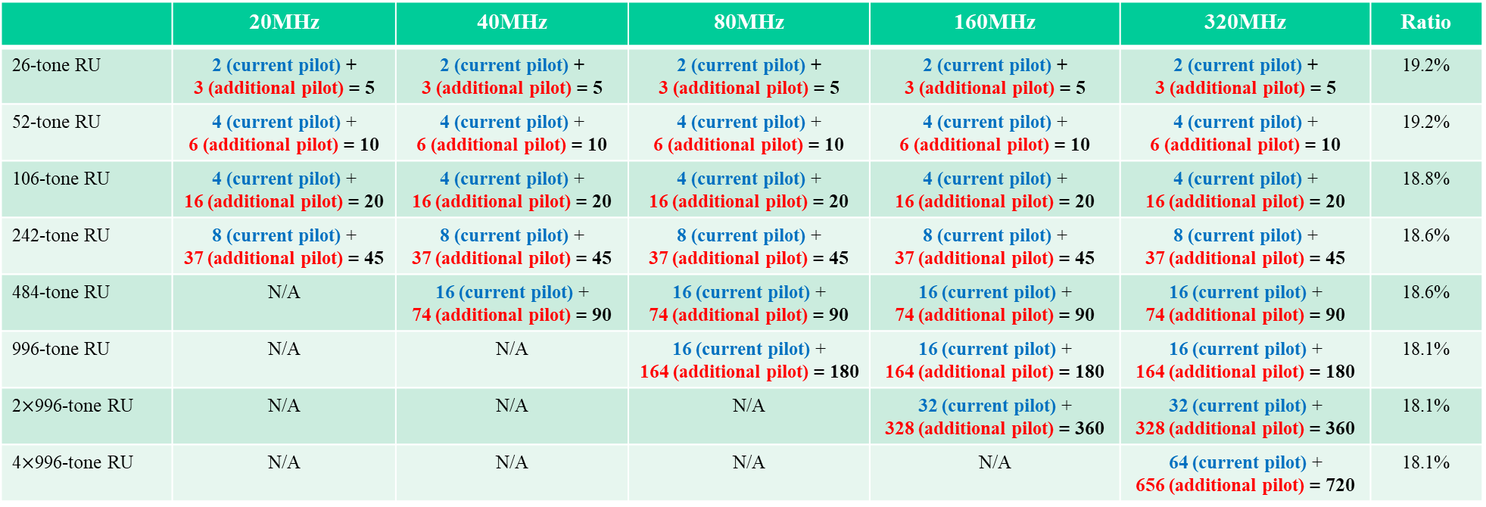
Discussion on design of interference mitigation pilots - example 1
IM pilots are additional pilots, located within the data portion of the PPDU, which are used for interference estimation. One example of fixed number of IM pilot (current pilot + additional pilot) subcarriers in RRUs is shown below:
 | 20MHz | 40MHz | 80MHz | 160MHz | 320MHz | Ratio
26-tone RU | 2 (current pilot) + 3 (additional pilot) = 5 | 2 (current pilot) + 3 (additional pilot) = 5 | 2 (current pilot) + 3 (additional pilot) = 5 | 2 (current pilot) + 3 (additional pilot) = 5 | 2 (current pilot) + 3 (additional pilot) = 5 | 19.2%
52-tone RU | 4 (current pilot) + 6 (additional pilot) = 10 | 4 (current pilot) + 6 (additional pilot) = 10 | 4 (current pilot) + 6 (additional pilot) = 10 | 4 (current pilot) + 6 (additional pilot) = 10 | 4 (current pilot) + 6 (additional pilot) = 10 | 19.2%
106-tone RU | 4 (current pilot) + 16 (additional pilot) = 20 | 4 (current pilot) + 16 (additional pilot) = 20 | 4 (current pilot) + 16 (additional pilot) = 20 | 4 (current pilot) + 16 (additional pilot) = 20 | 4 (current pilot) + 16 (additional pilot) = 20 | 18.8%
242-tone RU | 8 (current pilot) + 37 (additional pilot) = 45 | 8 (current pilot) + 37 (additional pilot) = 45 | 8 (current pilot) + 37 (additional pilot) = 45 | 8 (current pilot) + 37 (additional pilot) = 45 | 8 (current pilot) + 37 (additional pilot) = 45 | 18.6%
484-tone RU | N/A | 16 (current pilot) + 74 (additional pilot) = 90 | 16 (current pilot) + 74 (additional pilot) = 90 | 16 (current pilot) + 74 (additional pilot) = 90 | 16 (current pilot) + 74 (additional pilot) = 90 | 18.6%
996-tone RU | N/A | N/A | 16 (current pilot) + 164 (additional pilot) = 180 | 16 (current pilot) + 164 (additional pilot) = 180 | 16 (current pilot) + 164 (additional pilot) = 180 | 18.1%
2$×$996-tone RU | N/A | N/A | N/A | 32 (current pilot) + 328 (additional pilot) = 360 | 32 (current pilot) + 328 (additional pilot) = 360 | 18.1%
4$×$996-tone RU | N/A | N/A | N/A | N/A | 64 (current pilot) + 656 (additional pilot) = 720 | 18.1%
Note: [8] shows that 16% ~ 20% of the resources for IM pilots yield improved performance.

Slide 8
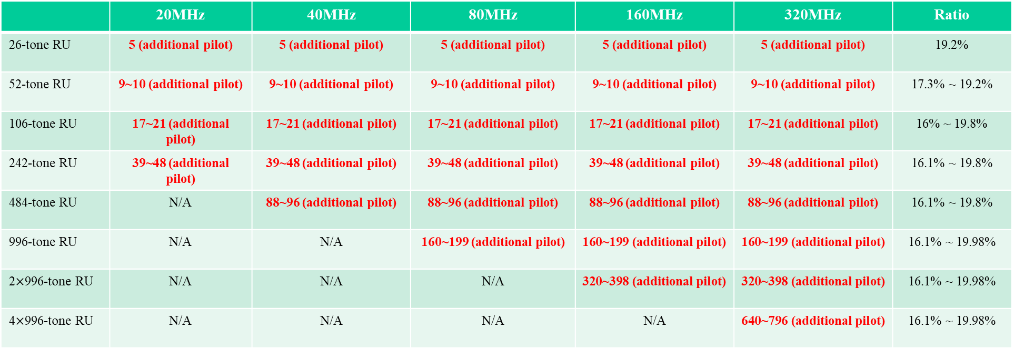
Discussion on design of interference mitigation pilots - method 2
IM pilots are additional pilots, located within the data portion of the PPDU, which are used for interference estimation. The number of IM pilot (only additional pilot) subcarriers in RRUs are suggested as shown below:
 | 20MHz | 40MHz | 80MHz | 160MHz | 320MHz | Ratio
26-tone RU | 5 (additional pilot) | 5 (additional pilot) | 5 (additional pilot) | 5 (additional pilot) | 5 (additional pilot) | 19.2%
52-tone RU | 9~10 (additional pilot) | 9~10 (additional pilot) | 9~10 (additional pilot) | 9~10 (additional pilot) | 9~10 (additional pilot) | 17.3% ~ 19.2%
106-tone RU | 17~21 (additional pilot) | 17~21 (additional pilot) | 17~21 (additional pilot) | 17~21 (additional pilot) | 17~21 (additional pilot) | 16% ~ 19.8%
242-tone RU | 39~48 (additional pilot) | 39~48 (additional pilot) | 39~48 (additional pilot) | 39~48 (additional pilot) | 39~48 (additional pilot) | 16.1% ~ 19.8%
484-tone RU | N/A | 88~96 (additional pilot) | 88~96 (additional pilot) | 88~96 (additional pilot) | 88~96 (additional pilot) | 16.1% ~ 19.8%
996-tone RU | N/A | N/A | 160~199 (additional pilot) | 160~199 (additional pilot) | 160~199 (additional pilot) | 16.1% ~ 19.98%
2$×$996-tone RU | N/A | N/A | N/A | 320~398 (additional pilot) | 320~398 (additional pilot) | 16.1% ~ 19.98%
4$×$996-tone RU | N/A | N/A | N/A | N/A | 640~796 (additional pilot) | 16.1% ~ 19.98%
Note: [8] shows that 16% ~ 20% of the resources for IM pilots yield improved performance.

Slide 9
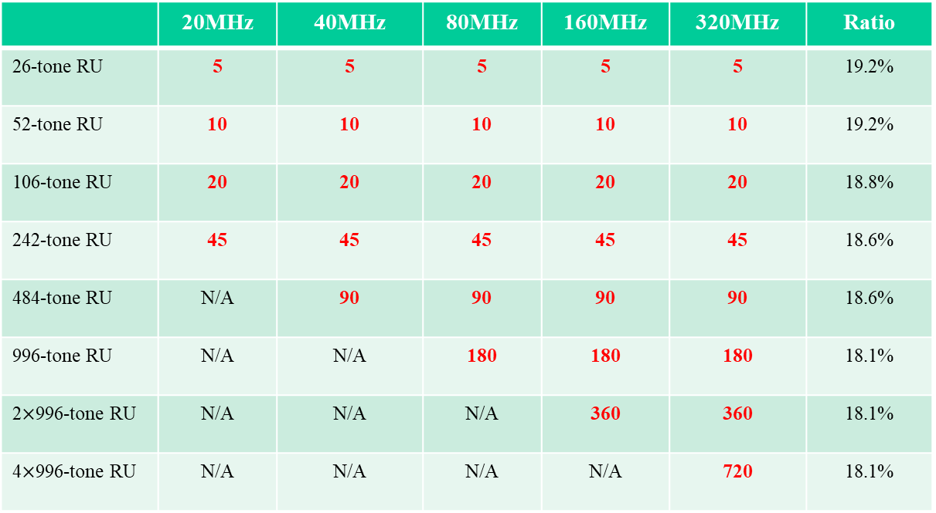
Discussion on design of interference mitigation pilots - example 2
IM pilots are additional pilots, located within the data portion of the PPDU, which are used for interference estimation. One example of fixed number of IM pilot (only additional pilot) subcarriers in RRUs is shown below:
 | 20MHz | 40MHz | 80MHz | 160MHz | 320MHz | Ratio
26-tone RU | 5 | 5 | 5 | 5 | 5 | 19.2%
52-tone RU | 10 | 10 | 10 | 10 | 10 | 19.2%
106-tone RU | 20 | 20 | 20 | 20 | 20 | 18.8%
242-tone RU | 45 | 45 | 45 | 45 | 45 | 18.6%
484-tone RU | N/A | 90 | 90 | 90 | 90 | 18.6%
996-tone RU | N/A | N/A | 180 | 180 | 180 | 18.1%
2$×$996-tone RU | N/A | N/A | N/A | 360 | 360 | 18.1%
4$×$996-tone RU | N/A | N/A | N/A | N/A | 720 | 18.1%
Note: [8] shows that 16% ~ 20% of the resources for IM pilots yield improved performance.

Slide 10
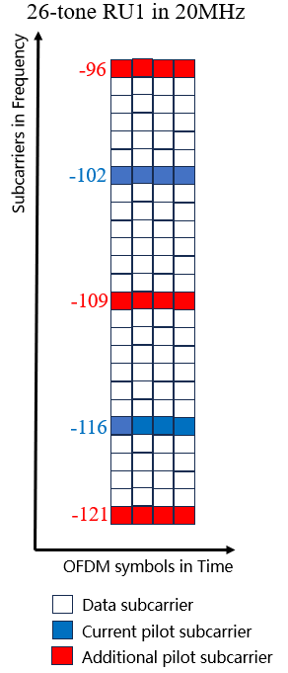
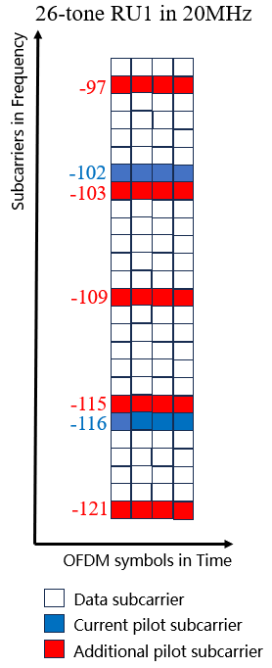


Discussion on design of interference mitigation pilots - examples
IM pilots are additional pilots, located within the data portion of the PPDU, which are used for interference estimation. One example of fixed number of IM pilot subcarriers in RRUs includes both current pilot and additional pilot — method 1
IM pilots are additional pilots, located within the data portion of the PPDU, which are used for interference estimation. One example of fixed number of IM pilot subcarriers in RRUs includes only additional pilot— method 2

Slide 11
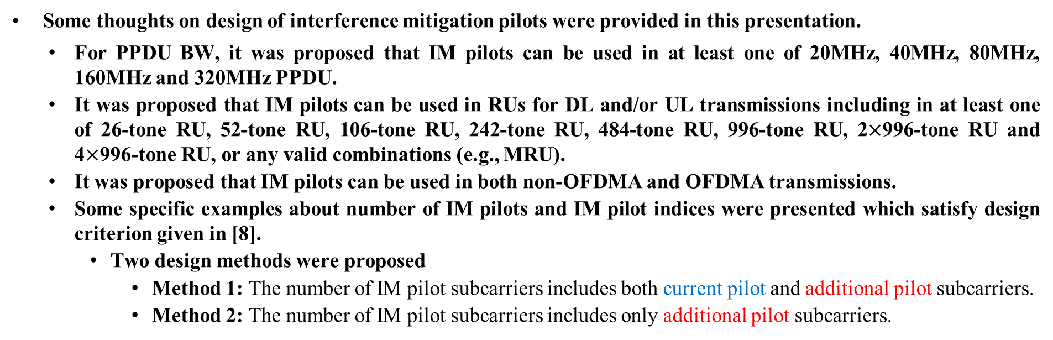
Conclusion
Some thoughts on design of interference mitigation pilots were provided in this presentation.
  For PPDU BW, it was proposed that IM pilots can be used in at least one of 20MHz, 40MHz, 80MHz, 160MHz and 320MHz PPDU.
  It was proposed that IM pilots can be used in RUs for DL and/or UL transmissions including in at least one of 26-tone RU, 52-tone RU, 106-tone RU, 242-tone RU, 484-tone RU, 996-tone RU, 2$×$996-tone RU and 4$×$996-tone RU, or any valid combinations (e.g., MRU).
  It was proposed that IM pilots can be used in both non-OFDMA and OFDMA transmissions.
  Some specific examples about number of IM pilots and IM pilot indices were presented which satisfy design criterion given in [8].
    Two design methods were proposed
      Method 1: The number of IM pilot subcarriers includes both current pilot and additional pilot subcarriers.
      Method 2: The number of IM pilot subcarriers includes only additional pilot subcarriers.

Slide 12
Straw Poll 1
March 2025
Do you agree to include the following into the 11bn SFD?
  IM pilots can be used in at least one of 20MHz, 40MHz, 80MHz, 160MHz and 320MHz PPDU.
    Yes:
    No:
    Abstain:
Ke Zhong, Ruijie Networks Co., Ltd

Slide 13
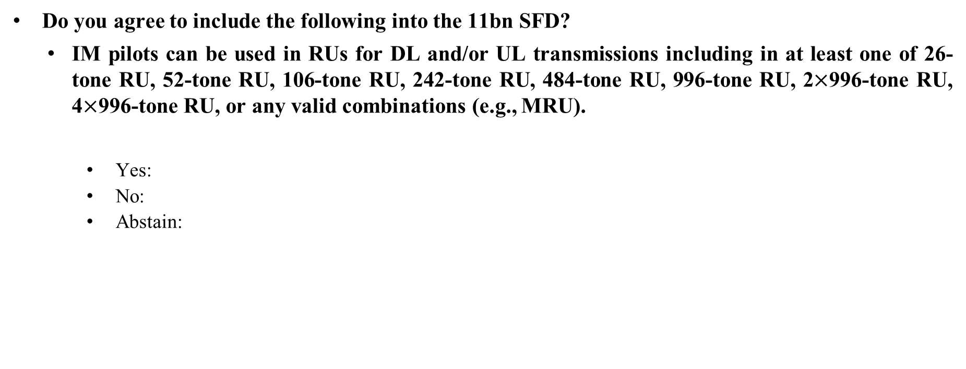
Straw Poll 2
March 2025
Do you agree to include the following into the 11bn SFD?
  IM pilots can be used in RUs for DL and/or UL transmissions including in at least one of 26-tone RU, 52-tone RU, 106-tone RU, 242-tone RU, 484-tone RU, 996-tone RU, 2$×$996-tone RU, 4$×$996-tone RU, or any valid combinations (e.g., MRU).
    Yes:
    No:
    Abstain:
Ke Zhong, Ruijie Networks Co., Ltd

Slide 14
Straw Poll 3
March 2025
Do you agree to include the following into the 11bn SFD?
  IM pilots can be used in both non-OFDMA and OFDMA transmissions.
    Yes:
    No:
    Abstain:
Ke Zhong, Ruijie Networks Co., Ltd

Slide 15
References
[1] IEEE 802.11-23/0480r3, UHR proposed PAR, Laurent Cariou (Intel)
[2] IEEE 802.11-24/0209r8, Specification framework for TGBn, Ross Jian Yu (Huawei)
[3] IEEE 802.11-23/1490r0, Physical layer reliability improvements, Shimi Shilo (Huawei)
[4] IEEE 802.11-23/1943r1, Physical layer reliability improvements – follow up, Shimi Shilo (Huawei)
[5] IEEE 802.11-24/107r0, PHY layer interference mitigation for improved reliability, Shimi Shilo (Huawei)
[6] IEEE 802.11-24/437r0, Interference mitigation for improved reliability – more insights, Shimi Shilo (Huawei)
[7] IEEE 802.11-24/0889r0, Interference mitigation for improved reliability – link adaptation perspective, Rani Keren (Huawei)
[8] IEEE 802.11-24/1264r0, Supporting rx interference mitigation in TGbn, Shimi Shilo (Huawei)
[9] IEEE 802.11-24/1747r0, Discussion on signalling of additional pilots for interference mitigation, Ke Zhong (Ruijie)
[10] IEEE 802.11-24/2008r2, PDT PHY Interference Mitigation, Shimi Shilo (Huawei)

