Slide 1
Consideration on ELR for 11bn
Date: 2025-06-16
Authors:
Name | Affiliation | Address | Phone | Email
Lei Zhou | New H3C |  |  | Zhou.leih@h3c.com
Lei Kong | New H3C
Renmu Luo | New H3C
Xiangxin Gu | Spreadtrum
Yingqiao Quan | Spreadtrum

Slide 2
Recap
Motion has passed to support ELR extension as follows[1]:
The BW of ELR PPDU is 20MHz and one Spatial stream is used for ELR transmission.
[Motion #92, [1] and [175]]
In the ELR transmission, a repeating of 52-tone RRU is used in 20MHz.
The same data is repeated in four 52-tone RRUs in 20 MHz.
The subcarrier allocation of 52-tone RRU equals the 52-tone RU defined in 11be.
[Motion #93, [1] and [175]]

Slide 3
Consideration on ELR operation for BW >20MHz(1/3)
Although BW of one ELR PPDU is limited to 20MHz, we still need consider BW> 20MHz case to support ELR feature with the following purpose.
Obtain good throughput performance
Mitigate frequency-selective interference

Slide 4
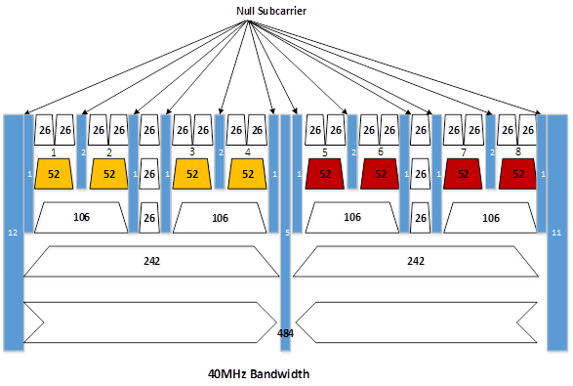
Consideration on ELR operation for BW >20MHz(2/3)
Using 40 MHz bandwidth as an example ，MRU with repeat transmission should be supported for Obtaining good throughput performance in ELR case

Slide 5
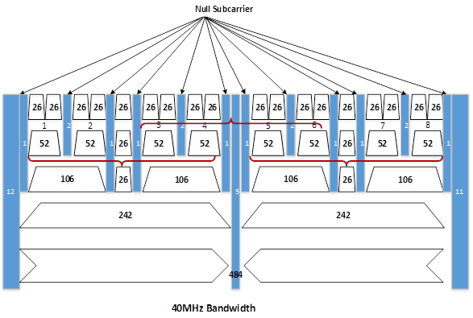
Consideration on ELR operation for BW >20MHz(3/3)
Using 40 MHz bandwidth as an example ，variable RU start location for repeat transmission should be supported for Mitigate frequency-selective interference in ELR case

Slide 6
Summary
ELR operation for BW >20MHz is proposed.
MRU with repeat transmission should be supported
RU start location for repeat transmission should be flexibly configured.

Slide 7
Reference
[1]. 11-24-0209-09-00bn-specification-framework-for-tgbn

Slide 8
SP1
Do you agree to include the following into the 11bn SFD?
ELR operation for BW >20MHz should be supported
At least 40MHz and 80MHz BW
Y
N
A

Slide 9
SP2
Do you agree to support MRU with repeat transmission and configured RU start location should be enabled if ELR operation for BW >20MHz is supported?
Y
N
A

