Slide 1
Feasibility Study of Phase-Synchronization for
Wireless Federated Learning on WLAN
Date: 2025-03-07
Authors:

Slide 2
Abstract
In this contribution, we discuss the feasibility of coherent over-the-air computation (OAC) to support federated learning on WLAN
  We discuss an approach to compensate the phase mismatches between the STAs and AP to achieve phase synchronization in the network
  We show proof-of-concept demonstrations on the phase synchronization

Slide 3
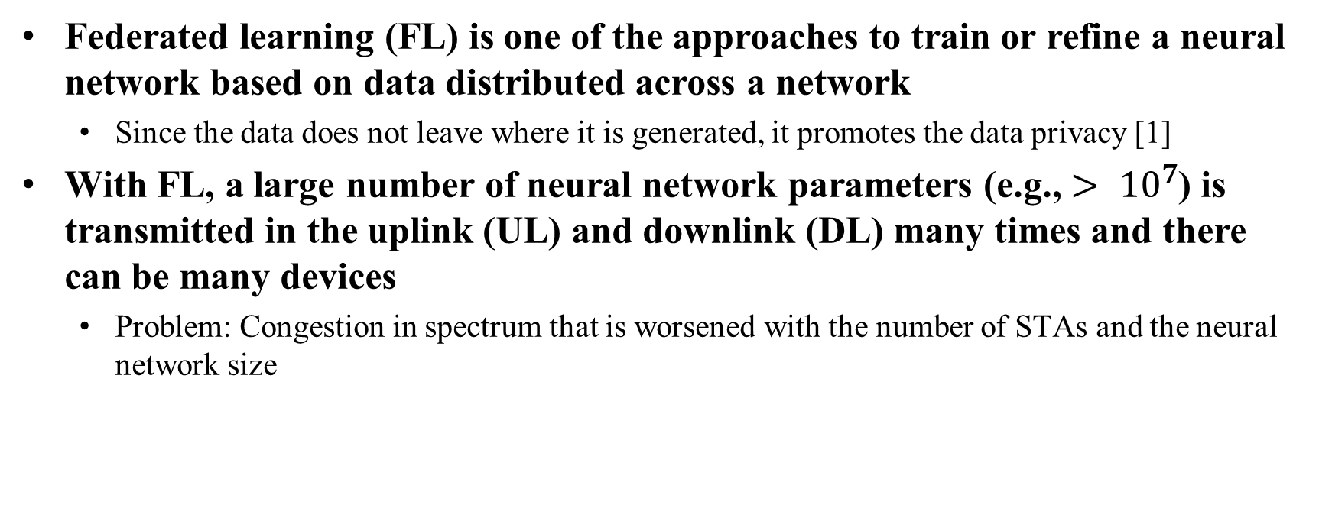
Federated Learning over WLAN
Federated learning (FL) is one of the approaches to train or refine a neural network based on data distributed across a network
  Since the data does not leave where it is generated, it promotes the data privacy [1]
With FL, a large number of neural network parameters (e.g., $> {10}^{7}$) is transmitted in the uplink (UL) and downlink (DL) many times and there can be many devices
  Problem: Congestion in spectrum that is worsened with the number of STAs and the neural network size

Slide 4

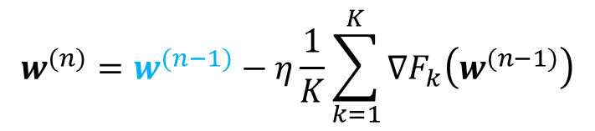



Recap - How Does FL Work over a Wireless Network? [2]
$$w^{(n−1)}$$
Local dataset
An example procedure:
Step 1: AP broadcasts the model
Step 2: Each STA calculates the gradients
Step 3: Each STA transmits the gradients
Step 4: AP averages the received gradients and updates the model
(and go back Step 1)
STA $1$
Local dataset
AP
STA 2
…
…
Local dataset
STA $K$
$$w^{(n)}=w^{(n−1)}−η\frac{1}{K}\sum_{k=1}^{K}{∇F_{k}\left(w^{(n−1)}\right)}$$
Model update rule:

Slide 5






Recap - How Does FL Work over a Wireless Network? [2]
$$w^{(n−1)}$$
Local dataset
An example procedure:
Step 1: AP broadcasts the model
Step 2: Each STA calculates the gradients
Step 3: Each STA transmits the gradients
Step 4: AP averages the received gradients and updates the model
(and go back Step 1)
STA $1$
Local dataset
AP
$$w^{(n−1)}$$
STA 2
…
…
Local dataset
$$w^{(n−1)}$$
STA $K$
$$w^{(n)}=w^{(n−1)}−η\frac{1}{K}\sum_{k=1}^{K}{∇F_{k}\left(w^{(n−1)}\right)}$$
Model update rule:

Slide 6




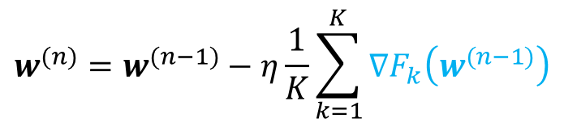

Recap - How Does FL Work over a Wireless Network? [2]
$$∇F_{1}\left(w^{(n−1)}\right)$$
An example procedure:
Step 1: AP broadcasts the model
Step 2: Each STA calculates the gradients
Step 3: Each STA transmits the gradients
Step 4: AP averages the received gradients and updates the model
(and go back Step 1)
STA $1$
$$∇F_{2}\left(w^{(n−1)}\right)$$
AP
STA 2
…
…
$$∇F_{K}\left(w^{(n−1)}\right)$$
STA $K$
Calculate gradients
$$w^{(n)}=w^{(n−1)}−η\frac{1}{K}\sum_{k=1}^{K}{∇F_{k}\left(w^{(n−1)}\right)}$$
Model update rule:

Slide 7




Recap - How Does FL Work over a Wireless Network? [2]
$$∇F_{1}\left(w^{(n−1)}\right)$$
Local dataset
An example procedure:
Step 1: AP broadcasts the model
Step 2: Each STA calculates the gradients
Step 3: Each STA transmits the gradients
Step 4: AP averages the received gradients and updates the model
(and go back Step 1)
STA $1$
$$∇F_{2}\left(w^{(n−1)}\right)$$
Local dataset
AP
STA 2
…
…
$$∇F_{K}\left(w^{(n−1)}\right)$$
Local dataset
STA $K$
$$w^{(n)}=w^{(n−1)}−η\frac{1}{K}\sum_{k=1}^{K}{∇F_{k}\left(w^{(n−1)}\right)}$$
Model update rule:

Slide 8
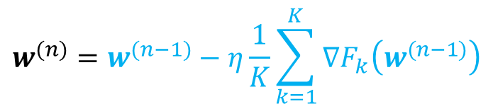


Recap - How Does FL Work over a Wireless Network? [2]
Local dataset
An example procedure:
Step 1: AP broadcasts the model
Step 2: Each STA calculates the gradients
Step 3: Each STA transmits the gradients
Step 4: AP averages the received gradients and updates the model
(and go back Step 1)
STA $1$
Local dataset
AP
STA 2
…
…
Local dataset
STA $K$
$$∇F_{1}\left(w^{(n−1)}\right),∇F_{2}\left(w^{(n−1)}\right),…,∇F_{K}\left(w^{(n−1)}\right)$$
Averaging & model update
$$w^{(n)}=w^{(n−1)}−η\frac{1}{K}\sum_{k=1}^{K}{∇F_{k}\left(w^{(n−1)}\right)}$$
Model update rule:

Slide 9








Communication Bottleneck
e.g., with TDMA:
Frequency
$$∇F_{1}\left(w^{(n−1)}\right)$$
Local dataset
$$∇F_{1}\left(w^{(n−1)}\right)$$
$$∇F_{2}\left(w^{(n−1)}\right)$$
$$∇F_{K}\left(w^{(n−1)}\right)$$
STA $1$
$$∇F_{2}\left(w^{(n−1)}\right)$$
Local dataset
AP
STA 2
Bandwidth
…
…
…
$$∇F_{K}\left(w^{(n−1)}\right)$$
Local dataset
STA $K$
Time
Occupied time
  The occupied time (or bandwidth) increase linearly with the number of STAs and the neural network size

Slide 10
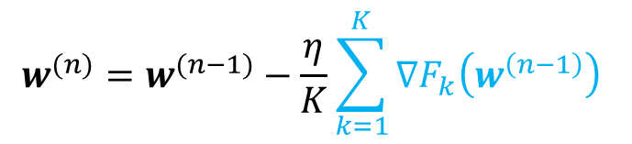
Over-the-Air Computation (OAC)
OAC aims to aggregate the gradients via superposition in the channel
  Benefit: A major saving in resource consumption as the resource utilization does not grow with the number of STAs
Frequency
All STAs transmit simultaneously & gradient aggregation occurs in the wireless channel through signal superposition
$$w^{(n)}=w^{(n−1)}−\frac{η}{K}\sum_{k=1}^{K}{∇F_{k}\left(w^{\left(n−1\right)}\right) }$$
Bandwidth
Is this really feasible given multi-path channel & hardware impairments?
…
Time
Occupied time

Slide 11
Over-the-Air Computation (OAC)
OAC aims to aggregate the gradients via superposition in the channel
  Benefit: A major saving in resource consumption as the resource utilization does not grow with the number of STAs
Frequency
All STAs transmit simultaneously & gradient aggregation occurs in the wireless channel through signal superposition
$$w^{(n)}=w^{(n−1)}−\frac{η}{K}\sum_{k=1}^{K}{∇F_{k}\left(w^{\left(n−1\right)}\right) }$$
Bandwidth
Is this really feasible given multi-path channel & hardware impairments?
…
Time
Occupied time

Slide 12

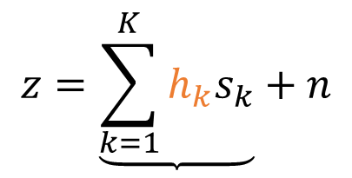

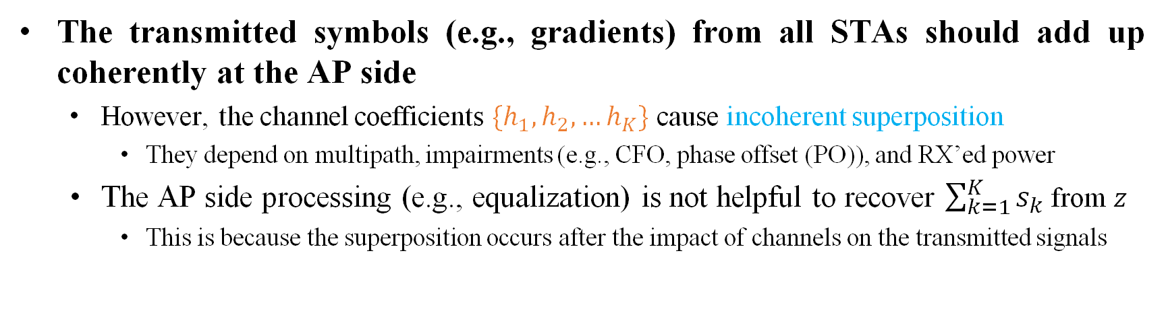






A Primary Challenge for OAC: Phase Synchronization
The transmitted symbols (e.g., gradients) from all STAs should add up coherently at the AP side
  However, the channel coefficients $\{h_{1},h_{2},…h_{K}\}$ cause incoherent superposition
    They depend on multipath, impairments (e.g., CFO, phase offset (PO)), and RX’ed power
  The AP side processing (e.g., equalization) is not helpful to recover $\sum_{k=1}^{K}{s_{k}}$ from $z$
    This is because the superposition occurs after the impact of channels on the transmitted signals
$$h_{1}$$
$$s_{1}$$
$$s_{2}$$
$$z=\underbrace{\sum_{k=1}^{K}{h_{k}s_{k}}}+n$$
$$z$$
$$h_{2}$$
$$n$$
…
$$h_{K}$$
$$s_{K}$$
Incoherent superposition
Multi-path channel & CFO, noise?

Slide 13
















A Closer Look at Phase Errors in UL and DL (1/2)
Assuming that the same oscillator is used at the TX and RX chains at each radio, the channel between the AP and a STA for an OFDM subcarrier:
Downlink (DL) channel
STA $1$
$$p$$
$$r_{d}$$
$$r_{d}=a_{d,k}e^{jθ_{d,k}}×e^{j\left(2πΔf_{k}t+Δθ_{k}\right)}×p$$
$$a_{d,k}e^{jθ_{d,k}}$$
…
$$e^{j2πf_{c}t}$$
$${\left(⋅\right)}^{∗}$$
DL channel
CFO and PO
AP
STA $k$
$${\left(⋅\right)}^{∗}$$
$$e^{j2π\left(f_{c}−Δf_{k}\right)t−Δθ_{k}}$$
…
$$r_{u}$$
$$a_{u,k}e^{jθ_{u,k}}$$
$$p$$
$$r_{u}=a_{u,k}e^{jθ_{u,k}}×e^{−j\left(2πΔf_{k}t+Δθ_{k}\right)}×p$$
STA $K$
UL channel
CFO and PO
Uplink (UL) channel
($p$: a pilot symbol)

Slide 14
















A Closer Look at Phase Errors in UL and DL (2/2)
Observation: The phase errors in UL and DL evolve rapidly due to the CFO
  A CFO pre-compensation, e.g. [3], may be used to mitigate the phase evolutions
Downlink (DL) channel
STA $1$
$$p$$
$$r_{d}$$
$$∠r_{d}=θ_{d,k}+2πΔf_{k}t+Δθ_{k}+∠p$$
$$a_{d,k}e^{jθ_{d,k}}$$
…
$$e^{j2πf_{c}t}$$
$${\left(⋅\right)}^{∗}$$
DL phase error
AP
STA $k$
$${\left(⋅\right)}^{∗}$$
$$e^{j2π\left(f_{c}−Δf_{k}\right)t−Δθ_{k}}$$
…
$$r_{u}$$
$$a_{u,k}e^{jθ_{u,k}}$$
$$p$$
$$∠r_{u}=θ_{u,k}−2πΔf_{k}t−Δθ_{k}+∠p$$
STA $K$
UL phase error
Uplink (UL) channel
($p$: a pilot symbol)

Slide 15
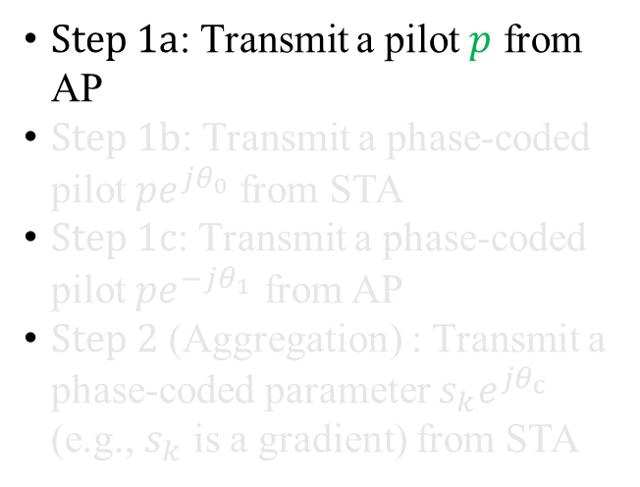







Phase-Coded Pilots (1/4)
An example procedure to correct the UL phase error for OAC is as follows:
Step 1a
$\text{Step}\text{ 1}\text{a}$: Transmit a pilot $p$ from AP
$\text{Step}\text{ 1}\text{b}$: Transmit a phase-coded pilot $pe^{jθ_{0}}$from STA
$\text{Step}\text{ 1}\text{c}$: Transmit a phase-coded pilot $pe^{−jθ_{1}}$ from AP
$\text{Step}\text{ 2}$ (Aggregation) : Transmit a phase-coded parameter $s_{k}e^{jθ_{c}}$ (e.g., $s_{k}$ is a gradient) from STA
$$t_{0}$$
AP:
$$p$$
$$a_{d,k}e^{jθ_{d,k}}$$
STA $k$:
$$p^{∗}$$
Phase est.
$$θ_{0}$$
STA estimates the phase in DL: $θ_{0}=2πΔft_{0}+Δθ+θ_{d,k}$
Note: We assume $\left|p\right|=1$

Slide 16

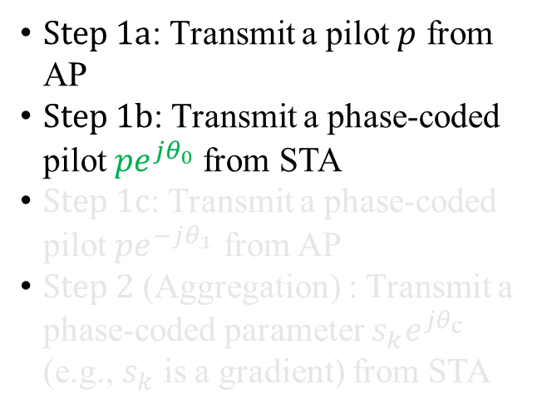






Phase-Coded Pilots (2/4)
An example procedure to correct the UL phase error for OAC is as follows:
Step 1a
Step 1b
$\text{Step}\text{ 1}\text{a}$: Transmit a pilot $p$ from AP
$\text{Step}\text{ 1}\text{b}$: Transmit a phase-coded pilot $pe^{jθ_{0}}$from STA
$\text{Step}\text{ 1}\text{c}$: Transmit a phase-coded pilot $pe^{−jθ_{1}}$ from AP
$\text{Step}\text{ 2}$ (Aggregation) : Transmit a phase-coded parameter $s_{k}e^{jθ_{c}}$ (e.g., $s_{k}$ is a gradient) from STA
$$t_{0}$$
$$p^{∗}$$
Phase est.
$$θ_{1}$$
AP:
$$p$$
$$a_{d,k}e^{jθ_{d,k}}$$
$$a_{u,k}e^{jθ_{u,k}}$$
STA $k$:
$$pe^{jθ_{0}}$$
$$p^{∗}$$
Phase est.
$$θ_{0}$$
$$t_{1}$$
AP estimates the phase in UL: $θ_{1}=2πΔf\left(t_{0}−t_{1}\right)+θ_{d,k}+θ_{u,k}$

Slide 17

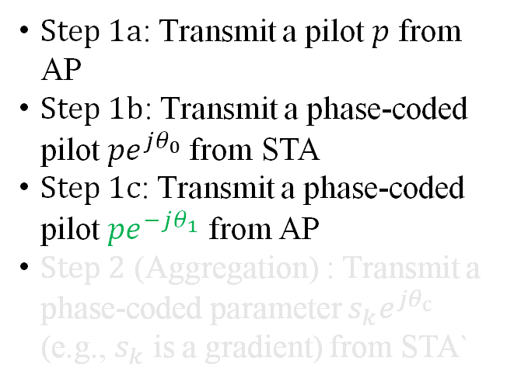













Phase-Coded Pilots (3/4)
An example procedure to correct the UL phase error for OAC is as follows:
Step 1a
Step 1b
Step 1c
$\text{Step}\text{ 1}\text{a}$: Transmit a pilot $p$ from AP
$\text{Step}\text{ 1}\text{b}$: Transmit a phase-coded pilot $pe^{jθ_{0}}$from STA
$\text{Step}\text{ 1}\text{c}$: Transmit a phase-coded pilot $pe^{−jθ_{1}}$ from AP
$\text{Step}\text{ 2}$ (Aggregation) : Transmit a phase-coded parameter $s_{k}e^{jθ_{c}}$ (e.g., $s_{k}$ is a gradient) from STA`
$$t_{0}$$
$$p^{∗}$$
Phase est.
$$θ_{1}$$
$$t_{2}$$
AP:
$$p$$
$$pe^{−jθ_{1}}$$
$$a_{d,k}e^{jθ_{d,k}}$$
$$a_{u,k}e^{jθ_{u,k}}$$
$$a_{d,k}^{′}e^{jθ_{d,k}^{′}}$$
STA $k$:
$$pe^{jθ_{0}}$$
$$p^{∗}$$
Phase est.
$$θ_{0}$$
$$t_{1}$$
$$p^{∗}$$
Phase est.
$$θ_{c}$$
STA estimates the phase in DL:
$$θ_{c}=2πΔf\left(t_{2}+t_{1}−t_{0}\right)−θ_{u,k}+Δθ+θ_{d,k}^{′}−θ_{d,k}$$

Slide 18

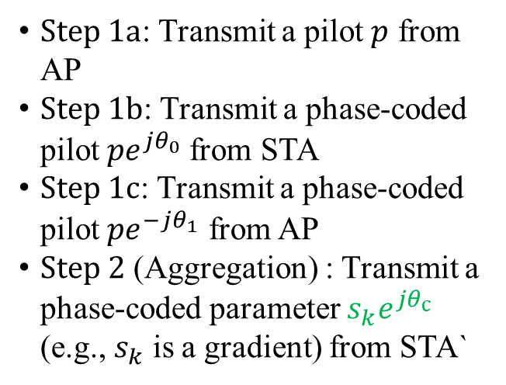









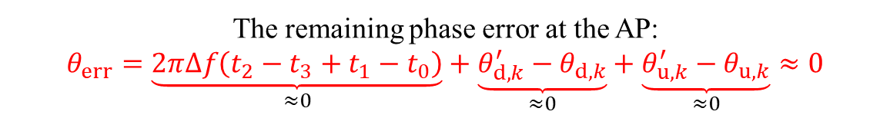
Phase-Coded Pilots (4/4)
An example procedure to correct the UL phase error for OAC is as follows:
Step 1a
Step 1b
Step 1c
Step 2
$\text{Step}\text{ 1}\text{a}$: Transmit a pilot $p$ from AP
$\text{Step}\text{ 1}\text{b}$: Transmit a phase-coded pilot $pe^{jθ_{0}}$from STA
$\text{Step}\text{ 1}\text{c}$: Transmit a phase-coded pilot $pe^{−jθ_{1}}$ from AP
$\text{Step}\text{ 2}$ (Aggregation) : Transmit a phase-coded parameter $s_{k}e^{jθ_{c}}$ (e.g., $s_{k}$ is a gradient) from STA`
$$t_{0}$$
$$p^{∗}$$
Phase est.
$$θ_{1}$$
$$t_{2}$$
AP:
$$∠r_{u}=∠s_{k}+θ_{err}$$
$$p$$
$$pe^{−jθ_{1}}$$
$$a_{d,k}e^{jθ_{d,k}}$$
$$a_{u,k}e^{jθ_{u,k}}$$
$$a_{d,k}^{′}e^{jθ_{d,k}^{′}}$$
$$a_{u,k}^{′}e^{jθ_{u,k}^{′}}$$
STA $k$:
$$pe^{jθ_{0}}$$
$$s_{k}e^{jθ_{c}}$$
$$p^{∗}$$
Phase est.
$$θ_{0}$$
$$t_{1}$$
$$p^{∗}$$
Phase est.
$$θ_{c}$$
$$t_{3}$$
The remaining phase error at the AP:
$$θ_{err}=\underset{≈0}{\underbrace{2πΔf\left(t_{2}−t_{3}+t_{1}−t_{0}\right)}}+\underset{≈0}{\underbrace{θ_{d,k}^{′}−θ_{d,k}}}+\underset{≈0}{\underbrace{θ_{u,k}^{′}−θ_{u,k}}}≈0$$

Slide 19
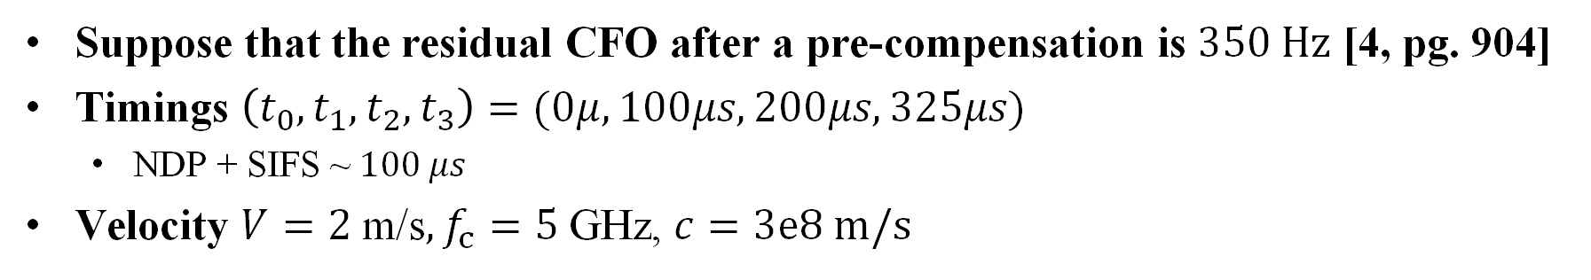
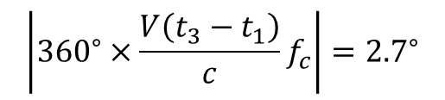
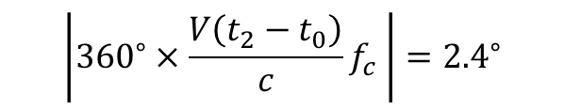
An Example for Phase Error
Suppose that the residual CFO after a pre-compensation is $350 Hz$ [4, pg. 904]
Timings $\left(t_{0},t_{1},t_{2},t_{3}\right)=(0μ,100μs,200μs,325μs)$
  NDP + SIFS ~ $100 μs$
Velocity $V=2 \text{m}\text{/}\text{s}, f_{c}=5 \text{GHz}$, $c=3e8 m/s$
$$θ_{err}=\underset{\left|{360}^{∘}×350 Hz×25μs\right|={3.15}^{∘}}{\underbrace{2πΔf\left(t_{2}−t_{3}+t_{1}−t_{0}\right)}}+\underset{={2.4}^{∘}}{\underbrace{θ_{d,k}^{′}−θ_{d,k}}}+\underset{≈{2.7}^{∘}}{\underbrace{θ_{u,k}^{′}−θ_{u,k}}}≈8^{∘}$$
$$\left|{360}^{∘}×\frac{V\left(t_{2}−t_{0}\right)}{c}f_{c} \right|={2.4}^{∘}$$
$$\left|{360}^{∘}×\frac{V\left(t_{3}−t_{1}\right)}{c}f_{c}\right|={2.7}^{∘}$$

Slide 20
Extending Phased-Coded Pilots to Multiple STAs
Phase synchronization phase
Aggregation phase
AP:
Request
FB
FB
FB
STA 1:
NDP
Local gradients
STA 2:
NDP
Local gradients
STA 3:
NDP
Local gradients
:Pilots (without phase coding)
:Phase-coded pilots
:Phase-coded OAC symbols
More STAs cause more overhead in this example procedure
  Room for optimization by exploiting the coherence bandwidth of the channel
  Notice that the duration of the aggregation phase will be much larger than the one for phase synchronization as the aggregation phase carries phase-coded symbols (e.g., local gradients)

Slide 21
Proof-of-Concept Demonstration – SDR Specifications
In the demonstrations, we use low-cost & off-the-shelf SDRs (Analog Device Adalm Pluto) (see [5] and [6] for specifications)
  For plausibility of the demos, we do not use cable- or GPS-based clock synchronization
  The clock rate is set to 20 Msps for all SDRs
The SDR has a very small FPGA; not possible to implement 802.11 PHY
  Instead, we implement a minimum set of TX and RX blocks to demonstrate the ideas
  SDRs transmit phase-coded sequences to obtain the phase correction values
  The gap between the sequences does not follow IEEE 802.11 rules
We use a basic CFO pre-compensation before phase-coded pilots:
  The AP transmits a sequence and the STAs adjust their local oscillators
  Measured residual CFO is about 25 Hz – 50 Hz in our experiments

Slide 22
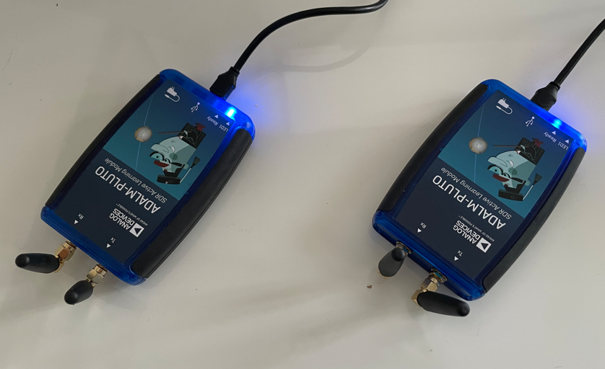
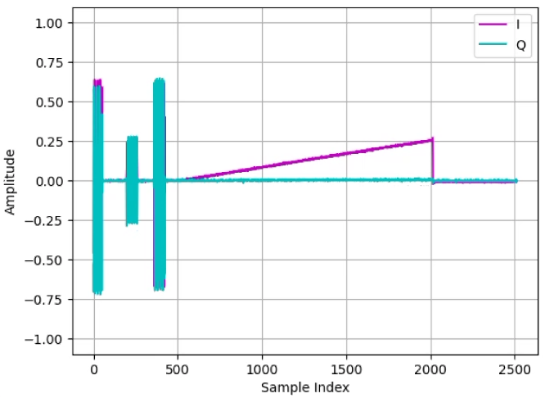
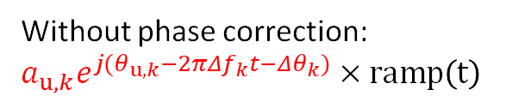


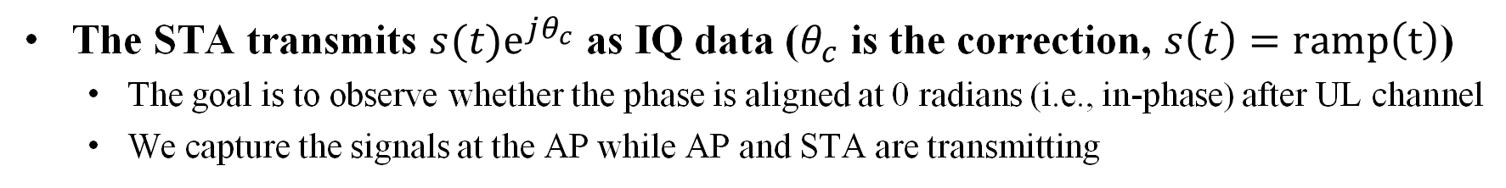
Proof-of-Concept Demonstration 1 – Single STA
The STA transmits $s(t)e^{jθ_{c}}$ as IQ data ($θ_{c}$ is the correction, $s\left(t\right)=ramp\left(t\right)$)
  The goal is to observe whether the phase is aligned at 0 radians (i.e., in-phase) after UL channel
  We capture the signals at the AP while AP and STA are transmitting
AP TX:
: Pilots (without phase coding)
STA TX:
: Phase-coded pilots
$$e^{jθ_{c}}×ramp\left(t\right)$$
: Phase-coded waveform
After the channel
  \
AP RX:
Goal: Recover $ramp\left(t\right)$
  Without phase correction: $a_{u,k}e^{j(θ_{u,k}−2πΔf_{k}t−Δθ_{k})}×ramp\left(t\right)$

Slide 23
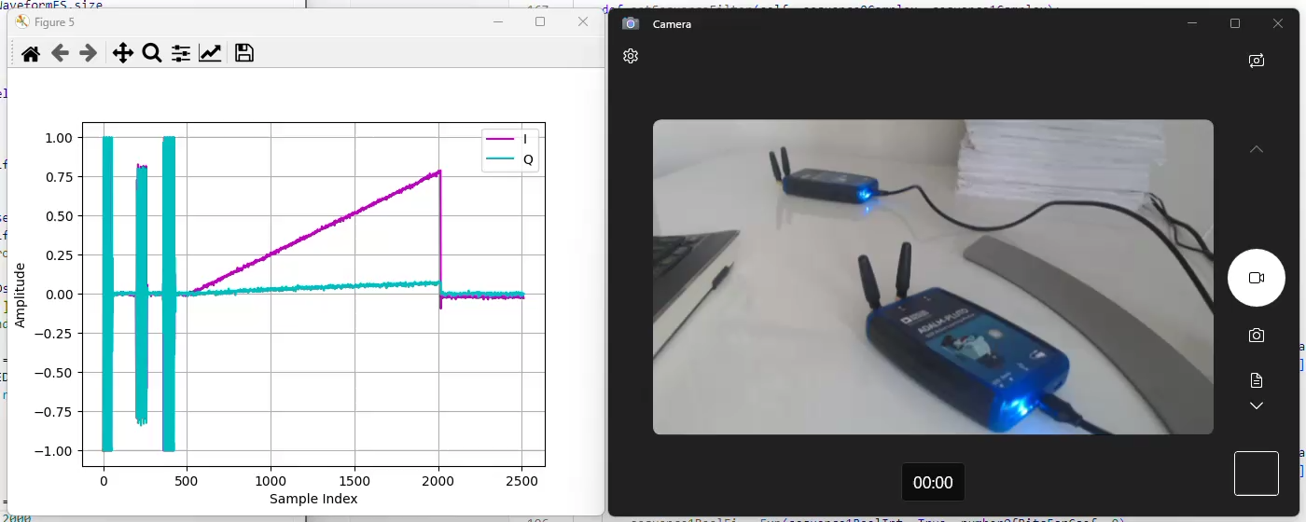
Proof-of-Concept Demonstration 1 – Single STA
STA
AP

Slide 24
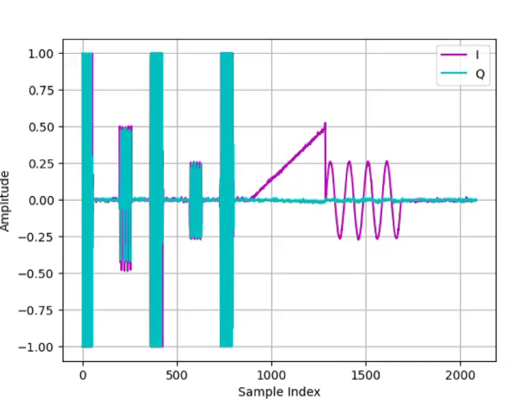
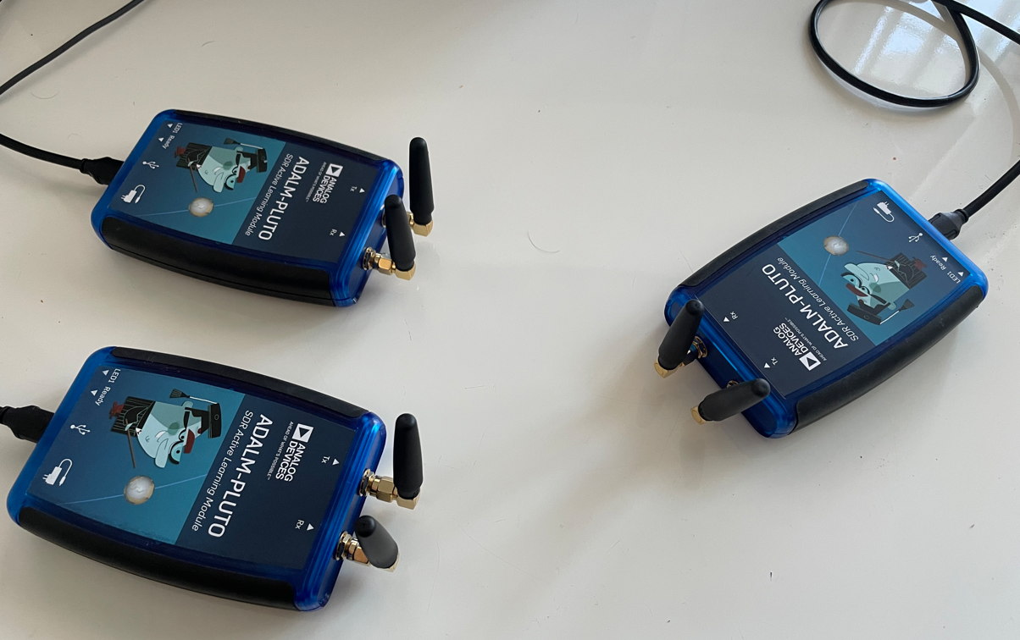
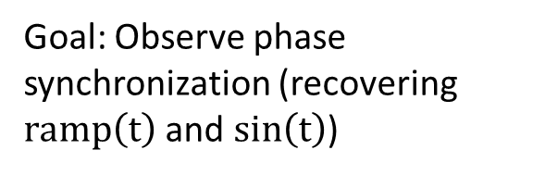


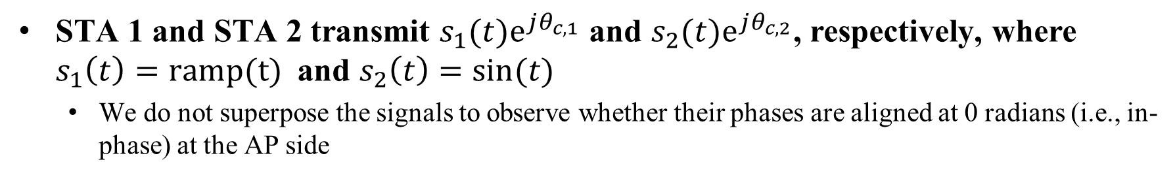
Proof-of-Concept Demonstration 2 – Two STAs
STA 1 and STA 2 transmit $s_{1}(t)e^{jθ_{c,1}}$ and $s_{2}(t)e^{jθ_{c,2}}$, respectively, where $s_{1}\left(t\right)=ramp(t)$ and $s_{2}\left(t\right)=\sin{(t)}$
  We do not superpose the signals to observe whether their phases are aligned at 0 radians (i.e., in-phase) at the AP side
AP TX:
STA 1 TX:
: Pilots (without phase coding)
$$e^{jθ_{c,1}}×ramp\left(t\right)$$
: Phase-coded pilots
STA 2 TX:
$$e^{jθ_{c,2}}×sin\left(t\right)$$
: Phase-coded waveform
After the channels
Goal: Observe phase synchronization (recovering $ramp\left(t\right)$ and $sin\left(t\right)$)
AP RX:

Slide 25
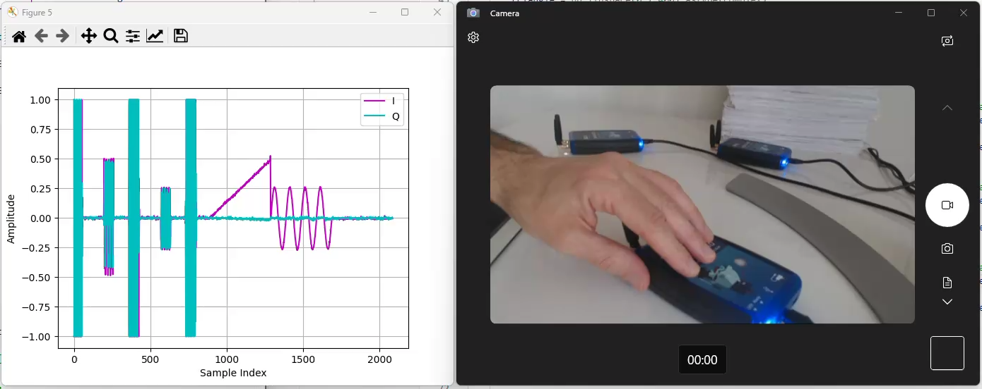
Proof-of-Concept Demonstration 2 – Two STAs
STA 2
STA 1
AP

Slide 26
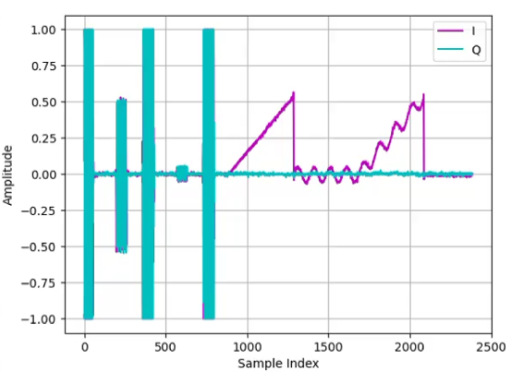


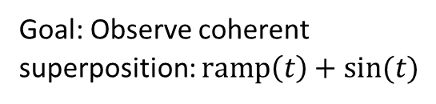
Proof-of-Concept Demonstration 3 – Superposition
STA 1 and STA 2 transmit a ramp function and a sine function as test waveforms at the same time to demonstrate the coherent superposition
AP TX:
STA 1 TX:
$$e^{jθ_{c,1}}×ramp\left(t\right)$$
: Pilots (without phase coding)
: Phase-coded pilots
STA 2 TX:
$$e^{jθ_{c,2}}×sin\left(t\right)$$
: Phase-coded waveform
Goal: Observe coherent superposition: $ramp\left(t\right)+sin(t)$
AP RX:

Slide 27
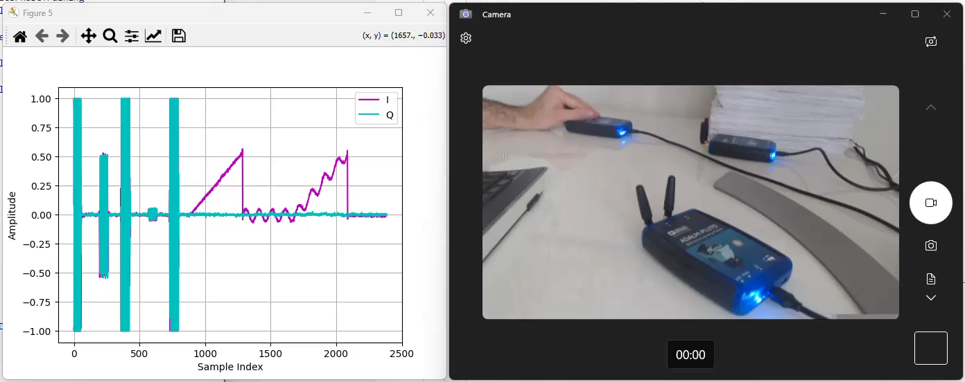
Proof-of-Concept Demonstration 3 – Superposition
STA 2
STA 1
AP

Slide 28
Conclusions
We study phase synchronization in the network for wireless federated learning with over-the-air computation
  We demonstrate on how we can maintain phase synchronization with phase-coded pilots
Note that our demos are not based on 802.11 sounding procedures
  Our goal is to study the feasibility of phase synchronization
  The existing procedures may be reused or enhanced for phase synchronization
Areas to explore:
  Phase and amplitude synchronization
  A model to study the existing 802.11 protocols
  A better residual CFO performance

Slide 29
References
[1] H. B. McMahan, E. Moore, D. Ramage, S. Hampson, and B. A. y Arcas, “Communication-efficient learning of deep networks from decentralized data,” 2017
[2] 09/22 - IEEE 802.11-22/1483r1 Wireless for ML - Over-the-Air Computation
[3] 11/24 - IEEE 802.11-24/1542r5 Sounding Schemes for Coordinated Beamforming
[4] IEEE 802.11be/D7.0, August 2024
[5] Rev. C. https://wiki.analog.com/university/tools/pluto/devs/specs
[6] AD9363, https://www.analog.com/media/en/technical-documentation/data-sheets/AD9363.pdf

