Slide 1
802.11be Awards
Date: 2025-09-15
Authors:

Slide 2
Abstract
This presentation contains the list of awards for the P802.11be project

Slide 3
Some Statistics
TGbe first met in May 2019 and last met in July 2024
  Meeting Slots: ~650 for PHY/MAC/Joint sessions
    ~25 % were in person (and the rest online)
Completed one WG CC, three WG LBs and two SA ballots
  Resolved over 13 500+ comments
Over 2600 documents were submitted of which
  ~1750 PDTs/CRs and ~850 technical submissions
From ~220 authors across ~70 affiliations

Slide 4

In-Person F2F Locations
Berlin
Warsaw
Denver
Montreal (2)
Vienna
Irvine
Atlanta (3)
Honolulu
Orlando
Kona (3)
Hanoi
Bangkok
Panama City
Slide 4

Slide 5
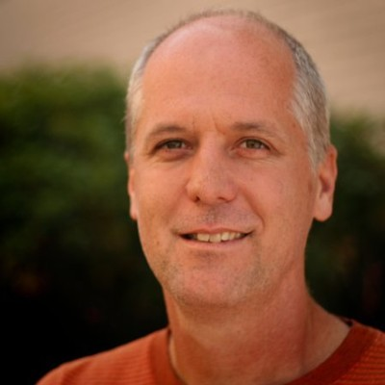
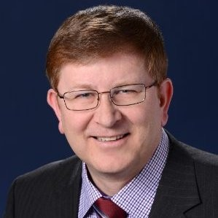
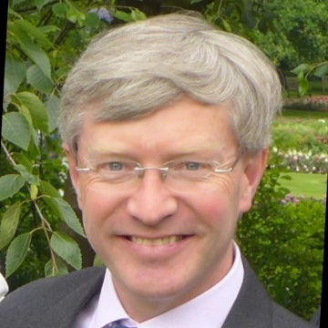
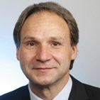
802.11 WG Officer Awards
Robert Stacey
(Chair)
Jon Rosdahl
(Vice Chair)
Stephen McCann
(Vice Chair)
Volker Jungnickel,
(Secretary)

Slide 6
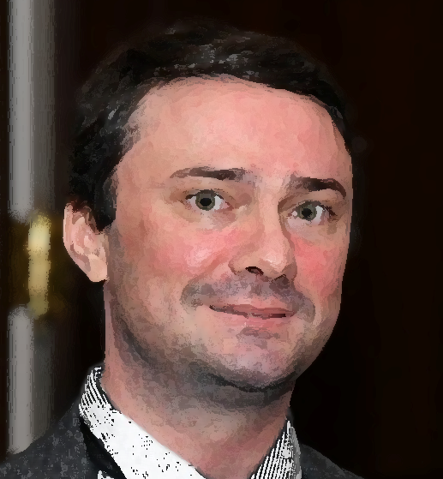
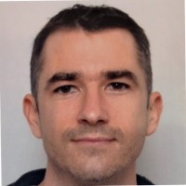
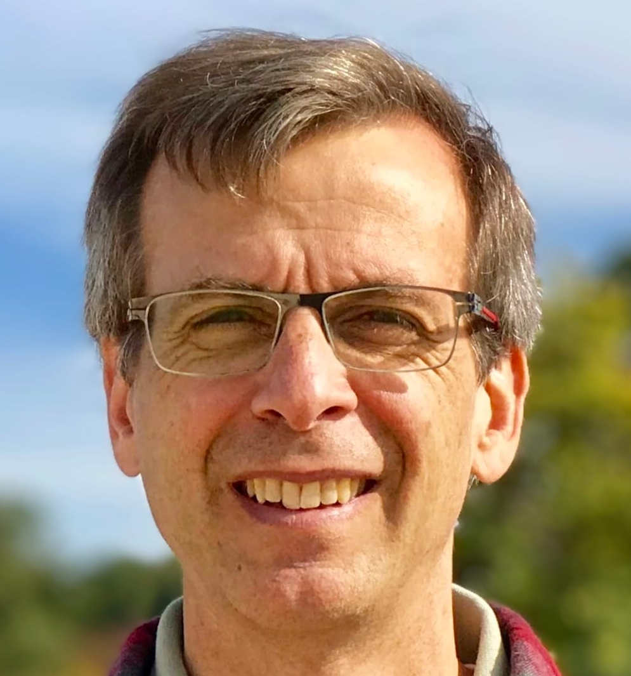
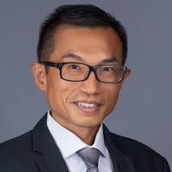
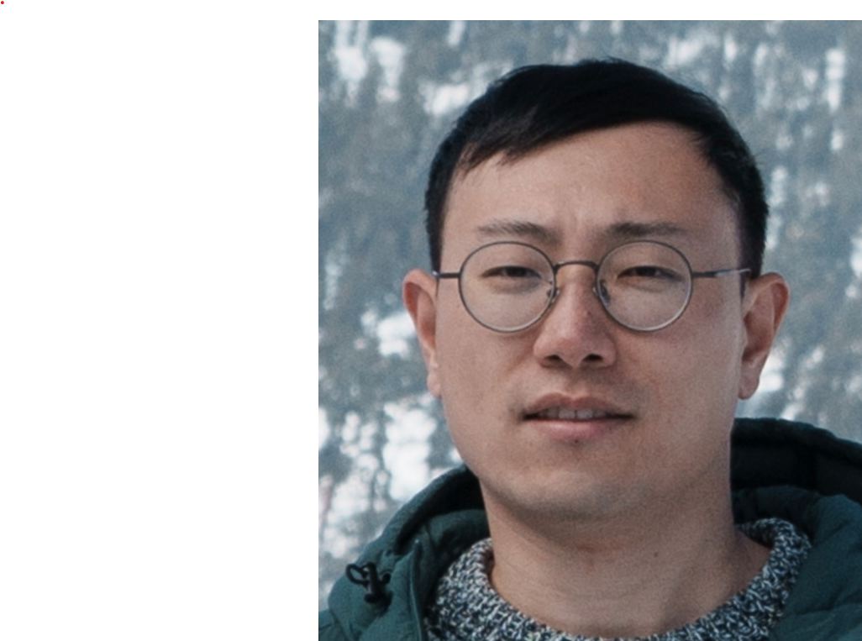
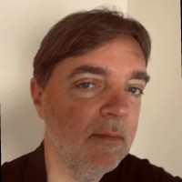
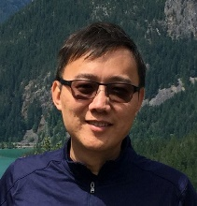

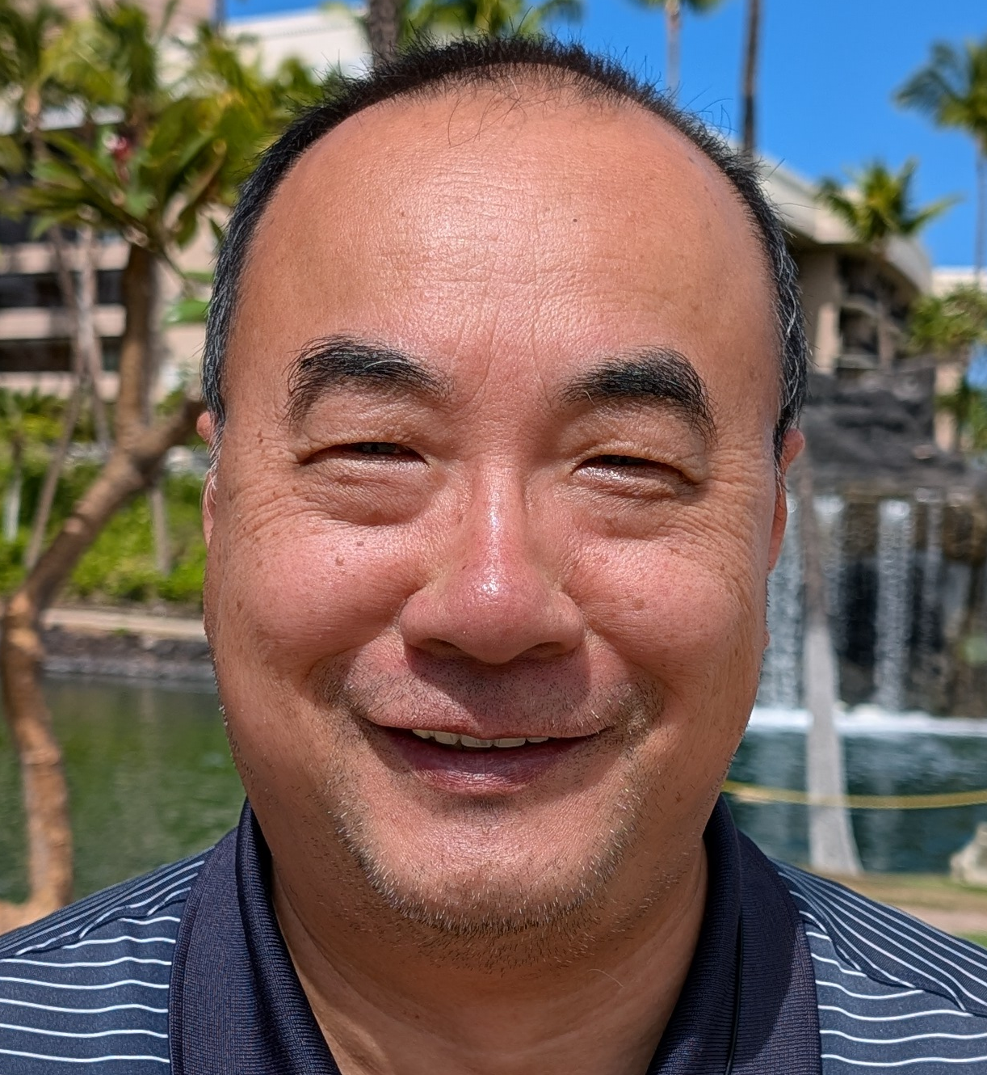
802.11be TG Officers Awards
Alfred Asterjadhi
(Chair)
Laurent Cariou
(Vice Chair)
Matthew Fischer
(Vice Chair)
Edward Au
(Tech Editor)
Jason Y. Guo
(Secretary)
PHY Ad-Hoc
Chairs
                MAC Ad-Hoc
                Chairs
Sigurd Schelstraete
Tianyu Wu
Jeongki Kim
Liwen Chu

Slide 7
802.11be Significant Contributors Awards
Po-Kai Huang - For MAC contributions on Multi Link (ML) setup, ML transition, ML security, ML architecture, and wide band control signaling.
Ming Gan - For MAC contributions on ML multicast delivery, ML individual TWT operation, AP assistance request (AAR), and extremely high throughput (EHT) BSS management.
Abhishek Patil - For MAC contributions on Multi Link (ML) discovery, ML power save, ML link management, and ML (block) acknowledgement.
Ross Jian Yu - For PHY contributions to Extremely High Throughput (EHT) PHY preamble, preamble puncturing, EHT-SIG contents, and multi-RU allocation.
Yunbo Li - For MAC contributions to Multi Link (ML) capabilities, ML channel access, ML non-simultaneous transmit receive (NSTR), and enhancements for 320 MHz operation.

Slide 8
802.11be Significant Contributors Awards
Eunsung Park - For PHY contributions to Extremely High Throughput (EHT) tone plan design, 240/320 MHz design, multi-RU aggregation, and EHT-STF design.
Dongguk Lim - For PHY contributions to Extremely High Throughput (EHT) PHY preamble, EHT PPDU format, preamble puncturing, and EHT-SIG design.
Mengshi Hu - For PHY contributions to Extremely High Throughput (EHT) PHY preamble, EHT-SIG contents, and EHT PHY packet extension (PPE) thresholds.
Yongho Seok - For MAC contributions to Multi Link (ML) management, ML non-simultaneous transmit receive (NSTR), and enhanced multi-link multi radio (eMLMR).
Guogang Huang - For MAC contributions to Extremely High Throughput (EHT) BSS operation, preamble puncturing signaling, and multi-link (ML) management.

Slide 9
802.11be Significant Contributors Awards
Yanjun Sun - For MAC contributions to Trigger frame format, preamble puncturing operation, and transmit power control.
Minyoung Park - For MAC contributions to enhanced multi-link single radio (eMLSR), multi-link (ML) traffic indication, and ML power save.
Wook Bong Lee - For PHY contributions to Extremely High Throughput (EHT) U-SIG contents, preamble puncturing, and spectrum mask requirements.
Gaurang Naik - For MAC contributions to multi-link (ML) signaling, ML critical updates, ML non-simultaneous transmit receive (NSTR), and enhanced multi-link single radio (eMLSR).
Bo Gong - For PHY contributions to Extremely High Throughput (EHT) SIG design, segment parser, and segment deparser.

Slide 10
802.11be Significant Contributors Awards
Ron Porat - For PHY contributions to Extremely High Throughput (EHT) channelization, EHT tone plan, RU design, and PHY enhancements for 6 GHz.
Dibakar Das - For MAC contributions to triggered SU transmissions, peer to peer (P2P) enhancements, SCS enhancements, and medium synchronization recovery.
Jianhan Liu - For PHY contributions to multi-RU design, dual carrier modulation (DCM), EHT PHY preamble, and segment parser/tone interleaver.
Jinyoung Chun - For PHY contributions to Extremely High Throughput (EHT) LTF, pilot subcarrier design, and sounding feedback.
Duncan Ho - For MAC contributions to Multi Link (ML) addressing, ML architecture, ML security, and QoS enhancements.

Slide 11
802.11be Significant Contributors Awards
Insun Jang - For MAC contributions to Multi Link (ML) signaling, and ML non-simultaneous transmit and receive (NSTR).
Alice Chen - For PHY contributions to Extremely High Throughput (EHT) preamble design, 320 MHz tone plan, and sounding feedback.
Genadiy Tsodik - For PHY contributions to beamforming and sounding feedback.
Rojan Chitrakar - For MAC contributions to Multi Link (ML) signaling, ML acknowledgement, and ML security.
Sameer Vermani - For PHY contributions to Extremely High Throughput (EHT) preamble design, EHT PPDU formats, and multiuser (MU-) MIMO.

Slide 12
802.11be Significant Contributors Awards
Kaiying Lu - For MAC contributions to Multi Link (ML) non-simultaneous transmit and receive (NSTR), NSTR mobile AP, and ML channel access.
Bin Tian - For PHY contributions to preamble puncturing, RU aggregation, Extremely High Throughput (EHT) tone plan, and spectral mask.
Michael Montemurro - For MAC contributions to multi-link (ML) security, and ML architecture.
Rubayet Shafin - For MAC contributions to multi-link (ML) broadcast target wake time (TWT) operation, restricted TWT, and peer to peer (P2P) enhancements.
Xiaogang Chen - For PHY contributions to 240 MHz, OFDMA, preamble structure, scrambler, and spectrum mask for puncturing.

Slide 13
802.11be Significant Contributors Awards
Youhan Kim - For PHY contributions to PPDU encoding process, scrambler initialization, and 20 MHz-only support.
Rui Cao - For PHY contributions to Extremely High Throughput (EHT) LTF, preamble design, padding and packet extension, and partial BW feedback.
Binita Gupta - For MAC contributions to multi-link (ML) reconfiguration, and ML signaling.
Qi Wang - For MAC contributions to multi-link (ML) groupcast delivery and enhanced multi-link single radio (eMLSR) operation.
Dmitry Akhmetov - For MAC contributions to the performance evaluation of multi-link (ML) operation, and non-simultaneous transmit and receive (NSTR).

Slide 14
802.11be Significant Contributors Awards
Subir Das - For MAC contributions to emergency preparedness communications service (EPCS) priority access.
Chunyu Hu - For MAC contributions to restricted TWT operation and latency sensitive traffic prioritization.
George Cherian - For MAC contributions to single response scheduling (SRS) and non-simultaneous transmit and receive (NSTR).
Sindhu Verma – For MAC contributions on enhanced multi link single radio (eMLSR) and ML power management.
Shubhodeep Adhikari – For MAC contributions on multi link (ML) operation, and non-simultaneous transmit and receive (NSTR).

Slide 15
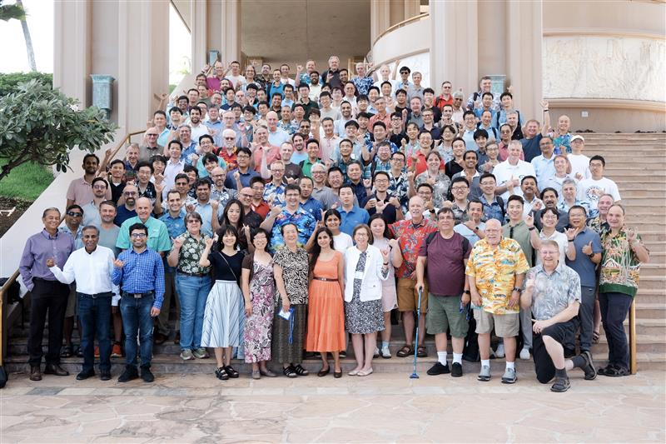
Special Thanks to IEEE 802.11

Slide 16
References
https://mentor.ieee.org/802.11/documents?is_dcn=DCN%2C%20Title%2C%20Author%20or%20Affiliation&is_group=00be
https://www.ieee802.org/11/Reports/tgbe_update.htm

