Slide 1
SFD Review for Long-Range Backscatter
Date: 2025-03-10
Authors:

Slide 2
Abstract
In the following, we review features in the Specification Framework Document (SFD, [1]).
Our intention is to help identify gaps in the SFD, and help get us closer to D0.1.
In the following we try to summarize what is already defined, what is missing, and what features we believe we need to enable long-range backscatter as an optional mode.
We attempt to relate SFD features to capabilities that a Backscatter non-AP AMP STA would have.

Slide 3
Background
In [2] we discussed the long-range backscatter use case.
The capabilities at the Backscatter non-AP AMP STA for long-range use case differs from that of close-range “sticker tag” use case.
Close-Range "Sticker" Tag | Long-Range Tag
Lower accuracy clock | Higher accuracy clock
OOK Modulation in Downlink | OOK Modulation in Downlink (same)
OOK Modulation in Uplink | DBPSK, DQPSK Modulation in Uplink
No carrier frequency shifting | Carrier frequency shifting
Low receive sensitivity: Receiver sensitivity limited by Energy Harvester | Higher receive Sensitivity: Not RF Energy Harvester limited
Limited energy storage | Lifetime battery or larger storage capacity

Slide 4
Background (2)
On further discussion, the group still had some questions.
  What specific SFD features would be required to enable a long-range backscatter mode?
Combined channel shifting and bit flipping. (SSB and PSK modulation in the Uplink) | [6-7]
1 Mb, 2 Mb DSSS in the AMP Excitation field | [4-5]
Medium protection mechanisms for long range backscatter | [8]

Slide 5
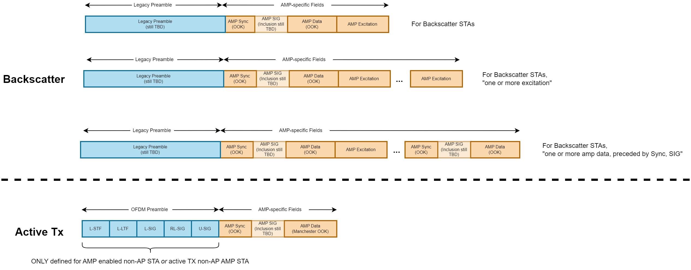
SFD So Far: Downlink PPDU Formats
In the downlink, the following downlink frame formats are proposed in the SFD

Slide 6
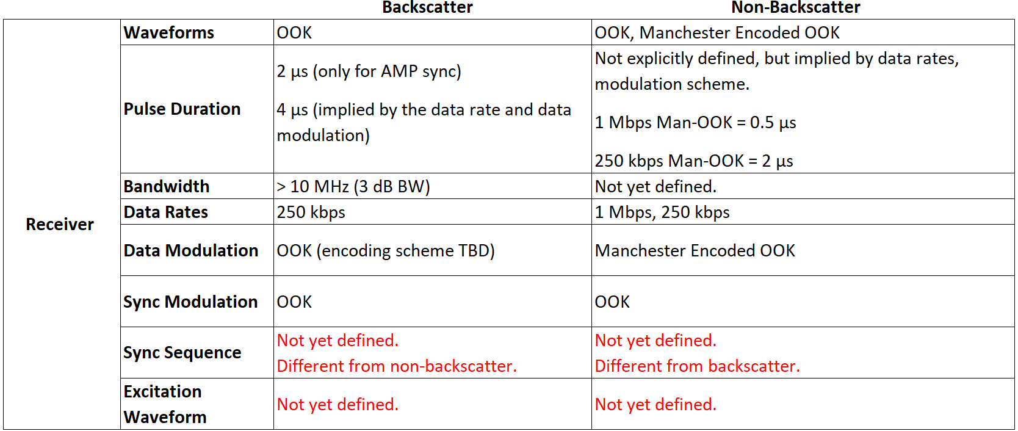
SFD Downlink PPDU: Receiver Capabilities
The DL PPDU clause implies several capabilities at the AMP STA receiver.

Slide 7

SFD Downlink PPDU: Backscatter Receiver Capabilities
Backscatter in the SFD
Long-range backscatter
Sync sequence design should depend on the receiver’s sensitivity level, not whether the device does backscatter or non-backscatter.
Focusing on receiver sensitivity,
  Energy Harvesting sensitivity is limited to around -23 dBm. [3]
  Our current long-range tags have around -35 to -40 dBm receiver sensitivity and are not EH limited.
  Active Tx devices are already assumed to have better receive sensitivity.
  Next generation long-range backscatter tags in newer process nodes will have better receiver sensitivity and consume less power.

Slide 8
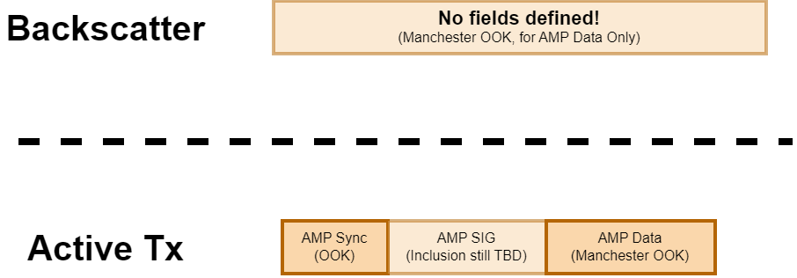
SFD So Far: Uplink PPDU Formats
The SFD is missing the most detail regarding the definition of uplink PPDUs.

Slide 9
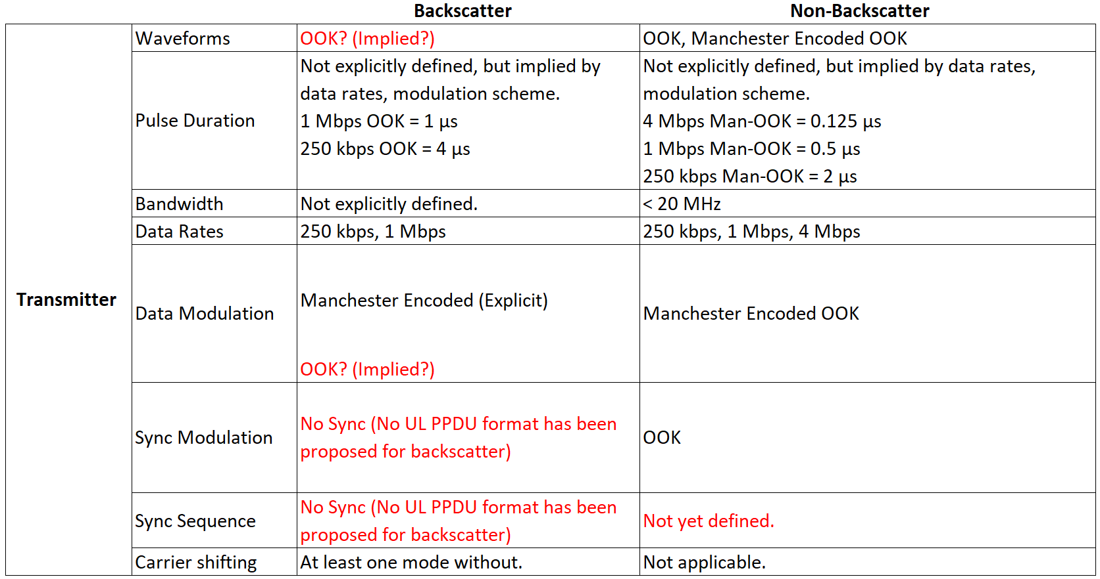
SFD Uplink PPDU: Transmitter Capabilities
The UL PPDU clause implies several capabilities at the AMP STA transmitter.

Slide 10
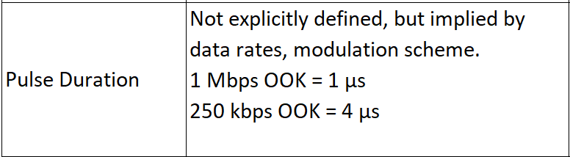

Uplink PPDU: Backscatter Transmitter Capabilities
Backscatter in the SFD
Long-range backscatter
[4-5] We proposed using 1 or 2 Mb DSSS in the Excitation field.
  This forms the entire UL PPDU after backscatter.
[6] We proposed using “bit flipping” or PSK modulation in the uplink.
  Bit flipping means the AMP STA only changes the phase of the chips already embedded in the downlink sequence.
  It does not generate pulses using OOK.
[6-7] We present how we can do channel shifting and DBPSK, DQPSK modulation at the same time.
  This implies both 1 and 2 Mb uplink rate “for free”.

Slide 11
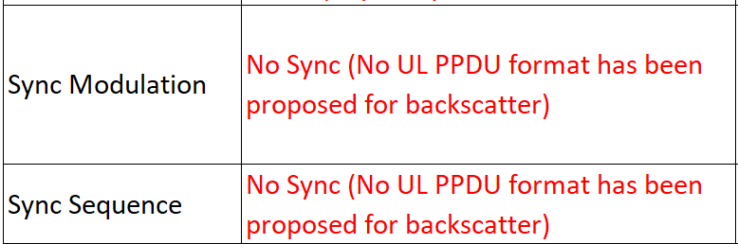
Uplink PPDU: Backscatter Transmitter Capabilities (2)
Backscatter in the SFD
Long-range backscatter
[8] Using 1 or 2 Mb DSSS in the Excitation field and channel shifting gives us the Sync in the uplink “for free”.
The tag doesn’t need to generate the Sync sequence; it can simply backscatter the exiting sequence!
The pre-embedded training sequences are critical for bistatic long-range applications.
[3-6] Using channel shifting gets us > 50 dB more link margin for long-range backscatter applications.

Slide 12
Conclusion
In this presentation, we discussed our interpretation of the current draft SFD.
In particular, we focused on the AMP DL PPDU and AMP UL PPDU formats, and how they map to the long-range backscatter use case.
We discussed what features we believe would be needed to enable a long-range backscatter use case.
  AMP DL PPDU:
    Longer Sync sequence, the design should be determined by receiver sensitivity not backscatter vs. non-backscatter.
    1 and 2 Mb DSSS PPDU as an optional waveform for the Excitation field.
  AMP UL PPDU:
    Channel shifting (Single Sideband Modulation) and PSK modulation in addition to OOK.

Slide 13
References
[1] Qi, Yinan, Specification framework for TGbp, 11-24/1613, September 2024.
[2] Costa et al., Long-Range Backscatter Use Case, 11-24/2115, January 2025.
[3] Shellhammer et al., WUR for Integrated Energizer Case, 11-24/1163, July 2024.
[4] Costa et al., Advantages of 802.11b DSSS in Long-Range Backscatter, 11-24/2143, January 2025.
[5] Kezys et al., Low Complexity Backscatter AMP STA, 11-24/2002, November 2024.
[6] Costa et al., PSK Modulation for Long-Range Backscatter, 11-25/0266, March 2025.
[7] Costa et al., Single Side Band Backscatter Modulation, 11-25/0265, March 2025.
[8] Nishat et al., Long-range Backscatter Protection Mechanisms, 11-25/0264, March 2025.

