Slide 1
Access Delay for Seamless transition
Date: 2025-7-15
Authors:
Name | Affiliations | Address | email
Haorui Yang | China Mobile | Hangzhou, Zhejiang, China | yanghaorui0217@163.com

Slide 2
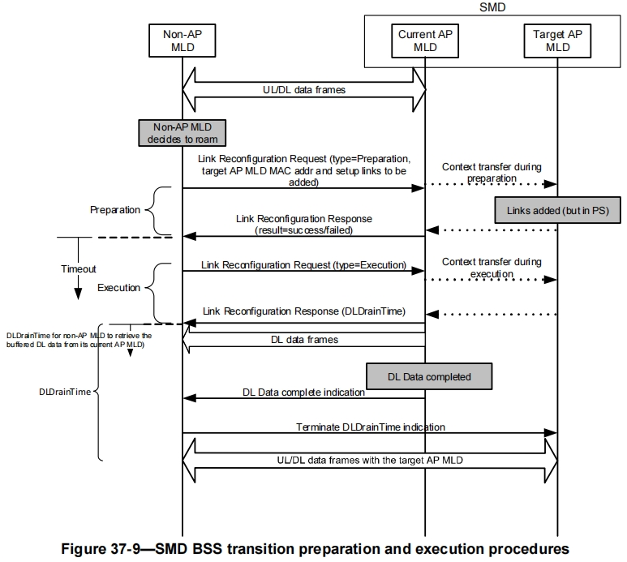
Introduction
SMD BSS transition procedure has been specified in 802.11bn D0.3[1], including the preparation phase and execution phase with frame exchange between non-AP MLD and AP MLD.
  The preparation phase is optional while the execution phase is mandatory.
The whole procedure is expected to be a long-duration procedure.

Slide 3
Introduction
The frame exchange between non-AP MLD and AP MLD, also between two AP MLDs over the air, should firstly obtain the TXOP by using DCF/EDCA as the baseline.
  EDCA is used if the STA supports QMF.
Therefore, this submission focus on how to reduce the access delay for the frame exchange over the air.

Slide 4
Issue
The whole SMD BSS transition procedure takes long duration and the performance of SMD BSS transition is strongly impacted by the access delay of the frame exchange over the air.
  The coverage of one BSS is relatively small in deployment, such as a few tens of meters.
  The movement from the source AP MLD to the target AP MLD will be fast compared to the SMD BSS transition procedure duration, especially in the dense deployment.
  Therefore, the SMD BSS transition procedure should be completed as soon as possible.
    Avoiding the scenario that the non-AP MLD has moved into the coverage of the target AP MLD but the procedure with source AP MLD is still ongoing.

Slide 5
Solution
The design principle is to make the SMD BSS transition performed as soon as possible.
To save the access time between the non-AP MLD and AP MLD, the management frames during the preparation and execution phase shall be treated with high priority.
  The existing QMF feature can be enhanced with adding the newly defined management frames for SMD BSS transition with mapping to AC_VO.
    e.g., adding the UHR Link Reconfigureation Request/Response frame with type = preparation/execution.
  These frames are treated as time priority management frames if QMF is not supported.

Slide 6
Futher Consideration
Besides the enhancement on transmitting the management frames for SMD BSS transition, the access to the target AP MLD can also be enhanced.
During the execution initiated to source AP MLD, the target AP MLD can send a trigger frame with RU allocation to the non-AP MLD via the source AP MLD.
  The trigger frame can be put in a container in the ST execution response to non-AP MLD.
When the non-AP MLD moves into the coverage of target AP MLD, non-AP MLD sends TB PPDU to the target AP MLD to inform its in-coverage by using the allocated RU.

Slide 7
Summary
This submission proposes to reduece the access delay for SMD BSS transition.
The proposed solution includes:
  The existing QMF feature can be enhanced with adding the newly defined management frames for SMD BSS transition with mapping to AC_VO. These frames are treated as time priority management frames if QMF is not supported.
  The target AP MLD sends Trigger frame to non-AP MLD via the source AP MLD to allocate the RU used by non-AP MLD to inform its in-coverage to target AP MLD.

Slide 8
Straw Poll 1
Do you support to include the following in 11bn SFD?
  Adding the management frames between non-AP MLD and AP MLD for SMD BSS transition to enhance the QMF with being mapped to AC_VO.
  Supporting List: [25/0237]

Slide 9
Straw Poll 2
Do you support to include the following in 11bn SFD?
  During the execution phase triggered to source AP MLD, the target AP MLD can send a trigger frame with RU allocation to the non-AP MLD via the source AP MLD.
  Supporting List: [25/0237]

Slide 10
References
[1]: IEEE Std 802.11bn D0.3

