Slide 1
UHR Frame Processing Enhancements
Date: 12 May 2025
Authors:
Name | Affiliations | Address | Phone | email
Michael Montemurro | Huawei | Toronto, Canada |  | Montemurro.Michael@gmail.com
Stephen McCann | Huawei | Southampton, UK |  | stephen.mccann@ieee.org
Arik Klein | Huawei TRC |  |  | arik.klein@huawei.com
Oren Hencinski | Huawei Datacom PL |  |  | oren.hencinski@huawei.com

Slide 2
Motivation
One of the key advantages of WLAN technology is that STAs are mobile and can maintain connectivity with the network as they move through coverage.
11be multi-link operation (MLO) introduces the ability for a non-AP MLD to re-configure links with its associated AP MLD, while maintaining its association.
If we can extend ML Reconfiguration beyond the single AP MLD, a non-AP MLD could seamlessly roam through the AP MLD coverage without ever losing data connectivity.
A non-AP MLD could be configured to communicate with links to affiliated APs on different AP MLDs simultaneously (with a centralized framework).

Slide 3
Scope
Previously submission 11-24/778 discussed issues related to non-collocated multi-link operation, including:
  Block-ACK operation
  The need for synchronization when traffic is transmitted on multiple links simultaneously
  A need for an interface between the Non-collocated (NC) MLD upper MAC Layer and the affiliated AP lower MAC layer
The submission also mentioned the following key use cases:
  The need for high reliability traffic delivery
  Seamless roaming with no data loss
  The ability to relay traffic through another affiliated STA
The contribution seeks to address these issues and builds on the NC MLO SMD Architecture presented in 11-24/2072 and the consensus on seamless mobility from motions #279 and #280.

Slide 4
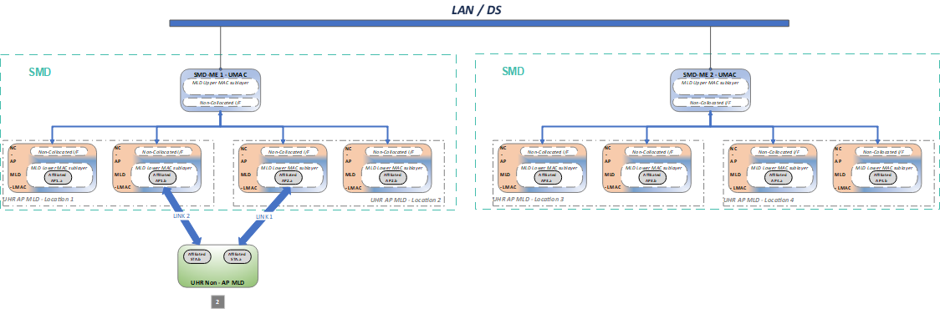
Example UHR non-AP MLD communication
The UHR non-AP MLD associates to the SMD ME and communicates through an AP MLD that is a member of the SMD-ME. The AP MLD can provide connectivity to non-UHR non-AP MLDs and non-AP STAs.

Slide 5
Current MLO processing
For WLAN (on the downlink), MSDUs are received from the DS, processed into MPDUs and then transmitted as PPDUs.
MSDUs can be fragmented into multiple MPDUs
Sequence Counters and Duplicate Detection caches are assigned to MSDUs
Cryptographic encapsulation is performed on MPDUs
Packet numbers are assigned to MPDUs
For MLO, when cryptographic encapsulation is done at the MLD, both the Sequence Counter and the PN need to be assigned at the MLD.
ALL PROCESSING IS DONE BY THE MLD
What about performing cryptographic encapsulation and assigning a PN to an MSDU before the Sequence Counter is assigned?

Slide 6
PN before SN
For MLO, cryptographic encapsulation needs to be done at the MLD, since the Security Association is at the MLD.
NOTE: For simplicity, MSDU below refers to an MSDU, A-MSDU, or MMPDU
So process the frames as follows (downlink as an example):
  At the MLD:
    An MSDU is received from the DS
    The MSDU is assigned a PN and cryptographically encapsulated.
    The MSDU is distributed to an affiliated AP for further processing and transmission.
  At the affiliated STA,
    The MSDU is delivered from the NC MLD
    The MSDU is assigned an SN
    The MSDU is processed to create one or more MPDUs
    The affiliated STA converts the MPDUs to PPDUs and transmits them on the medium.

Slide 7
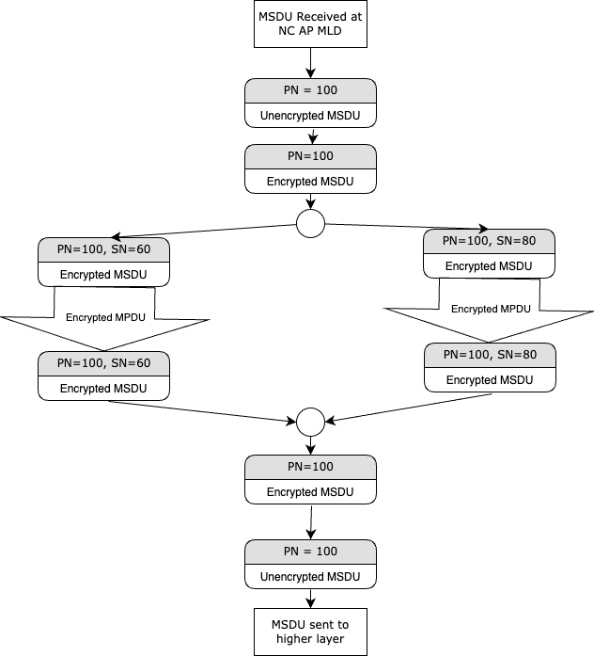
This sounds radical, but really it isn’t.
With this new processing:
  The processing at the MLD involves assigning a PN and encrypting frames.
  The header for an encrypted frame is already designed.
  The processing of the MPDUs in the affiliated STA does not involve encryption/decryption since the MSDUs are encrypted at the MLD level. The only difference is that the encryption header is present in the frame.
  The receiving MLD will have to perform any re-ordering, if necessary and replay detection using the PN (note that with a BA agreement, when retries occur, a similar re-ordering exercise needs to be done). Note that reordering would only occur for MSDUs received across MLDs.
The new processing mechanism would be negotiated:
    By specifying a new cipher suite
    By specifying new capabilities.

Slide 8
Acknowledgement, Duplicate Detection and Re-ordering
Acknowledgement and BA scoreboarding are handled at each affiliated STA.
  The affiliated STA transmitter performs all BA operation and retransmissions if necessary.
  The affiliated STA receiver performs all BA operation, acknowledgment, BA scoreboarding, duplicate detection, and any re-ordering required based on SN and MPDU retransmissions.
Replay detection and re-ordering across links are handled by the MLD
  The MLD assigns a PN to the MSDU, A-MSDU, or MMPDU and distributes them to an affiliated STA(s) for transmission.
  The receiving MLD processes the PN of the MSDU, A-MSDU, or MMPDU received from an affiliated STA to perform replay detection, and re-ordering if necessary
    If a TID is mapped to multiple links, the MSDU, A-MSDU, or MMPDU could be received out of order. The receiving MLD maintains a window for each replay counter and re-orders MSDU, A-MSDU, or MMPDUs that arrive within that window according to the PN, for a given TID.

Slide 9
Example Frame Processing at the MLD
IEEE 802.1X port filtering
RX/TX MSDU rate limiting
A-MSDU Aggregation/Deaggregation
PS Deferred Queuing for MSDU, A-MSDU, or MMPDU | (null)
PN Assignment | SYNRA Receive Filtering
MSDU, A-MSDU, or MMPDU Encryption (TX) / Decryption (RX) (individually addressed only)
(null) | MSDU, A-MSDU, or MMPDU Reordering /Duplicate Detection by PN
Affiliated STA encrypted MSDU, A-MSDU, or MMPDU distribution / PN Sync messaging | Affiliated STA MSDU, A-MSDU, or MMPDU reception / PN Sync messaging
MSDU Flow - Transmitting
MSDU Flow - Receiving
To/From Affiliated STA
NOTE: Modified frame processing steps indicated in bold.
9

Slide 10
Example Frame Processing at the Affiliated STA
To/From MLD
MLD encrypted MSDU, A-MSDU, or MMPDU reception / PN Sync messaging | MLD encrypted MSDU, A-MSDU, or MMPDU distribution/ PN Sync messaging
RX and TX addresses to MPDU header | RX and TX address to MLD address swap
Sequence Number (SN) Assignment | Block ACK buffering and reordering
MSDU, A-MSDU, or MMPDU Encryption (TX) / Decryption (RX) (only for group addressed MSDU payload)
Fragmentation (TX) / Defragmentation (RX)
(null) | Block ACK scoreboarding
(null) | Address 1 address filtering
MPDU Header + CRC Creation (TX) / Validation (RX)
A-MPDU Aggregation (TX) / Deaggregation (RX)
MSDU Flow - Transmitting
MSDU Flow - Receiving
NOTE: Modified frame processing steps indicated in bold.
10

Slide 11
Summary
Perform cryptographic encapsulation and assign a PN to an MSDU, A-MSDU, or MMPDU before the Sequence Counter is assigned.
BA agreements can now be done on a link by link basis (i.e. a 160 MHz link does not have to use the same BA agreement as a 40 MHz link)
Fragmentation and reassembly can be applied on a link by link basis.
Note that some of these benefits apply to both MLO and MLO

Slide 12
PN Management and reordering
If an MLD is receiving frames that are duplicated across multiple links or interleaved on multiple links, it may have to re-order the received frames prior to performing replay detection.
  This is distinctly different from score-boarding and (block) acknowledgment procedures.
  Per-link reordering is still performed, based on the SN values.
    In the baseline, clause 10.25.6.6.2 states “Gaps may exist in the Sequence Number subfield values of the MSDUs or A-MSDUs that are passed up to the next MAC process”
  When frames are received from a single link/affiliated AP, no further PN-based re-ordering is required.
  When duplicate frames are received from multiple links, duplicates need to be discarded (based on their PN values, per TID) prior to replay detection.
  When frames are received interleaved from multiple links, the MLD may have to re-order frames according to the PN value, per TID, prior to replay detection.

