Slide 1
Power Management Across Multi-Link
Date: 2025-01-23
Authors:
Name | Affiliation | Address | Mail
Xiangxin Gu | Spreadtrum | Spreadtrum Center, Lane 2288, Zu Chongzhi Road, Shanghai | Xiangxin.gu@unisoc.com
Yingqiao Quan | Spreadtrum |  | Yingqiao.quan@unisoc.com
Lei Zhou | H3C |  | zhou.leiH@h3c.com

Slide 2
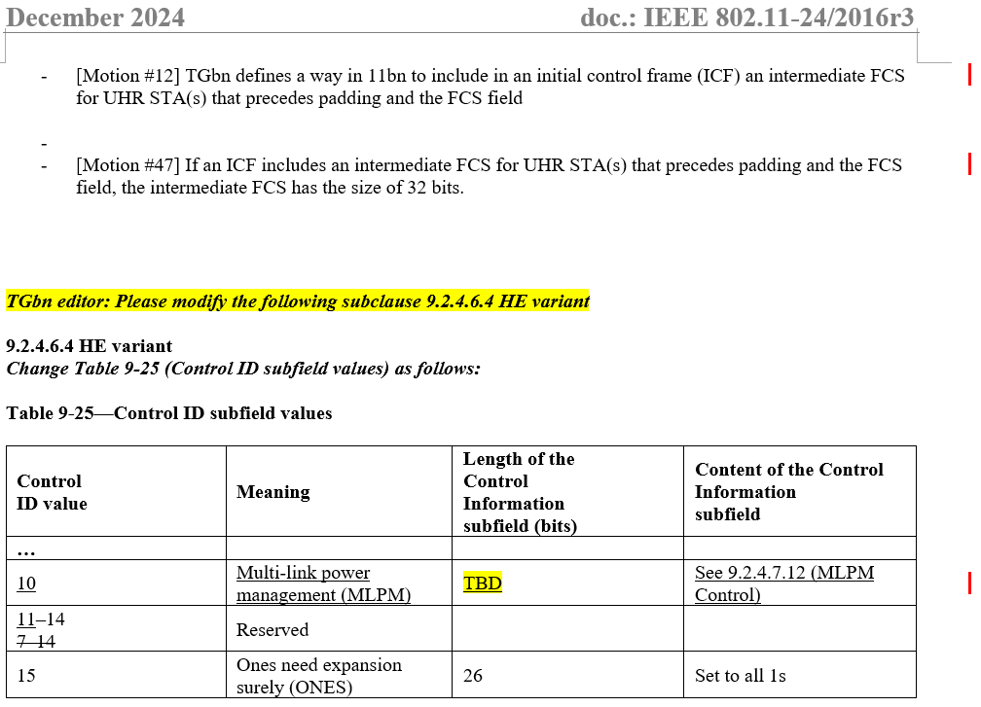
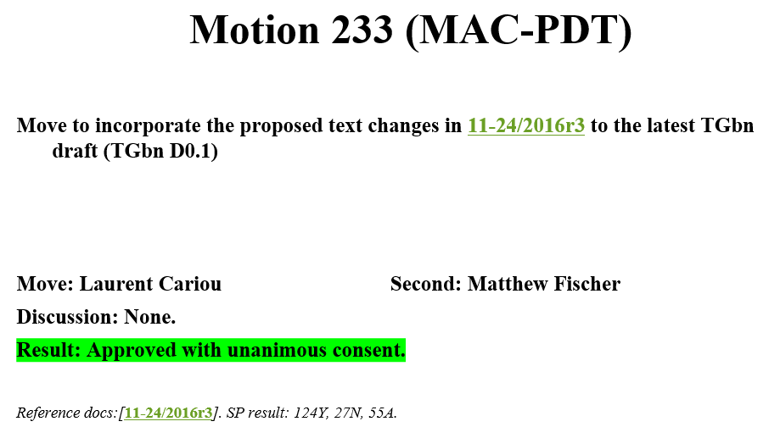
Recap
It’ time to design MLPM Control subfield.

Slide 3
Discussion
3 designs to indicate PM mode for multi-link.
Design 1: Sharing PM subfield in Frame Control field with a bitmap in MLPM Control subfield to indicate STA(s) other than the STA sent the frame.
Design 2: A separate PM subfield and a bitmap in MLPM Control subfield for STA(s) other than the STA sent the frame.
Design 3: A separate PM subfield for each STA(s) other than the STA sent the frame in MLPM Control subfield.
 | Design 1: Sharing PM subfield in Frame Control field | Design 2: A separate PM subfield for other STA(s) | Design 3: A separate PM subfield for each other STA(s)
Changing PM mode for each STA. | Same PM mode change as the STA sent the frame. Need another frame on another link to treat other scenarios. | Same PM mode change for STA(s) other than the STA sent the frame. Need another frame to treat other scenarios. | Feasible to treat all scenarios.
Triggering DL data for STA(s) in PS mode. | Can indicate subset of STA(s) in PS mode. | Can indicate subset of STA(s) in PS mode. | Can’t indicate subset of STA(s) in PS mode.

Slide 4
Discussion
Each design has pros and cons.
Design 1 (Sharing PM subfield in Frame Control field) and Design 3 (A separate PM subfield for each other STA(s) ) are straightforward.
Design 2 is more complex than Design 1 but no gains.
Design 3 can’t deal with triggering DL data for STA(s) in PS mode.

Slide 5
Summary
In this contribution, we compared 3 designs for MLPM Control subfield.
Each design has pros and cons.
Design 1 (Sharing PM subfield in Frame Control field) and Design 3 (A separate PM subfield for each other STA(s) ) are straightforward.
Design 2 is more complex than Design 1 but no gains.
Design 3 can’t deal with triggering DL data for STA(s) in PS mode.
It is proposed to use Design 1 (Sharing PM subfield in Frame Control field with a bitmap in MLPM Control subfield to indicate STA(s) other than the STA sent the frame) for multi-link power management.

Slide 6
SP
Do you agree to that multi-link power management shares PM subfield in Frame Control field with a bitmap in MLPM Control subfield to indicate STA(s) other than the STA sent the frame?

Slide 7
References
[1] 11-25-0014-07-00bn-tgbn-motions-list-part-2.pptx Alfred Asterjadhi
[2] 11-24-2016-03-00bn-pdt-mac-power-save.docx Liwen Chu
[3] 11-22-2045-01-00be-lb266-cr-misc-part2.docx Minyoung Park

