Slide 1
ARC SC
Frame exchange Sequence
Figure 10-14 is ONE frame exchange sequence
Date: 2025-July
Authors:
Name | Company | Address | Phone | email
Graham Smith | SRT / Bluehalo | Sunrise , FL |  | Graham.smith@bluehalo.com

Slide 2
Intro
DEFINITION
frame exchange sequence: A sequence of frames that maintains control of the wireless medium.
Points for consideration:
The definition is clear. When a frame exchange sequence is on air, all STAs know it and obey the rule not to transmit until it is complete.
For example, a STA that is not part of the frame exchange sequence, but in the same network, knows that a frame exchange sequence is happening, and does not transmit during it.
Rev 2 – Presented
Rev 4 - Added content from Slide 11.
Rev 5 – edits and update from Madrid Plenary.

Slide 3
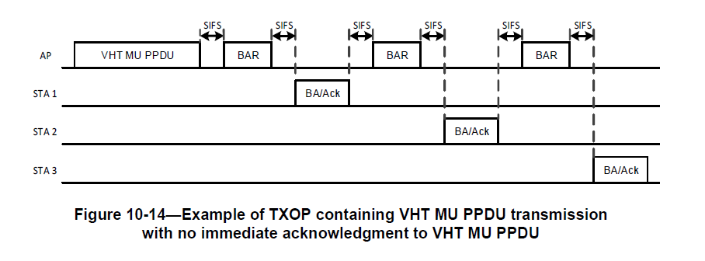
What has been the contention?
Q - Is this 1, 3, or 4 frame exchange sequences?
A – ONE and I will show why.
See also Figures 10-43, 10-44 (Example of frame exchange sequence - NOT sequences)

Slide 4
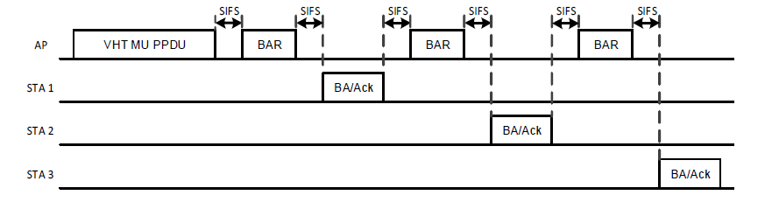
The arguments for 3 or 4 frame exchange sequences have centered on STA 1
The argument is that once STA 1 has sent its BA/Ack, it could change its state, e.g., go scanning or go into power save.
BUT
Even if true (we will investigate this further), it must not transmit until the frame exchange sequence is complete.

Slide 5
Consider STA 4, not part of the frame exchange sequence, but in the same network.
Must NOT transmit
STA 4
STA 4 knows that a frame exchange sequence is happening AND it continues until STA 3 has transmitted.
STA 4 sees just ONE frame exchange sequence.
Note: STA 4 cannot inform the AP of a change of power save but could sleep (until frame exchange sequence is over).
STA 1 is the same, it knows the frame exchange sequence length.

Slide 6
Following the definition, i.e., the transmit restriction, it is clear that this example is one frame exchange sequence.
  If 3 or 4, how does STA 4 behave?
  If 3 or 4, how does the transmit rules apply to STA 1?
HOWEVER, there are rules about what a STA can do during a frame exchange sequence, and it has been suggested that STA 1 may violate such rules and hence as far as STA 1 is concerned the frame exchange sequence ends after it has transmitted.
  BUT it still cannot transmit
So, let’s now look at these frame exchange related PS rules.

Slide 7
Power Save and frame exchange sequence
9.2.4.1.7 Power Management subfield
The Power Management subfield is used to indicate the power management mode of a STA. The subfield is either reserved (as defined below) or remains constant in each frame from a particular STA within a frame exchange sequence. The value indicates the mode of the STA after the successful completion of the frame exchange sequence.

Slide 8
Power Save Rules
11.2.3.1.
A STA that is associated with an AP and that changes power management mode shall inform the AP of this fact using the Power Management subfield within the Frame Control field of transmitted frames. The STA shall remain in its current power management mode until it informs the AP of a power management mode change via a frame exchange sequence(#109) that includes an acknowledgment from the AP. Power management mode shall not change during any single frame exchange sequence.
11.2.3.2
To change power management modes a STA shall inform the AP by completing a successful frame exchange that is initiated by the STA.
A non-AP STA shall not change power management mode using a frame exchange sequence that does not receive an Ack or BlockAck frame from the AP, or using a BlockAckReq frame.
NOTE 2—The Power Management subfield is ignored in frame exchange sequences initiated by the AP.
Note: There is no reason given as to why these rules exists. Presumably, it seemed a good idea at the time.

Slide 9
Conclusions for power save
In the example Fig 10-14, 11.2.3.2 Note 2 says that STA 1 cannot tell AP that it is going into power save.
  Can’t set PS bit in frame control.
STA 1 could go into power save but AP would not know.
  If STA 1 set PS bit, the AP could ignore it as it should not be even checking the bit in a BA/Ack.
  STA 1 would have to wake after end of frame exchange sequence to send new frame exchange sequence and set PS bit.
  NOTES:
  -The “rule” is that the STA cannot set and transmit the PS bit in a frame exchange sequence (the PS bit is ignored), not that it can’t sleep or go off and do something passive.
  -There is no reason given as to why these rules exists. Presumably, it seemed a good idea at the time.

Slide 10
Change the power save rules?
If it is felt that in FIG 10-14 STA 1 should be able to sleep AND inform the AP, then a change in the specification is required. For example, the PS bit could be set in the BA/Ack BUT the AP would need to Ack it, and existing APs would not expect it.
  I contend that this is not practical.
STA 1 could simply sleep until end of the frame exchange sequence but then would need to wake up and send packet to AP with PS bit set.
  Simpler to just wait? But up to the STA. No need to specify internal behavior, i.e., does not affect interoperability
No text changes are proposed for power save.

Slide 11
Discussion - 1
Originally it was not considered that a STA was not 100% involved in a frame exchange sequence
  Hence, idea to specify that it can’t do things was good
Even IF some consider still that there are 3 or 4 frame exchange sequences it is, in fact, immaterial.
If STA 1 is no longer taking part, there is still a frame exchange sequence in effect.
HENCE
STA 1 is now in the same situation as STA 4.
We can agree that STA 1, and STA 4 for that matter, can do stuff as long as they do not transmit, i.e., no interoperability concern as an FES is taking place.

Slide 12
Discussion - 2
So…IF we agree that STA 1, and STA 4 for that matter, can do stuff as long as they do not transmit
Let’s see where there is any text that may be preventing this….

Slide 13
MLME-SCAN 1
“6.5.3.2.4 Effect of receipt
This request initiates the scan process when the current frame exchange sequence is completed”
Note that Scan includes Active/Passive
Do we need to be clear that active scan shall not transmit over a frame exchange sequence. OR is this obvious? Transmission rules are clear already.
Also, this process only initiates the process, it does not directly start any PHY actions.
Possible change to text:
“This request initiates the scan process.”
It has been pointed out that no instructions if STA is already scanning. But that has nothing to do with FES, it is simply that the STA has decided to be unavailable for a period (not new).

Slide 14
MLME-SCAN 2
“11.1.4.1 General
A STA shall operate in either a Passive Scanning mode or an Active Scanning mode depending on the current value of the ScanMode parameter of the MLME-SCAN.request primitive.
NOTE 1—Active scanning is restricted in some frequency bands and regulatory domains.”
Could edit NOTE 1 or add NOTE 2 to cover the frame exchange sequence case.
“NOTE 2 - No active scan transmission(s) may be sent on the same frequency band as a current frame exchange sequence until the frame exchange sequence is completed.” (but this is obvious!)
AGAIN, no clear need to add anything.

Slide 15
MLME-JOIN
6.5.4.2.4 Effect of receipt
This primitive initiates a synchronization procedure once the current frame exchange sequence is complete.
The MLME synchronizes its timing with the specified BSS based on the information provided in the SelectedBSS parameter. The MLME subsequently issues an MLME-JOIN.confirm primitive that reflects the results.
This is probably fine. Joining involves transmitting and won’t (can’t) do that while a frame exchange sequence is active.

Slide 16
MLME-START
6.5.11.2.4 Effect of receipt
This primitive initiates the BSS initialization procedure once the current frame exchange sequence is complete. The MLME subsequently issues an MLME-START.confirm primitive that reflects the results of the creation procedure.
Probably OK as is. Same argument as Join.

Slide 17
Take Away
Even if some still insist that the case of FIG 10-14 shows 3 or 4 frame exchange sequences, then these suggested additions still work. It does not really matter as “AP-FES” still covers the entire sequence.
There is also no need, however, to describe this sequence as 3 (4?) separate sequences as this will do nothing but confuse, IMHO.
There is nothing to stop STA 1 or STA 4 from dozing if it wants.

Slide 18
Conclusions - 1
The frame exchange sequence definition is simple, clear and sufficient.
The power save rules that have been written for frame exchange sequences (The PS bit is ignored in a frame exchange sequence), seem to be practical and keep things simple.
  Changing them would cause problems
Figure 10-14 represents one frame exchange sequence.
  STA 1 must obey the basic no transmit rule until frame exchange sequence is complete.
  Keep it simple so ALL STAs see the same frame exchange sequence. BUT it does not matter, there is still an FES (the AP).

Slide 19
Conclusions - 2
Could Remove “when the current frame exchange sequence is completed” from MLME-SCAN, and we are done.

