Slide 1
Elicitation of Response Transmissions in Coordinated Spatial Reuse
Date: 2025-01-17
Authors:

Slide 2
Backgrounds
Coordinated spatial reuse (Co-SR) is a UHR feature that allows two APs to perform concurrent downlink (DL) single-user (SU) equal-duration transmissions, which are initiated using a trigger frame transmitted by a Co-SR coordinating AP and carrying a specified duration of the initiated Co-SR transmissions (Motions 29, 206, 253, and 254)
A Co-SR coordinating AP controls the maximum transmit power of a Co-SR coordinated AP but not that of any non-AP STA in the Co-SR coordinated AP’s BSS [1] (Motion 29 and 429)
Hence, if a Co-SR coordinated AP elicits a response transmission from a non-AP STA, the elicited response transmission may be sent with a (non-controlled) transmit power that results in a corruption of another response transmission elicited by the Co-SR coordinating AP, as described in the following
Notes:
Co-SR motions:
29 (initial Co-SR motion), 206 (DL SU for Co-SR), 217 (Max NSS), 253 (trigger frame and SIFS-separated UHR transmissions), 254 (trigger frame content: transmission duration), 307 (BSS color indication), 308 (packet extension (PE) duration), 414 (spatial reuse subfield setting), 429 (trigger frame content: transmit power), 455 (single PHY version in Co-SR invite and response), 456 (trigger frame content: PHY version), 472 (Co-SR rejection due to LTF type), 475 (Co-SR transmission padding), 480 (Co-SR rejection), 491 (same Co-SR and Co-BF frame exchange sequence), 522 (sequential ACK procedure).

Slide 3

Main Issue
Consider the following scenario:
  STA1 is associated with AP1 and STA2 is associated with AP2
  The path loss between AP1 and STA1 is equal to the path loss between AP1 and STA2
  By employing Co-SR, the simultaneous DL transmissions from AP1 and AP2 are successful, if the coordinating AP properly controls the maximum transmit power of the coordinated AP, and the coordinated AP properly selects an MCS value for its transmission to STA2, based on the interference from the coordinating AP to STA2 (which is known to the coordinated AP via a measurement/report scheme) [2]
Room 2
Room 3
STA1
Successful DL transmissions by AP1 and AP2
Co-trigger
Illustration of DL PPDU transmissions by the coordinating AP and coordinated AP
An interference that is controlled by the Co-SR coordinating AP
Room 4
Coordinating AP
DL PPDU
SIFS
time
STA2
AP1
(Coordinating AP)
Coordinated AP
DL PPDU
time
AP2
(Coordinated AP)
Desired signal
Room 1
Interference signal

Slide 4
Main Issue
Consider the following scenario:
  STA1 is associated with AP1 and STA2 is associated with AP2
  The path loss between AP1 and STA1 is equal to the path loss between AP1 and STA2
  However, the ACK frame transmission from STA1 to AP1 may not be successful (even with MCS 0), as a result of a high interference that is caused by the ACK frame transmission from STA2 to AP2 with an uncontrolled transmit power, resulting in an SINR of approximately 0 dB at the coordinating AP
Room 2
Room 3
STA1
Unsuccessful ACK transmission from STA1 to the AP1
Co-trigger
ACK
Illustration of ACK frame transmissions by STA1 and STA2
Uncontrolled interference
Room 4
Coordinating AP
DL PPDU
SIFS
SIFS
time
ACK
STA2
AP1
(Coordinating AP)
Coordinated AP
DL PPDU
SIFS
time
AP2
(Coordinated AP)
Desired signal
Room 1
Interference signal

Slide 5
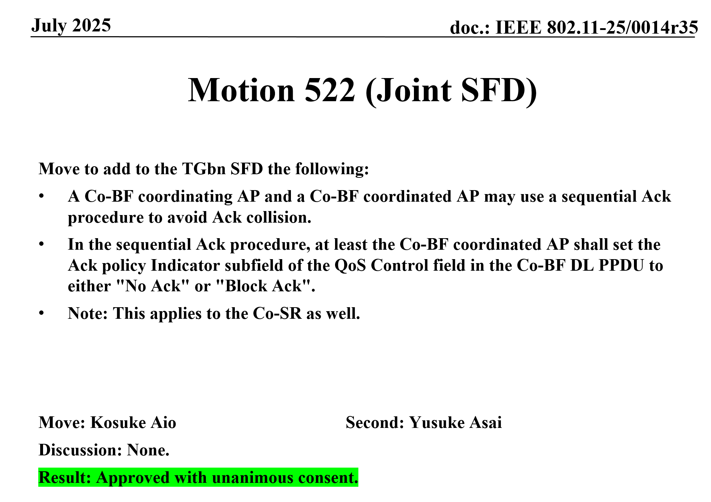
Proposed Solution
Optionally require a coordinated AP not to transmit any frame that elicits a response transmission
In this case, the Ack policy for a DL frame sent by the coordinated AP shall be set to ‘No Ack’ or ‘Block Ack’
Successful ACK transmission from STA1 to AP1
Co-trigger
ACK
Coordinating AP
DL PPDU
SIFS
SIFS
time
BA
Coordinated AP
DL PPDU
BAR
SIFS
time
The Ack policy of a carried frame is set to Block Ack
Block Ack transmitted by STA2 after receiving a Block Ack Request (BAR) frame
Hassan Omar et al., Huawei Technologies
Notes:
Currently, there is no specification that prevents a coordinated AP from eliciting other types of UL transmissions (e.g., a TB PPDU)

Slide 6
Conclusions
In several Co-SR scenarios, the elicitation of a response transmission by a coordinated AP may impact another response transmission elicited by a coordinating AP
To deal with this issue, it is suggested that, we optionally require a coordinated AP not to transmit any frame that elicits a response transmission

Slide 7
References
[1] 11-24-0050-00bn-coordinated-spatial-reuse-types
[2] 11-23-1832-00bn-multi-ap-coordinated-spatial-reuse

Slide 8
SP
In Co-SR, when a ‘sequential Ack procedure’ is employed, do you agree that:
  a Co-SR coordinated AP shall not transmit any frame that elicits a response transmission.
  Note: this requirement applies only throughout the Co-SR transmission duration specified in the trigger frame that initiates the Co-SR transmissions
  Yes
  No
  Abstain

