Slide 1
Ad-hoc mode for ELC
Date: 2025-01-16
Authors:

Slide 2
Does ELC cover what applications need?
To be successful in a certain use case / for a certain application, the communication technology shall FULLY cover the needs of that application.
Alternatives should be noticeably insufficient for the same application.
Let us consider the main applications considered so far in the TGbb and ELC SG (next slide).

Slide 3
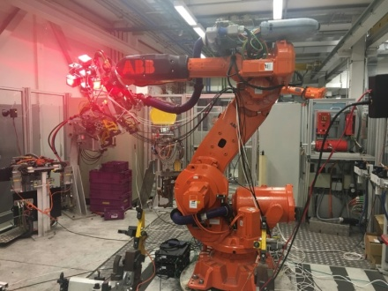
Applications and their requirements (1/3)
Medical/Industrial applications [1]
RF prohibited or inappropriate due to EMI restrictions or high inter-BSS interference
Low latency and high reliability are required (<5 ms latency, 99.9% reliability) [2]
Moreover, user devices need to be small, cheap and power-efficient.
The latter is covered in ELC PAR:
Simpler integration of the IEEE 802.11 baseband with optical frontends
Methods to reduce the peak-to-average-power ratio
Hospital
Industrial robot

Slide 4
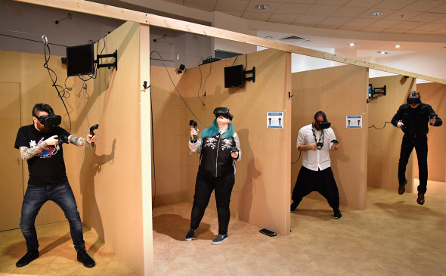
Applications and their requirements (2/3)
Wires = restrictions
Massive VR (Internet/Intranet Access) [1]
Suffers from restrictions of wired connections – need wireless
High capacity, low latency and high reliability are required. (<3 ms latency, 99.9% reliability, >1000 Mbps) [2]
Covered in ELC PAR:
Operations in new optical bands in the range of 400 nm to 600 nm and 1200 nm to 1600 nm
New channelization (wider bandwidth)
The use of wavelength division multiplexing (WDM)
MAC support for the ELC PHY and multi-link operation
Jeff J Mitchell / Getty Images
VR club
Conference hall

Slide 5
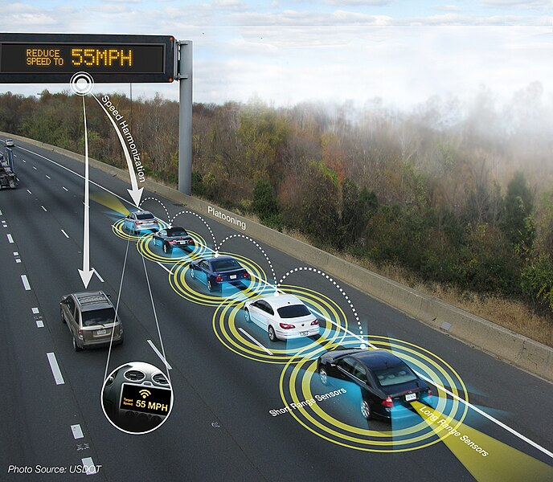
Applications and their requirements (3/3)
V2X communication [1]
Robust and interference-free communication
Low latency and very high reliability are required. (delay < 5 ms, 1e-8 PER, 99.9% reliability) [3]
Notably, the power efficiency and device cost seem to be less important
the stations are deployed in cars and not in mobile hand-held or wearable devices.
However, a vital element to reach the low latency reliably is ad-hoc communication
All cars are equal -> ad-hoc is natural
5G has less spectrum that ELC can have, and RF has longer range -> interference (5G V2X uses random access)
Platooning

Slide 6
Summary
ELC does not seem to co-work well with ad-hoc.
802.11bb, 802.11be and 802.11bn rely on AP having a dominating and coordinating role in every scenario, which does not directly map onto the use case of V2X.
The newest features like multi-link, higher bandwidth, multiple TX/RX antennas seem to be not applicable for ad-hoc networks.
This is, the gap cannot be covered by the mere combination of the 802.11 amendments.
We believe that ELC SG should consider ad-hoc communication.

Slide 7
SP 1
Do you agree that ad-hoc mode should be considered in the context of ELC/802.11br?
Y -
N -
A -

Slide 8
SP 2
Do you agree that ad-hoc mode shall be explicitly included in ELC PAR?
Y -
N -
A -

Slide 9
References
https://mentor.ieee.org/802.11/dcn/17/11-17-1743-01-00lc-proposed-usage-models-for-ieee-802-11-light-communication-study-group.pptx
https://mentor.ieee.org/802.11/dcn/17/11-17-1778-01-00lc-consolidated-kpi-for-par-csd.xlsx
https://mentor.ieee.org/802.11/dcn/18/11-18-0931-01-00lc-lc-outdoor-usage-models.pptx

