Slide 1
802.11ac waveform transmission over mmWave carrier
January 2025
Date: 2025-01-16
Authors:
Name | Affiliations | Address | Phone | email
Micky Mehta | Pharrowtech BV |  |  | micky.mehta@pharrowtech.com
Micky Mehta (Pharrowtech), et al.

Slide 2
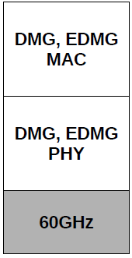
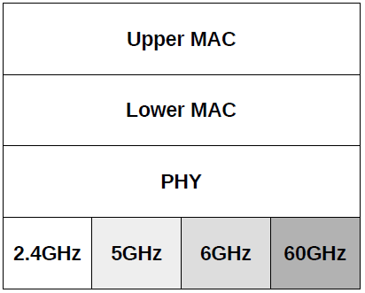
Introduction
802.11ac MAC & PHY, and possibly beyond to include 802.11ax, 802.11be …
802.11ad,
802.11ay
TGbq aims to integrate a 60GHz front-end to existing MAC & PHY specifications operating largely in sub-7GHz [1]
This submission presents results of Over-the-Air (OTA) experiments with realistic 60GHz RF front-end module and upclocked 802.11ac waveform
Micky Mehta (Pharrowtech), et al.

Slide 3
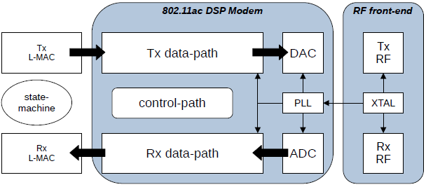
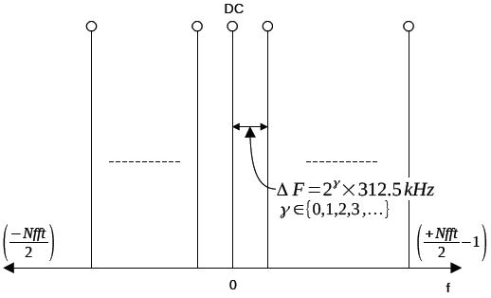
Upclocking 802.11ac PHY
Increasing subcarrier spacing beyond 312.5kHz dilutes 60GHz RF impairments
What should be the value of γ?
  Larger γ will yield better immunity against some RF impairments, but will increase ADC/DAC power consumption and consume more RF bandwidth
  Smaller γ reduces bandwidth expansion
Micky Mehta (Pharrowtech), et al.

Slide 4
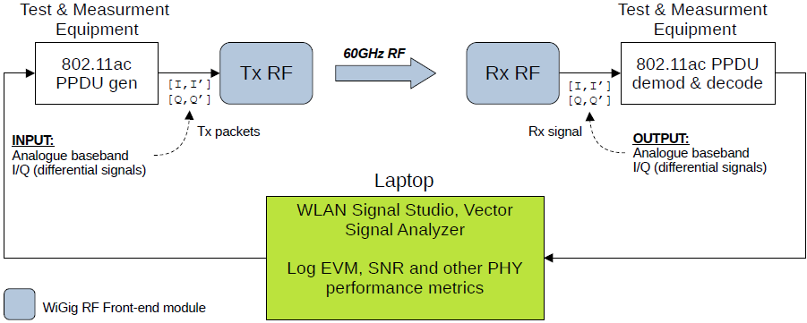
mmWave WLAN PoC: Experimental setup
Further details on the WiGig RF front-end module can be found here https://pharrowtech.com/products/wireless-modules/ together with details on RFIC https://pharrowtech.com/products/rf-chipset/
Micky Mehta (Pharrowtech), et al.

Slide 5
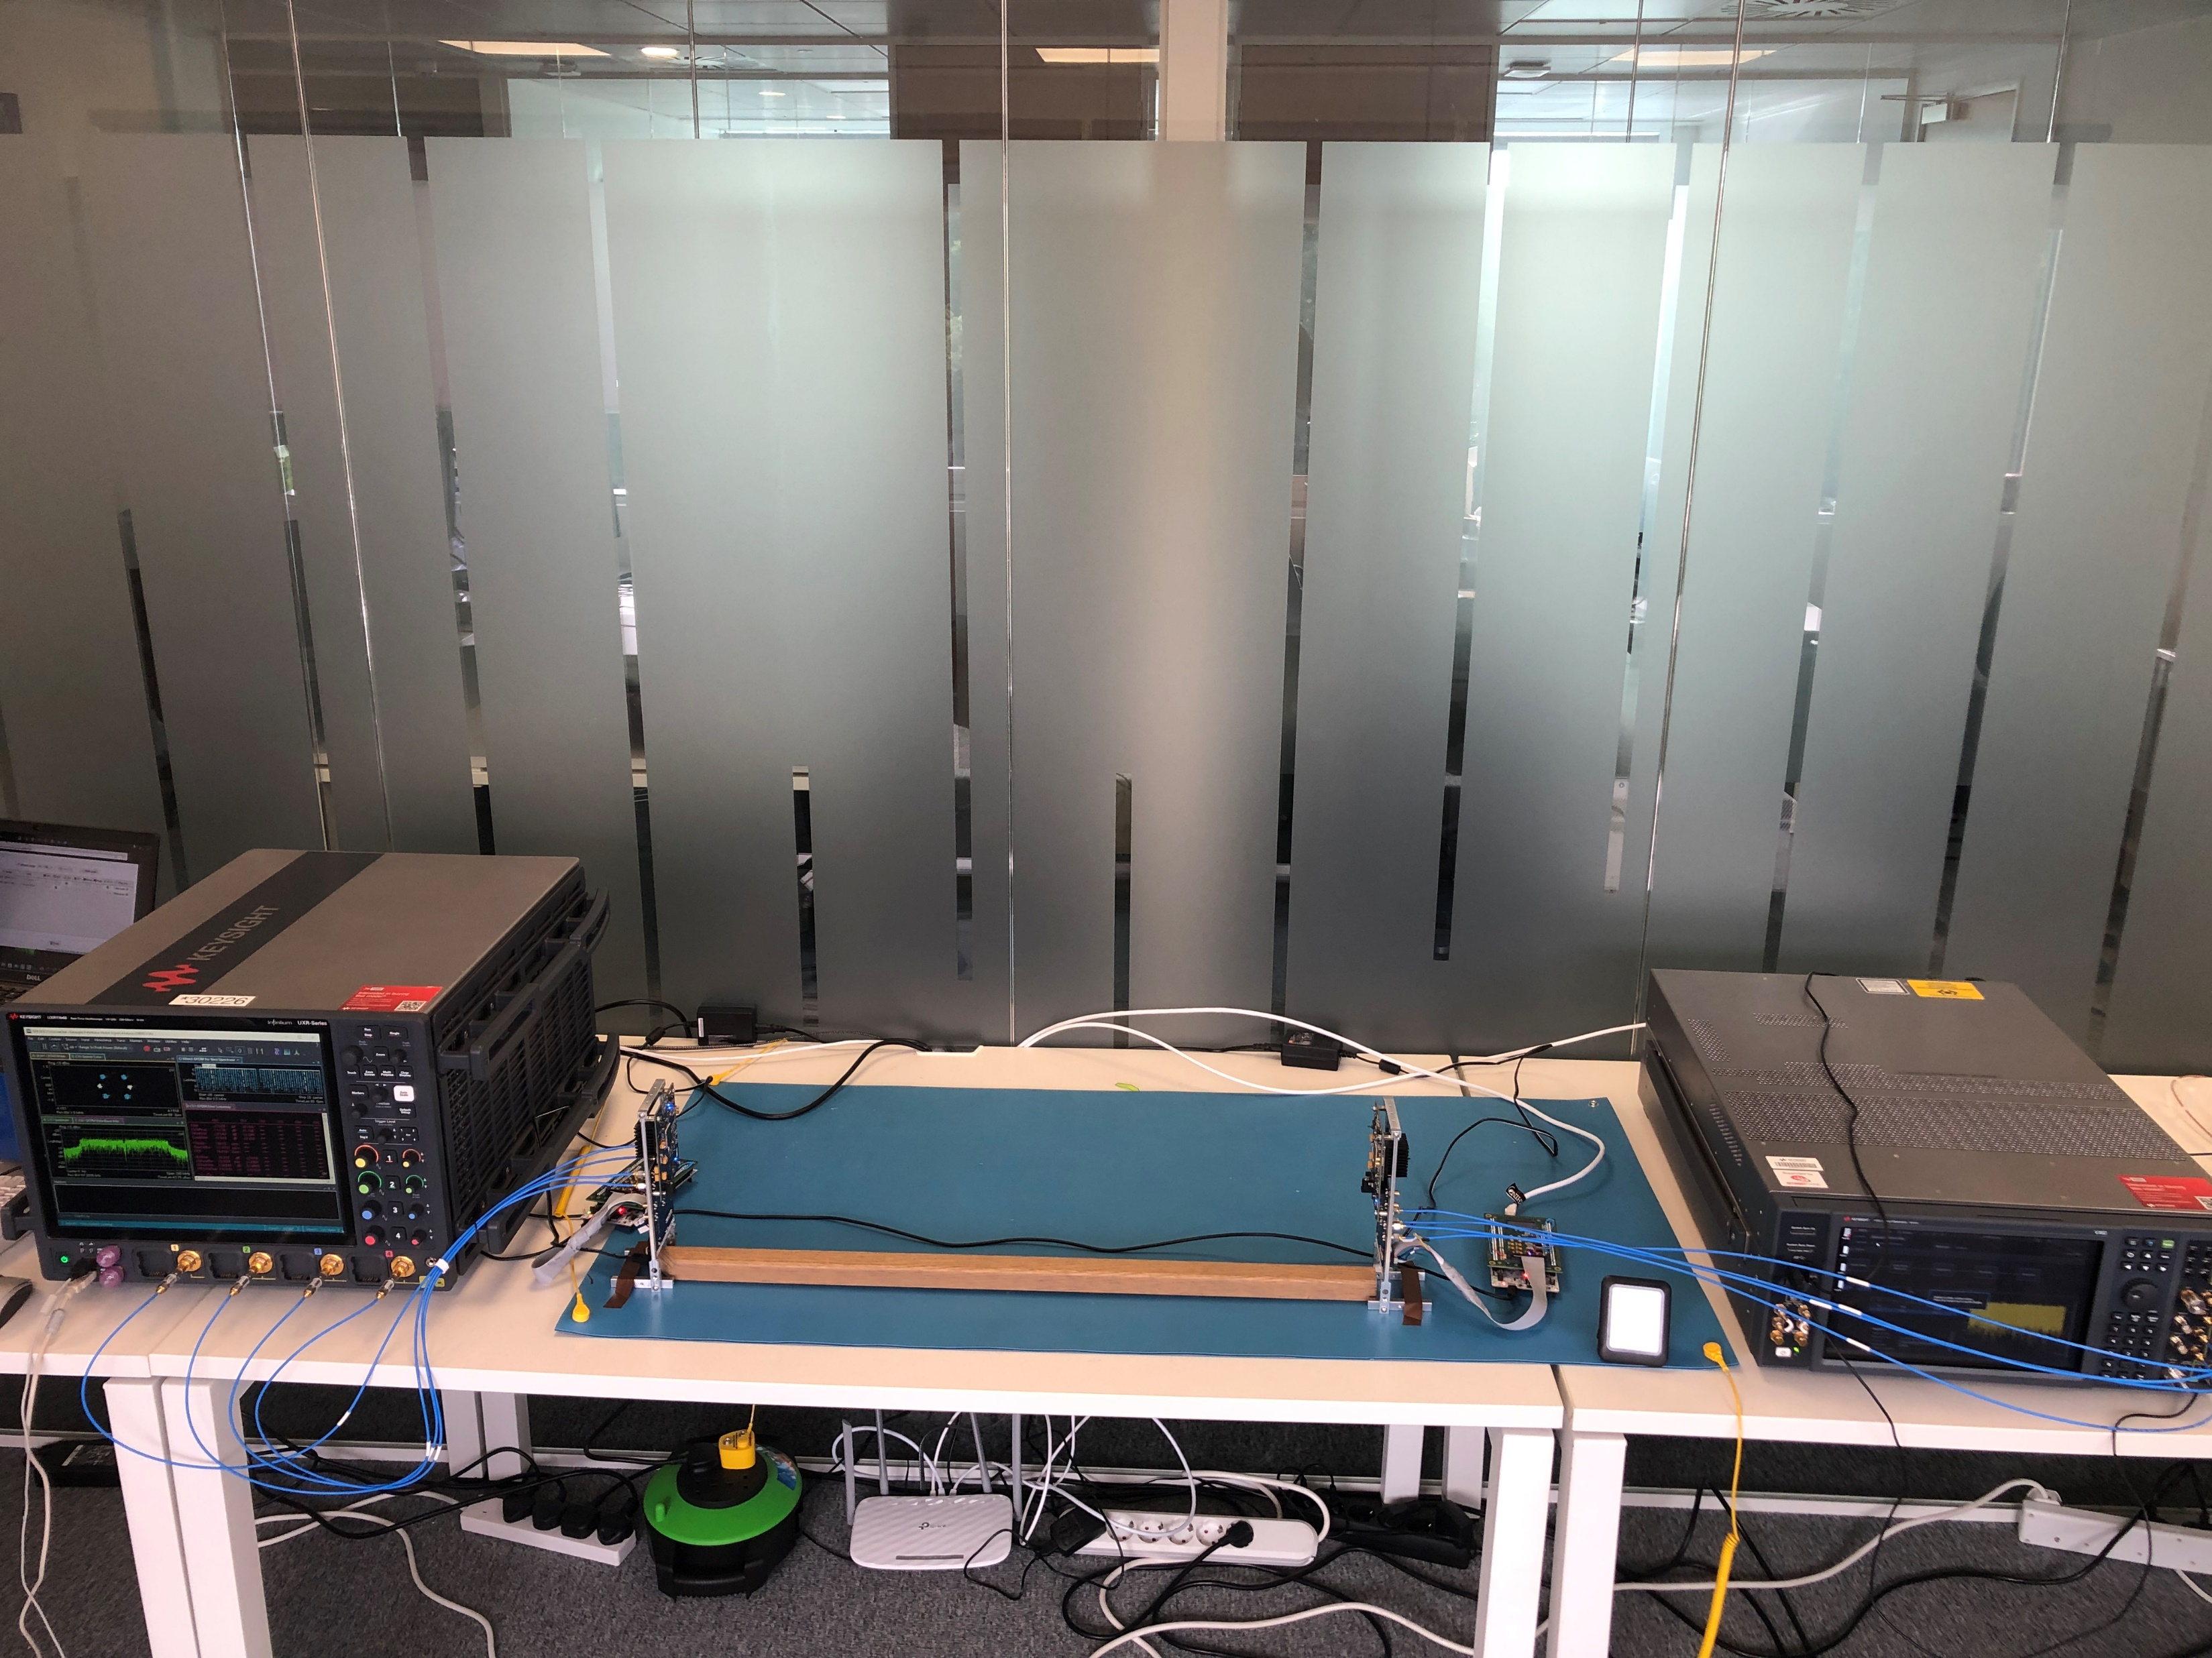
mmWave WLAN PoC: Experimental setup
WLAN Signal Capture & process
- UXR033B
Signal Analysis s/w (VSA 89601C)
WLAN Signal Generator
- VXG-B, M9384B
- Signal Studio s/w N7617C, N7608C
PC to drive radio firmware, Calibration, RF parameters
WiGig RF Front-end
module (Rx)
WiGig RF Front-end
module (Tx)
Micky Mehta (Pharrowtech), et al.

Slide 6
mmWave WLAN PoC: Experiment Sets
Measurements | Tx | Rx | Notes
Set-1 | ‘Ideal’ RF front-end (T&M) | ‘Ideal’ RF front-end (T&M) | This will help establish the target performance that we should strive for.
Set-2 | ‘Ideal’ RF front-end (T&M) | WiGig RF front-end module | This will help establish performance floor if all impairments are just at the Rx end
Set-3 | WiGig RF front-end module | ‘Ideal’ RF front-end (T&M) | This will help establish Tx EVM; which is one of the KPIs for inter-operability and compliance
Set-4 | WiGig RF front-end module | WiGig RF front-end module | This should yield OTA (over-the-air) link performance across real 60GHz RF front-ends
✓
Analogue baseband filters set to ‘quarter-band’ setting [2]
  WiGig full-band symbol rate = 1760MHz
Micky Mehta (Pharrowtech), et al.

Slide 7
Determining optimum value of γ
Is the subcarrier spacing beyond γ≥3 acceptable, for a given receiver algorithm and for a given pilot density?
γ ≥3 yields better PER (packet error rate), but inferior EVM!
  This needs further investigation
Micky Mehta (Pharrowtech), et al.

Slide 8
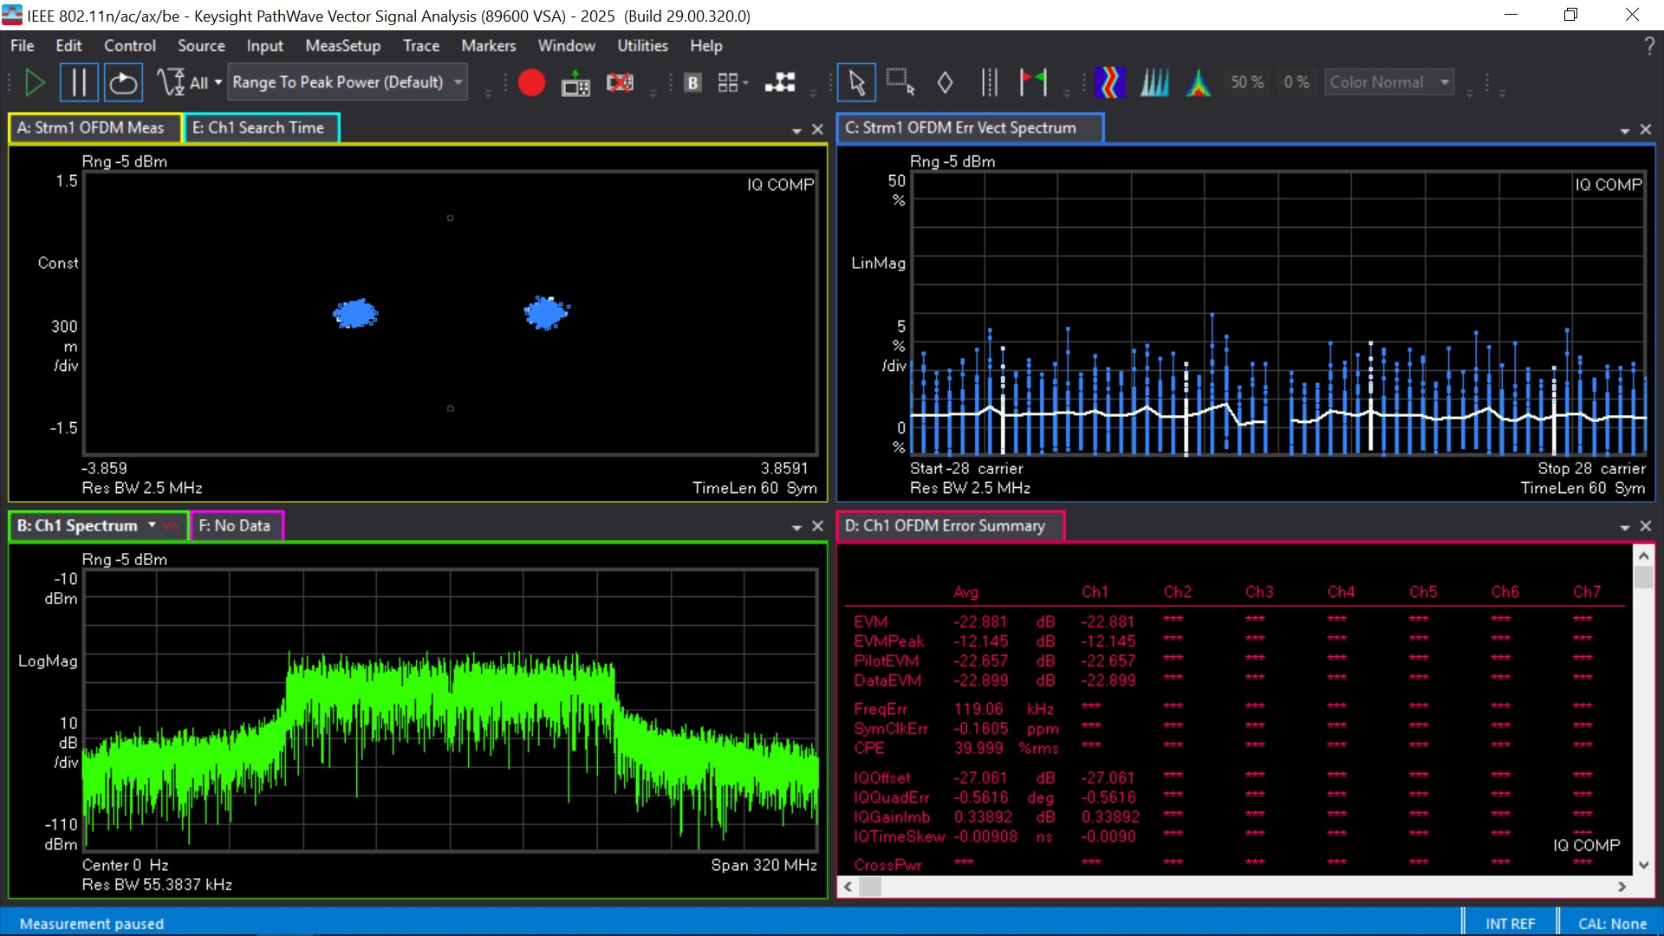
Set-4 Configuration: 802.11ac waveform, MCS0 (BPSK)
CBW = 160MHz, [20MHz x8]
EVM ≈ -22.88dB
Micky Mehta (Pharrowtech), et al.

Slide 9
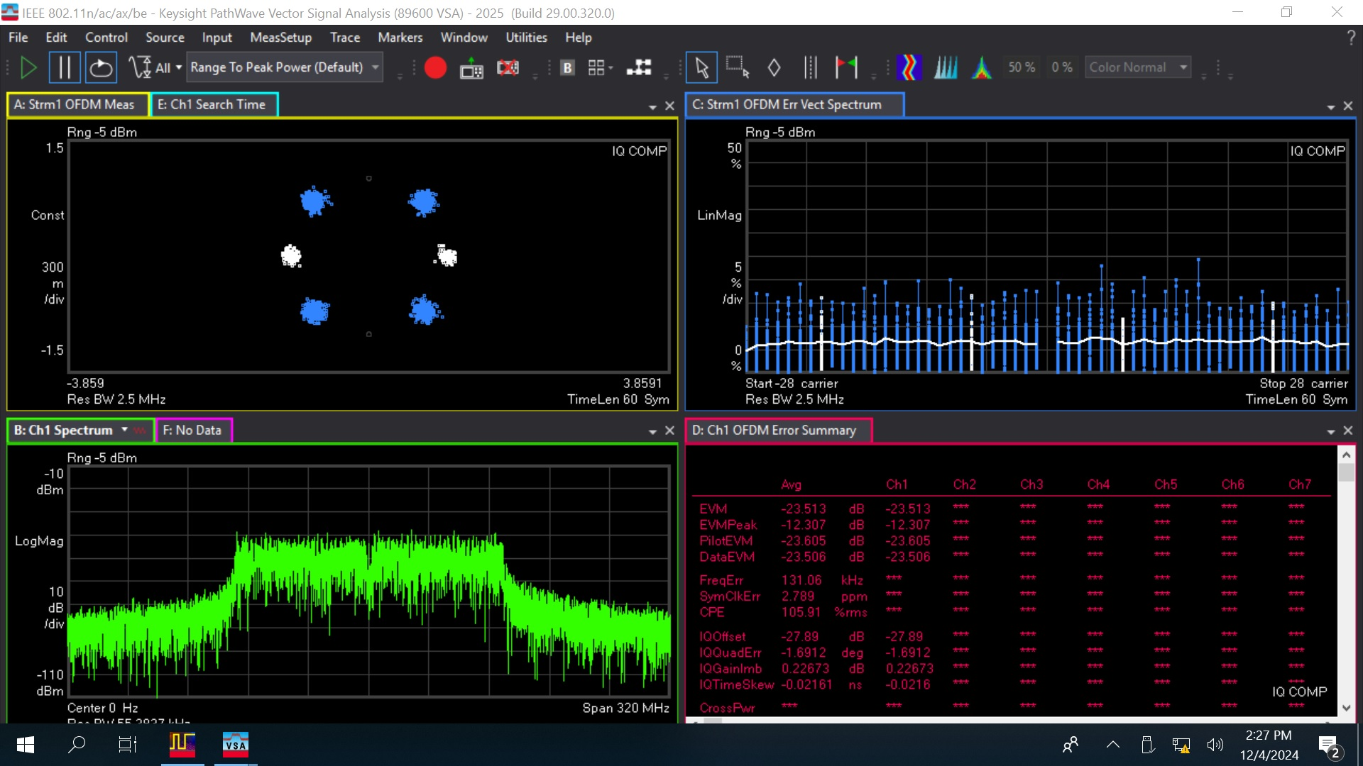
Set-4 Configuration: 802.11ac waveform, MCS1 (QPSK)
CBW = 160MHz, [20MHz x8]
EVM ≈ -22.88dB
EVM ≈ -23.51dB
Micky Mehta (Pharrowtech), et al.

Slide 10
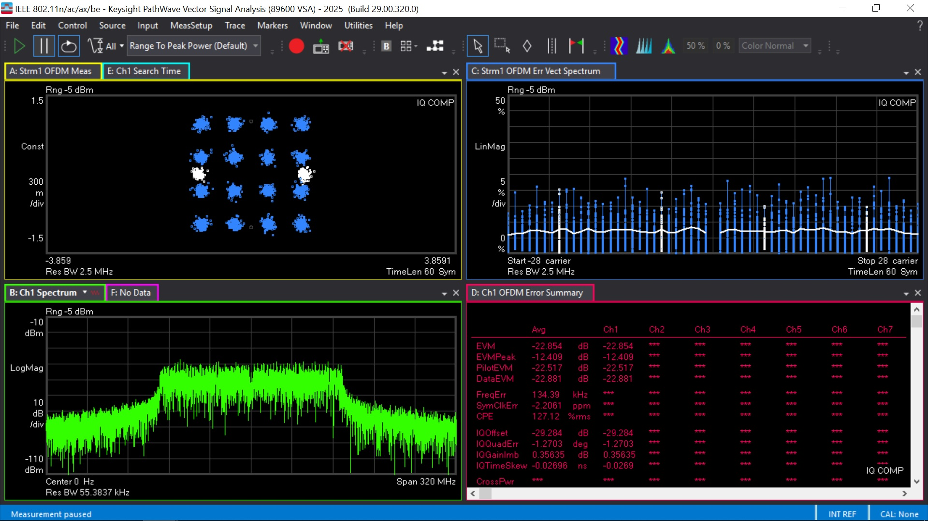
Set-4 Configuration: 802.11ac waveform, MCS3 (16QAM)
CBW = 160MHz, [20MHz x8]
EVM ≈ -22.88dB
EVM ≈ -22.85dB
Micky Mehta (Pharrowtech), et al.

Slide 11
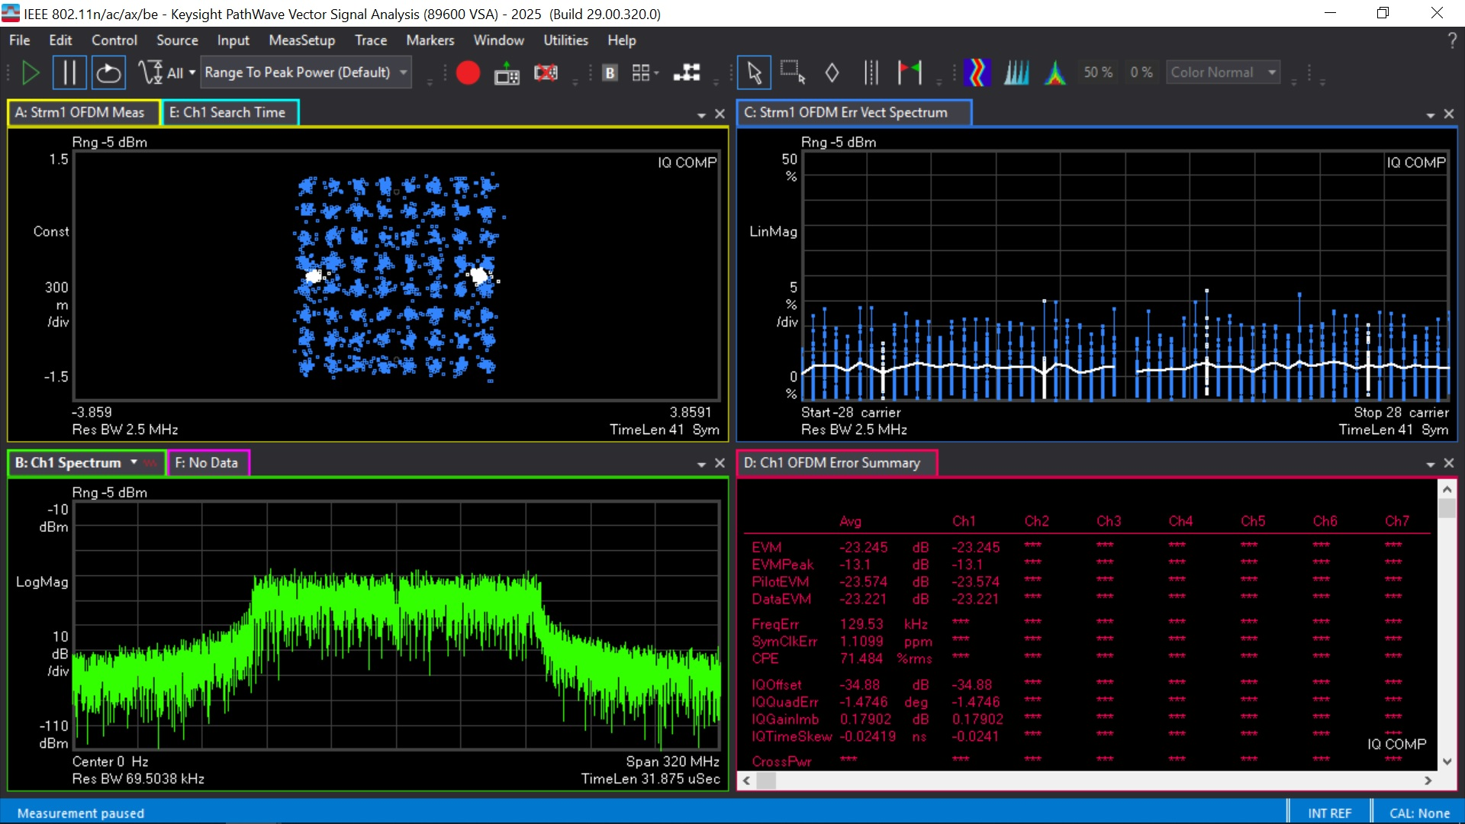
Set-4 Configuration: 802.11ac waveform, MCS5 (64QAM)
CBW = 160MHz, [20MHz x8]
EVM ≈ -22.88dB
EVM ≈ -23.24dB
Micky Mehta (Pharrowtech), et al.

Slide 12
Set-4 Configuration: 802.11ac waveform, MCS0 (BPSK) & MCS1 (QPSK)
CBW = 160MHz, [20MHz x8]
Micky Mehta (Pharrowtech), et al.

Slide 13
mmWave WLAN PoC: Summary of results
Measurements | Tx | Rx | EVM and notes
Set-1 | ‘Ideal’ RF front-end (T&M) | ‘Ideal’ RF front-end (T&M) | EVM = -42dB
Set-2 | ‘Ideal’ RF front-end (T&M) | WiGig RF front-end module | EVM ≈ -28dB
Set-3 | WiGig RF front-end module | ‘Ideal’ RF front-end (T&M) | EVM ≈ -28dB
Set-4 | WiGig RF front-end module | WiGig RF front-end module | EVM ≈ -22dB
✓
There is scope for some improvement
  Locked clocks at Tx and Rx ends, respectively
  Alternative calibration of the WiGig RF Front-end
  Alternative configuration of RF Front-end parameters, such as PA (OBO) back-off, Array Gain etc
Micky Mehta (Pharrowtech), et al.

Slide 14
mmWave WLAN PoC: Closing remarks
Simplex OTA link has been achieved for upclocked 802.11ac waveform
  Upclocking factor of 8 yields good preliminary results
  Explore γ≤3 – scope for further investigations
The WiGig RF Front-end used here was designed for single-carrier waveform
  802.11ad (DMG), 802.11ay (EDMG)
  And so, there is scope for further improvement in both Tx EVM and Link performance
    Analogue filter bandwidth, PA back-off (linearity), choice of XTAL, PLL configurations etc
    Number of analogue beamforming paths
    Alternative calibration strategy – one better suited for the ‘peaky’ OFDM waveform
  Signal fidelity through connectors in/out of the PoC is also an area for improvement
Post-process captured received baseband signal through a representative bit-accurate model of an 802.11ac modem
Micky Mehta (Pharrowtech), et al.

Slide 15
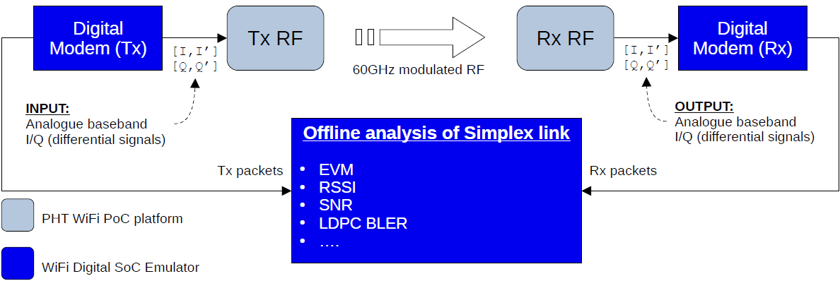
mmWave WLAN PoC: Setup for a more realistic evaluation
Upclocking feature will be needed in the digital baseband modem
Micky Mehta (Pharrowtech), et al.

Slide 16
References
[1] 11-23/1819r1 “Integrated mmWave Design Considerations”
[2] 11-24/0133r0 “Channel raster considerations for 60GHz band in IMMW”
[2] 11-23-2004r0, “IMMW technical scope proposal”
[3] 11-23/1905r0 “High Level Thoughts on IMMW”
[4] 11-23/1878r0 “Design Considerations on IMMW”
[5] 11-23/1968r0 “Discussion on general direction of integrated mmWave”
Micky Mehta (Pharrowtech), et al.

